Slide 1
REVIEW 2.2
teacher: tran thi quynh
school: hoa nghia primary school
class: 3a

Slide 2
Table of Contents
1
2
3
4
Warm-up and review
Read and match.
Look, complete and read.
Ask and anwer.
5
Fun corner and wrap-up

Slide 3
1
Warm-up and review

Slide 4
Look and guess!

Slide 5
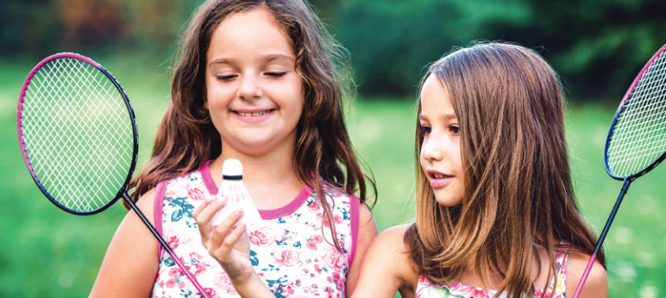

Slide 6


Slide 7
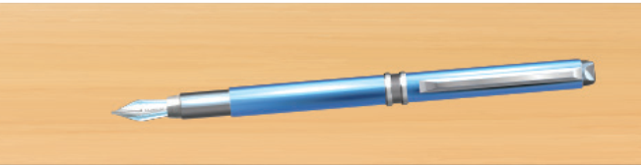

Slide 8
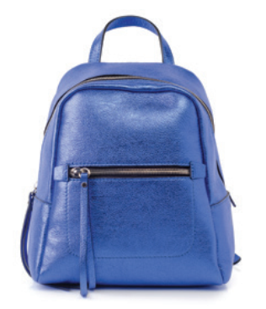

Slide 9


Slide 10


Slide 11
2
Read and match.

Slide 12
WHO IS FASTER?
Work in groups of 4-5 pupils.
Each group receives 1 set of sentences from the teacher.
Work together, match the questions with the answers.
The fastest one will be the winner.
Notes:
Giáo viên in các câu hỏi và trả lời của bài 3 trang 75 và cắt rời câu hỏi/trả lời thành các set để đưa cho hs.

Slide 13
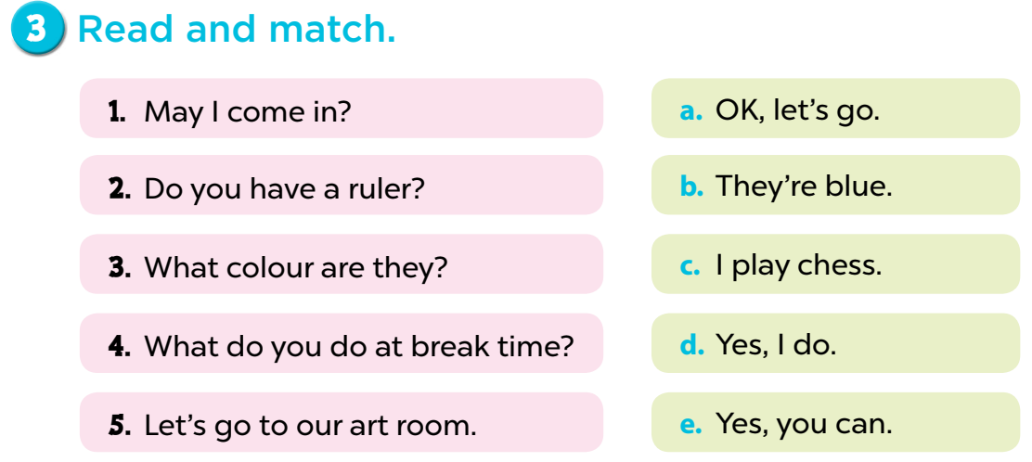

Slide 14
3
Look, complete and read.

Slide 15
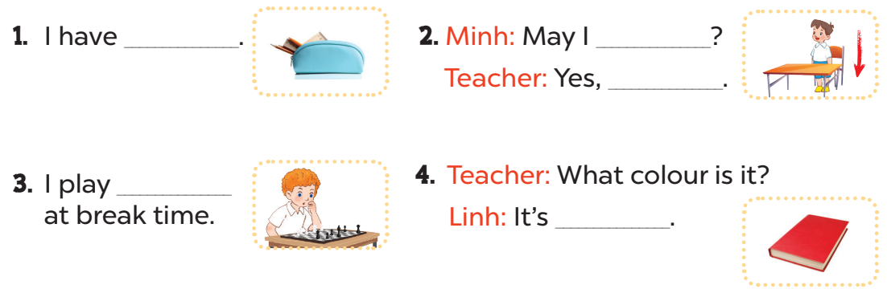
a pencil case
sit down
you can
chess
red

Slide 16
4
Ask and anwer.

Slide 17
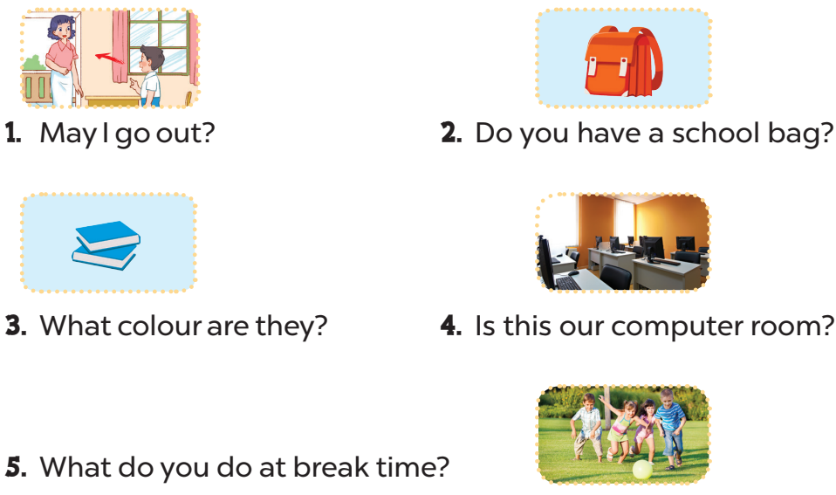
Yes, you can/No, you can’t.
Yes, I do.
They’re blue.
Yes, it is.
I play football.

Slide 18
5
Fun corner and wrap-up

Slide 19


Slide 20

1
2
3
4
TEAM 1
5
6
7
8
TEAM 2
9
10
11
12
TEAM 3
Notes:
Lucky number

Slide 21
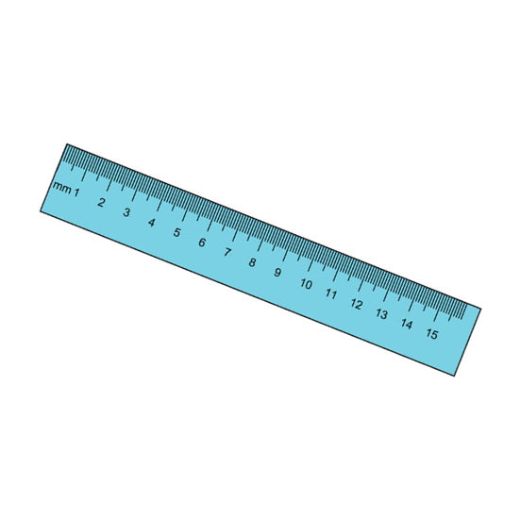

What colour is it?
+ 2 points
It’s blue.

Slide 22


What colour are they?
They’re green.

Slide 23
Do you have ......................?
Yes, I do.

Slide 24
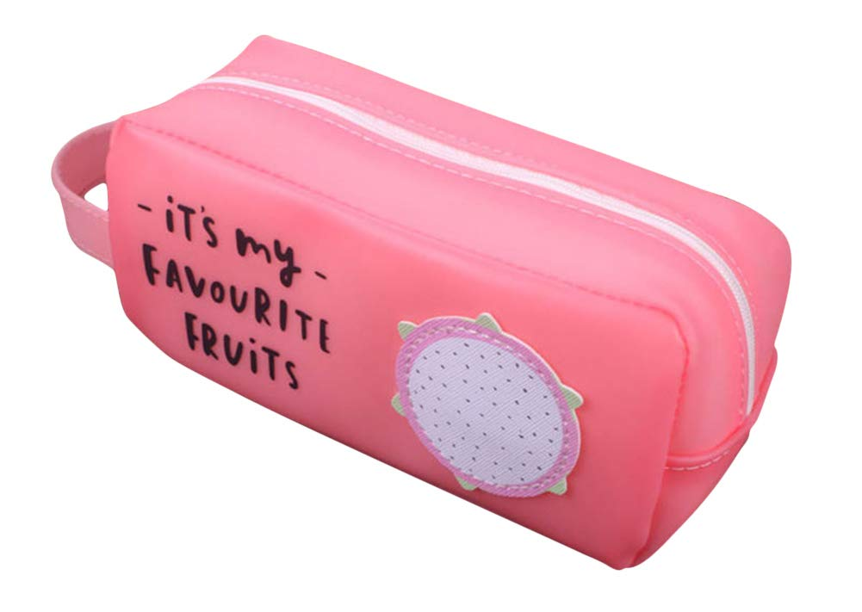
What colour is it?
It’s pink.

Slide 25
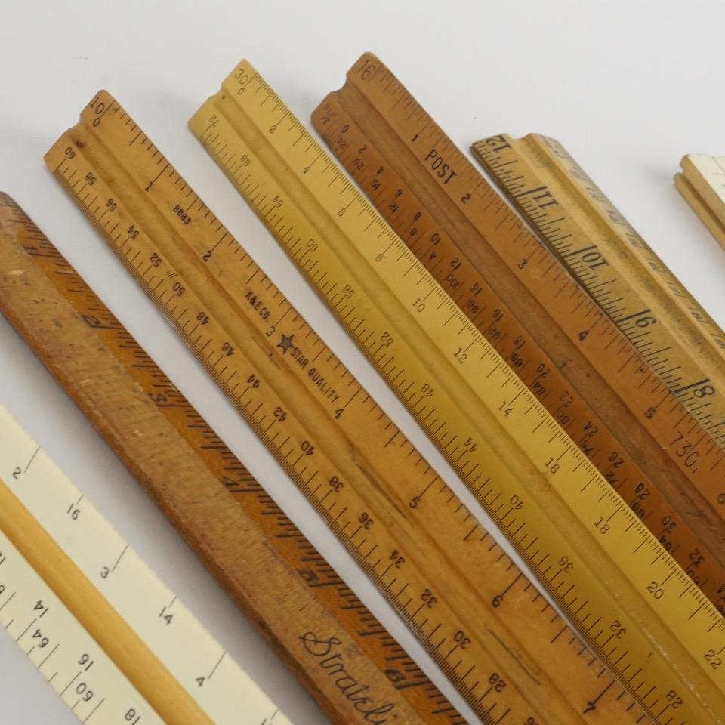
Do you have erasers?
No, I don’t. I have rulers.

Slide 26
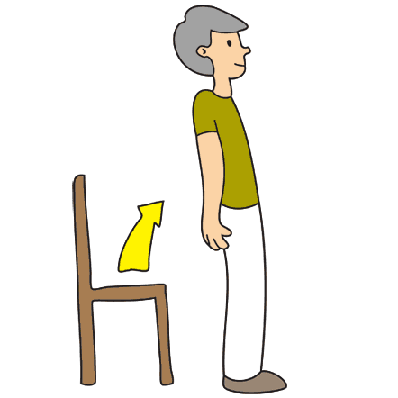
Stand up, please!

Slide 27
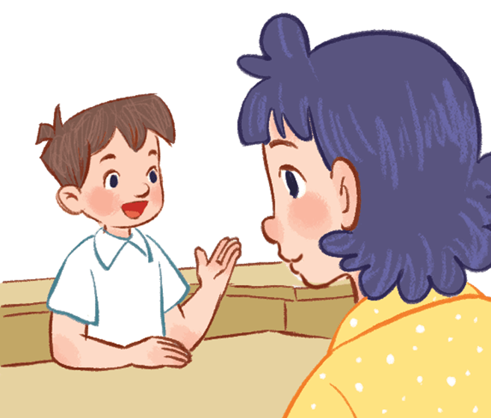
Vietnamese?
May I speak Vietnamese?

Slide 28
What do you do at break time?
I play football.

