Slide 2

Unit 9 Our outdoor activities
Lesson 1(act 5,6)
Teacher: Pham Thi Thu Trang
Hoa Nghia primary school
Class: 5D

Slide 3


5. Read and complete.

Slide 4

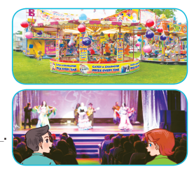
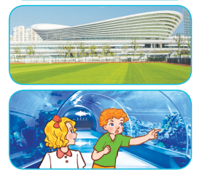
Read and complete.

Slide 5
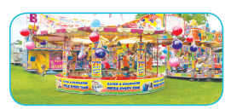
Read and complete.
1. A: Were you and Linh at the _______ last weekend?
B: Yes, ________.
funfair
we were

Slide 6

Read and complete.
2. A: Were you at the cinema last Saturday?
B: No, _________. We were at the ______.
we weren’t
theatre

Slide 7

Read and complete.
3. A: Where were you and Ben last Sunday?
B: ________ at the sports centre.
We were

Slide 8

Read and complete.
4. A: Where were you and Mary yesterday?
B: ____________________.
We were at the aquarium

Slide 9
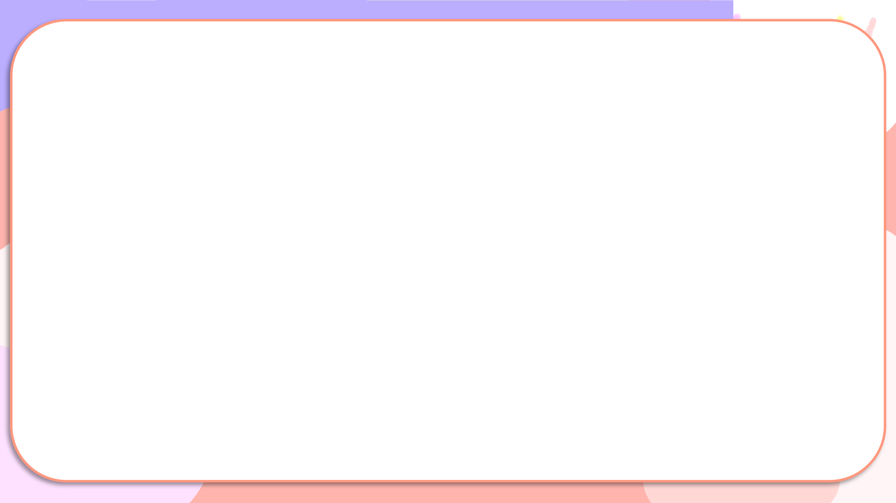
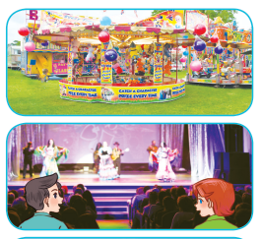
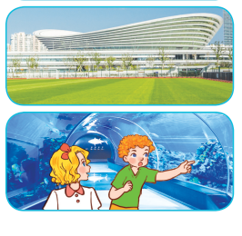
funfair
1. A: Were you and Linh at the _______ last weekend?
B: Yes, ________.
we were
2. A: Were you at the cinema last Saturday?
B: No, _________. We were at the ______.
we weren’t
theatre
3. A: Where were you and Ben last Sunday?
B: ________ at the sports centre.
We were
4. A: Where were you and Mary yesterday?
B: ____________________.
We were at the aquarium

Slide 10
Activity 6. Let’s play.

Slide 11
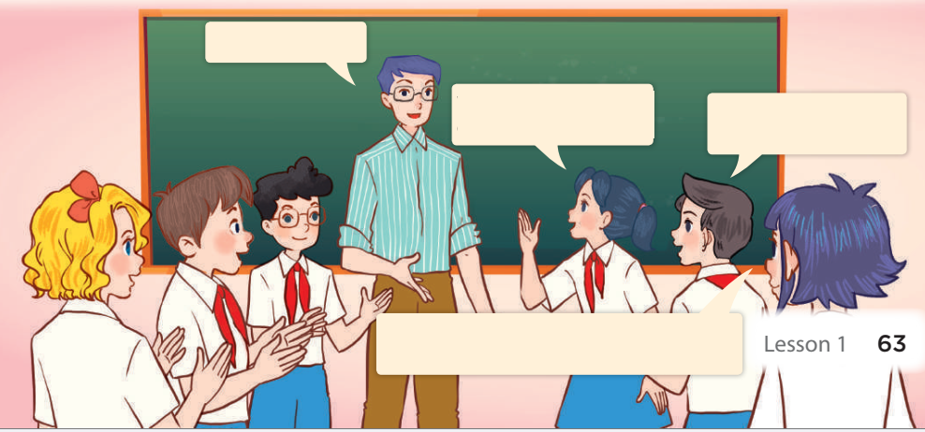
Memory game
at the campsite
We were at the campsite yesterday.
They were at the campsite yesterday.
They were at the campsite yesterday, and we were at the campsite, too.

Slide 12
5. Read and complete.

Slide 13
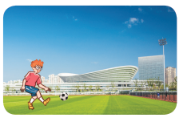
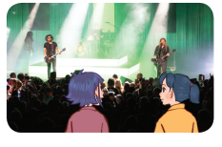
Read and complete.

Slide 14
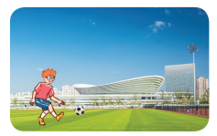
Read and complete.
1. A: Where were you last weekend?
B: I was at the ____________.
A: What did you do there?
B: I ____________.
sports centre
played football

Slide 15
Read and complete.
2. A: Were you and Mai at the theatre yesterday?
B: Yes, ________.
A: What did you ____ there?
B: We ________________.
we were
do
listened to music

