Slide 1

Welcome to our class!

Slide 2


Slide 3
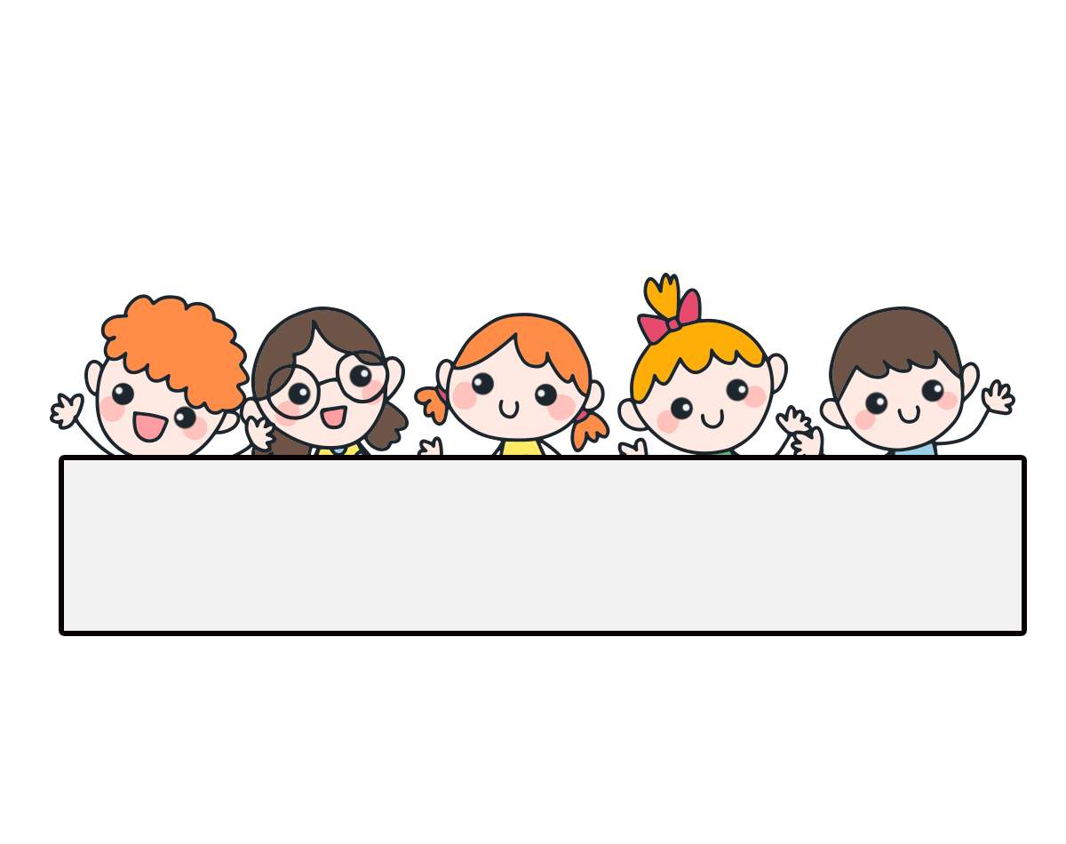
Warm-up

Slide 4




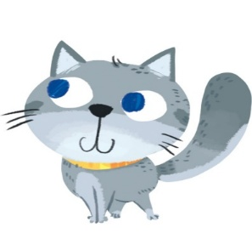
Let’s play!
What is the missing letter?
_up
c
_ar
c
c
_at
_ake
c

Slide 5

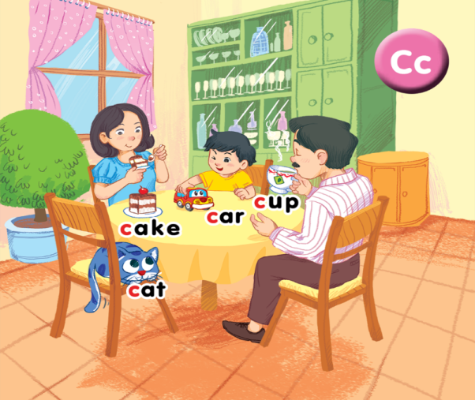
Facebook: Bùi Liễu
0968142780
Unit 2
In the dining room

Slide 6







Contents
Listen and chant.
Listen and tick.
Look and trace.

Slide 7

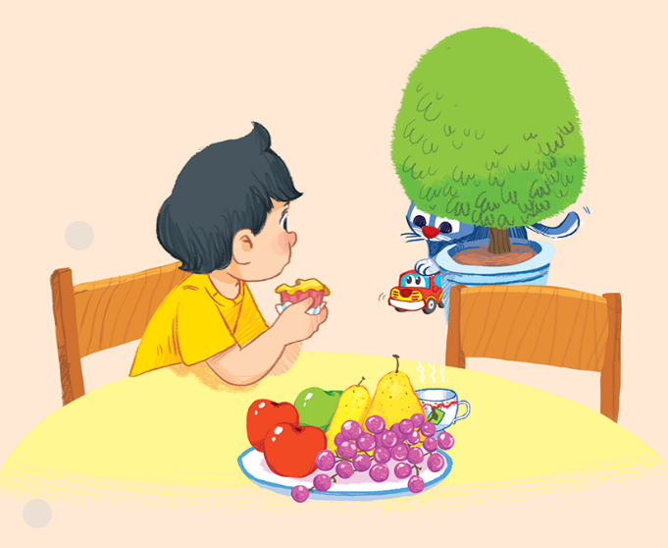






3. Listen and chant.
C, c, a cup.
C, c, a cake.
A cup and a cake.
C, c, a cat.
C, c, a car.
A cat and a car.

Slide 8

3. Listen and chant.

Slide 9

3. Listen and chant.
C, c,
a cup.
C, c,
a cake.
A cup and a cake.
C, c,
a cat.
C, c,
a car.
A cat and a car.

Slide 10
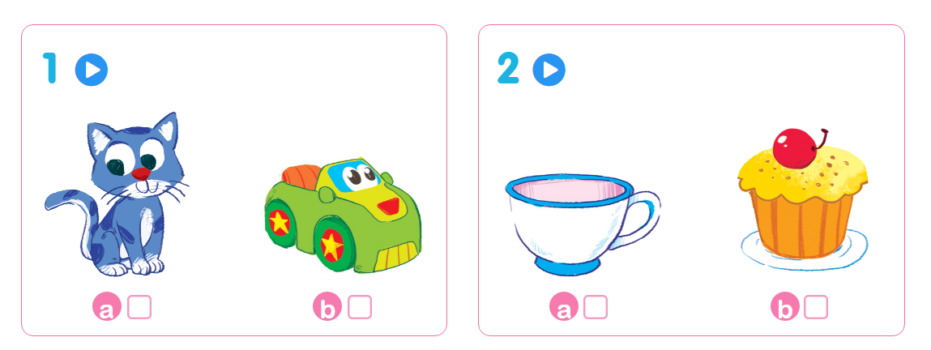

4. Listen and tick.

Slide 11
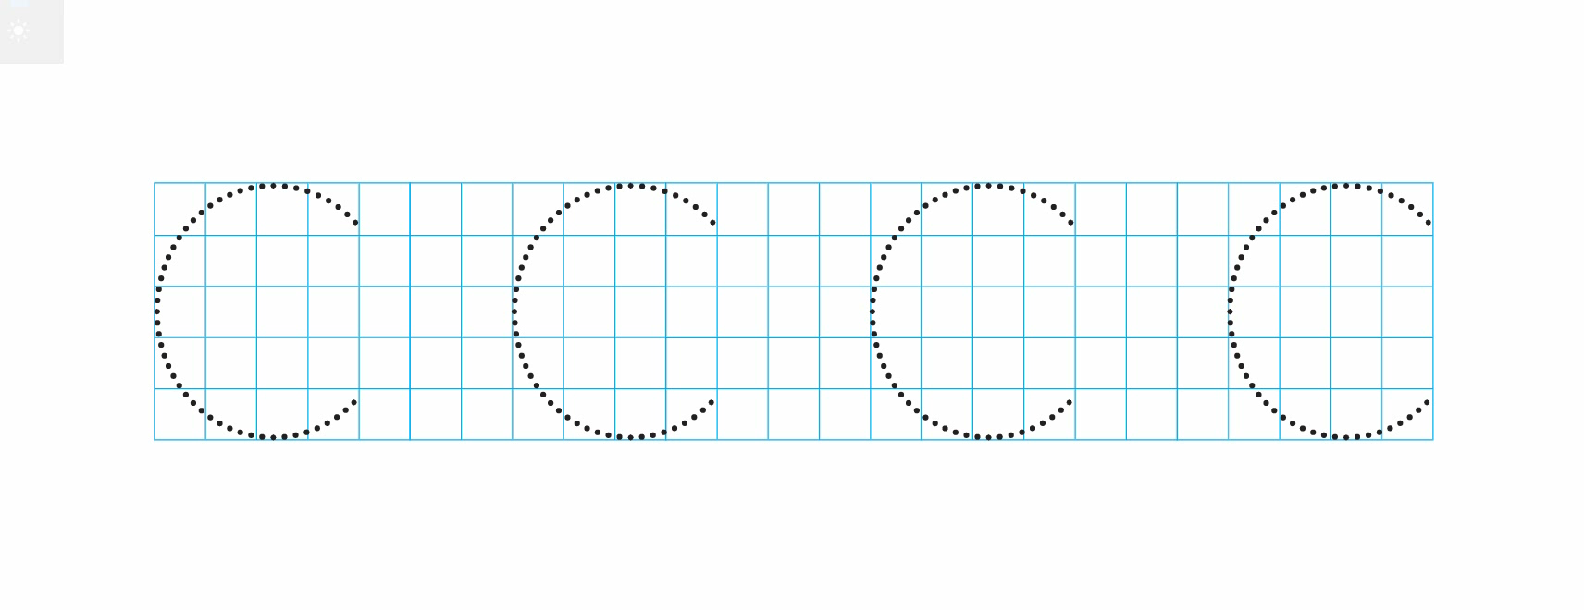
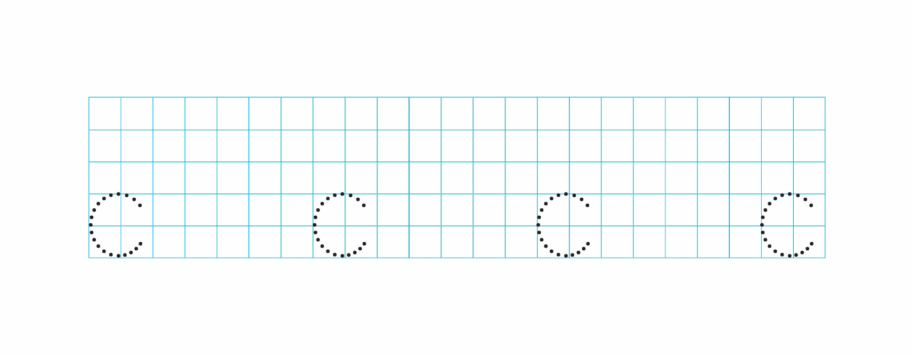
5. Look and trace.

Slide 12
Let’s play a game!

Slide 13







AND
GAME
PLAY

Slide 14




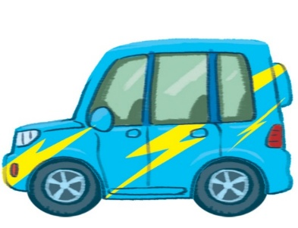
Look and tick.
car
cat
a
b
Next

Slide 15



Look and tick.
cup
cake
a
b
Next

Slide 16

Look and tick.
cat
cup
a
b
Next

Slide 17

Look and tick.
car
cup
a
b
Next

Slide 18


Listen and tick.
a
b
Next

Slide 19


Listen and tick.
a
b
Next

Slide 20




Listen and tick.
a
b
Next

Slide 21

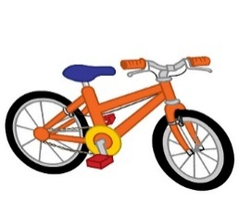
Listen and tick.
a
b
End

Slide 22




Slide 23




Review
cat
cake
car
cup

Slide 24
Homework
...............................................
...............................................

Slide 25

Thank you!

