Slide 1

Hoa Nghia Primary School
Welcome to our class!
Teacher: Dao Thi Thu Van

Slide 2


Let’s play!

Slide 3

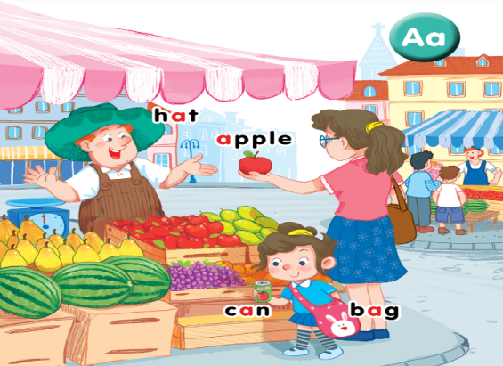
Facebook: Bùi Liễu
0968142780
Unit 3
At the street market

Slide 4




Contents
Listen and repeat.
Point and say.

Slide 5






1. Listen and repeat.

Slide 6

Vocabulary
apple
quả táo

Slide 7

Vocabulary
bag
cái túi

Slide 8

Vocabulary
can
lon đồ uống

Slide 9

Vocabulary
hat
cái mũ

Slide 10




Review
apple
bag
can
hat

Slide 11




Vocabulary
1. apple
: quả táo
2. bag
: cái túi
3. can
: lon đồ uống
4. hat
: cái mũ

Slide 12
2. Point and say.

Slide 13
Let’s play!

Slide 14
Review
apple
bag
can
hat

Slide 15

Facebook: Bùi Liễu
0968142780
Thank you!

