Slide 1
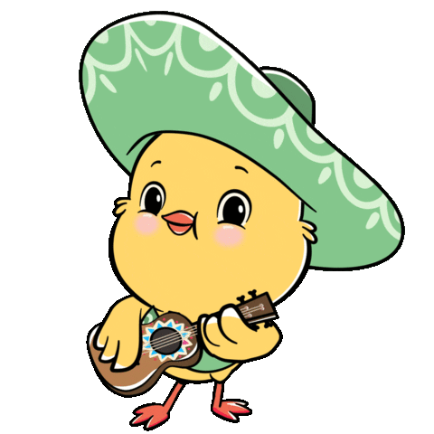
Hoa Nghia Primary School
Welcome to our class!
Teacher: Dao Thi Thu Van

Slide 2

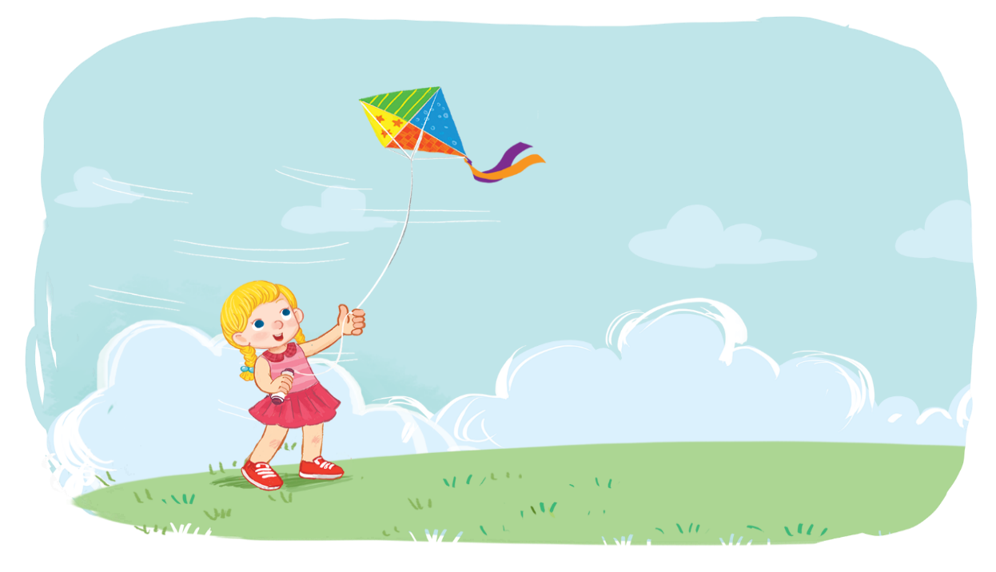
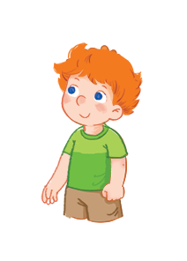
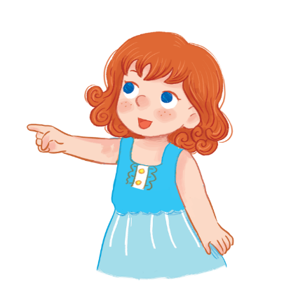
Unit
2
In the backyard
Lesson 2

Slide 3

Warm up

Slide 4
Let’s play!

Slide 5

Good job!

Slide 6






Content
Listen and chant.
Listen and circle.
Look and write.

Slide 7

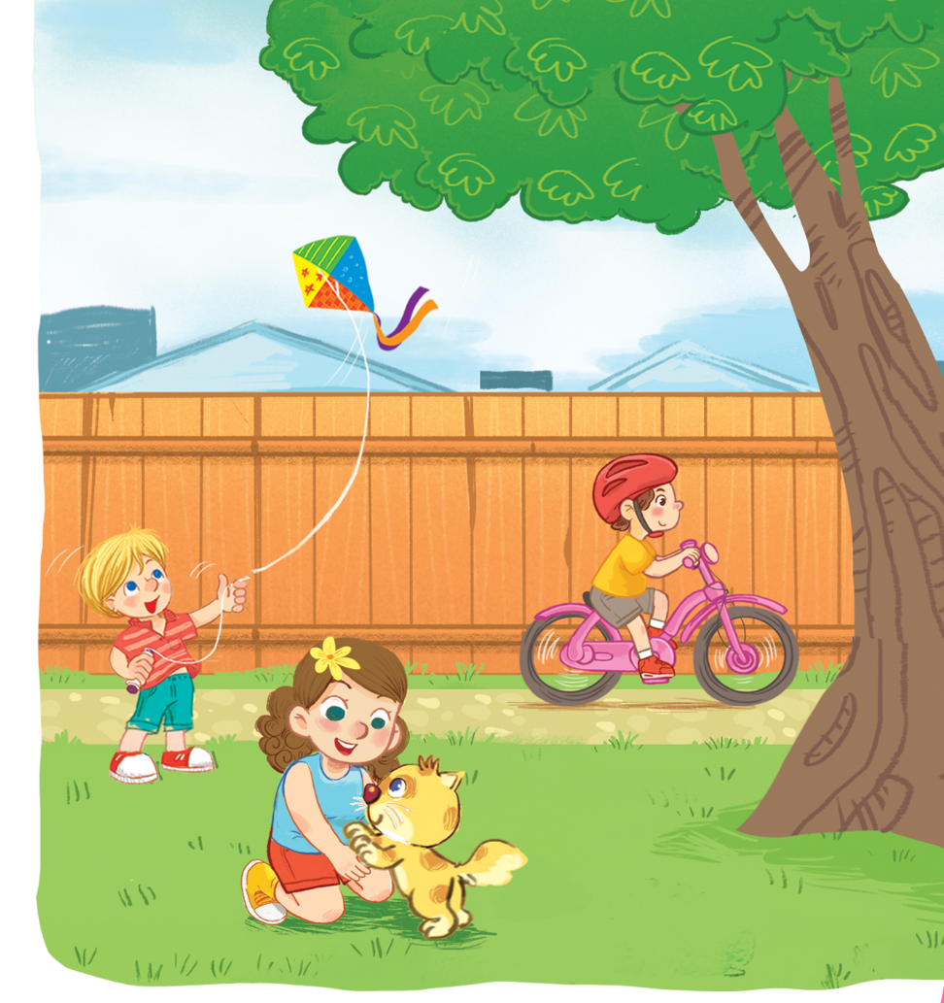
Listen and chant.
K, k, kite.
K, k, kite.
K, k, kite.
K, k, kite.
He’s flying a kite.
He’s flying a kite.
He’s flying a kite.
He’s flying a kite.
K, k, bike.
K, k, bike.
K, k, bike.
K, k, bike.
He’s riding a bike.
He’s riding a bike.
He’s riding a bike.
He’s riding a bike.
K, k, kitten.
K, k, kitten.
K, k, kitten.
K, k, kitten.
She’s playing with a kitten.
She’s playing with a kitten.
She’s playing with a kitten.
She’s playing with a kitten.

Slide 8

Listen and chant.

Slide 9
Listen and chant.

Slide 10


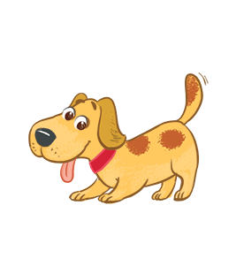
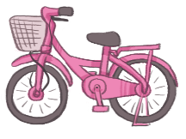
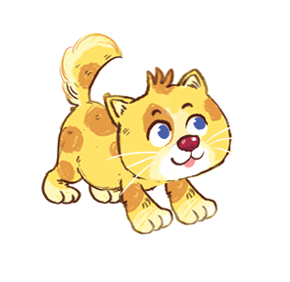


Listen and circle.
1
2

Slide 11
Listen and circle.
1

Slide 12
Listen and circle.
2

Slide 13


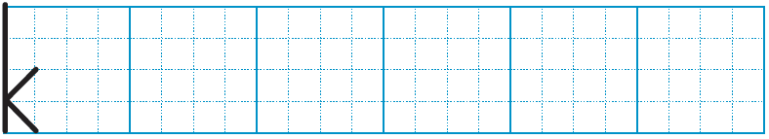
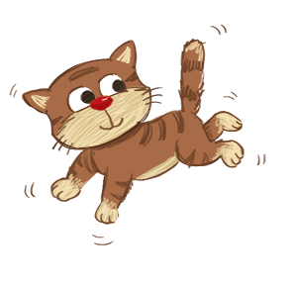
Look and write.
k
k
ite
k
itten
bi e

Slide 14
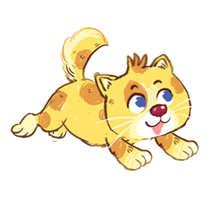

Review

Slide 15

Thank you!

