Slide 1
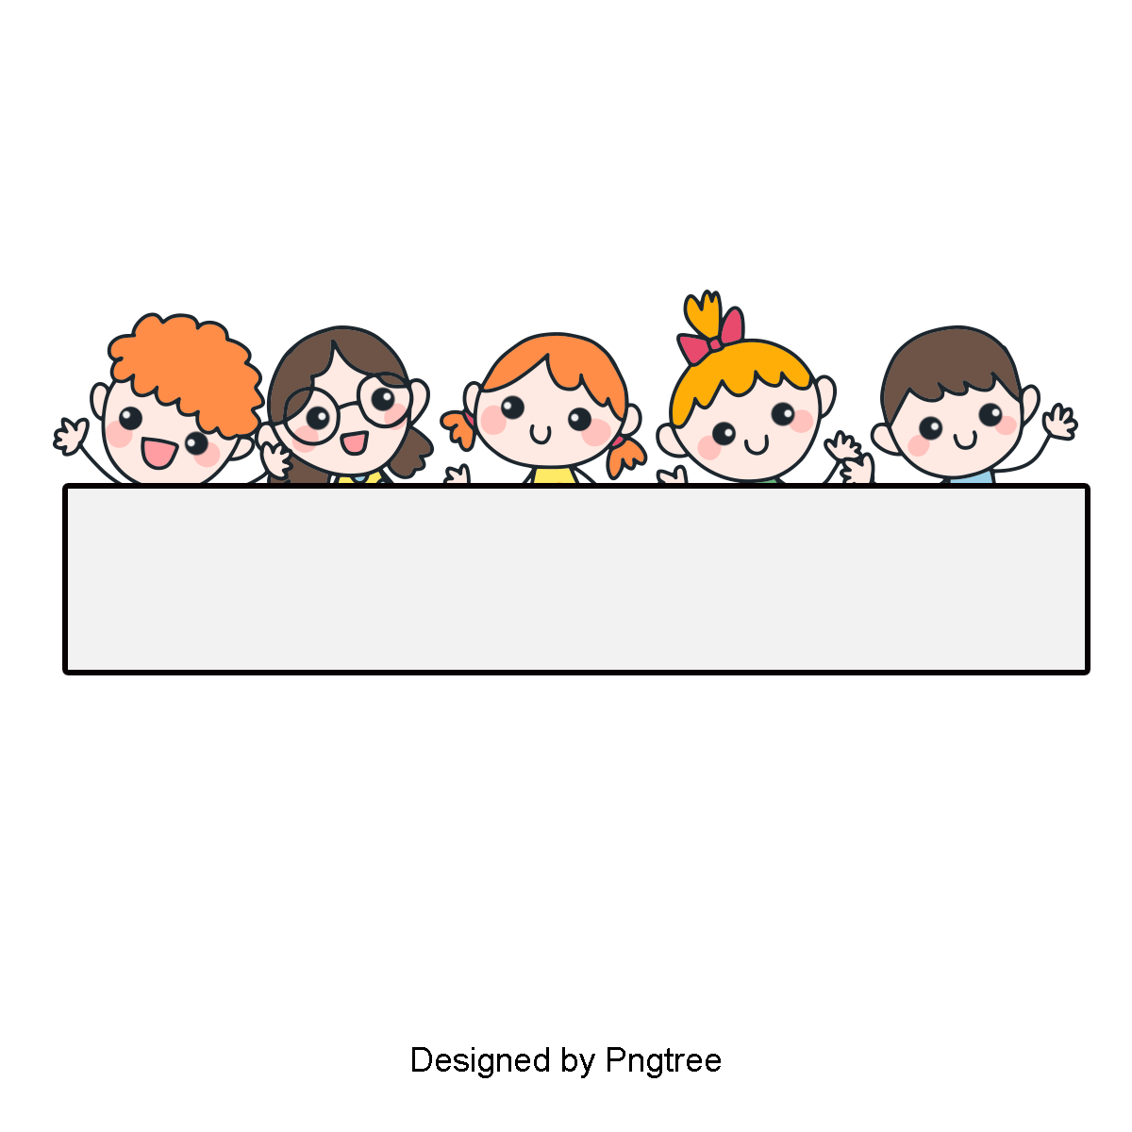
Warm-up

Slide 2


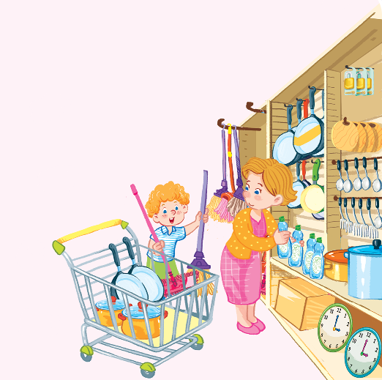
Let’s sing!
One, two. One, two.
There are two clocks.
Two, three. Two, three.
There are three locks.
Three, four. Three, four.
There are four pots.
Four, five. Four, five.
There are five mops.

Slide 3

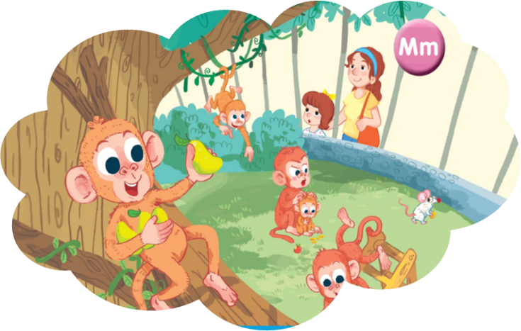
Unit 10
At the zoo
Teacher: Dao Thi Thu Van

Slide 4




Contents
Listen and repeat.
Point and say.

Slide 5
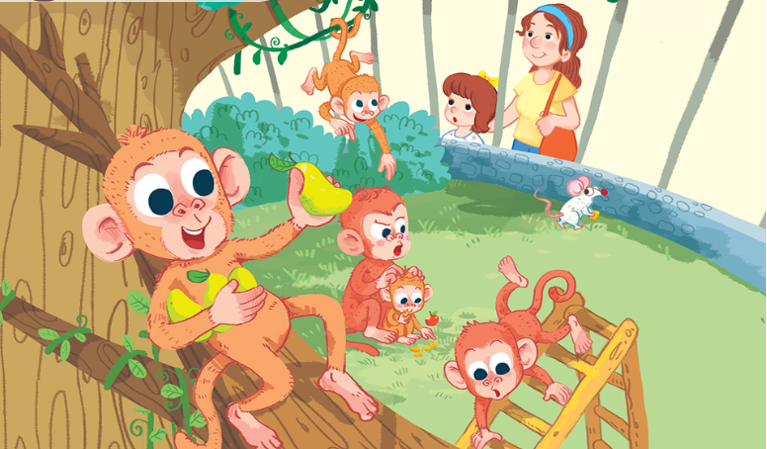

1. Listen and repeat.
mother
mango
mouse
monkey
Click on the words to listen again.

Slide 6
How to pronounce “Mm”.

Slide 7
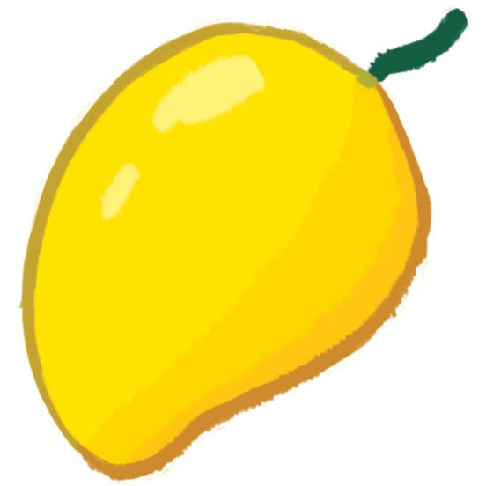

Vocabulary
mango
quả xoài
Click on the word to listen.

Slide 8
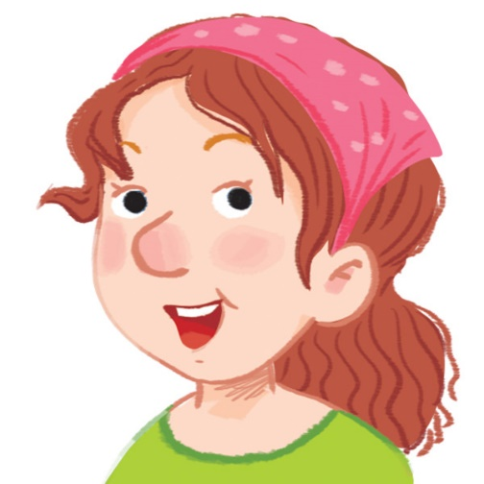
mother
mẹ

Slide 9
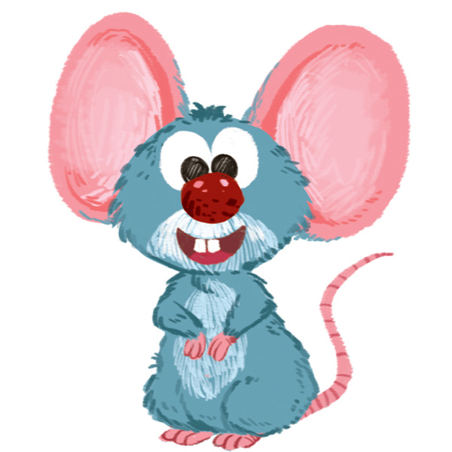
mouse
con chuột

Slide 10
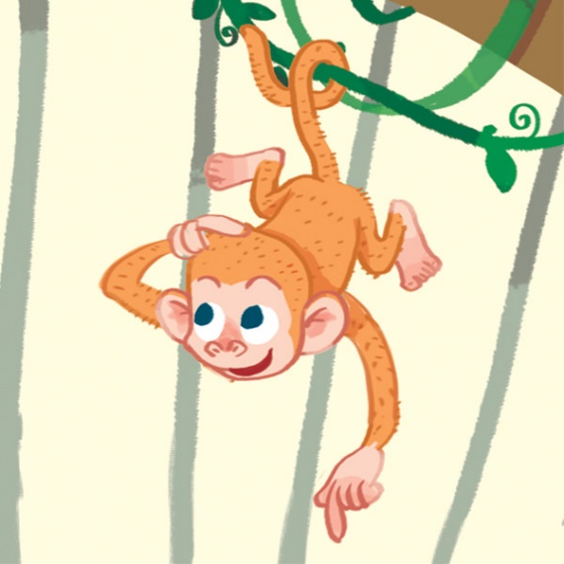
monkey
con khỉ

Slide 11


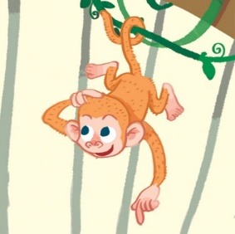

Review
mango
mother
mouse
monkey

Slide 12



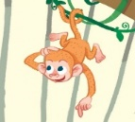
Vocabulary
1. mango
: quả xoài
2. mother
: mẹ
3. mouse
: con chuột
4. monkey
: con khỉ
Click on the words to listen again.

Slide 13
Let’s play a game!

Slide 14




Slide 15









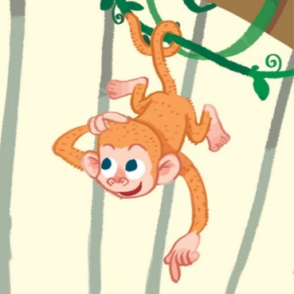





Slide 16







Slide 17








Slide 19




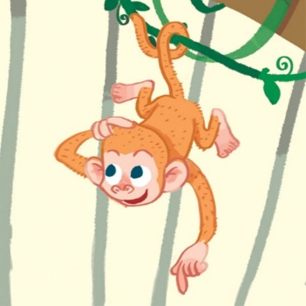
mango

Slide 20





monkey

Slide 21




mother
1
2
3
mouse
4
5
6
monkey

Slide 22


monkey
1
2
3
mango
4
5
6
mouse

Slide 23

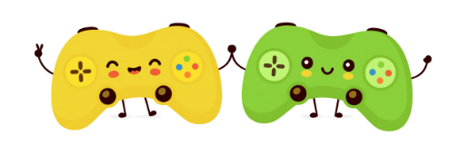
WELL DONE!

Slide 24
2. Point and say.
mother
mango
mouse
monkey
Click on the words to listen again.

Slide 25

Let’s guess!

Slide 26


Can you guess?
Nhấn vào ống nhòm lần thứ nhất để chuyển động.
Nhấn lần thứ 2 để hiển thị đáp án.
mother

Slide 27
Can you guess?
mouse

Slide 28

Can you guess?
monkey

Slide 29

Can you guess?
mango

Slide 30
Good job!

Slide 31
Review
mango
mother
mouse
monkey

Slide 32
Homework
...............................................
...............................................

