Slide 1

Unit
9
In the grocery store
Lesson 3
Teacher: Dao Thi Thu Van

Slide 2

Warm-up!

Slide 3
Let’s chant!

Slide 4

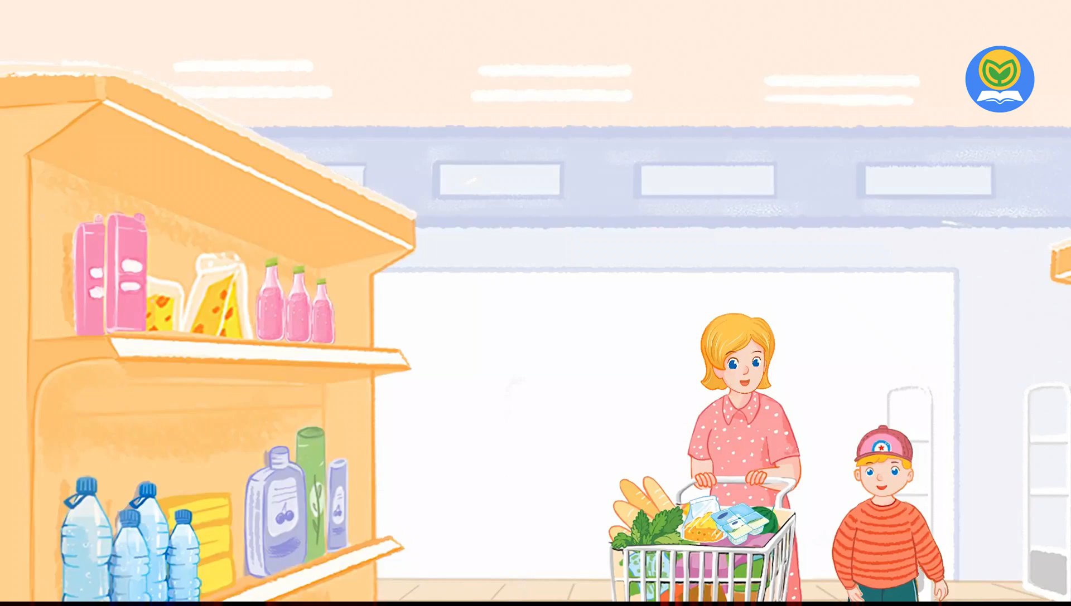
Let’s chant.

Slide 5






Content
Listen and repeat.
Let’s talk.
Let’s sing.

Slide 6





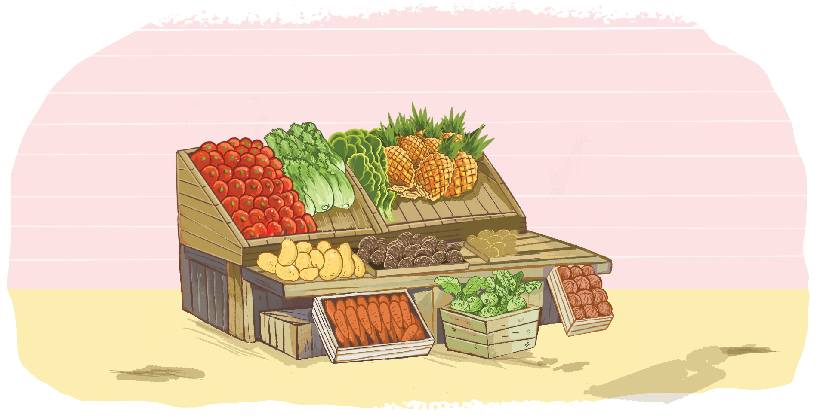
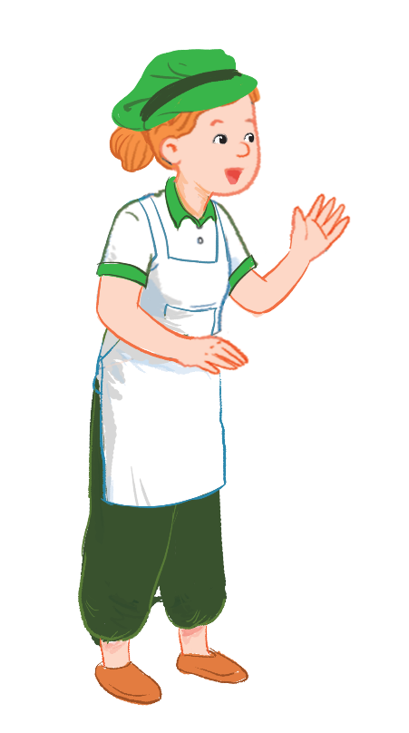
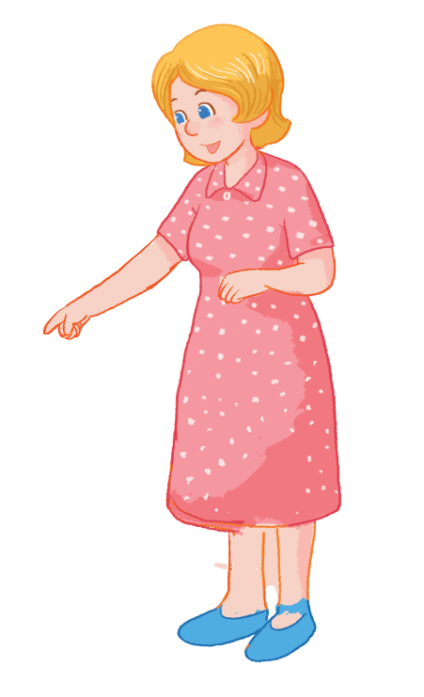
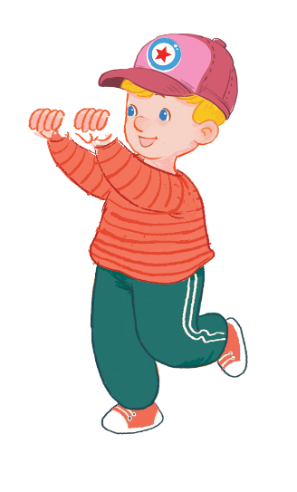

Listen and repeat.
I want some yams.
I want some yams.
I want some yams.
I want some yams.
What do you want?
What do you want?
What do you want?
What do you want?

Slide 7


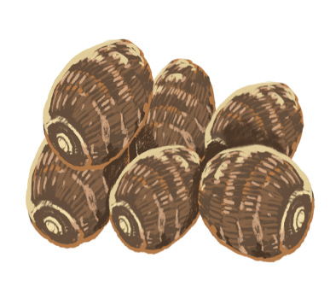

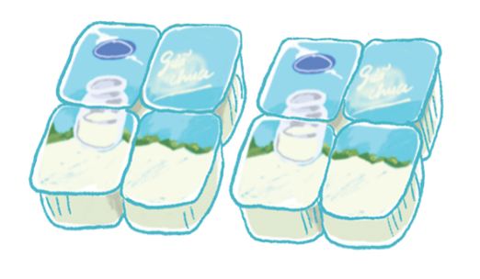
Sentence parttern
What do you want?
I want some ___.
yams
yogurt
yo-yos

Slide 8



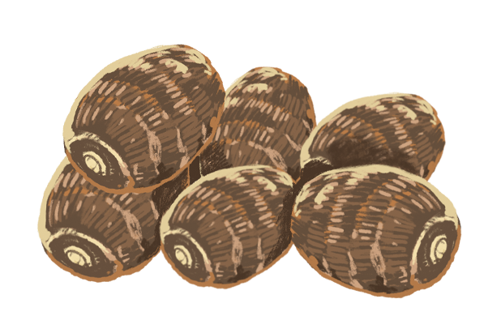
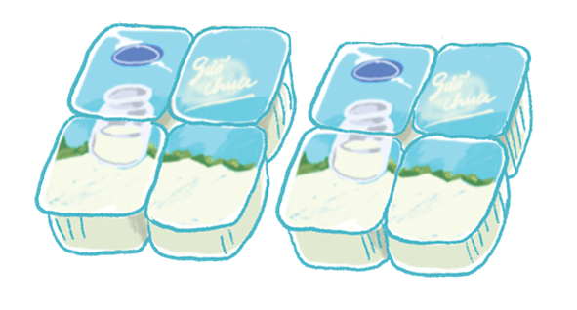
Let’s talk.
What do you want?
I .
a
b
c

Slide 9
Let’s talk.
What do you want?
want some yams
I ________________.
a

Slide 10
Let’s talk.
What do you want?
want some yogurt
I _________________.
b

Slide 11
Let’s talk.
What do you want?
I _____________.
want some yo-yos
c

Slide 12

Let’s play!

Slide 13




Choose the correct answer.
NEXT
I want some yogurt.
I want some
yo-yos.

Slide 14


Choose the correct answer.
NEXT
I want some yo-yos.
I want some yams.

Slide 15
Choose the correct answer.
NEXT
I want some yogurt.
I want some yo-yos.

Slide 16
Choose the correct answer.
NEXT
I want some yams.
I want some yogurt.

Slide 17
Choose the correct answer.
NEXT
I want some yo-yos.
I want some yogurt.

Slide 18
Choose the correct answer.
NEXT
I want some yams.
I want some yogurt.

Slide 19
Choose the correct answer.
NEXT
I want some yogurt.
I want yogurt.

Slide 20
Choose the correct answer.
NEXT
I some yams.
I want some yams.

Slide 21
Choose the correct answer.
END
I some yo-yos want.
I want some yo-yos.

Slide 22

WELL DONE!

Slide 23


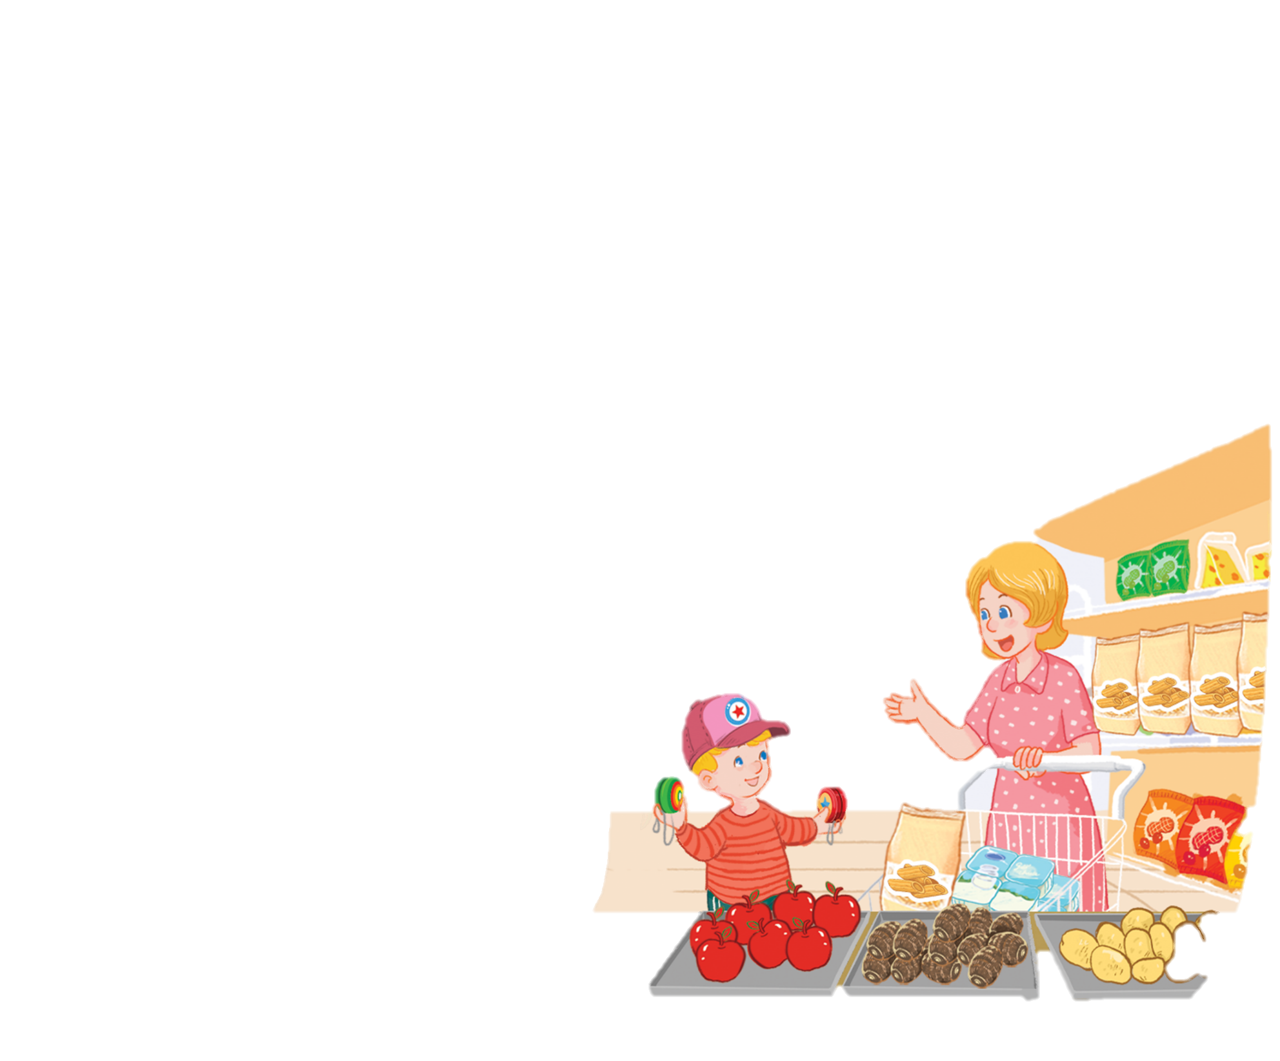
Let’s sing!
Yo-yos and yogurt.
Yo-yos and yogurt.
Yo-yos and yogurt.
Yo-yos and yogurt.
I want some yo-yos.
I want some yo-yos.
I want some yo-yos.
I want some yo-yos.
I want some yogurt.
I want some yogurt.
I want some yogurt.
I want some yogurt.
Yams and apples.
Yams and apples.
Yams and apples.
Yams and apples.
Mum wants some yams.
Mum wants some yams.
Mum wants some yams.
Mum wants some yams.
Mum wants some apples.
Mum wants some apples.
Mum wants some apples.
Mum wants some apples.

Slide 24
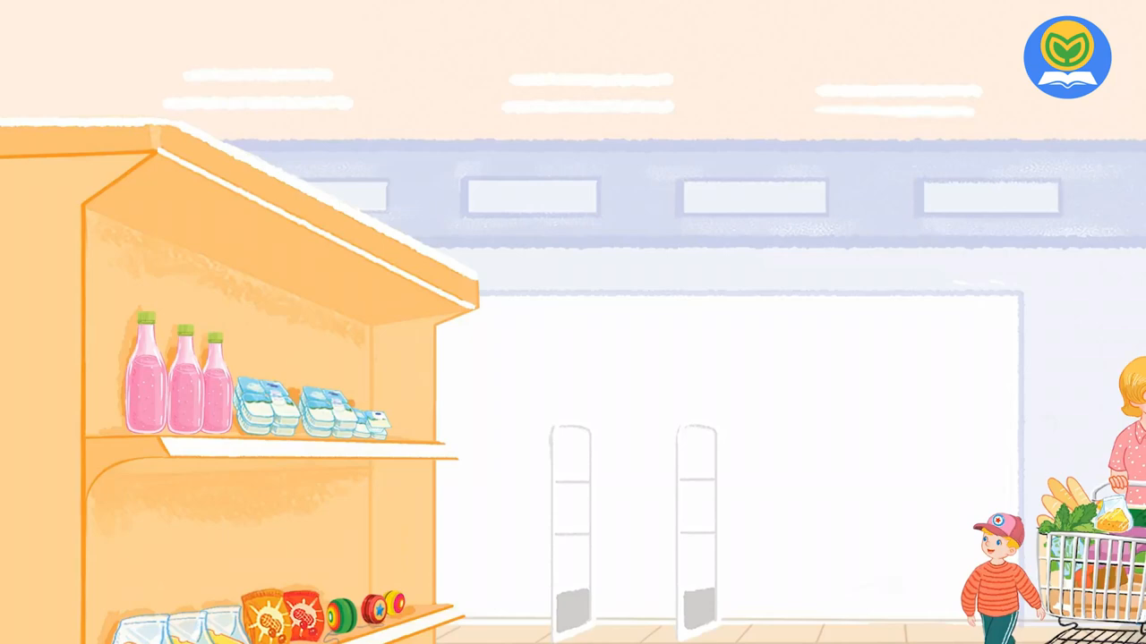
Let’s sing!

Slide 25
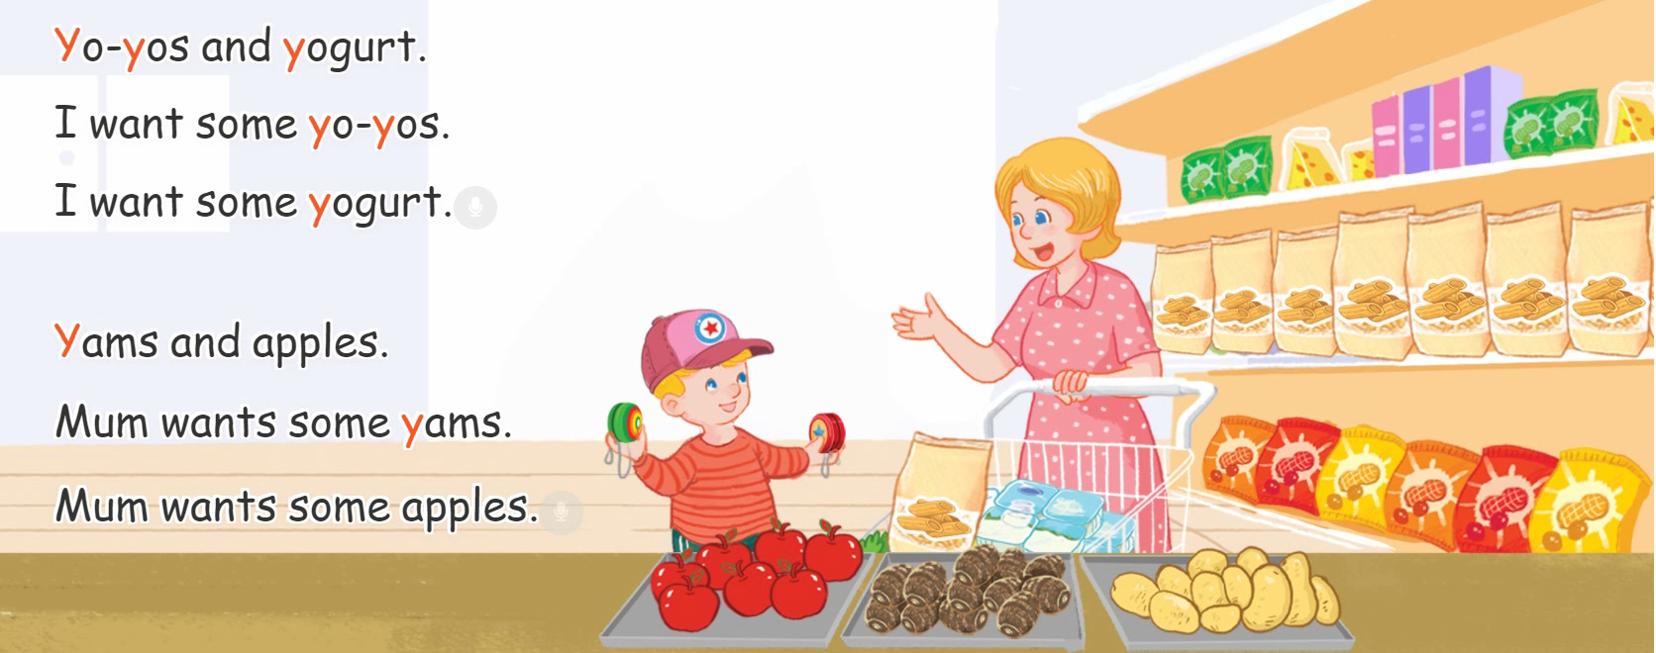
Let’s sing!

Slide 26
Thank you!
Notes:
Facebook : Bùi Liễu Mobile phone: 0968142780

