Slide 1

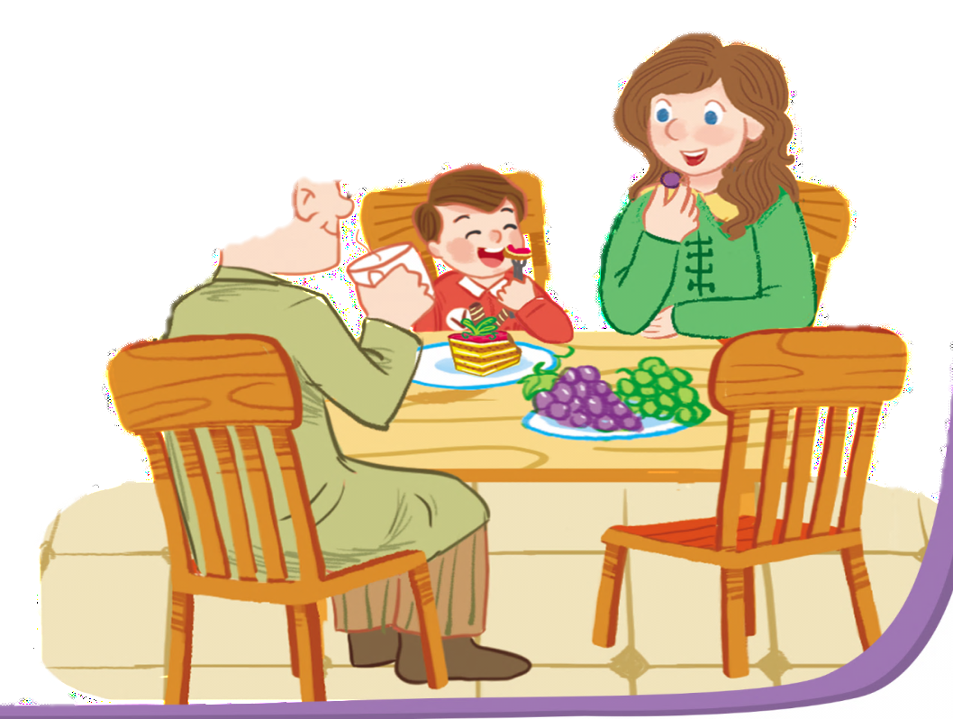
Unit
12
At the cafe’
Lesson 3

Slide 2
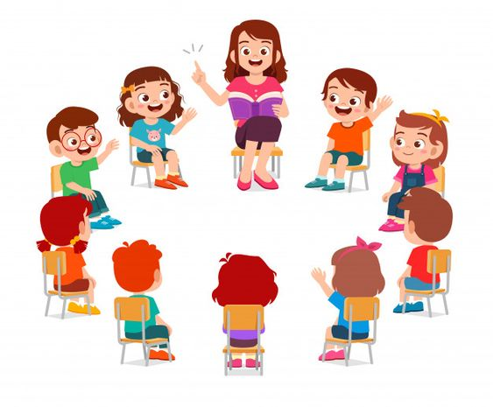
Warm up!

Slide 3

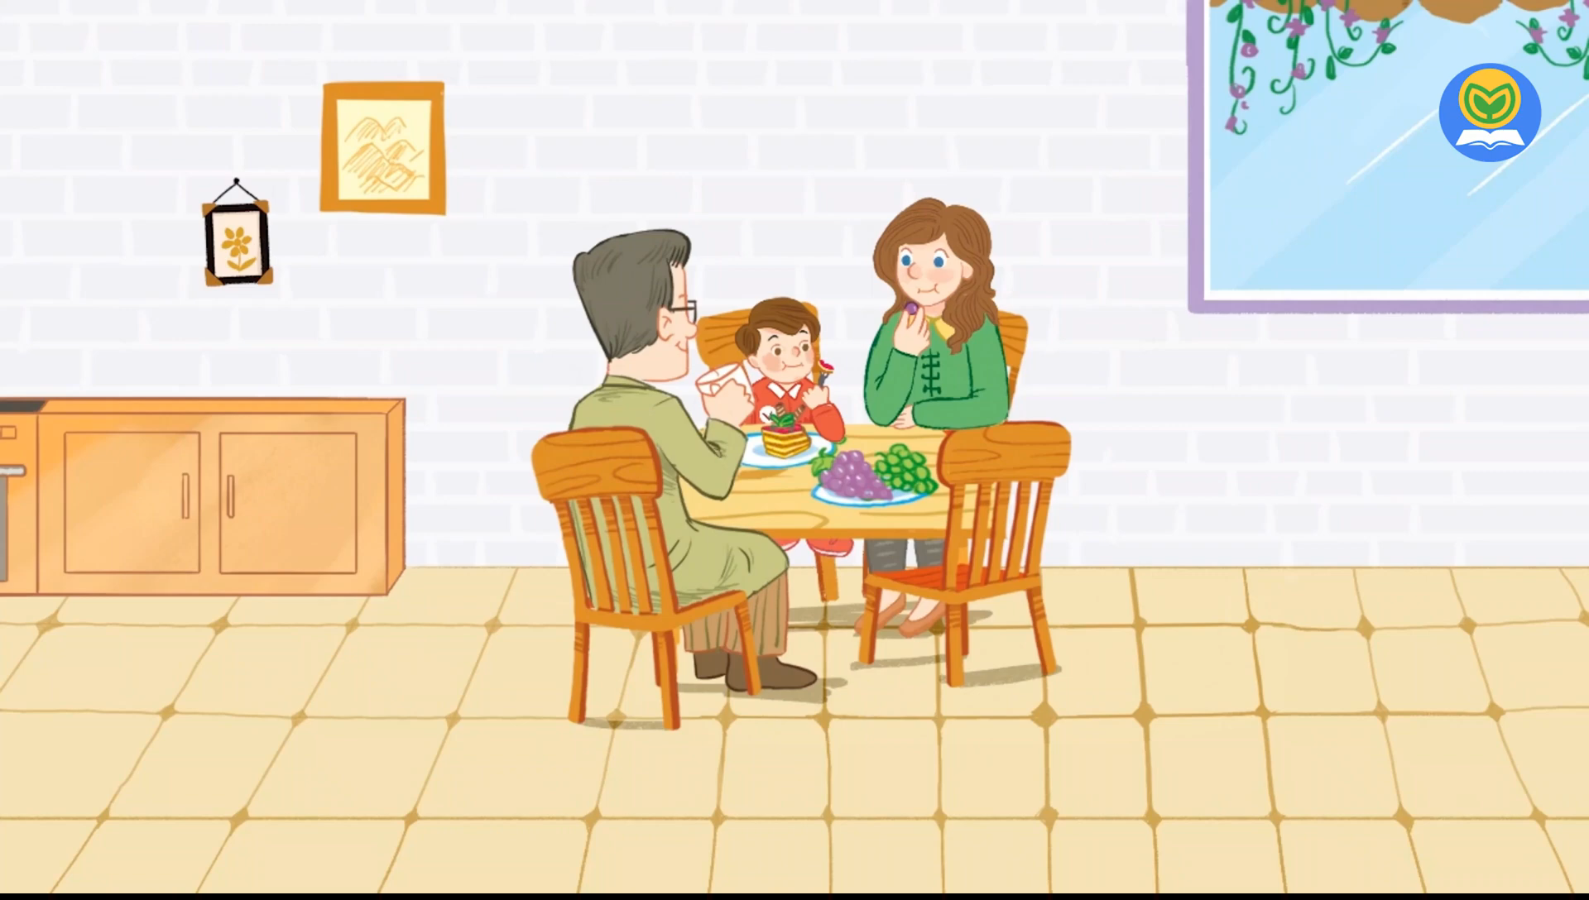
Let’s chant.

Slide 4






Content
Listen and repeat.
Let’s talk.
Let’s sing.

Slide 5



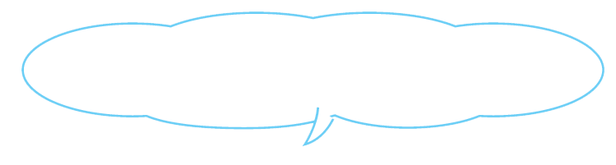
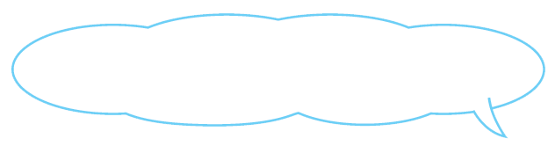
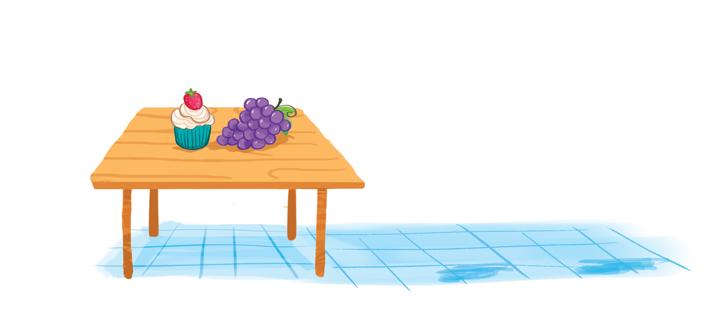
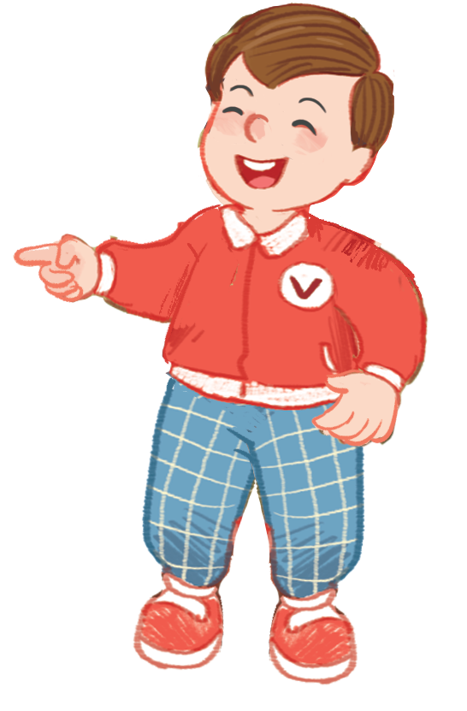
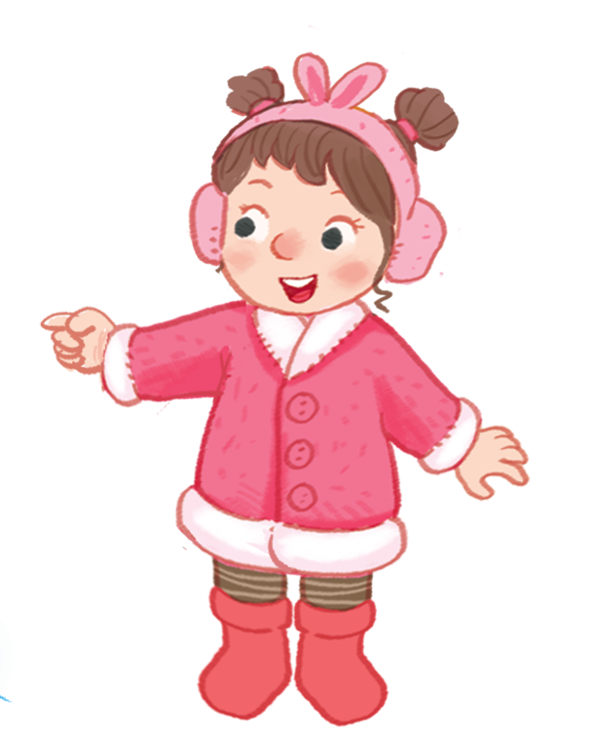
Listen and repeat.
The grapes are on the table.
The grapes are on the table.
The grapes are on the table.
The grapes are on the table.
The cake is on the table.
The cake is on the table.
The cake is on the table.
The cake is on the table.

Slide 6



Sentence parttern
The cake is on the table.
The grapes are on the table.

Slide 7


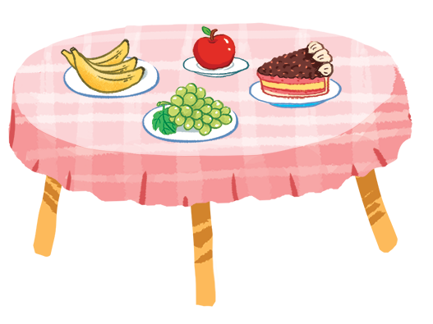
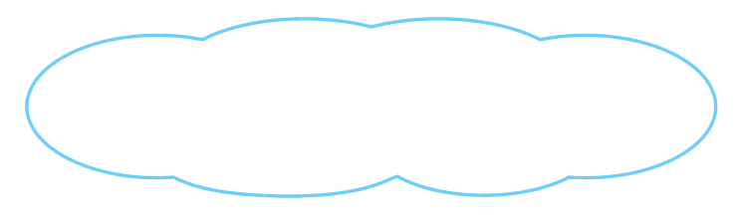
Let’s talk.
The grapes are on the table.
a
b
d
c
c
The is .
The are .

Slide 8
Let’s talk.
The grapes are on the table.
a
a
b
d
c
c
apple
on the table
The is .
The are .

Slide 9
Let’s talk.
The grapes are on the table.
a
a
b
d
b
c
c
The is .
bananas
on the table
The are .

Slide 10

Let’s talk.
The grapes are on the table.
a
a
d
b
d
b
c
c
on the table
The is .
cake
The are .

Slide 11

Let’s play!

Slide 12



Slide 13






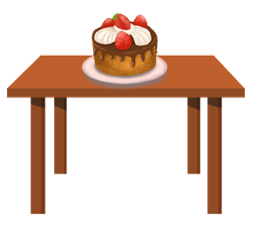
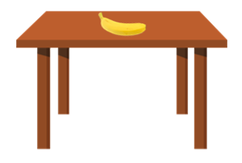
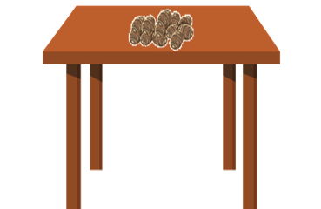




The banana is on the table.

Slide 14



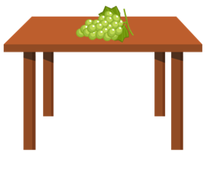
The yams are on the table

Slide 15
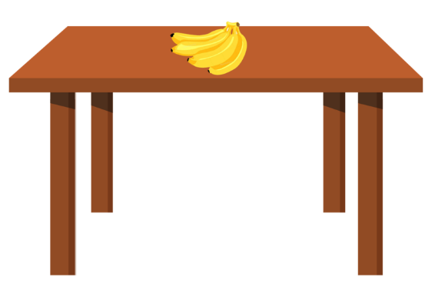
The banana is on the table.

Slide 16
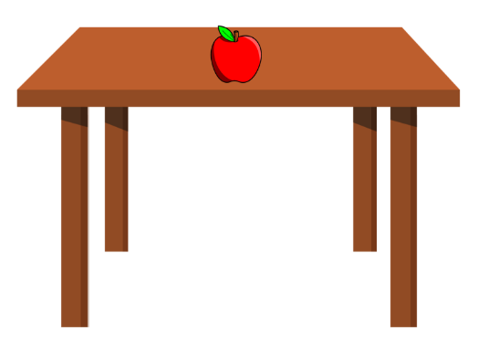
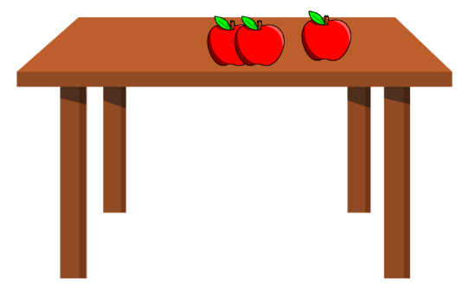
The apples are on the table

Slide 17
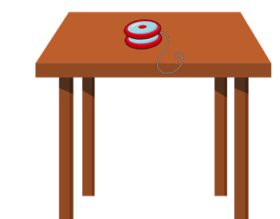
The grapes are on the table.

Slide 18
The cake is on the table

Slide 19


The grapes __ on the table.
are
is
yams

Slide 20
The cake __ on the table.
are
is
yams

Slide 21
The yo-yo __ on the table.
is
are
zebra

Slide 22
The ____ are on the table.
grapes
yo-yos
apples

Slide 23
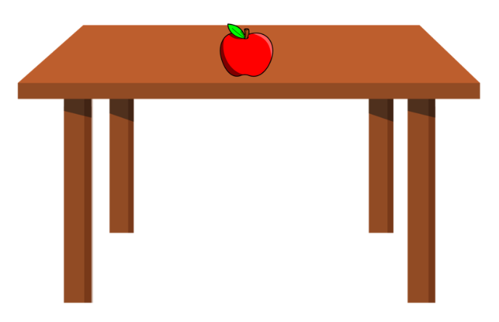
The apple __ on the table.
is
are
banana

Slide 24
The grapes are on the ____.
table
ball
bike

Slide 25



Slide 26




Slide 27
Look and say.
The cake is on the table.

Slide 28
Look and say.
The grapes are on the table.

Slide 29
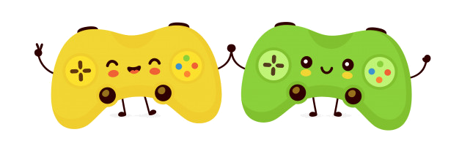
WELL DONE!

Slide 30

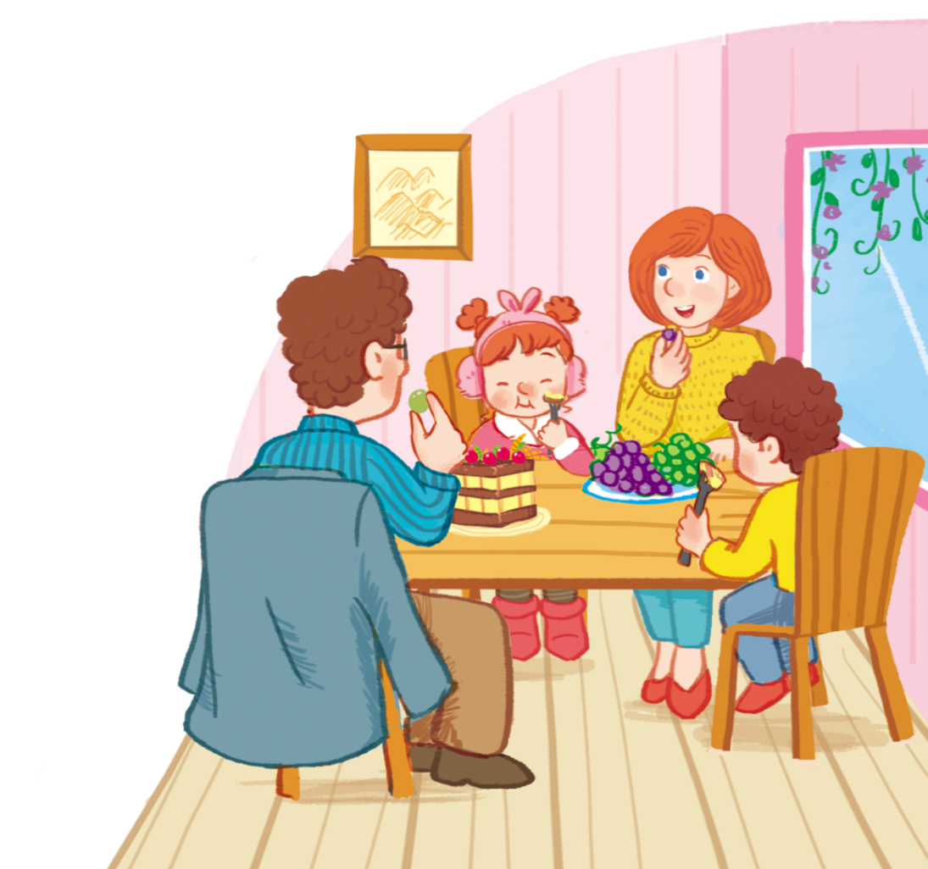
Let’s sing.
Look at the cake.
Look at the cake.
Look at the cake.
Look at the cake.
The cake is on the table.
The cake is on the table.
The cake is on the table.
The cake is on the table.
Look at the grapes.
Look at the grapes.
Look at the grapes.
Look at the grapes.
The grapes are on the table.
The grapes are on the table.
The grapes are on the table.
The grapes are on the table.
We’re having a cake.
We’re having a cake.
We’re having a cake.
We’re having a cake.
We’re having grapes.
We’re having grapes.
We’re having grapes.
We’re having grapes.

Slide 31
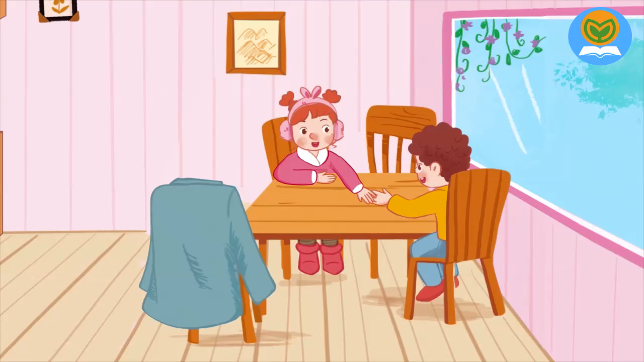
Let’s sing.

Slide 32
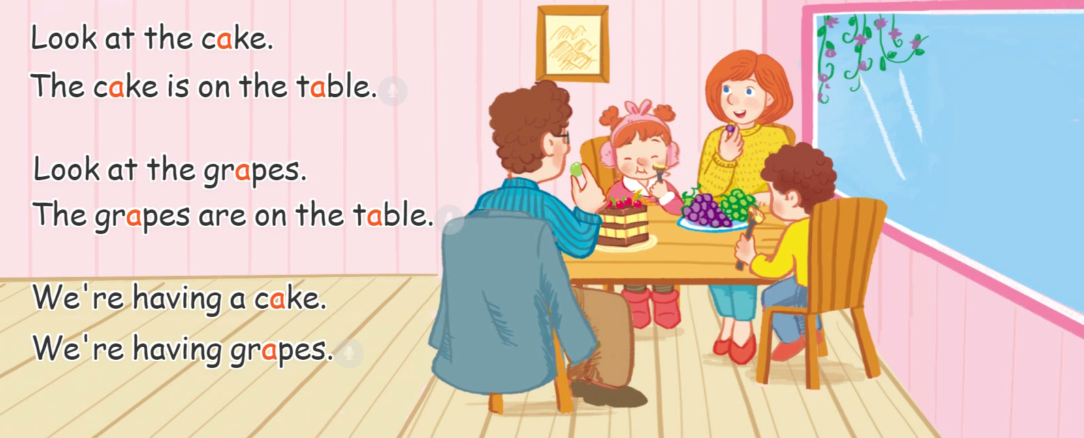
Let’s sing.

Slide 33
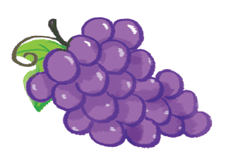
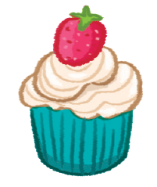
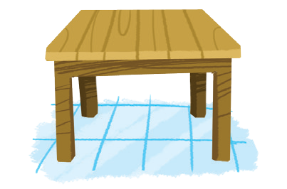
Review
a

Slide 34
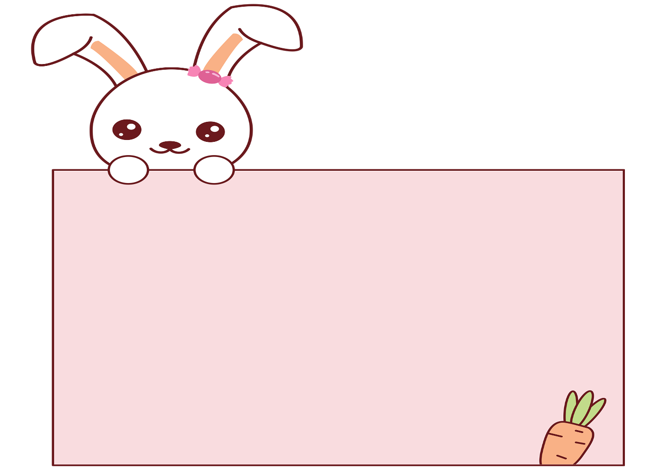
Thank you!

