Slide 1





Hoa Nghia Primary school
Welcome to our class !
Teacher: Mai Hong Phuong

Slide 2
Unit 11: My home
Lesson 1 - period 2

Slide 3
Table of Contents
01
02
03
04
Listen and tick or cross.
Warm-up
Look, complete and read.
Let’s play.
Fun corner & wrap-up
05

Slide 4
01
Warm-up

Slide 5
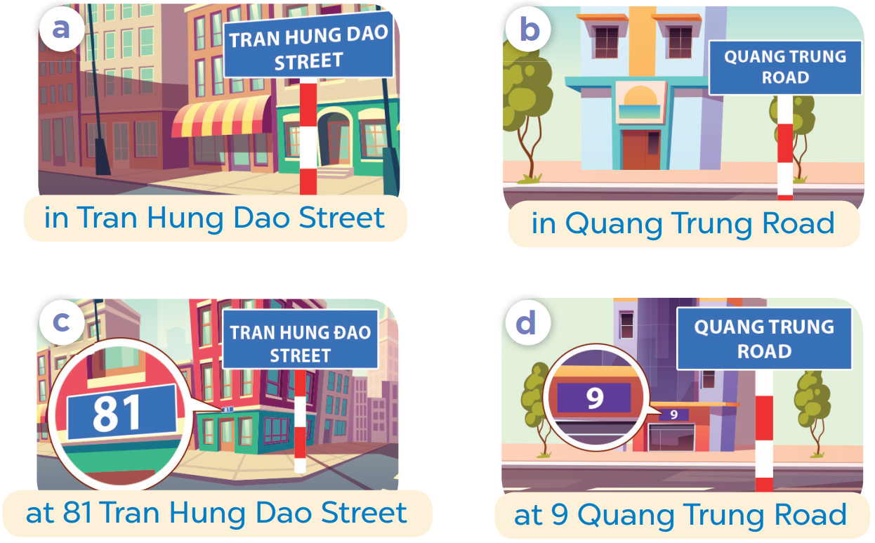
SLAP THE BOARD

Slide 6
02
Listen and tick or cross.

Slide 7
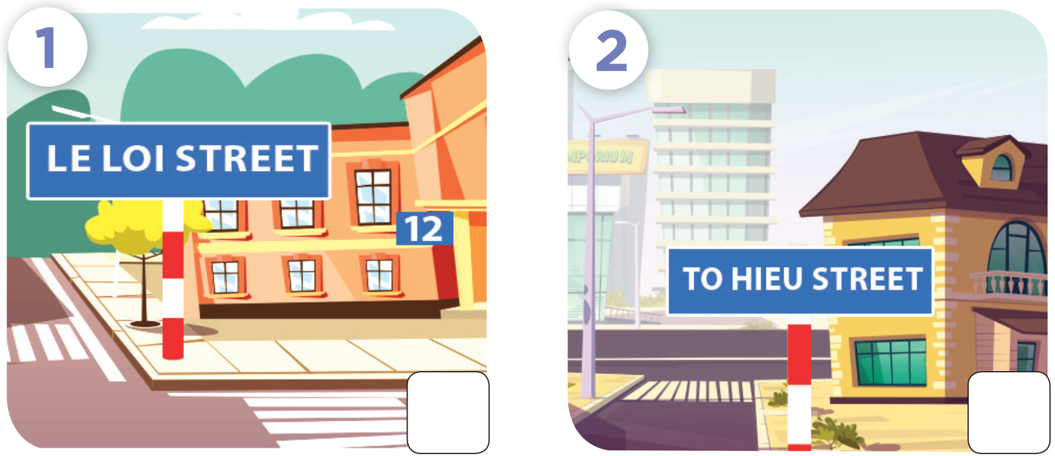

Slide 8
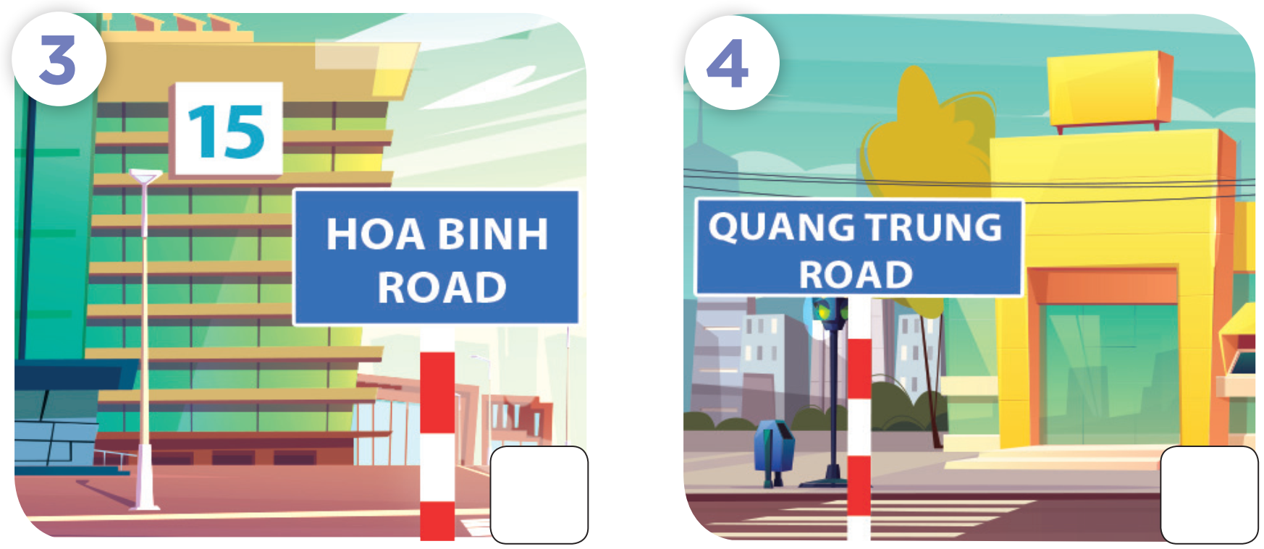

Slide 9


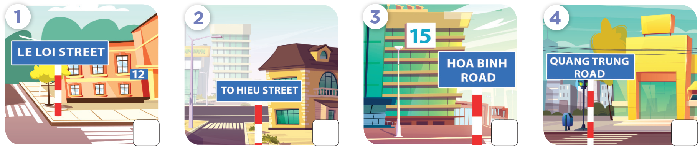

Slide 10



Slide 11
03
Look, complete and read.

Slide 12
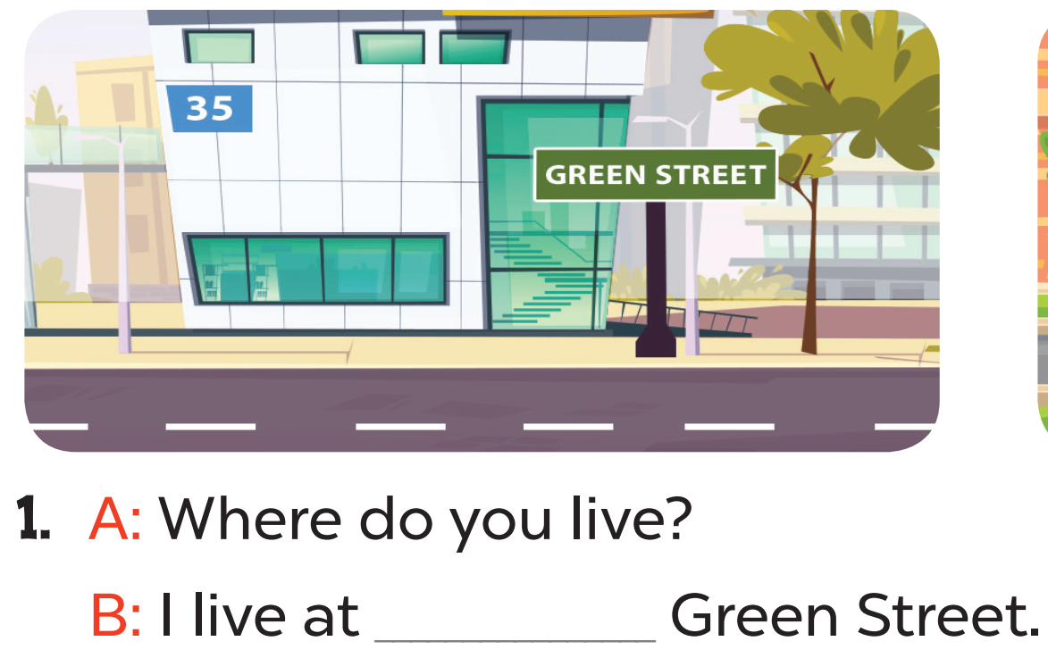
35

Slide 13

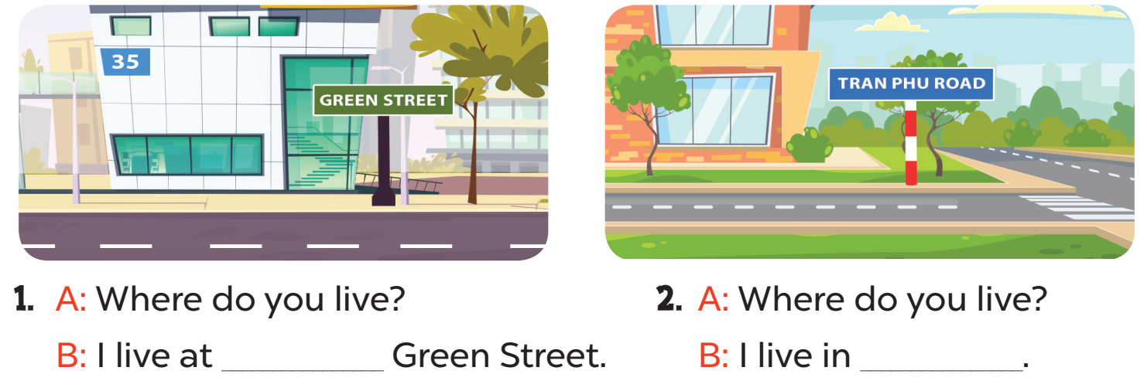
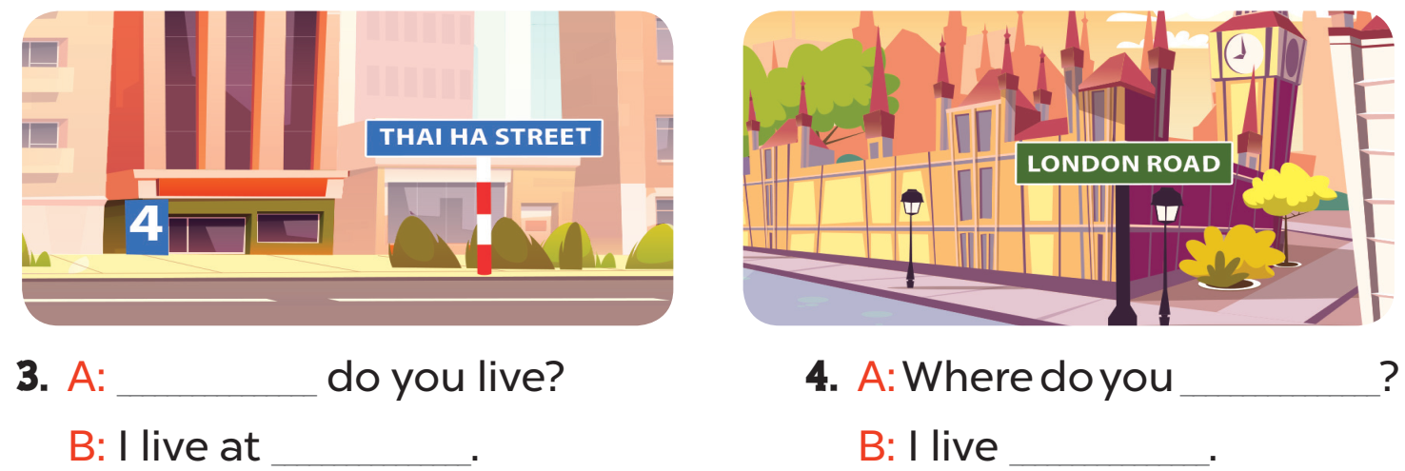

Slide 14
35
Tran Phu Road
Where
live
4 Thai Ha Street
at London Road

Slide 15
04
Let’s play.

Slide 16
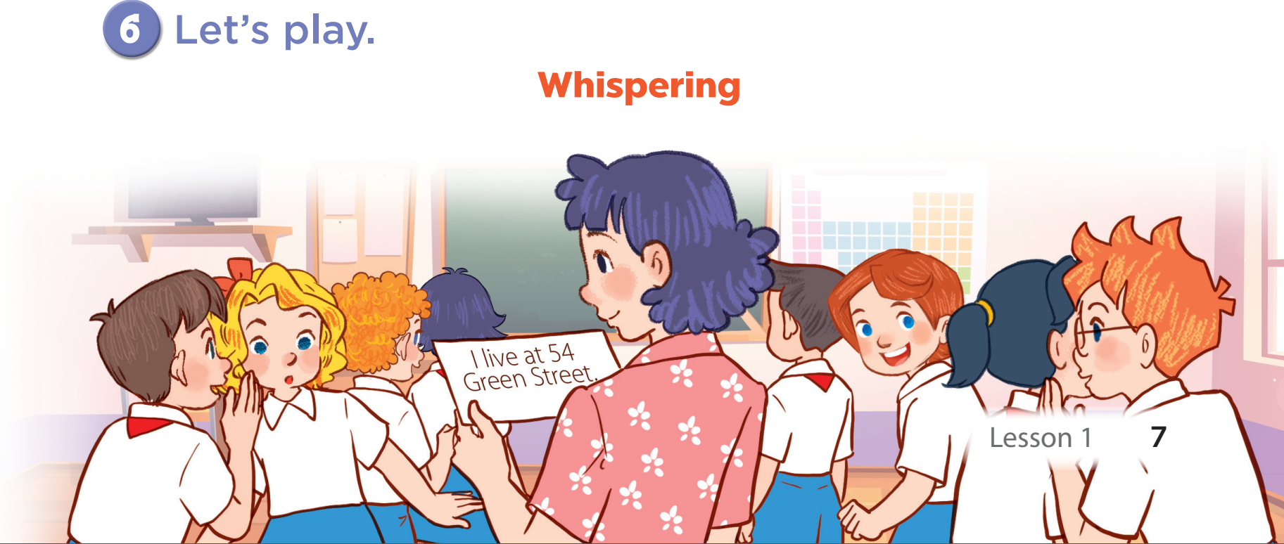

Slide 17
05
Fun corner & wrap-up

Slide 18
What have you learnt today? 2. What the core value of the lesson?

