Slide 1




Hoa Nghia Primary school
Welcome to our class !
Teacher: Mai Hong Phuong

Slide 2
Unit 11: My home
Lesson 2 - period 3

Slide 3
Table of Contents
01
02
03
04
Warm-up
Look, listen and repeat.
Listen, point and say.
Let’s talk.
fun conner
& Wrap-up
05

Slide 4
01
Warm-up

Slide 5
02
Look, listen and repeat.

Slide 6
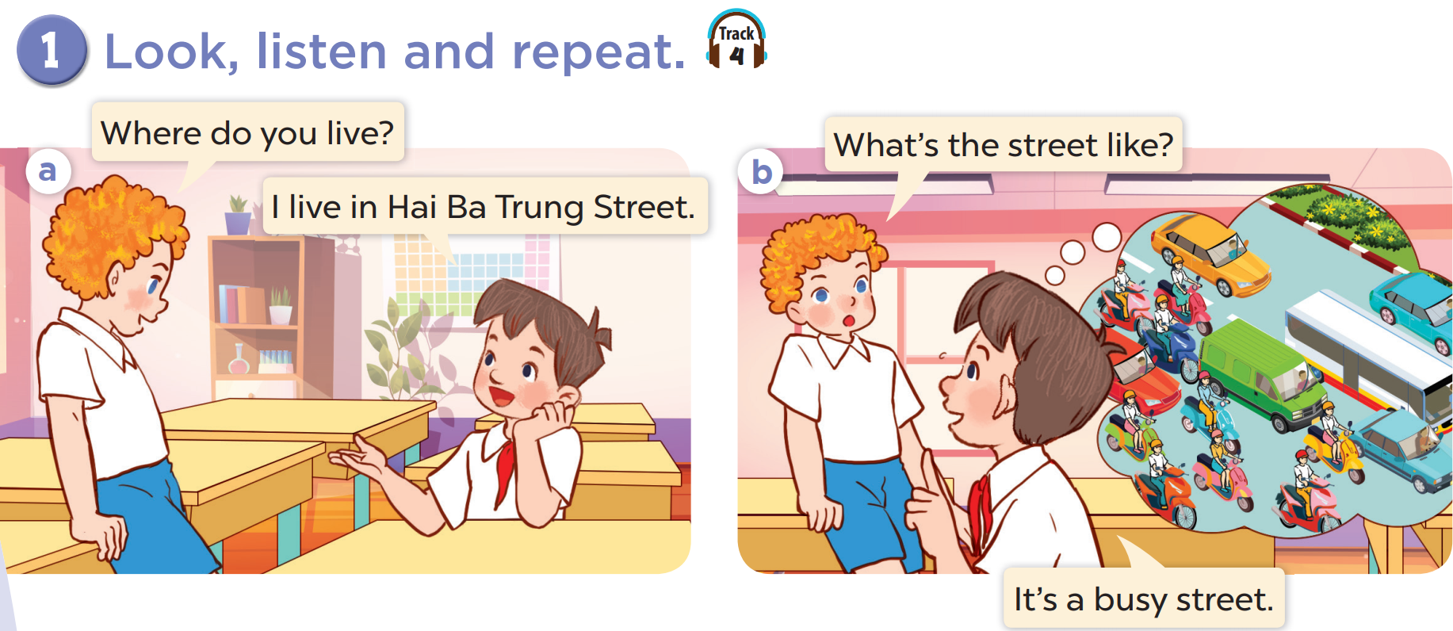

Slide 7
03
Listen, point and say.

Slide 8
vocabulary

Slide 9
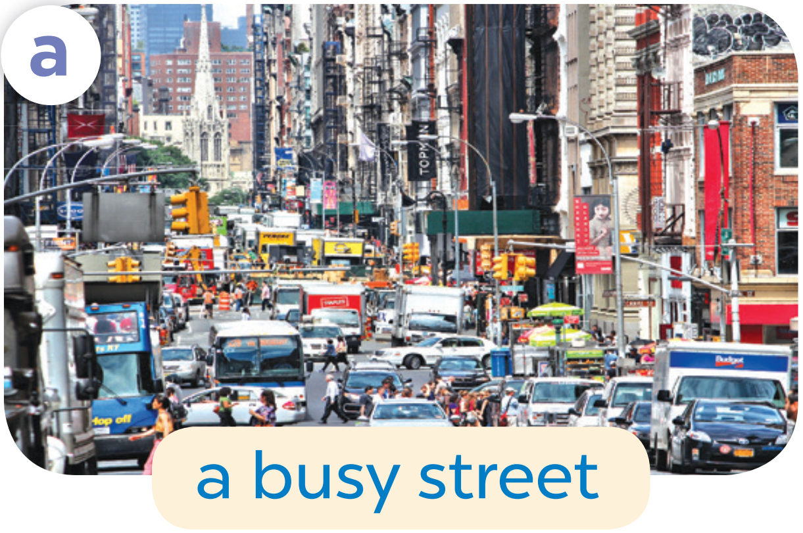

Slide 10


Slide 11
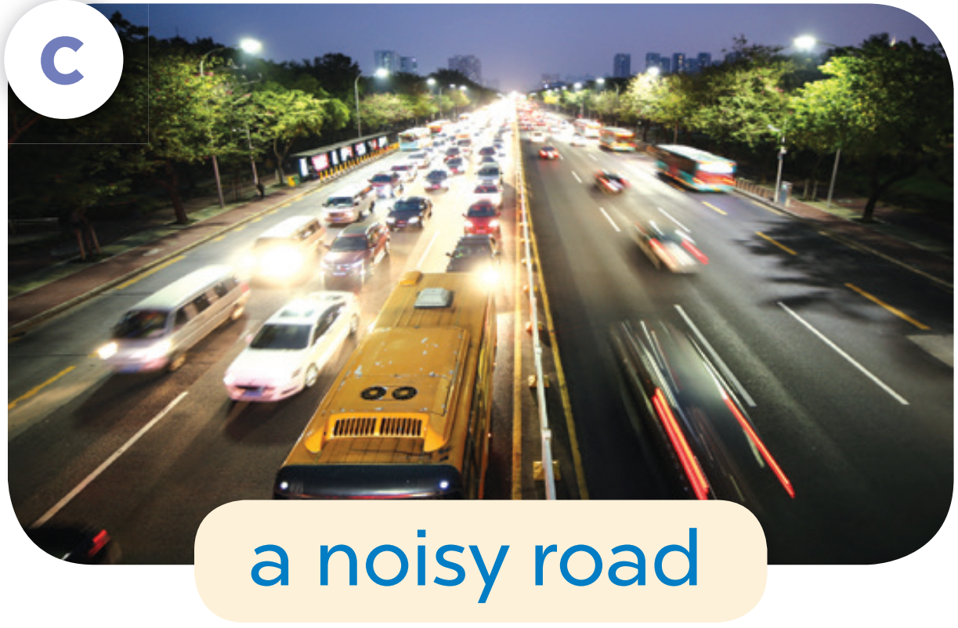

Slide 12


Slide 13
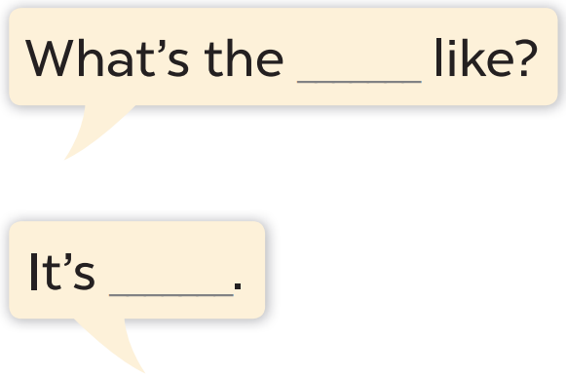
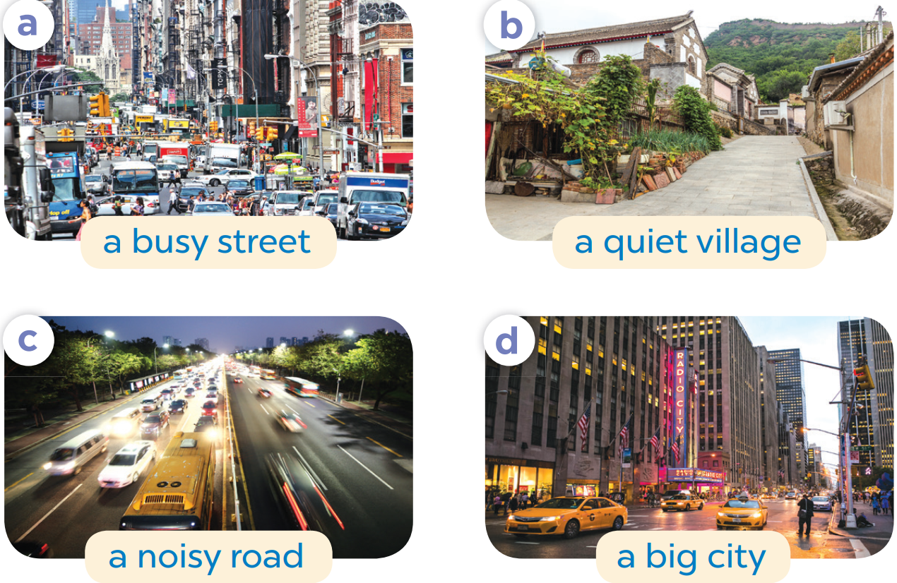

Slide 14
What the street like?
It’s a busy street.

Slide 15
04
Let’s talk.

Slide 16
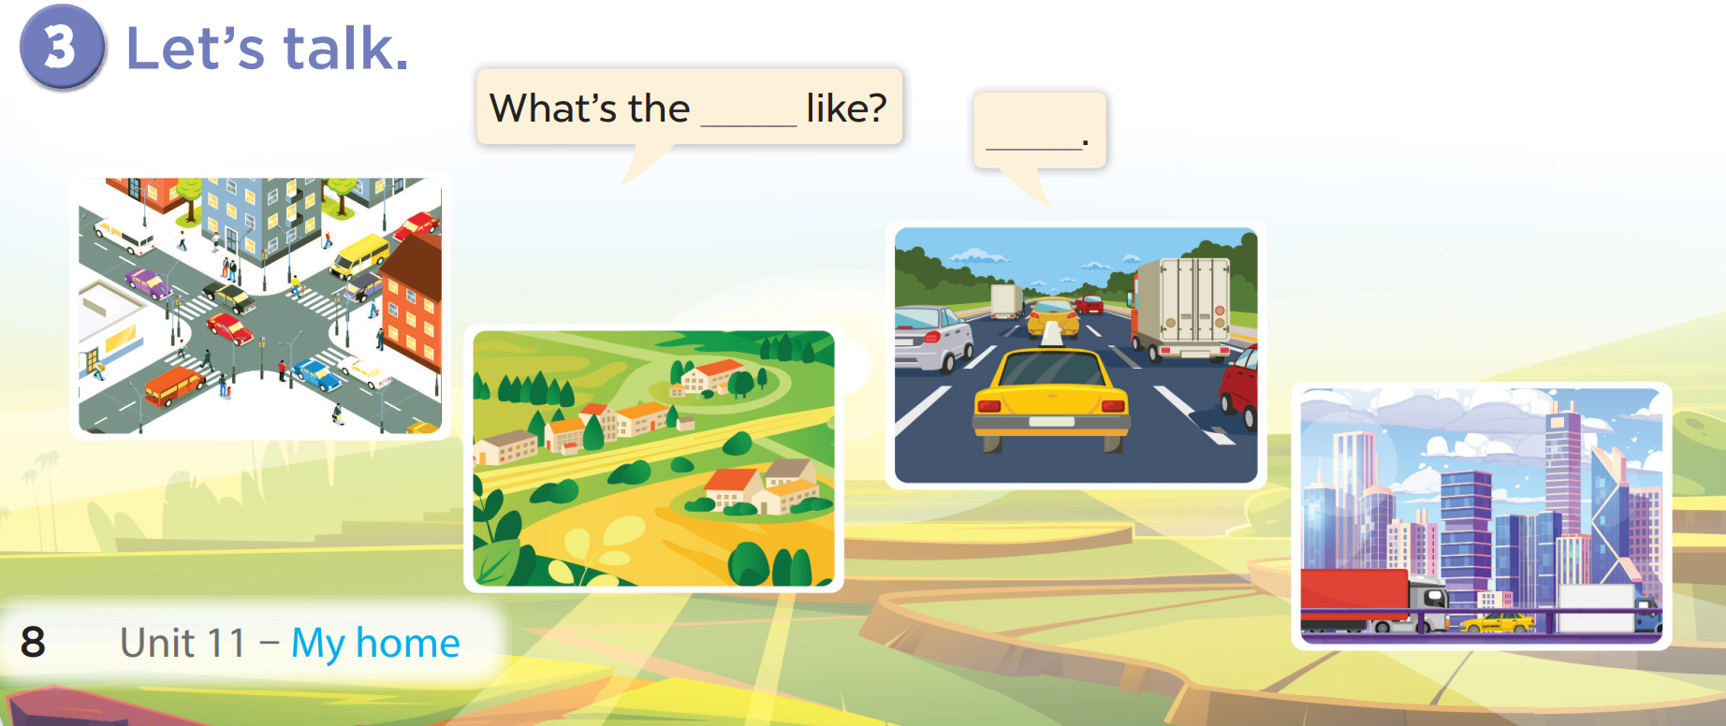

Slide 17
05
fun conner
& Wrap-up

Slide 18
What have you learnt today?
2. What the core value of the lesson?

