Slide 1




Hoa Nghia Primary school
Welcome to our class !
Teacher: Mai Hong Phuong

Slide 2
Unit 11: My home
Lesson 2 - period 4

Slide 3
Table of Contents
01
02
03
04
Listen and tick.
Warm-up
Look, complete and read.
Let’s sing.
05
Fun corner & Wrap-up

Slide 4
01
Warm-up

Slide 5
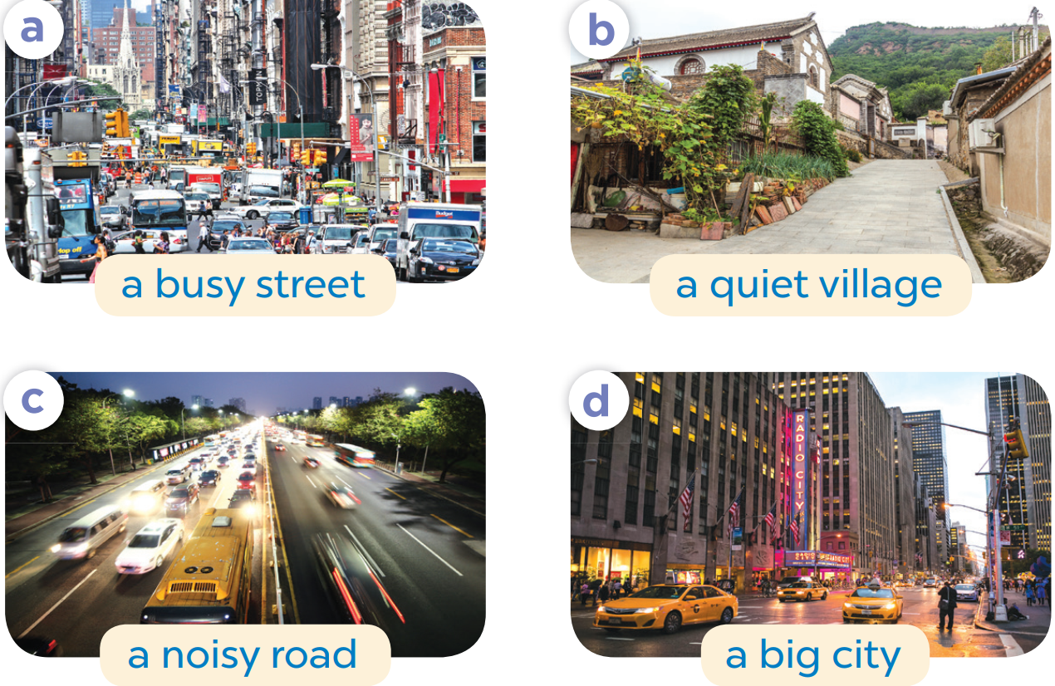
Slap the board

Slide 6
02
Listen and tick.

Slide 7
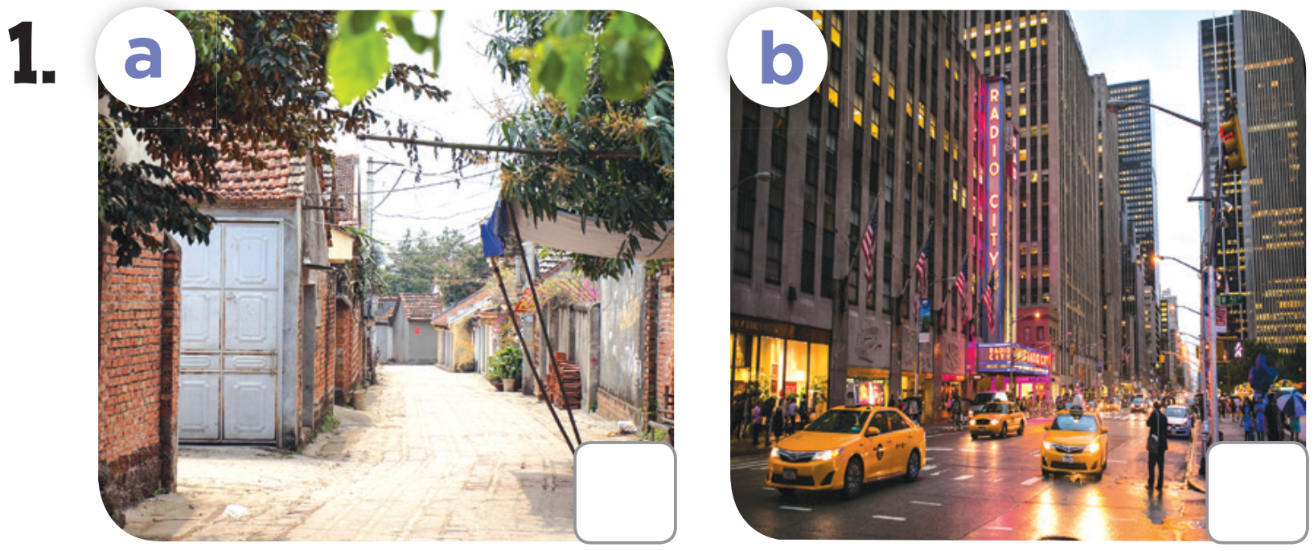

Slide 8
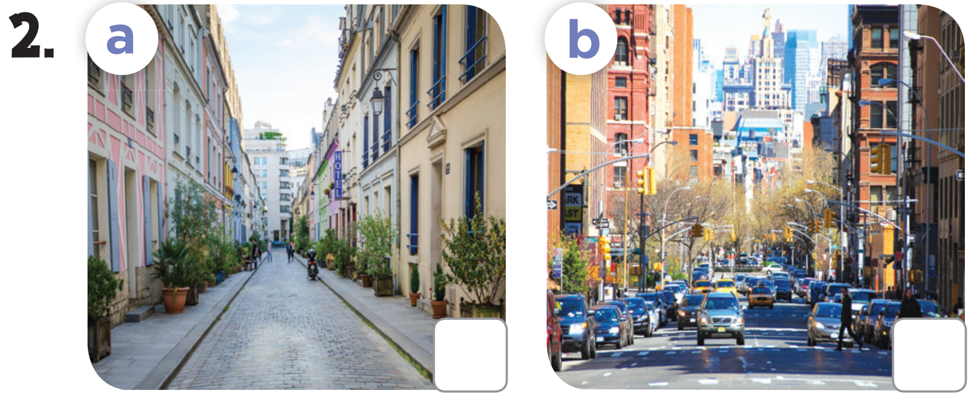

Slide 10


Slide 11
03
Look, complete and read.

Slide 12
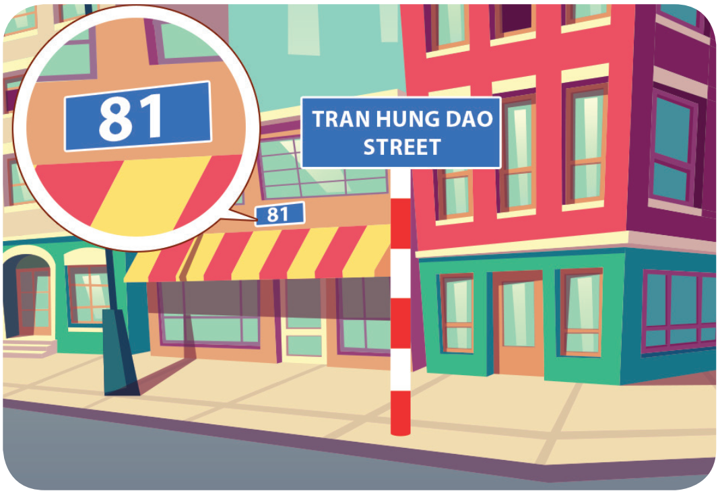
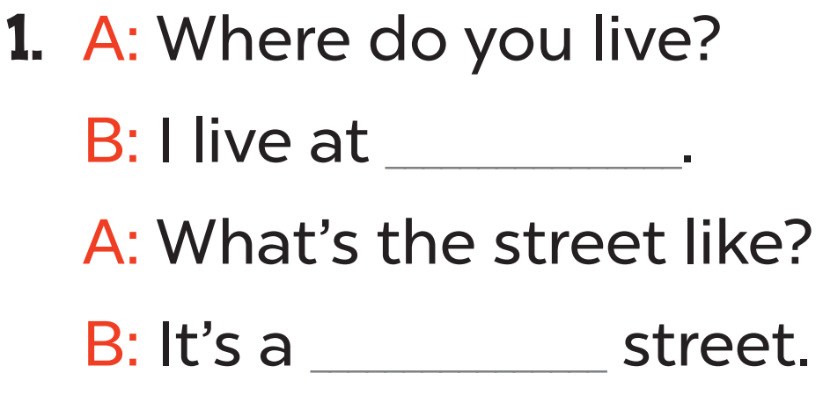
81 Tran Hung Dao Street
quiet

Slide 13
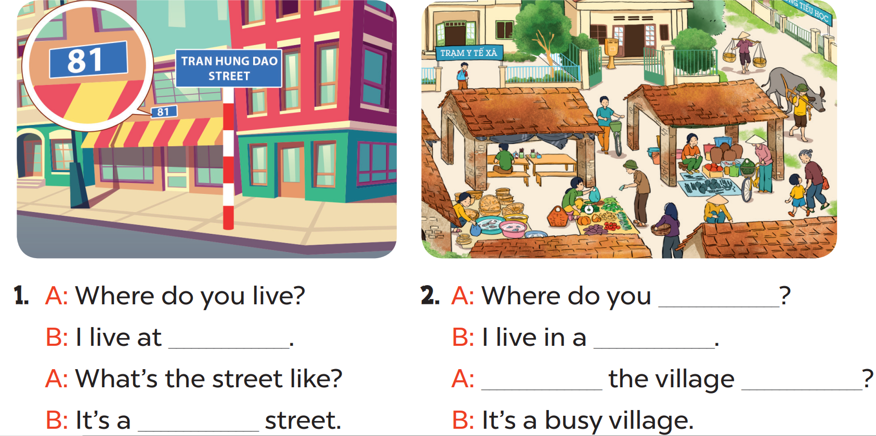

Slide 14
live
village
81 Tran Hung Dao Street
What’s
like
quiet

Slide 15
04
Let’s sing.

Slide 16
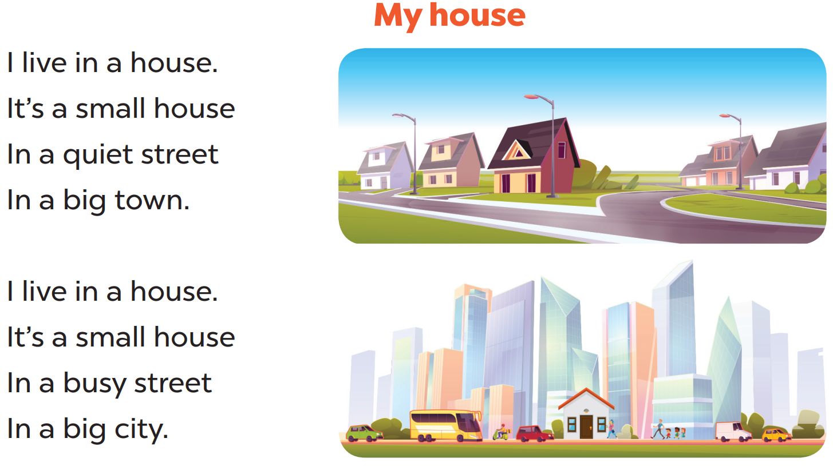

Slide 17
05
Fun corner & Wrap-up

Slide 18
What have you learnt today?
2. What the core value of the lesson?

