Slide 1




Hoa Nghia Primary school
Welcome to our class !
Teacher: Mai Hong Phuong

Slide 2
Unit 11: My home
Lesson 3 - period 5

Slide 3
Table of Contents
01
02
03
04
Listen and repeat.
Warm-up
Listen and circle.
Let’s chant.
fun conner & wrap-up
05

Slide 4
01
Warm-up

Slide 5
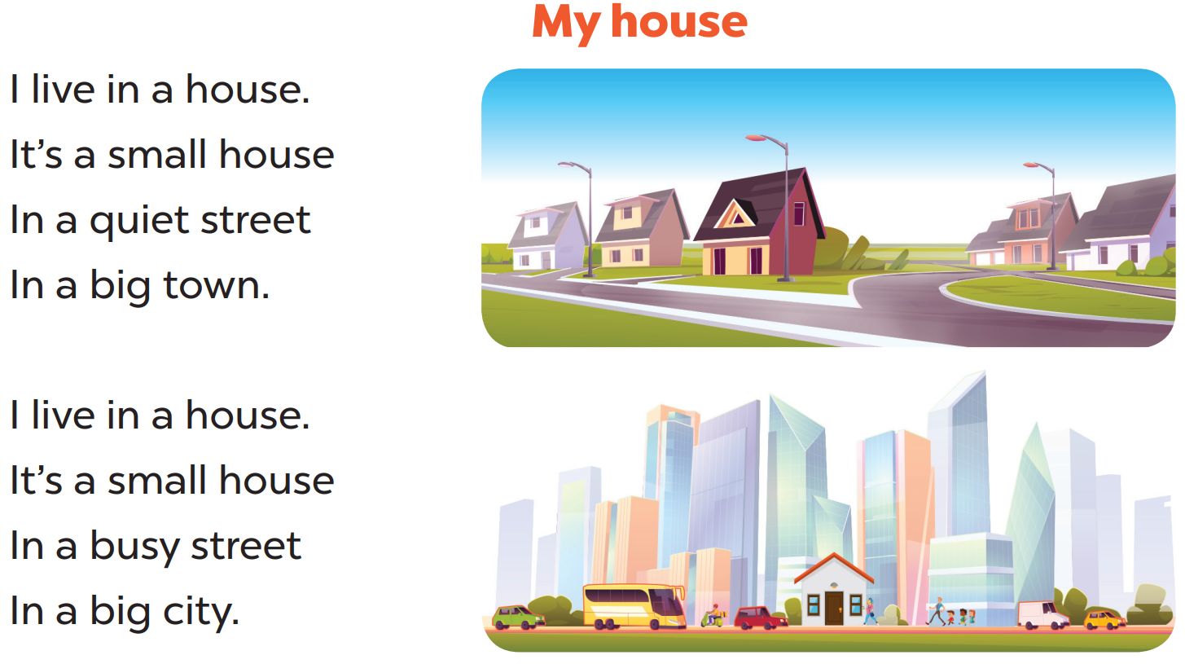

Slide 6
02
Listen and repeat.

Slide 7



Slide 8
03
Listen and circle.

Slide 9

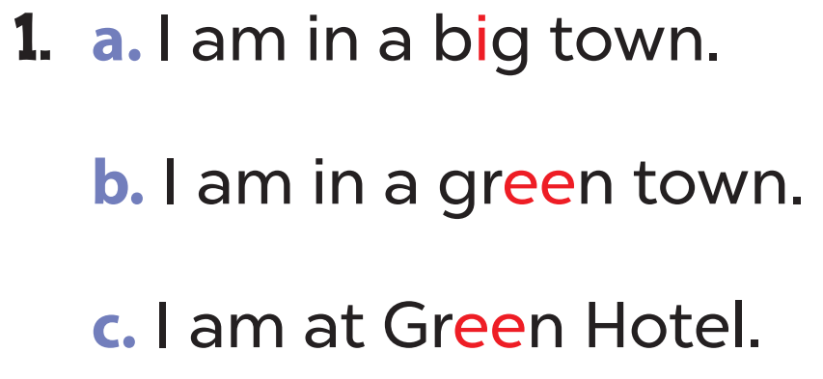
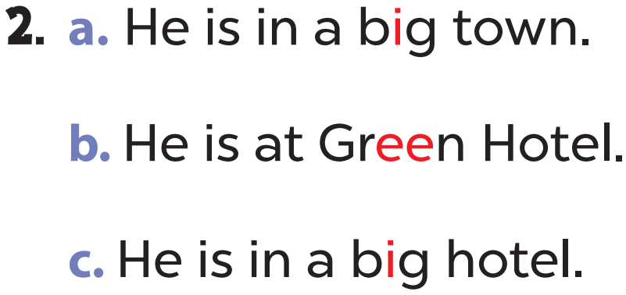

Slide 10


Slide 11
04
Let’s chant.

Slide 12
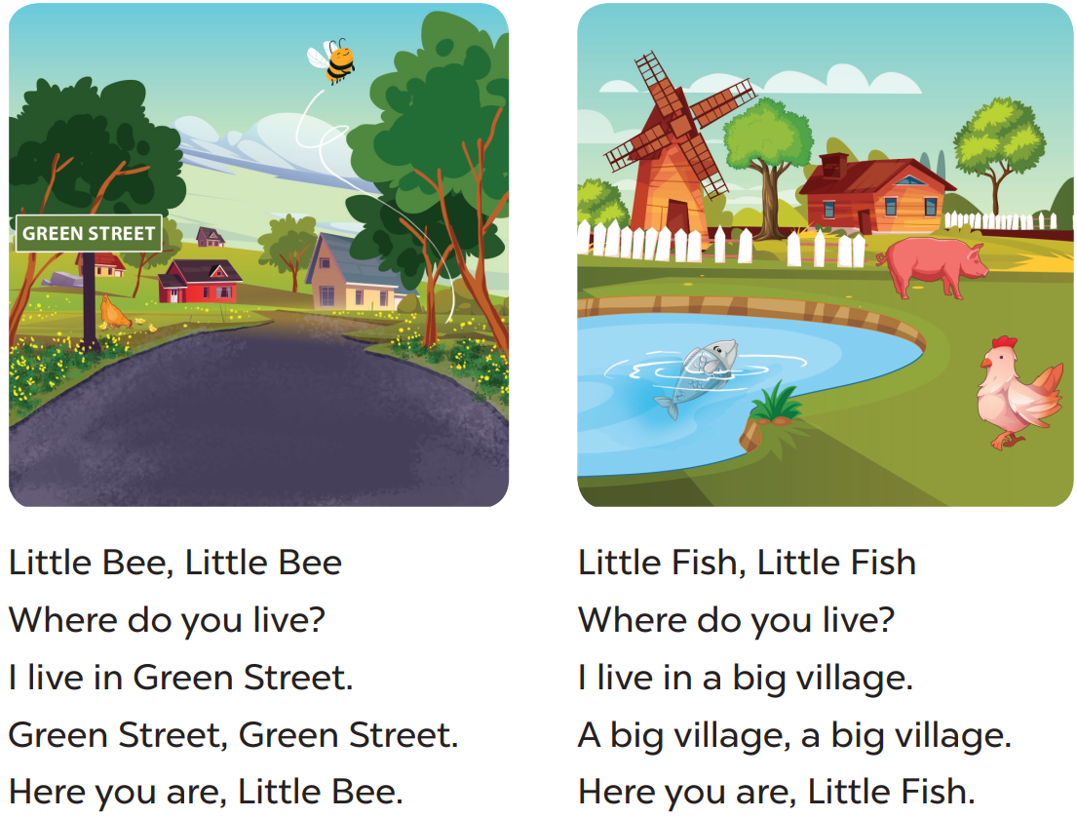

Slide 13
05
fun conner & wrap-up

Slide 14
What have you learnt today?
2. What the core value of the lesson?

