Slide 1





Hoa Nghia Primary school
Welcome to our class !
Teacher: Mai Hong Phuong

Slide 2
Unit 11: My home
Lesson 3 - period 6

Slide 3
Table of Contents
01
02
03
04
Read and circle.
Warm-up
Let’s write.
Project
fun conner & Wrap-up
05

Slide 4
01
Warm-up

Slide 5
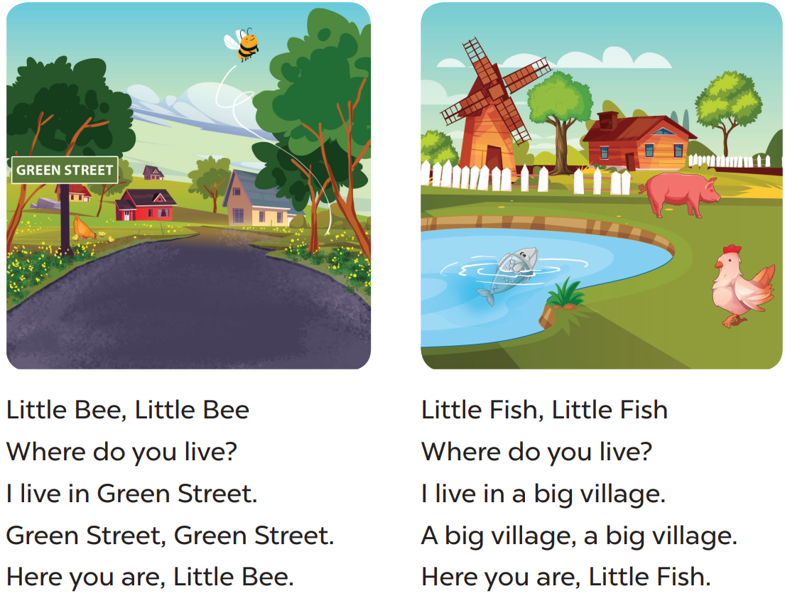

Slide 6
02
Read and circle.

Slide 7
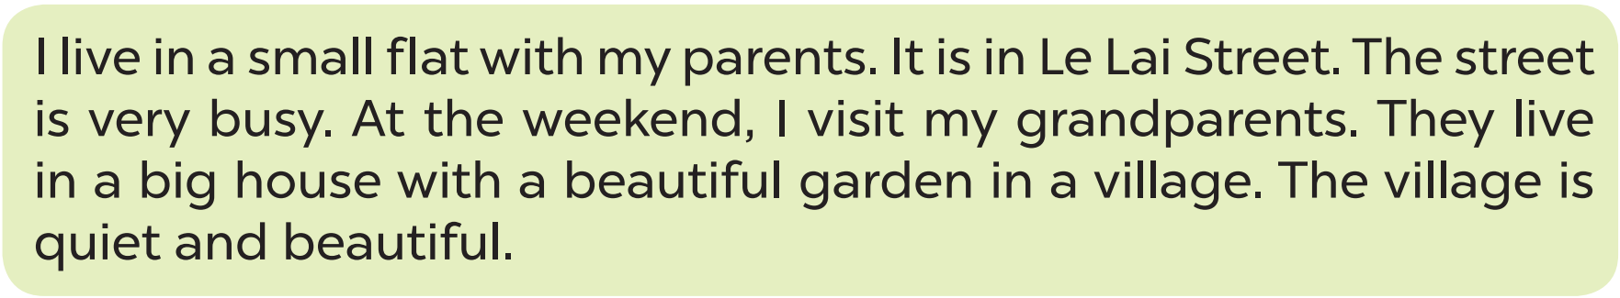

Slide 8
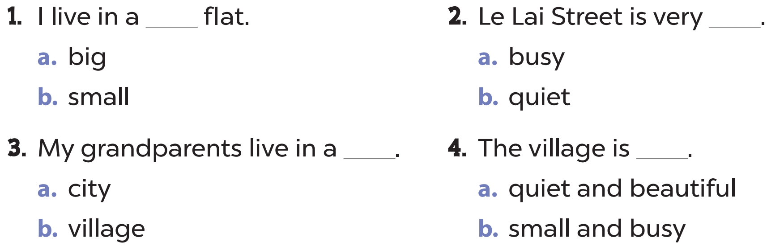

Slide 9


Slide 10
03
Let’s write.

Slide 11
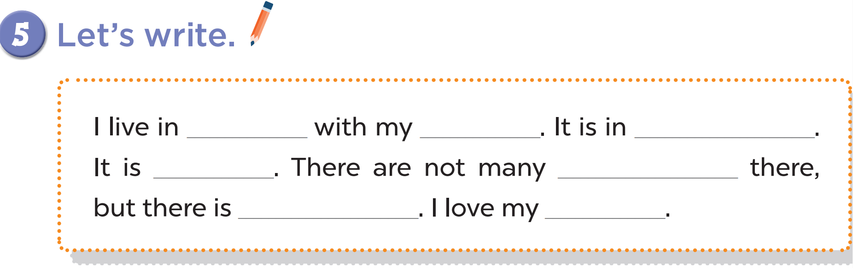

Slide 12
04
Project

Slide 13
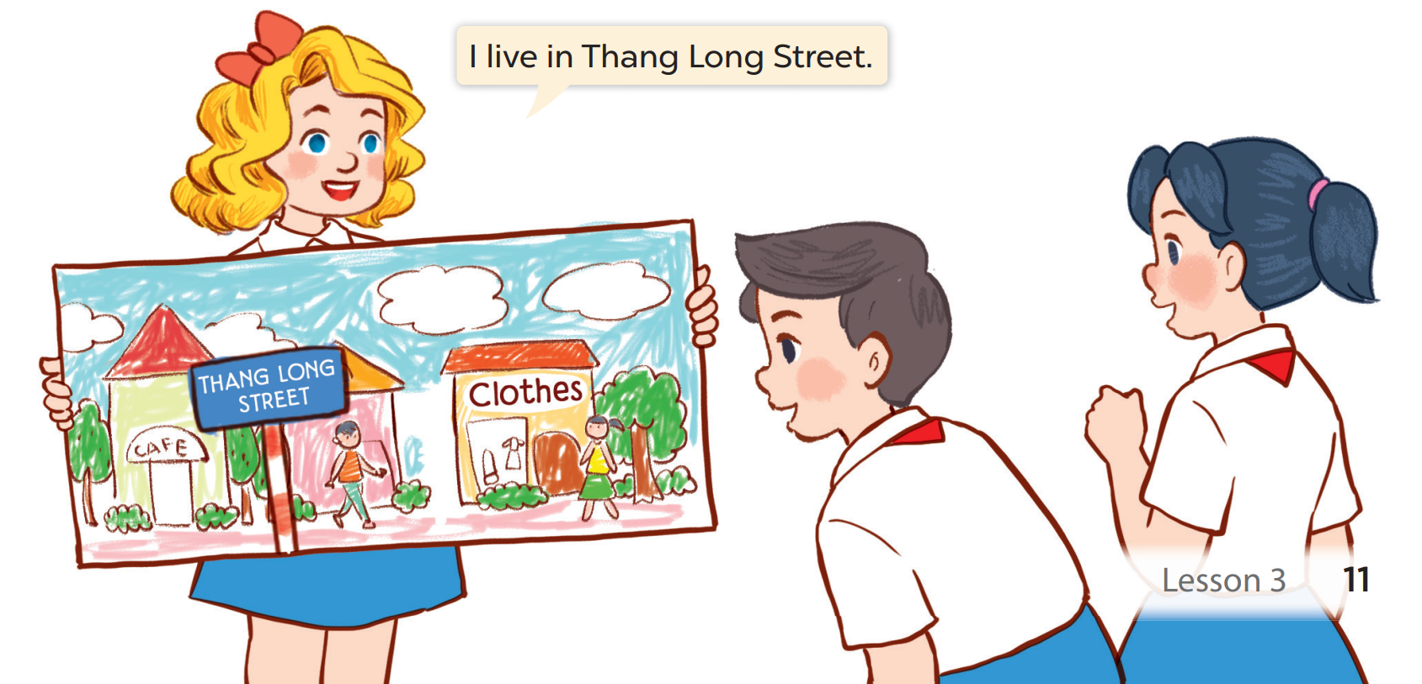

Slide 14
05
fun conner & Wrap-up

Slide 15
What have you learnt today?
2. What the core value of the lesson?

