Slide 2









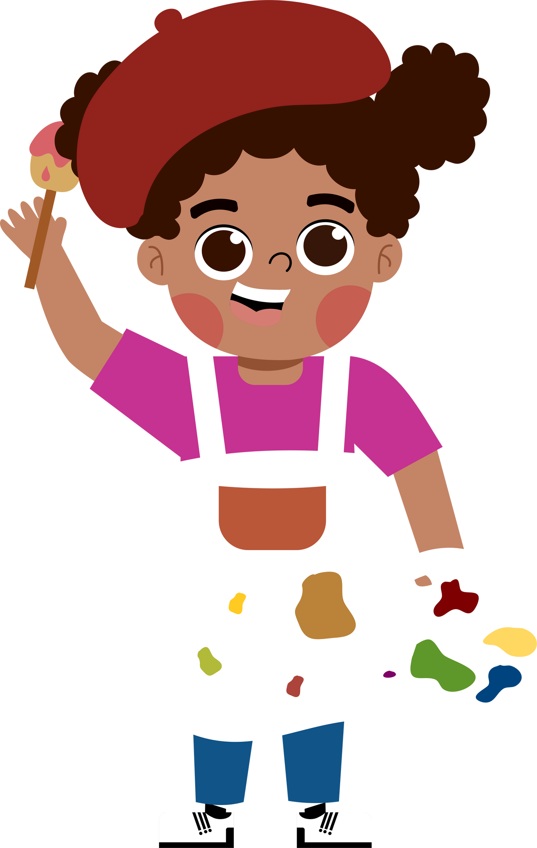
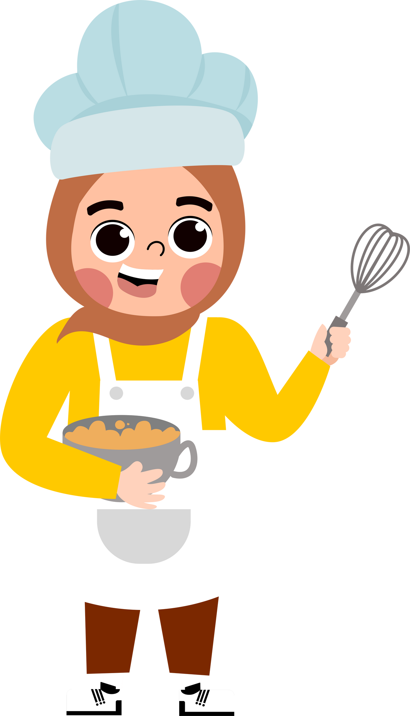


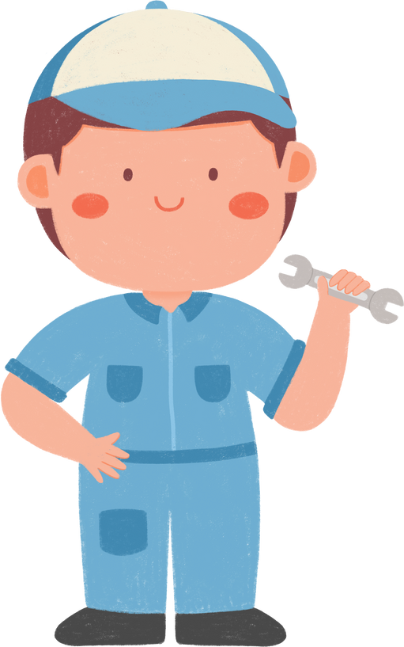
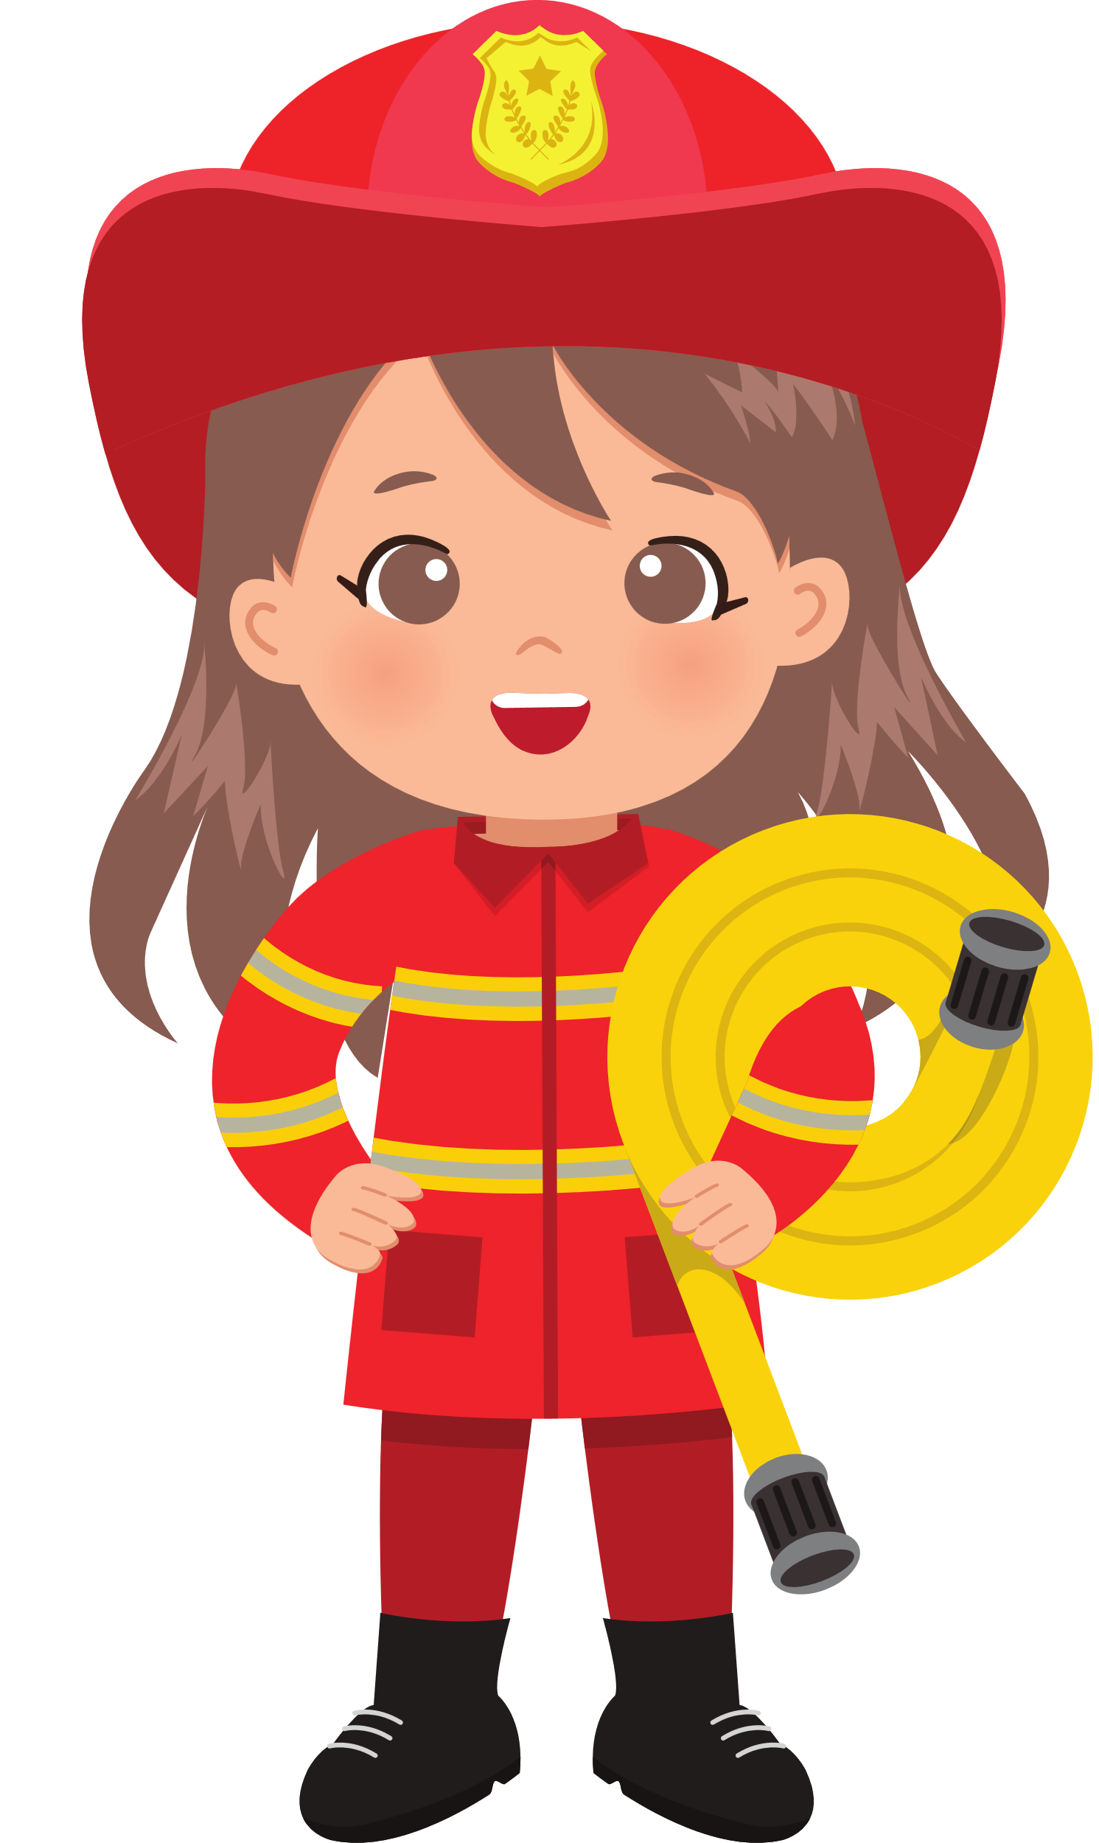



5
HOA NGHIA PRIMARY SCHOOL
Class: 5B
Teacher: Pham Thi Thu Trang
My future job
Lesson 2(act 2,3)

Slide 3











Slide 4






Why would you like to be a teacher?
Because I’d like to …………………………………….
teach children
report the news

Slide 5

Why would you like to be a writer?
Because I’d like to …………………………………….
help sick people
write stories

Slide 6
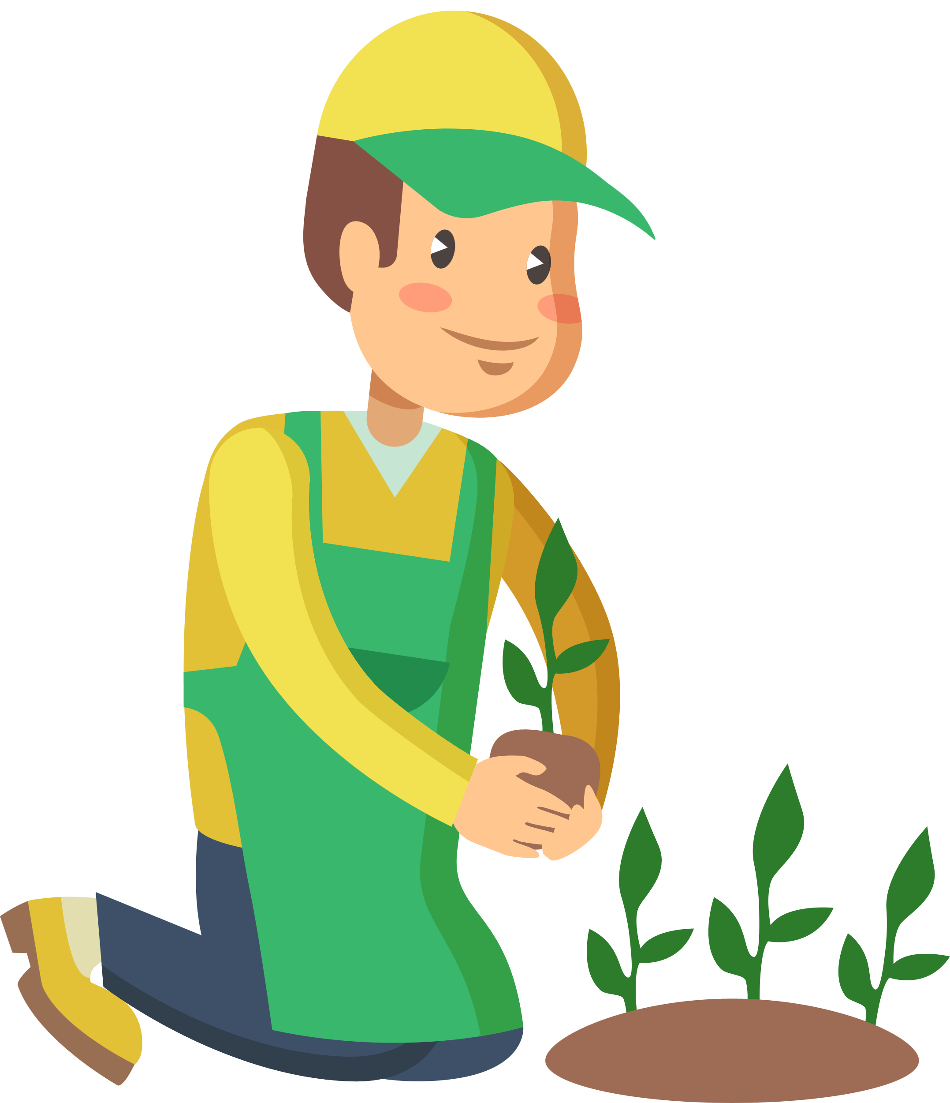
Why would you like to be a gardener?
Because I’d like to …………………………………….
grow flowers
put out fire

Slide 7

Why would you like to be a doctor?
Because I’d like to …………………………………….
help sick people
grow flowers

Slide 8
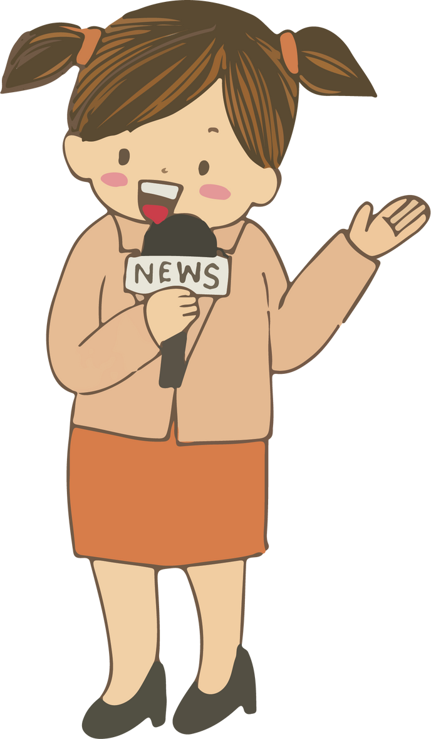
Why would you like to be a reporter?
Because I’d like to …………………………………….
write stories
report the news

Slide 9
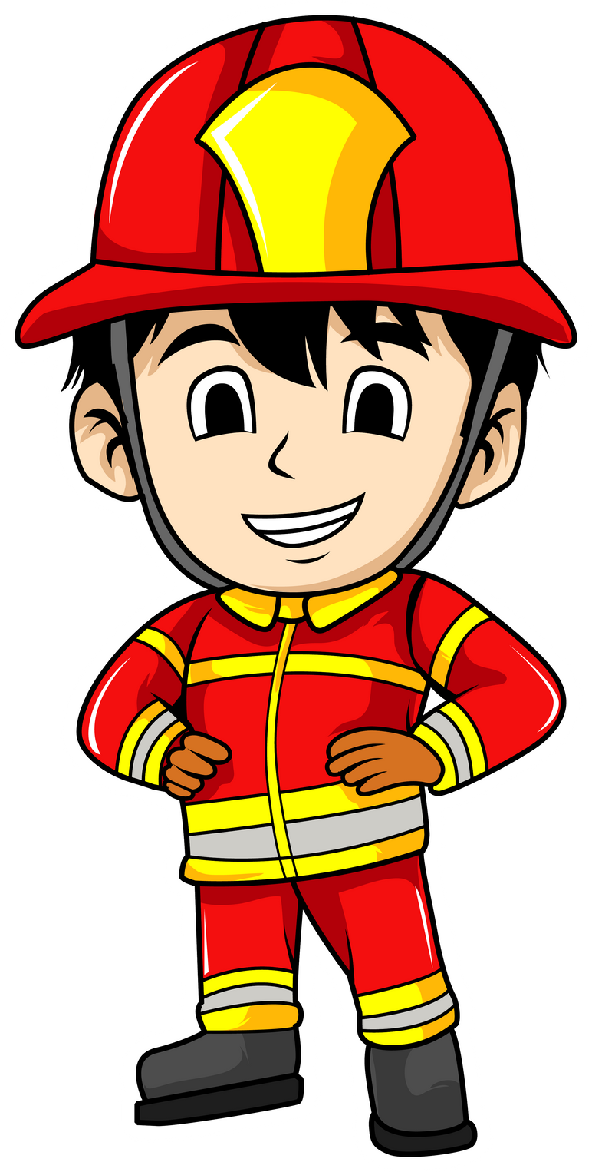
Why would you like to be a firefighter?
Because I’d like to …………………………………….
teacher children
put out fire

Slide 10




Fun corner and wrap-up

Slide 11
What would you like to be in the future?
doctor
gardener
teacher
reporter
firefighter
writer

Slide 12
I’d like to grow flowers.
doctor
firefighter
reporter
writer
teacher
gardener

Slide 13
I’d like to report the news.
doctor
firefighter
reporter
writer
teacher
gardener

Slide 14
I’d like to write stories.
doctor
firefighter
reporter
writer
teacher
gardener

Slide 15
I’d like to teach children.
doctor
firefighter
reporter
writer
teacher
gardener

Slide 16
I’d like to help sick people.
doctor
firefighter
reporter
writer
teacher
gardener

Slide 17
I’d like to put out the fire.
doctor
firefighter
reporter
writer
teacher
gardener

