Slide 1


My pets
Lesson 1 - Period 1
16

Slide 2
1
2
3
Warm-up and review
4
5
Fun corner and wrap-up
Look, listen and repeat.
Listen, point and say.
Let’s talk.

Slide 3
1
Warm-up and review

Slide 4
Sing the song: I have a pet.
Notes:
Sing the song from youtube - https://www.youtube.com/watch?v=pWepfJ-8XU0

Slide 5
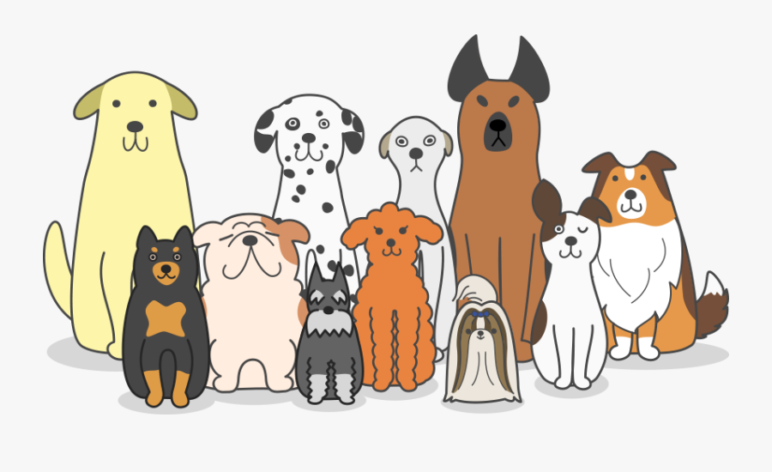
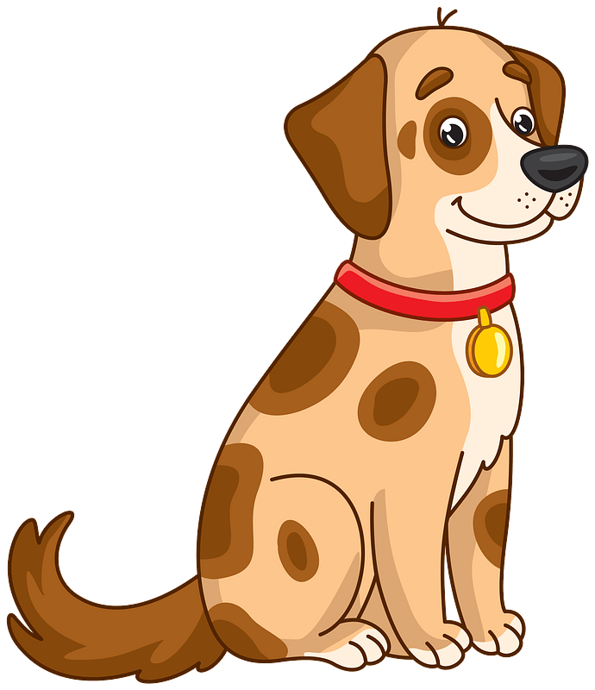
a dog
dogs

Slide 6
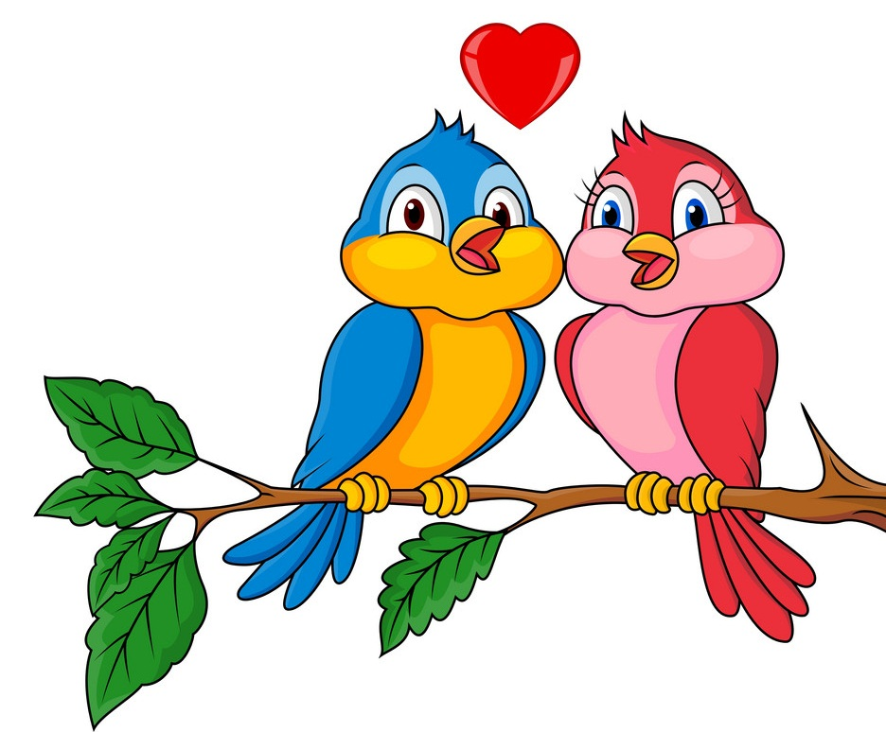
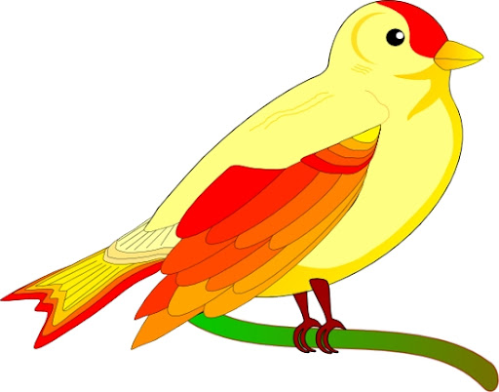
a bird
birds

Slide 7
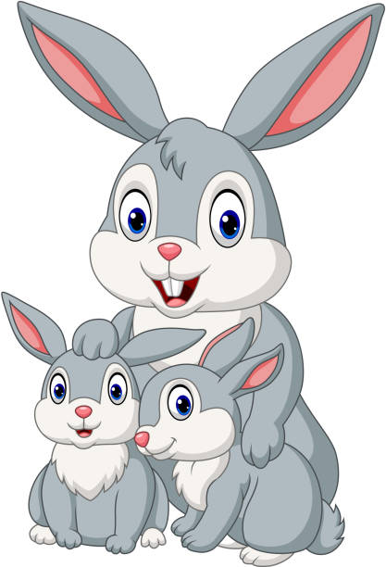
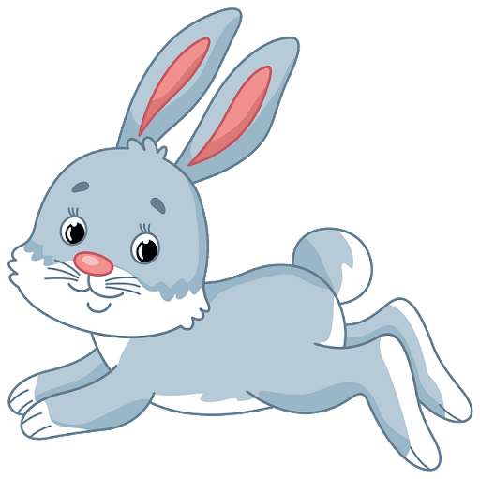
a rabbit
rabbits

Slide 8
2
Look, listen and repeat.

Slide 9
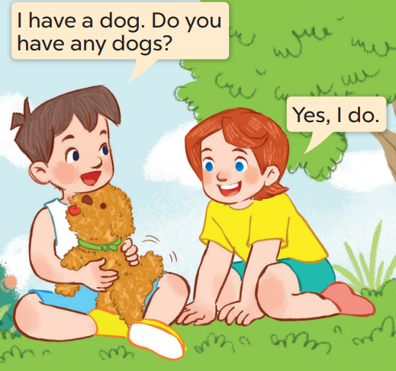
What does Minh have?
Who are they?
Now listen and repeat.
He has a dog.
They’re Minh and Lucy.

Slide 10
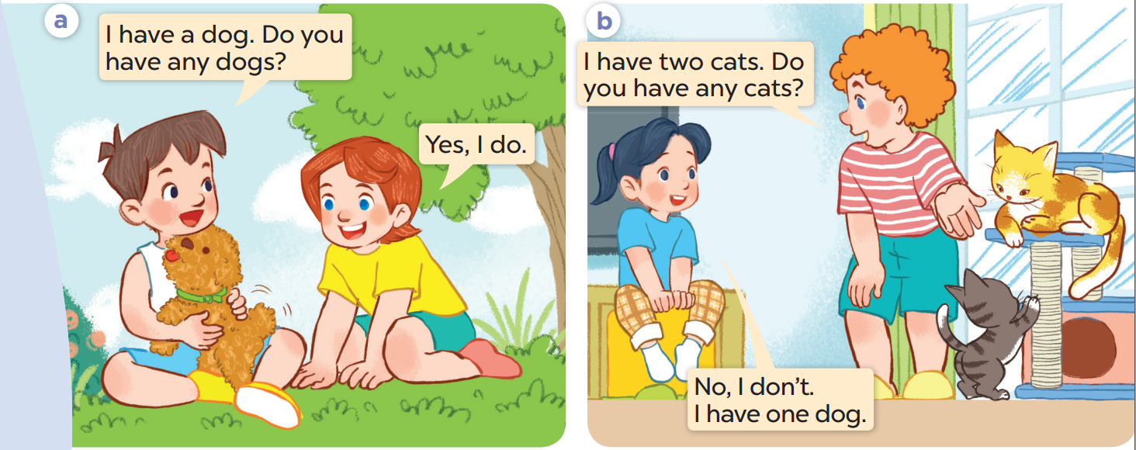
Listen again and repeat.

Slide 11
Work in pairs. Act and say

Slide 12
3
Listen, point and say.

Slide 13
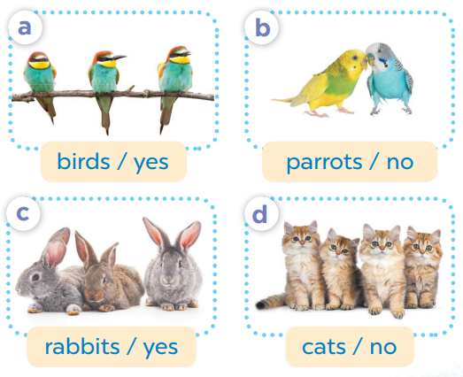
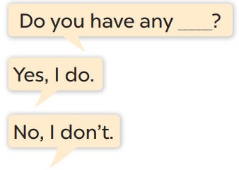

Slide 14
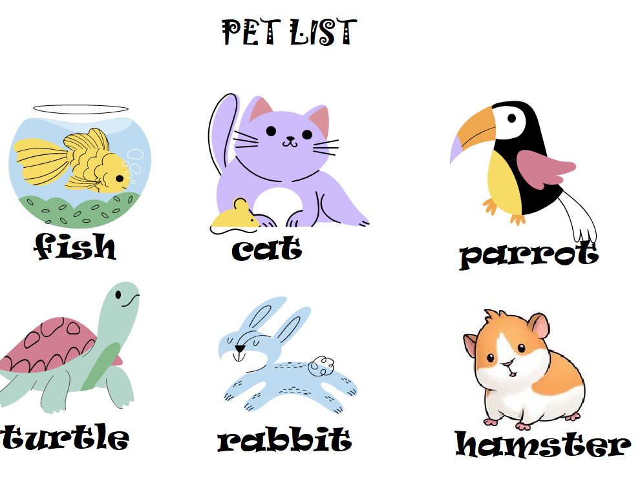


fish
Do you have any……?
No, I don’t.

Slide 15
cats
Do you have any .…….?
Yes, I do.

Slide 16
parrots
Do you have any ……….?
Yes, I do.

Slide 17
turtles
Do you have any ……….?
No, I don’t.

Slide 18
Pair work
Do you have any ……….?
Yes, I do.
No, I don’t.

Slide 19
4
Let’s talk.

Slide 20
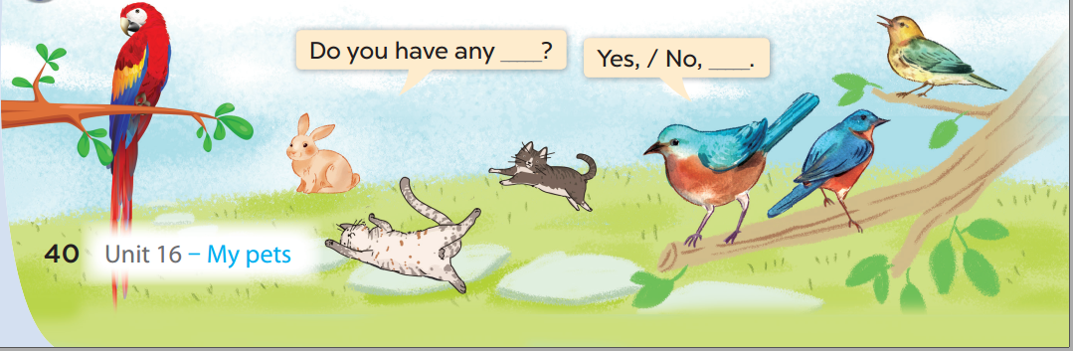

Slide 21
5
Fun corner and wrap-up

