Slide 1


My pets
Lesson 2 - Period 3
16

Slide 2
1
2
3
Warm-up and review
4
5
Fun corner and wrap-up.
Look, listen and repeat.
Listen, point and say.
Let’s talk.

Slide 3
1
Warm-up and review

Slide 4

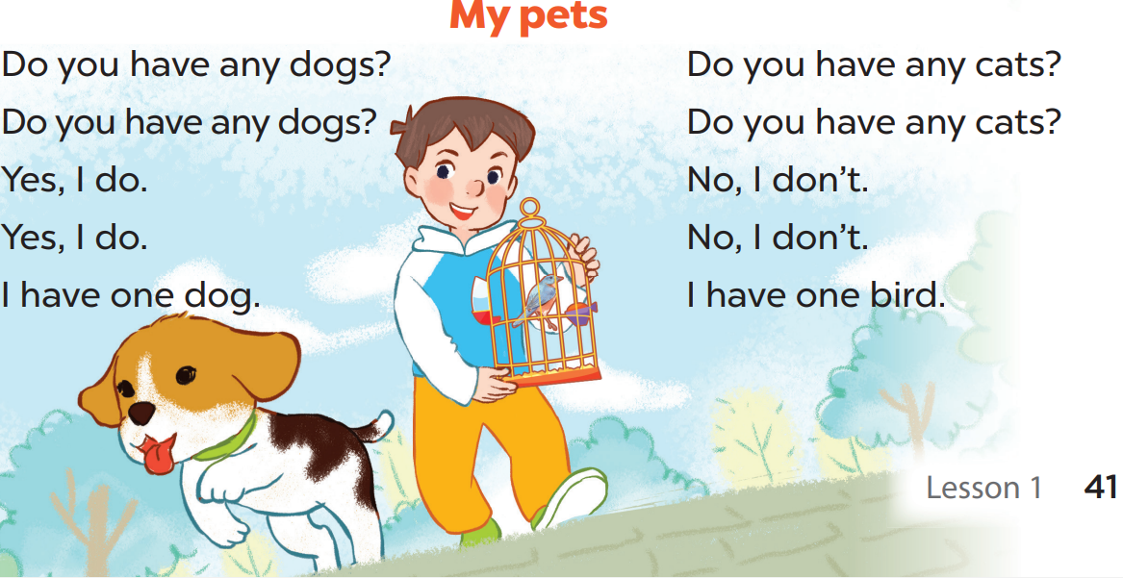

Slide 5
2
Look, listen and repeat.

Slide 6
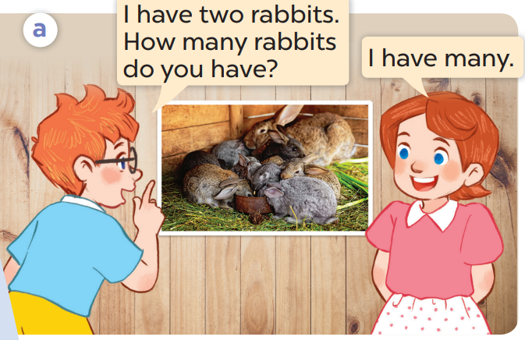
What pets does Ben have?
Now listen and repeat.
Who are they?
He has 2 rabbits.
They’re Ben and Lucy.

Slide 7
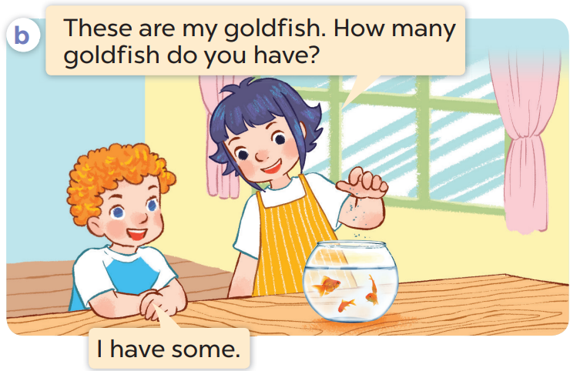
Whose goldfish are they?
What pets can you see?
Who are they?
I can see ….goldfish.
They’re Linh and Bill.
They are Linh’s.

Slide 8
Listen again and repeat.

Slide 9
Work in pairs. Act and say.

Slide 10
3
Listen, point and say.

Slide 11
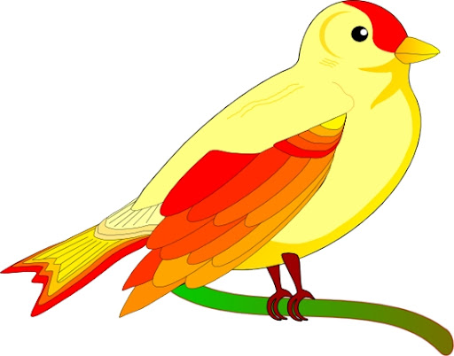
a bird

Slide 12
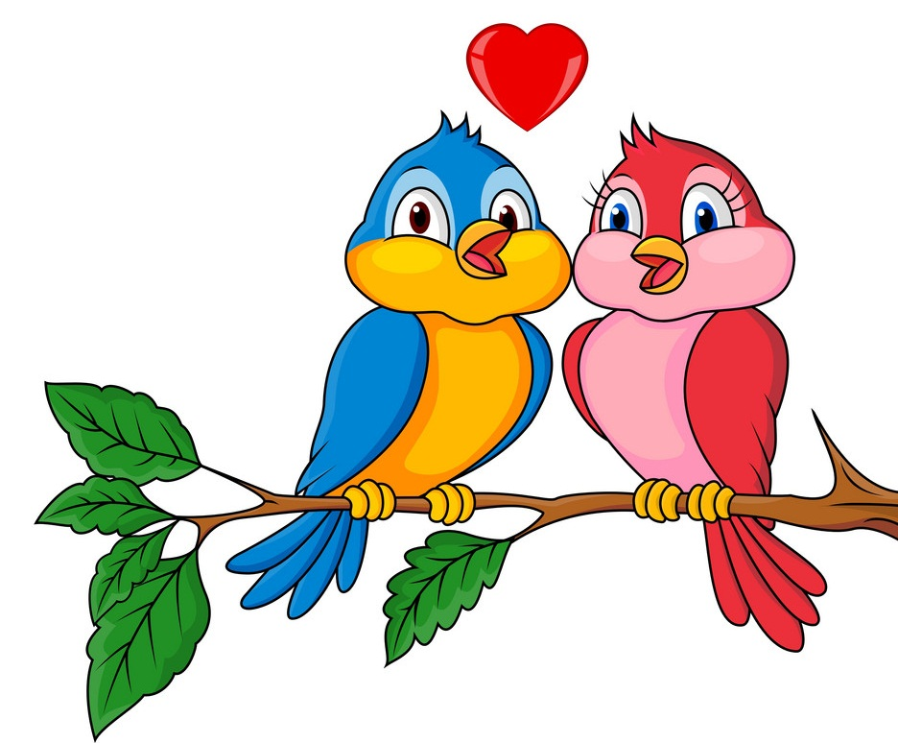
2 birds

Slide 13
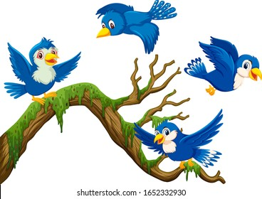
some birds

Slide 14
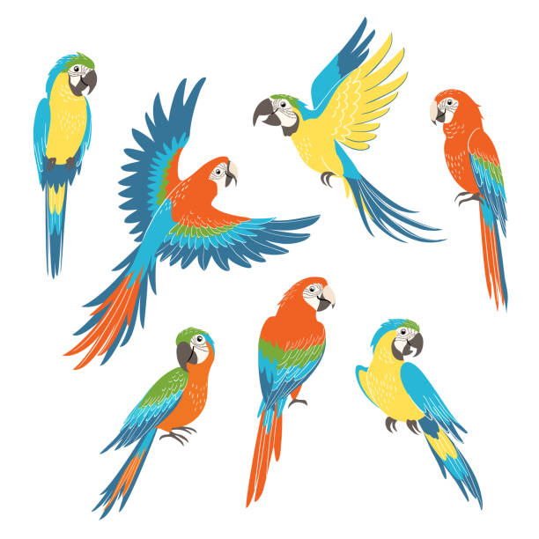
many birds

Slide 15

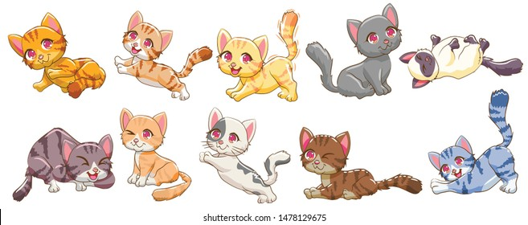



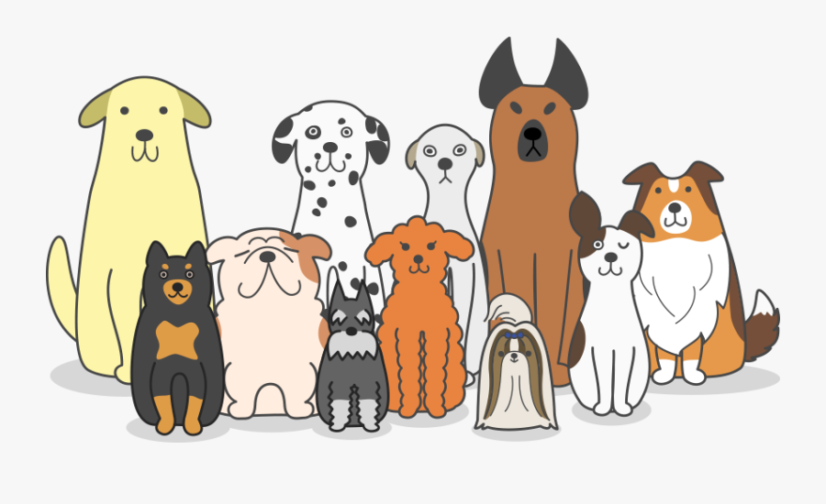
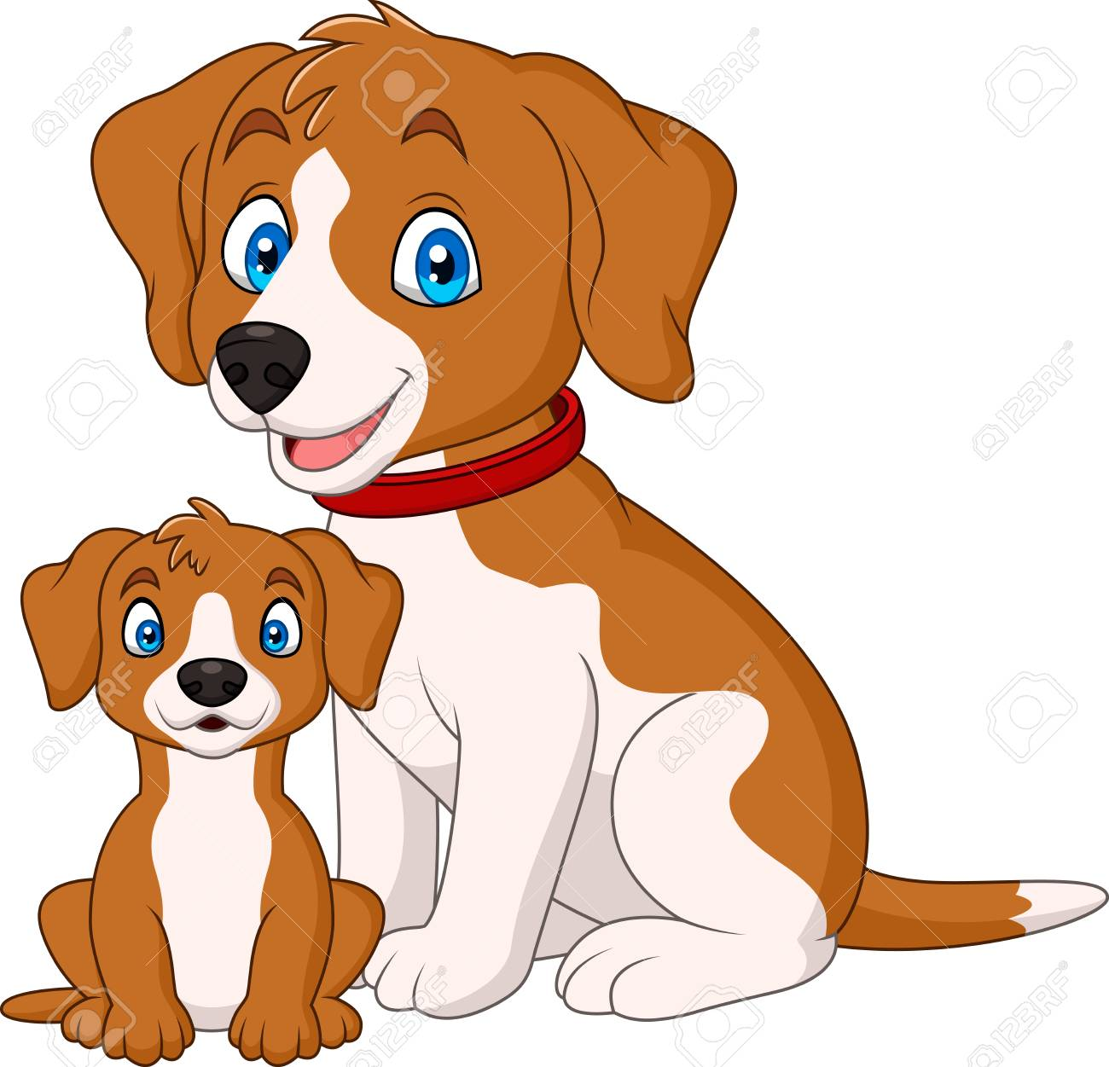

a cat
2 cats
some cats
many cats
a dog
2 dogs
some dogs
many dogs

Slide 16
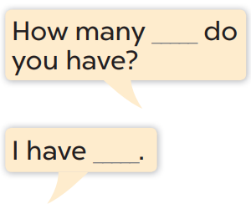
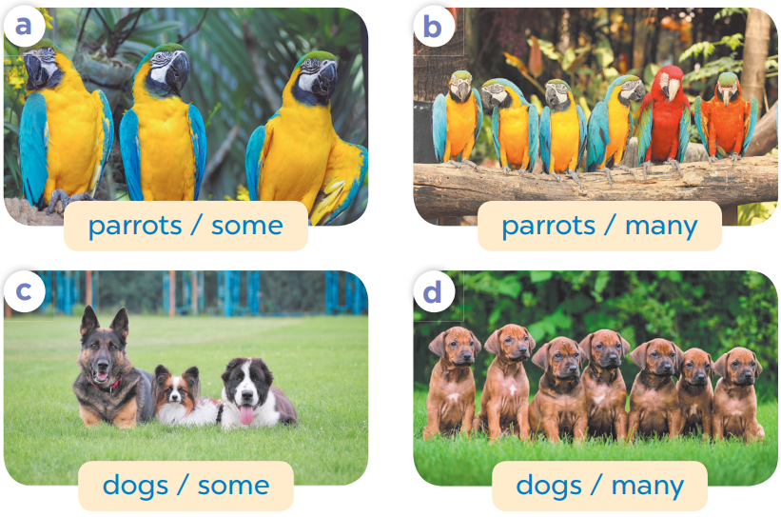

Slide 17
4
Let’s talk.

Slide 18
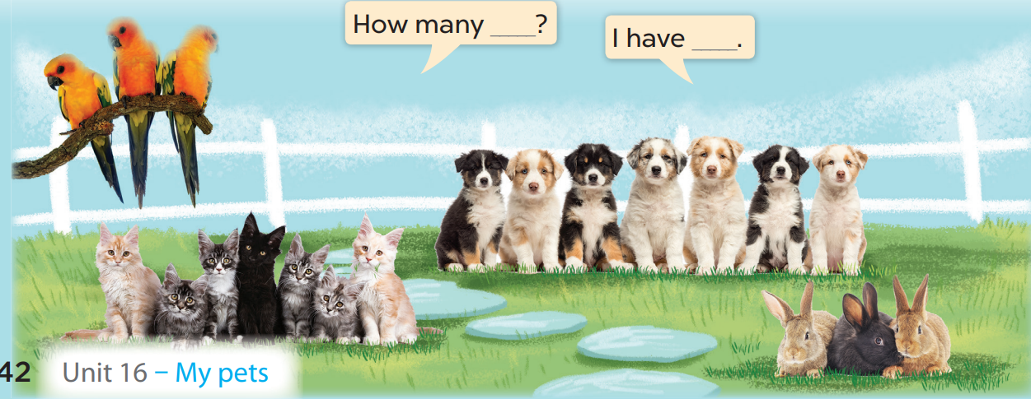

Slide 19
5
Fun corner and wrap-up

