Slide 1

HOA NGHIA PRIMARY SCHOOL
REVIEW 4 1+2+3
Teacher: Dao Thi Thu Van

Slide 2





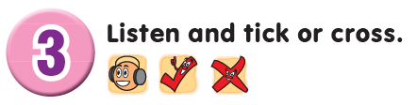
Contents
Listen and tick.
Listen and circle.
Listen and tick or across.

Slide 3

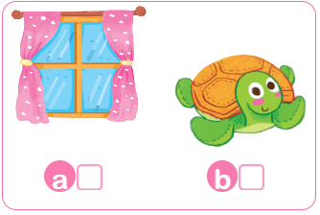
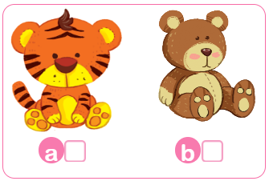
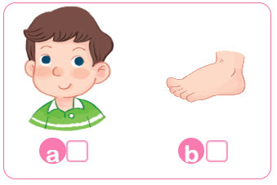
1. Listen and tick.
1.
2.


3.


Slide 4
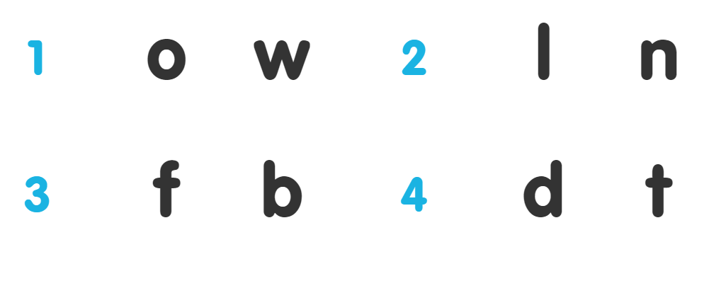
2 Listen and circle.

Slide 5
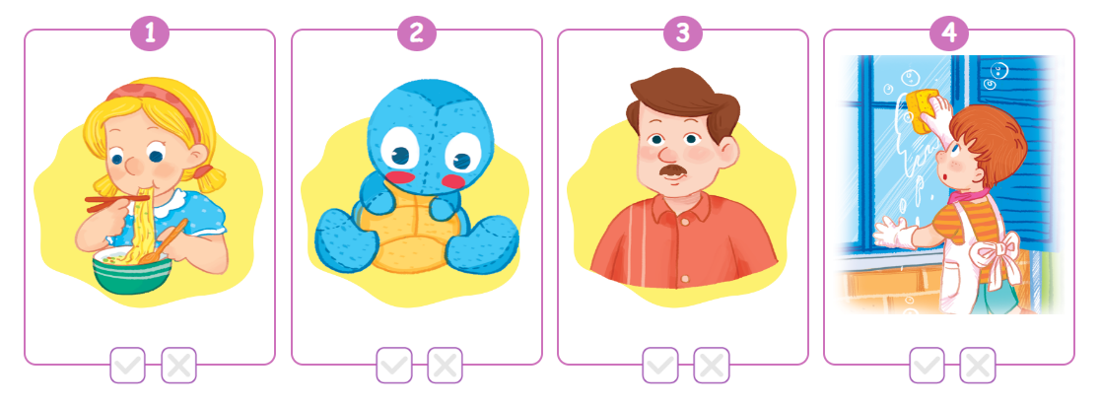




3. Listen and tick or across.

x

x

Slide 6

Review

Slide 7
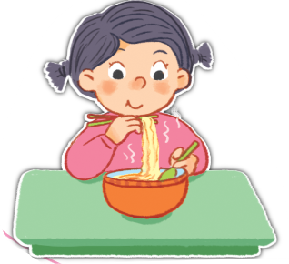
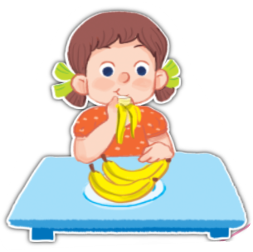
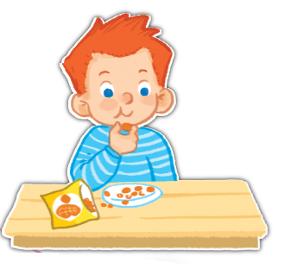
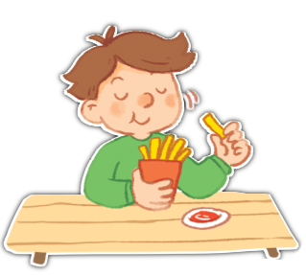
Unit 13
he’s = he is
she’s = she is
He’s having ____.
She’s having ____.
nuts
chips
noodles
bananas

Slide 8
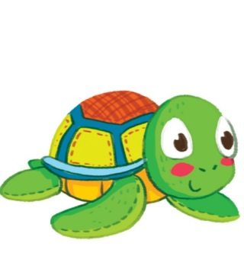
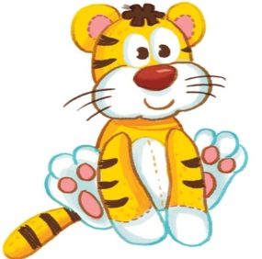

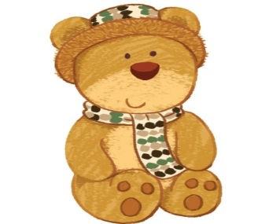
Unit 14
I can see a ___.
tiger
turtle
top
teddy bear

Slide 9
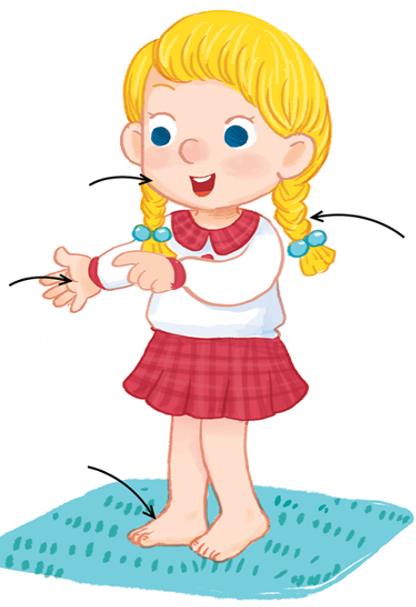
Unit 15
Point to your ____.
face
hand
hair
foot

Slide 10
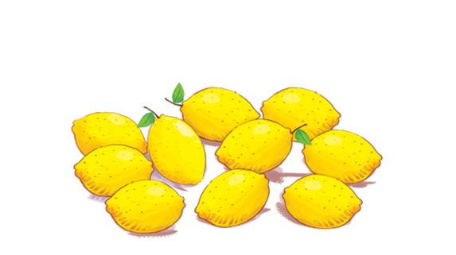


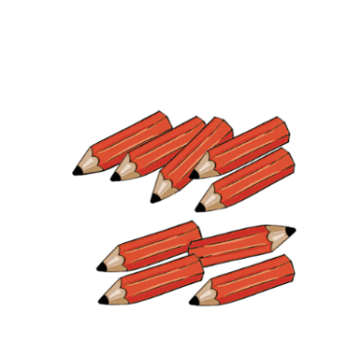
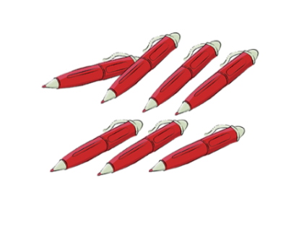
Unit 16
How many ____ can you see?
I can see ____.
windows
lemons
pens
books
pencils
Click on the words to listen again.

Slide 11
Homework
...............................................
...............................................

Slide 12

Thank you!

