Slide 1

Hoa Nghia Primary School
Welcome to our class!
Teacher: Dao Thi Thu Van

Slide 2

Warm-up

Slide 3


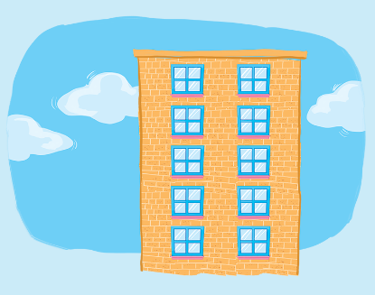
Let’s chant.
W, w,
window.
How many
windows?
Six or
seven.
W, w,
window.
How many
windows?
Eight, nine or ten.
Six, seven.
Eight, nine, ten.

Slide 4

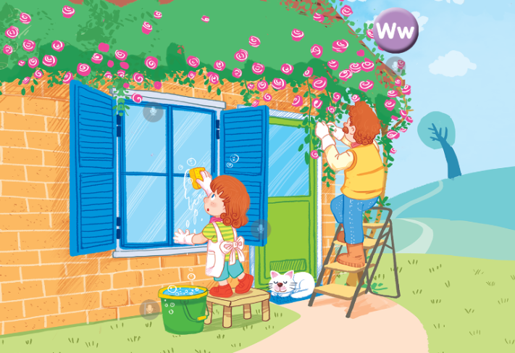
At home
Unit 16

Slide 5






Contents
Listen and repeat.
Let’s talk.
Let’s sing!

Slide 6


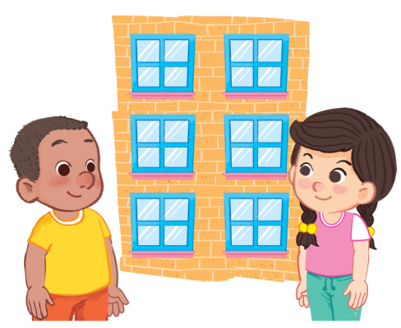
6. Listen and repeat.
How many windows can you see?
I can see six.
Click on the sentences to listen again.

Slide 7
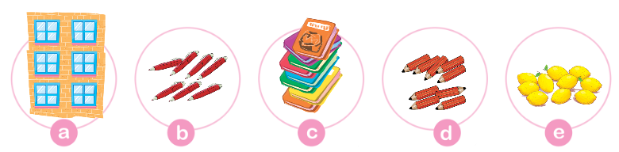
7. Let’s talk.
How many ______ can you see?
I can see ______.

Slide 8

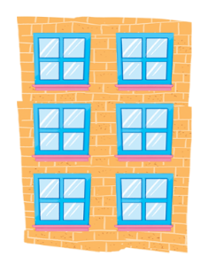
7. Let’s talk.
How many ______ can you see?
windows
I can see _________.
six windows
a

Slide 9

7. Let’s talk.
seven pens
How many _____ can you see?
I can see ________.
pens
b

Slide 10

7. Let’s talk.
I can see _________.
books
eight books
How many _____ can you see?
c

Slide 11
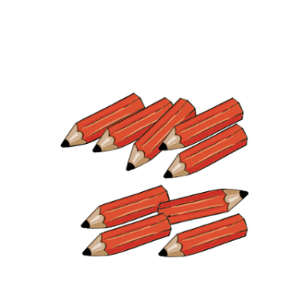
7. Let’s talk.
I can see _________.
nine pencils
How many _____ can you see?
pencils
d

Slide 12

7. Let’s talk.
How many _____ can you see?
lemons
I can see _________.
ten lemons
e

Slide 13
Sentence pattern
How many ____ can you see?
I can see ____.
windows
lemons
pens
books
pencils
Click on the words to listen again.

Slide 14

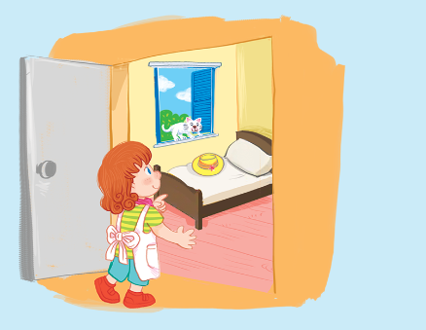






8. Let’s sing.
One, two, three, four.
Wendy at her bedroom door.
Five, six, seven, eight.
She can see a hat on her bed.
Seven, eight, nine, ten.
She can see a cat at the window.

Slide 15

8. Let’s sing.

Slide 16
8. Let’s sing.
One, two, three, four.
Wendy at her bedroom door.
Five, six, seven, eight.
She can see a hat on her bed.
Seven, eight, nine, ten.
She can see a cat at the window.

Slide 17

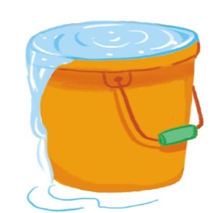



Review
washing
water
window
Wendy

Slide 18
Review
How many ____ can you see?
I can see ____.
windows
lemons
pens
books
pencils
Click on the words to listen again.

Slide 19

Thank you!

