Slide 1

HOA NGHIA PRIMARY SCHOOL
Unit
At home
14
Lesson 3
Teacher: Dao Thi Thu Van
Notes:
Facebook : Bùi Liễu
Mobile phone: 0968142780

Slide 2






Content
Listen and repeat.
Let’s talk.
Let’s sing.

Slide 3







Listen and repeat.
How old is your brother?
How old is your brother?
How old is your brother?
He’s nineteen.
How old is your brother?
He’s nineteen.
He’s nineteen.
He’s nineteen.

Slide 4


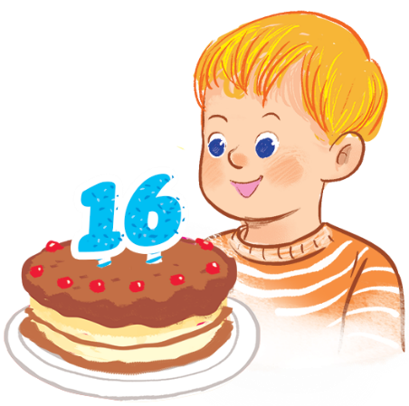


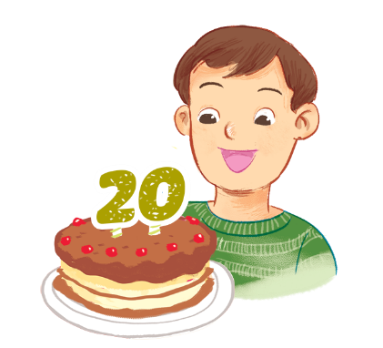
Let’s talk.
How old ?
.
a
b
c
d

Slide 5

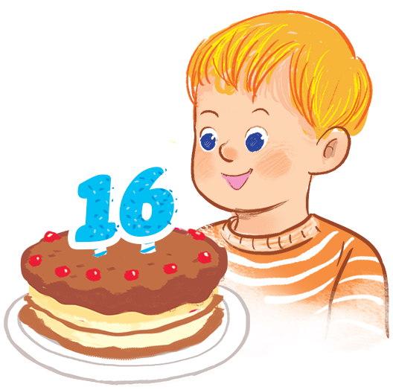
Let’s talk.
How old ____________?
is your brother
__________.
He’s sixteen
a

Slide 6

Let’s talk.
How old ___________?
is your sister
She’s seventeen
________________.
b

Slide 7

Let’s talk.
How old ___________?
is your sister
She’s eighteen
_______________.
c

Slide 8
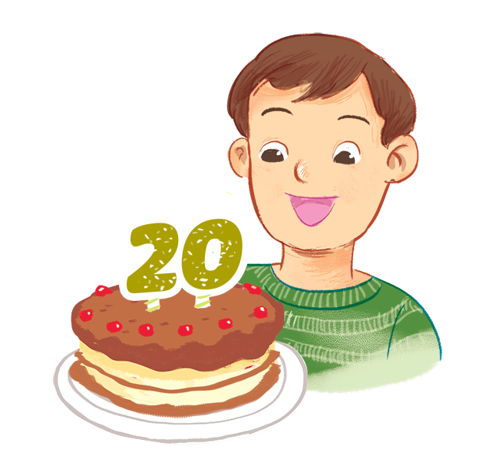
Let’s talk.
How old ____________?
is your brother
He’s twenty
____________.
d

Slide 9


Let’s sing!
That’s my brother.
That’s my brother.
That’s my brother.
That’s my brother.
How old is he?
How old is he?
How old is he?
How old is he?
He’s nineteen.
He’s nineteen.
He’s nineteen.
He’s nineteen.
My grandmother is here.
My grandmother is here.
My grandmother is here.
My grandmother is here.
My sister is here.
My sister is here.
My sister is here.
My sister is here.
We are all here.
We are all here.
We are all here.
We are all here.
At his birthday party.
At his birthday party.
At his birthday party.
At his birthday party.

Slide 10
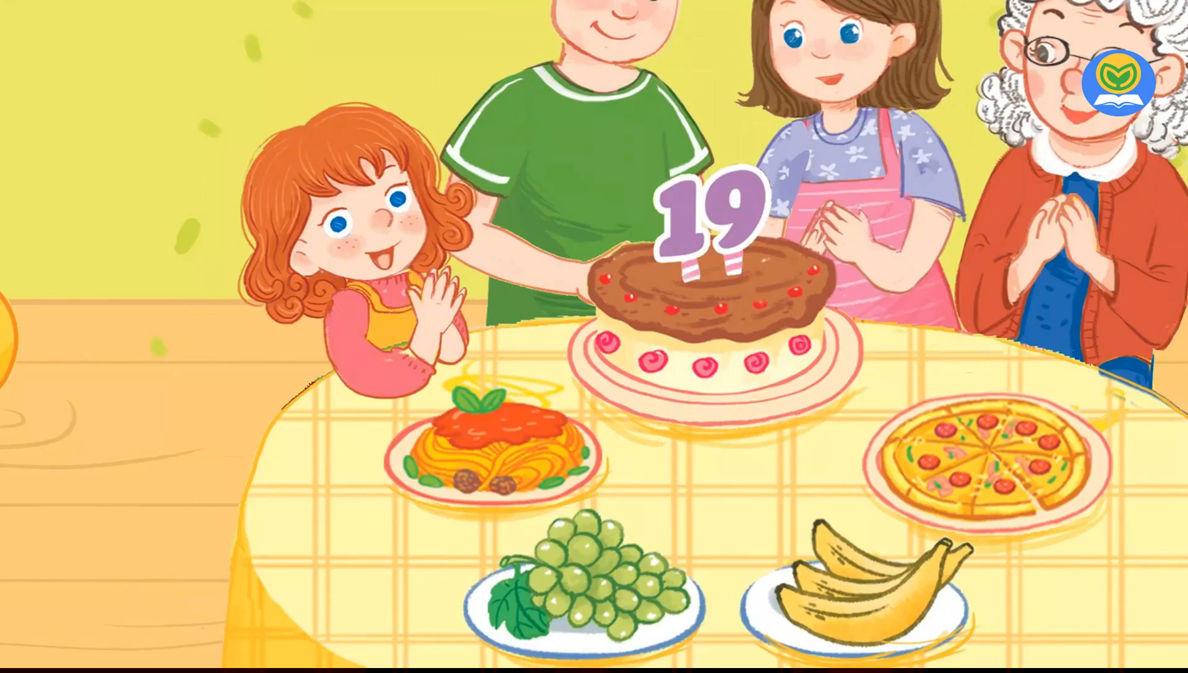
Let’s sing!

Slide 11
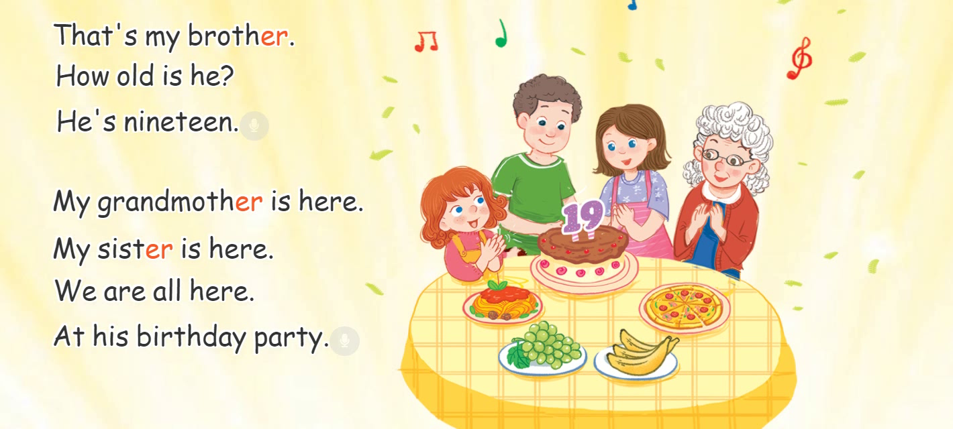
Let’s sing!

Slide 12

Let’s play!

Slide 13



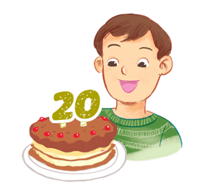





Choose the right answer.
a
b
c
Next
How old is your brother?
He’s twenty.

Slide 14


Choose the right answer.
a
b
c
Next
How old is your brother?
He’s sixteen.

Slide 15


Choose the right answer.
a
b
c
Next
How old is your sister?
She’s seventeen.

Slide 16

Choose the right answer.
a
b
c
Next
How old is your sister?
She’s eighteen.

Slide 17
Choose the right answer.
a
b
c
Next

Slide 18
Choose the right answer.
a
b
c
Next

Slide 19
Choose the right answer.
a
b
c
Next

Slide 20
Choose the right answer.
a
b
c
Next

Slide 21
Good job!
End
Notes:
Facebook : Bùi Liễu Mobile phone: 0968142780

Slide 22
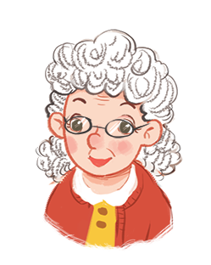



Review
Review

Slide 23

Facebook : Bùi Liễu
0968142780
Thank you!
Facebook : Bùi Liễu
Mobile phone: 0968142780
Notes:
Facebook : Bùi Liễu
0968142780

