Slide 1


Lesson 1
Period 2
Teacher: Tran Thi Quynh
School: Hoa Nghia Primary School

Slide 2
Table of contents
01
02
03
04
05
Warm up
Listen and tick
Look, complete and read
Let’s sing
Fun time

Slide 3
01
Warm up
Let’s play a game.

Slide 4
Slap the board
Choose the correct answer.

Slide 5
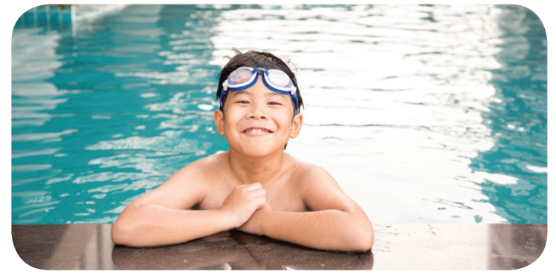
What's the missing letter?
_SWIMMING
PO__L
O
L
U
O
A
B
C

Slide 6
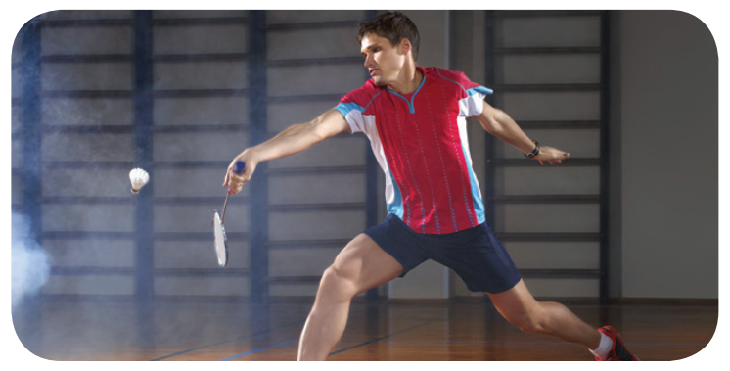
What's the missing letter?
SP__RTS
C__NTER
O
E
O-E
O-I
A-E
A
B
C

Slide 7

What's the missing letter?
S__OPPING CENTER
H
T
H
O
A
B
C

Slide 8

What's the missing letter?
_C__N__MA
I
E
I-A
E-A
I-E
A
B
C

Slide 9
02
Listen and tick

Slide 10

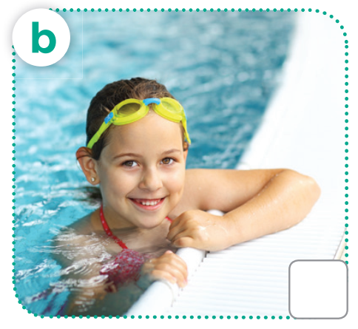
LOOK and SAY
cinema
swimming pool

Slide 11

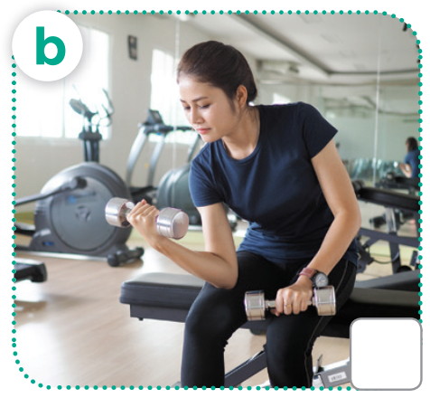
LOOK and SAY
shopping center
gym

Slide 12
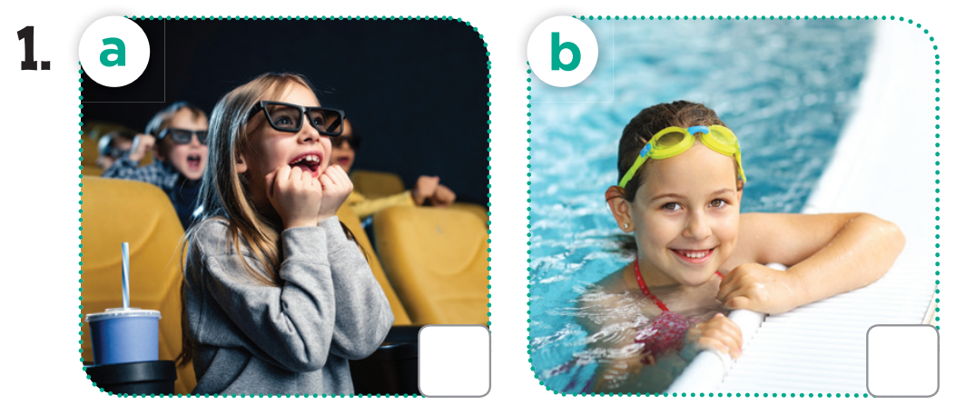
Listen and tick
✓

Slide 13
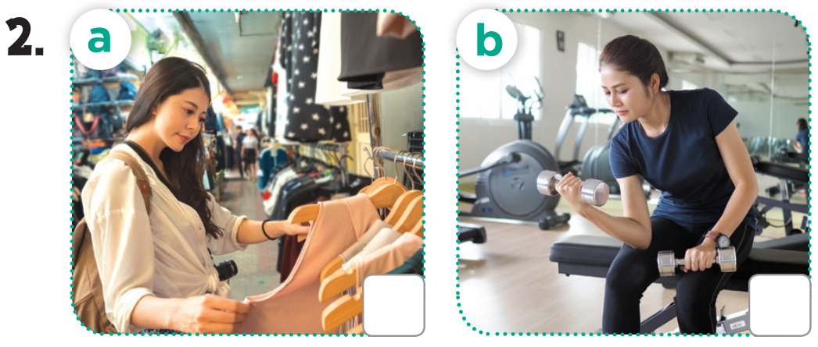
Listen and tick
✓

Slide 14
03
Look, complete and read.

Slide 15
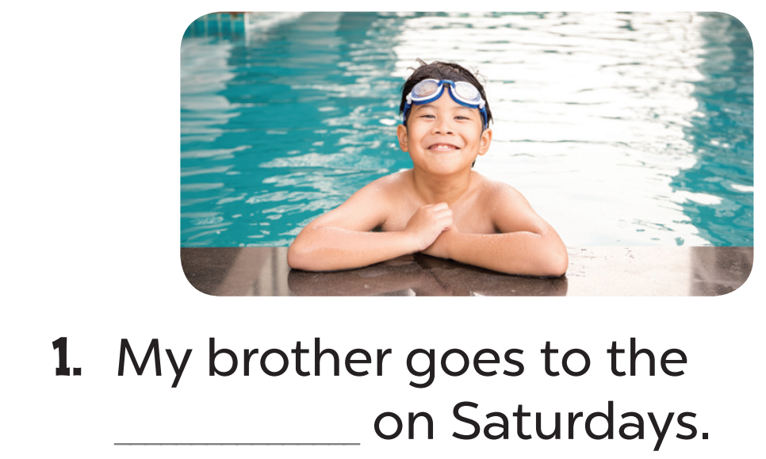
Look, complete and read.
swimming pool

Slide 16
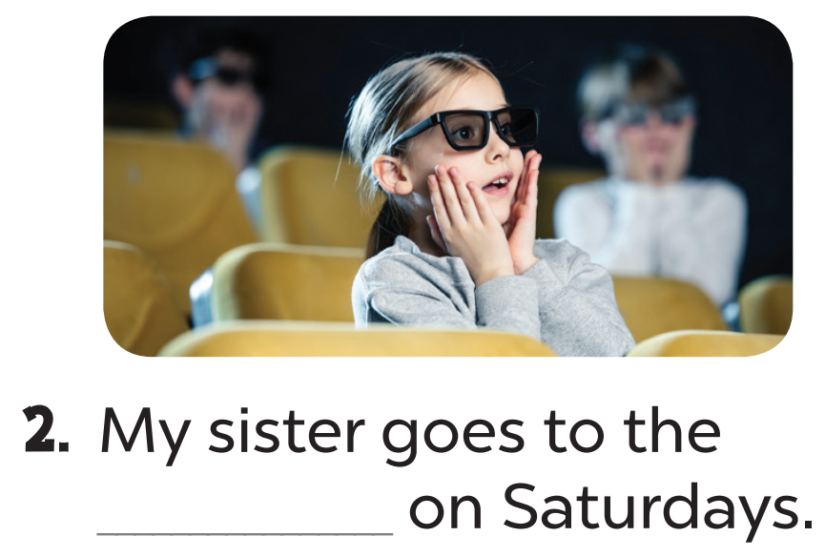
Look, complete and read.
cinema

Slide 17
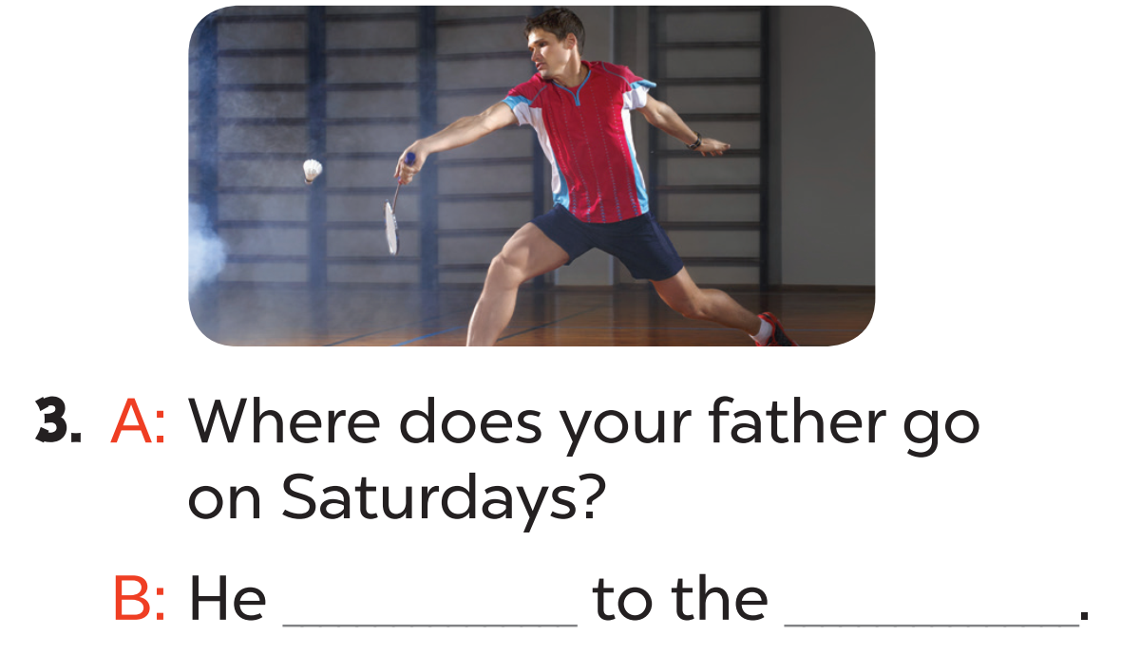
goes
sports centre.

Slide 18
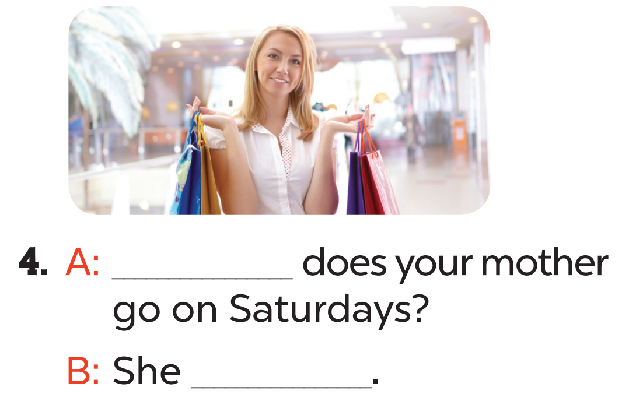
Where
goes to the shopping centre.

Slide 19
04
Let’s sing.

Slide 20
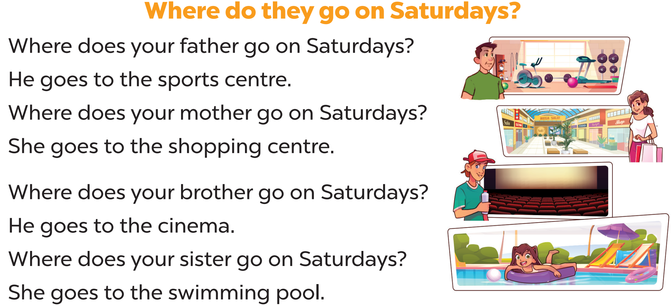
Let’s sing.

Slide 21
05
Fun time

