Slide 1
Unit 15: My family’s weekend
Lesson 2_Period 3
Teacher: Tran Thi Quynh
School: Hoa Nghia Primary School

Slide 2
Table of contents
01
02
03
04
05
06
Warm up
New words
Activity 1
Look, listen and repeat
Activity 2
Listen point and say
Activity 3
Let’s talk
Game

Slide 3
Warm up
01
Look and guess

Slide 4
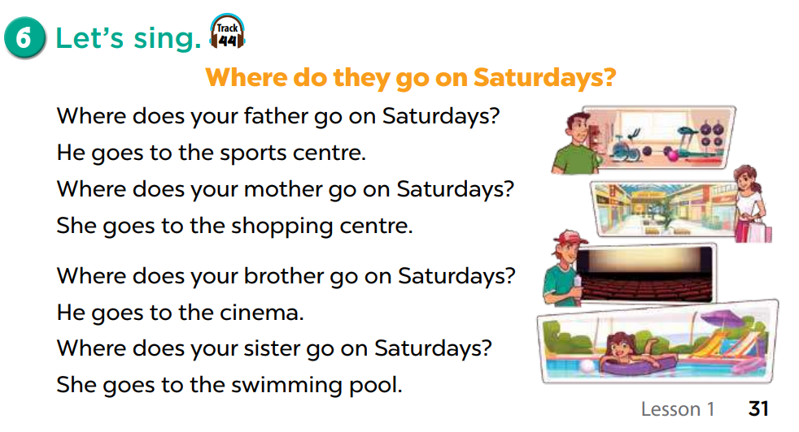

Slide 5
New words
02

Slide 6

do yoga

Slide 7
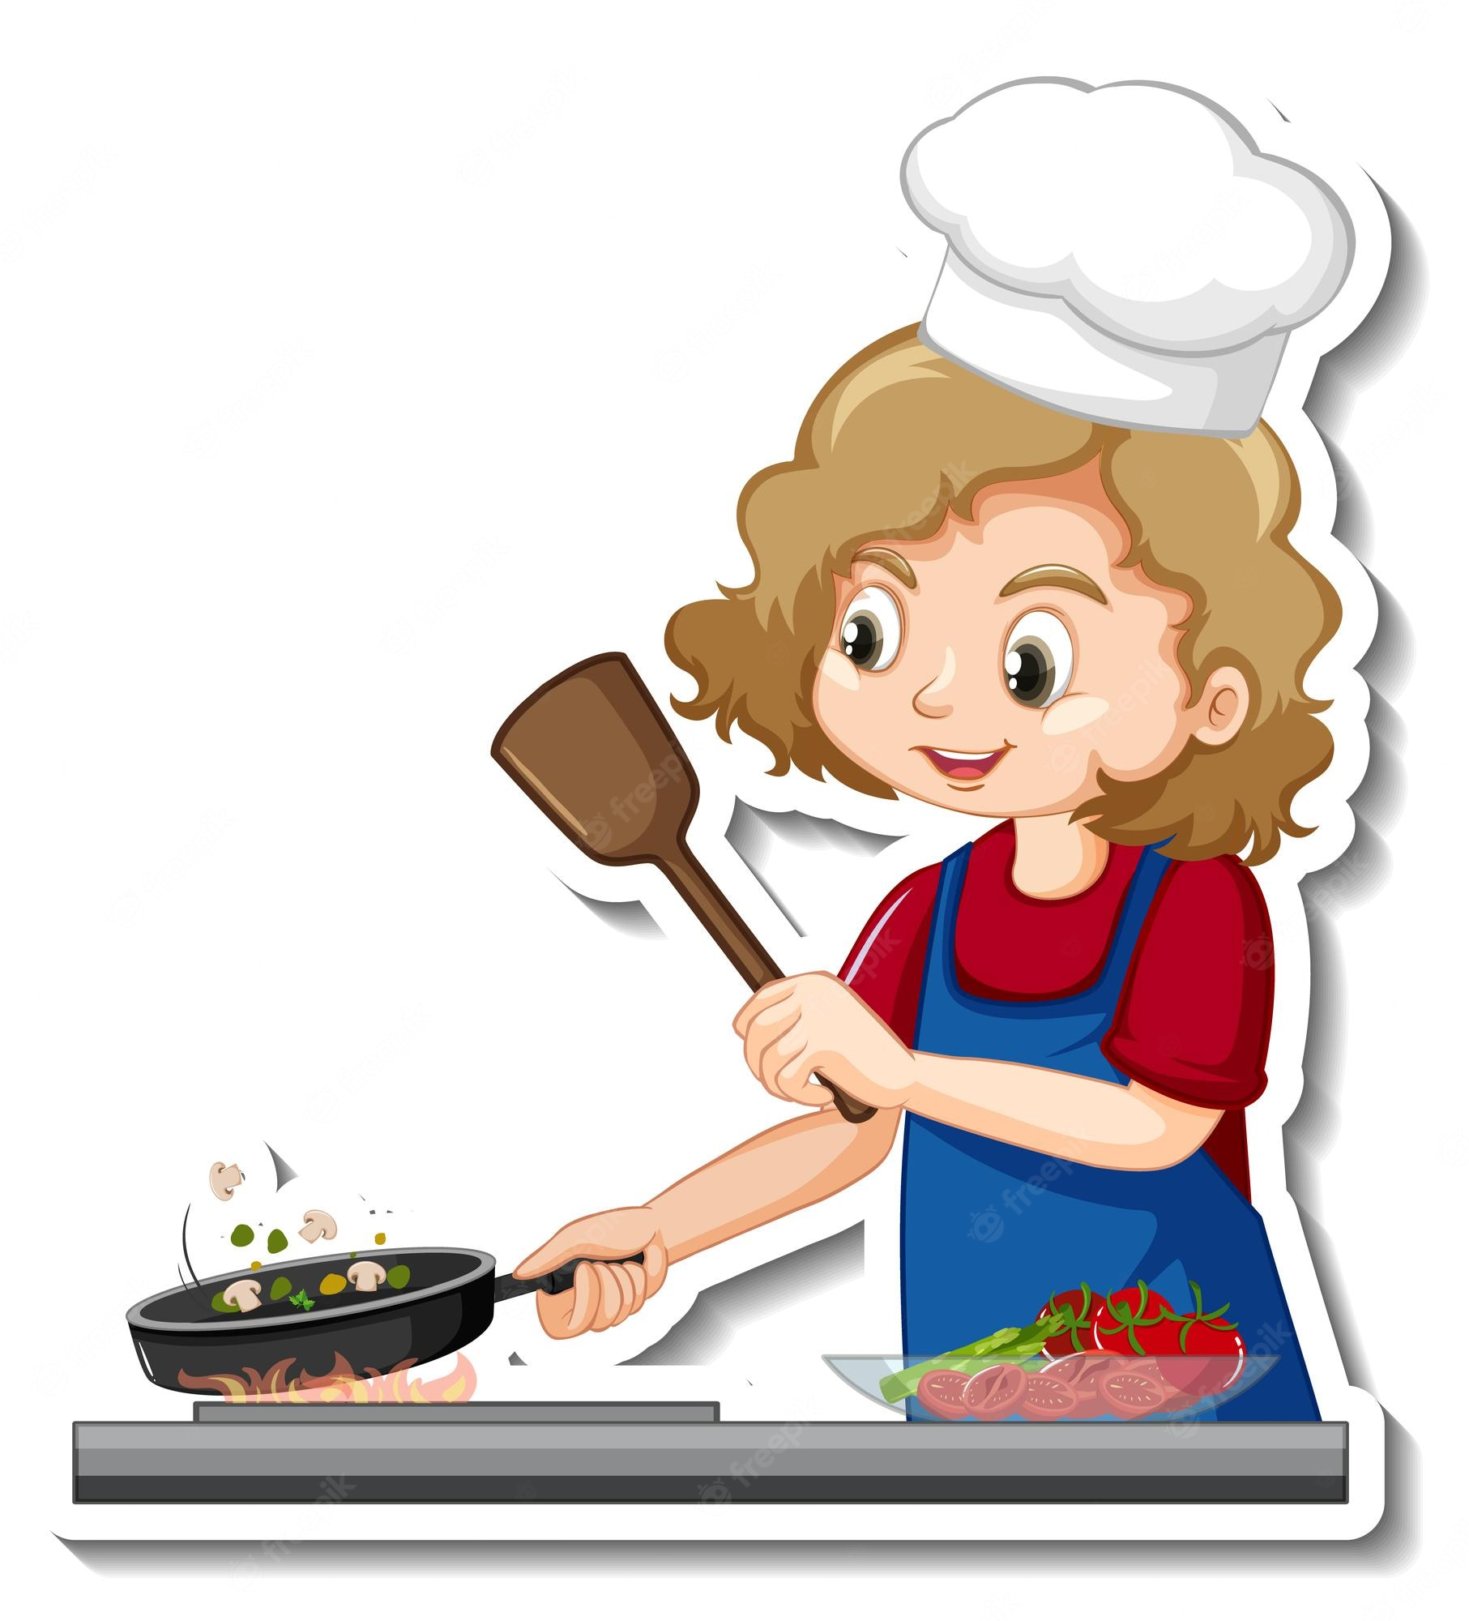
cook meals

Slide 8
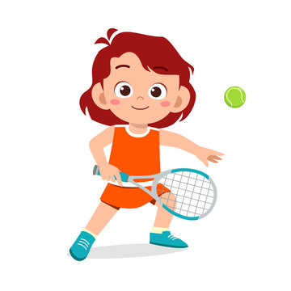
play tennis

Slide 9

watch films

Slide 10
What are the missing letters?

Slide 11
wa_ch f_lms
t
i

Slide 12
a
do y_ g _
o

Slide 13
p
n
i
_lay te_n_s

Slide 14
o
e
l
c_ok m_a_s

Slide 15
Activity 1
02
Look, listen and repeat

Slide 16
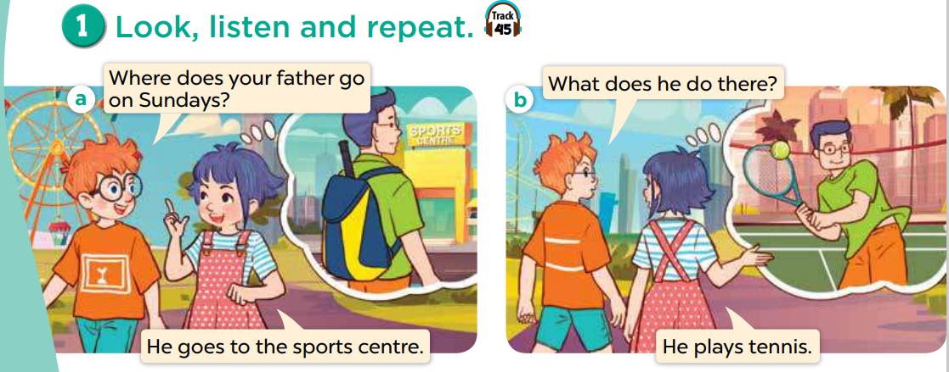
Look, listen and repeat

Slide 17
Look, listen and repeat

Slide 18
Activity 2
03
Look, listen and repeat

Slide 19
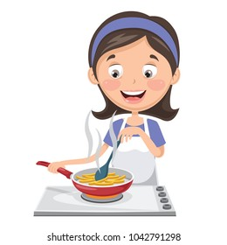
What does she do on Sundays?
She cooks meals.

Slide 20
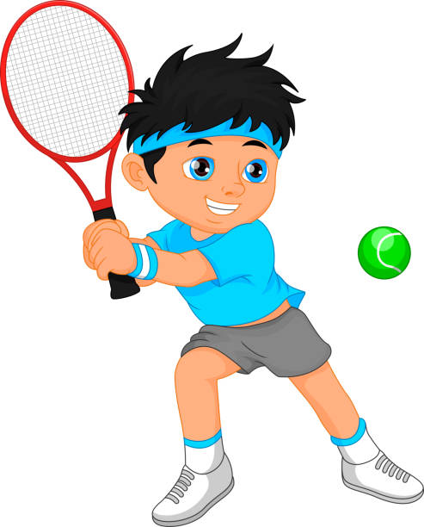
What does he do on Sundays?
He plays tennis.

Slide 21

What does he do on Sundays?
He watches films.

Slide 22

What does he do on Sundays?
He does yoga.

Slide 23
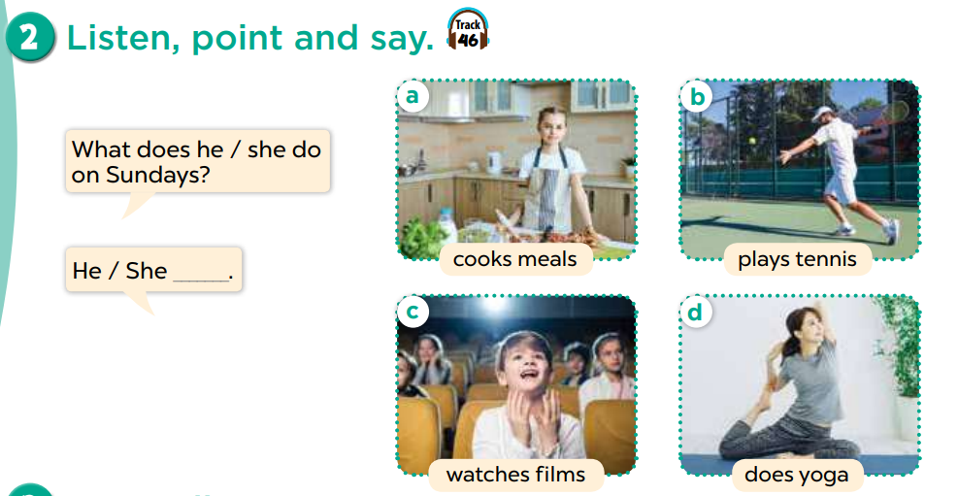
Listen, point and say

Slide 24
REMEMBER!
I | She / He
cook meals
play tennis
watch films
do yoga
cooks meals
plays tennis
watches films
does yoga

Slide 25
Activity 2
04
Listen, point and say

Slide 26
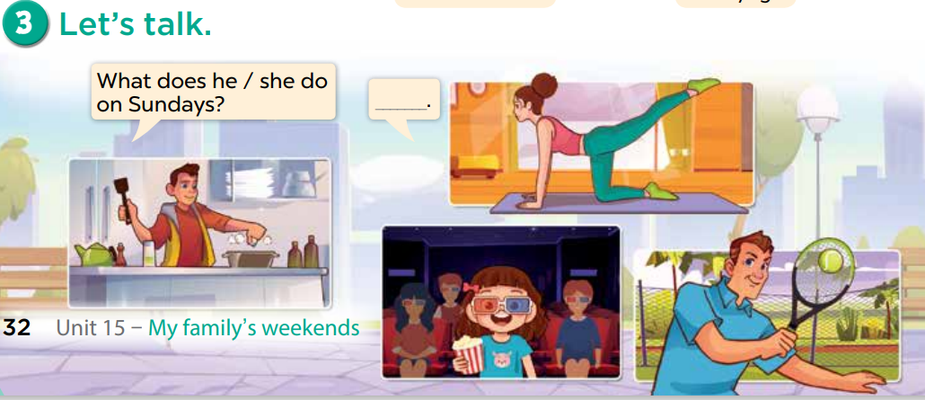
She does yoga.
She watches fills.
He plays tennis.
He cooks meals.

Slide 27
5 Game
Let’s play

