Slide 1


Lesson 2
Period 4
Teacher: Tran Thi Quynh
School: Hoa Nghia Primary School

Slide 2
Table of contents
01
02
03
04
05
Warm up
Listen and match
Look, complete and read
Let’s play
Fun time

Slide 3
01- warm up
Let’s sing a song.

Slide 4
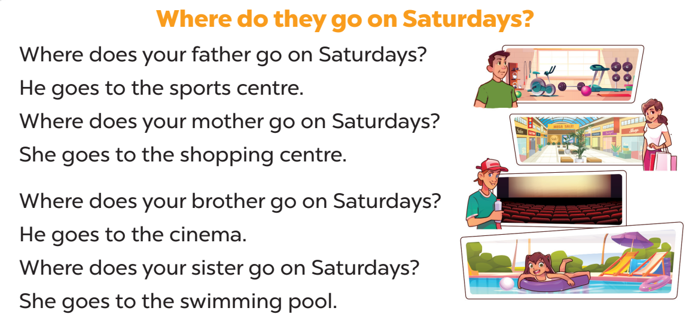

Slide 5
Table of contents
01
02
03
04
05
Warm up
Listen and match
Look, complete and read
Let’s play
Fun time

Slide 6
02- Listen and match.
.

Slide 7
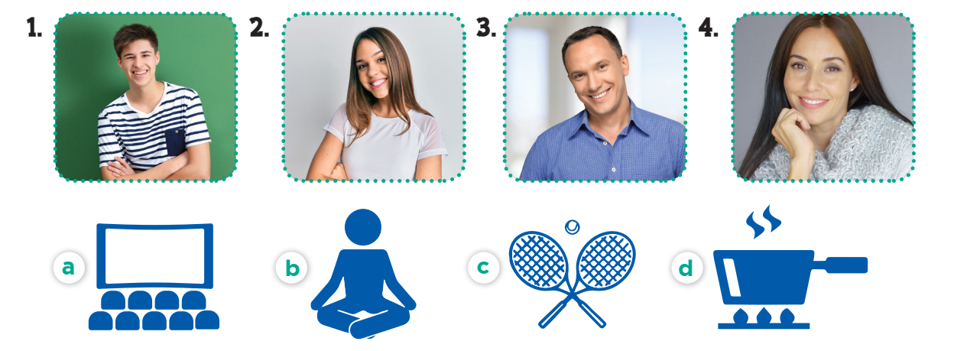
Look and say
brother
sister
father
mother

Slide 8



Look and say
watch films
play tennis
do yoga
cook meals

Slide 9


Slide 10
Table of contents
01
02
03
04
05
Warm up
Listen and match
Look, complete and read
Let’s play
Fun time

Slide 11
03- Look, complete and read
.

Slide 12
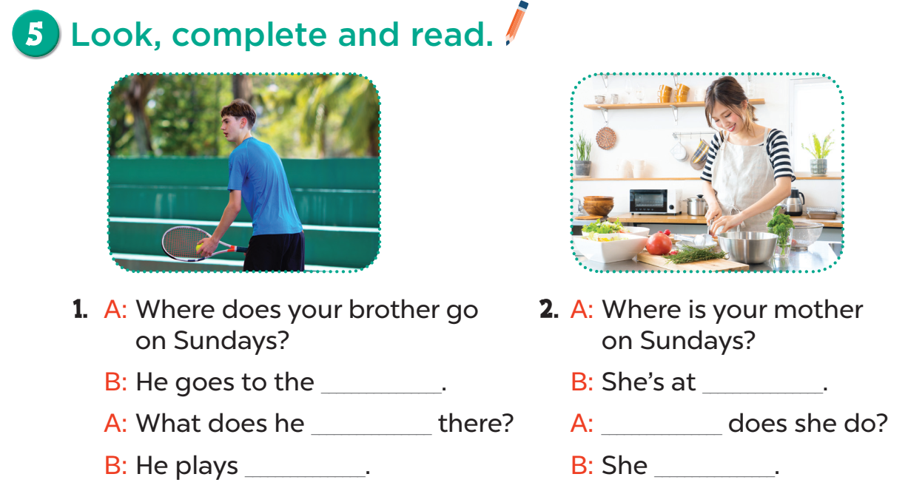
sports center.
home
do
What
tennis
cooks meals.

Slide 13
Table of contents
01
02
03
04
05
Warm up
Listen and match
Look, complete and read
Let’s play
Fun time

Slide 14
04- let’s play
.

Slide 15
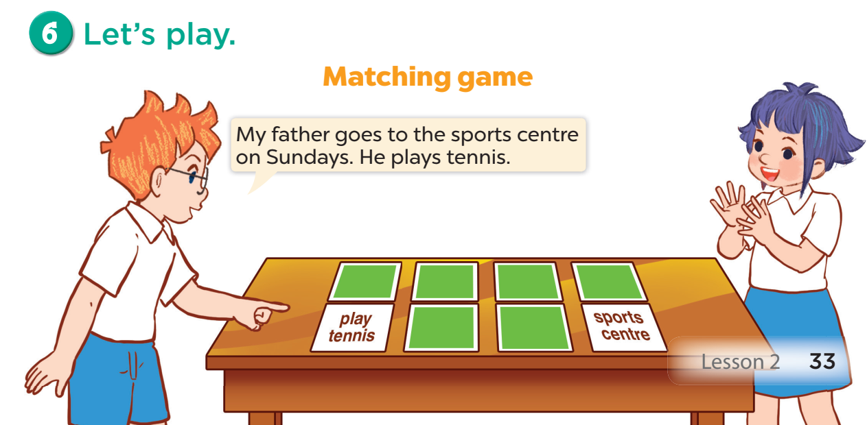

Slide 16
Table of contents
01
02
03
04
05
Warm up
Listen and match
Look, complete and read
Let’s play
Fun time

Slide 17
05-Fun time
.

