Slide 1



REVIEW 1
Period 1
Teacher: Pham Thi Thu Trang
Class: 5A
School: Hoa Nghia Primary

Slide 2





Warm-up and Review

Slide 3












Let's Play
The Memory Game

Slide 4

Round 1
Let's Go!

Slide 5

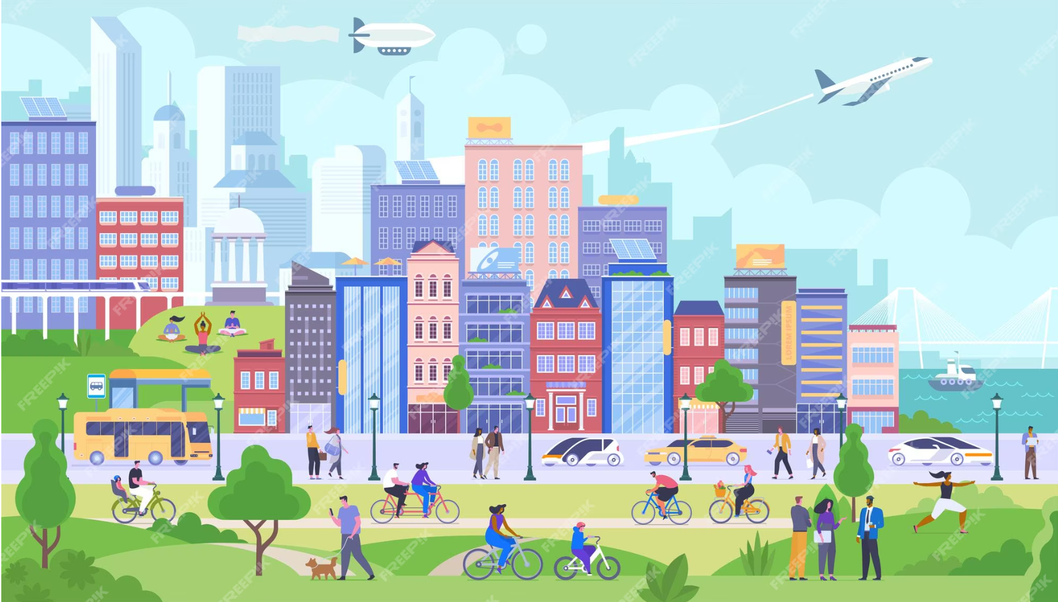

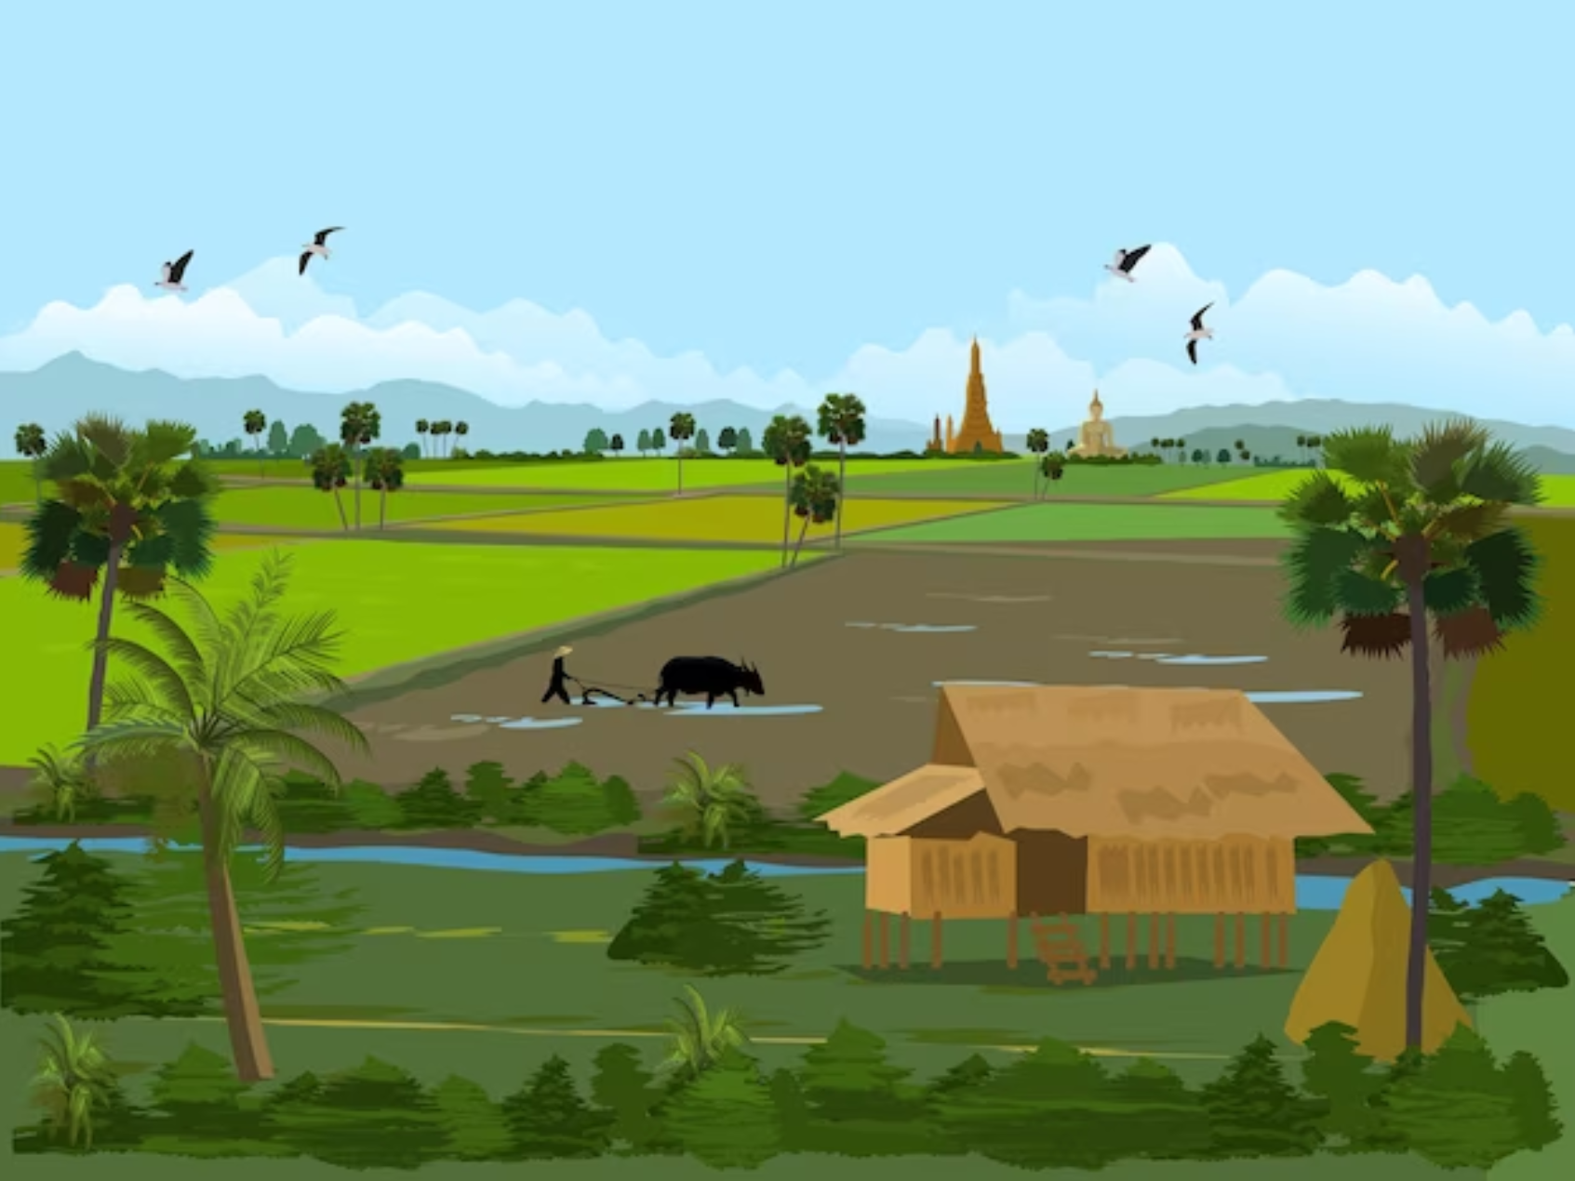
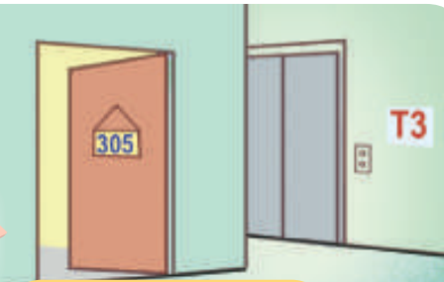
A
B
C
D
E
F
G
H
house
flat
countryside
city

Slide 6

Round 1 Score Board
Use this to keep track of the points! Copy and paste the token for every point a player receives.
Player 1
Player 2
Player 3
Notes:
Copy and paste the token for every point a player receives.

Slide 7
Round 2
You got this!

Slide 8


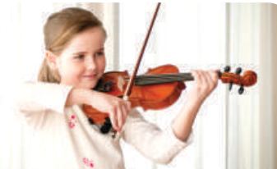


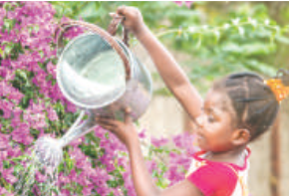
A
B
C
D
E
surf
the
Internet
water
the
flowers
play
the violin
I
F
G
H
J
Malaysia
Australia

Slide 9
Round 2 Score Board
Use this to keep track of the points! Copy and paste the token for every point a player receives.
Player 1
Player 2
Player 3

Slide 10

Thank you for playing!
See you next time!

Slide 11


1. Listen and circle a, b, or c.

Slide 12



Look and read.
a. I have a dolphin.
b. It’s a dolphin.
c. I can see a dolphin.
Notes:
Step 1: Draw pupils’ attention to the first set of suggested answers. Have them read the answer options. Check comprehension.

Slide 13


Look and read.
a. Yes, I can.
b. Yes, I do.
c. Yes, I am.
Notes:
Step 1: Draw pupils’ attention to the first set of suggested answers. Have them read the answer options. Check comprehension.

Slide 14

Look and read.
a. I’d like to write stories for children.
b. I’m a writer.
c. I’d like to be a writer.
Notes:
Step 1: Draw pupils’ attention to the first set of suggested answers. Have them read the answer options. Check comprehension.

Slide 15

Look and read.
a. He’s in the computer room.
b. He likes playing football.
c. He’s active.
Notes:
Step 1: Draw pupils’ attention to the first set of suggested answers. Have them read the answer options. Check comprehension.

Slide 16
Listen and circle a, b or c.
a. I have a dolphin.
b. It’s a dolphin.
c. I can see a dolphin.
Notes:
Step 2: Play the recording for Question 1. Play the recording again for pupils to do the task. Play the recording a third time for pupils to check their answers.

Slide 17



Listen and circle a, b or c.
a. I’d like to write stories
for children.
b. I’m a write.
c. I’d like to be a writer.
a. I have a dolphin.
b. It’s a dolphin.
c. I can see a dolphin.
a. Yes, I can.
b. Yes, I do.
c. Yes, I am.
a. He’s in the computer room.
b. He likes playing football.
c. He’s active.
a. I like watering flowers.
b. I’m watering flowers.
c. I like flowers.
Notes:
Step 3: Repeat Steps 1 and 2 for the rest of the questions.

Slide 18

YOUR ANSWERS
b
______
______
______
______
______
Notes:
Step 4: Get pupils to swap books with a partner, then check answers as a class. Write the correct answers on the board.
Step 5: Play the recording for pupils to double-check their answers.

Slide 19
Let’s check!
a. Yes, I can.
b. Yes, I do.
c. Yes, I am.
Notes:
* Key: 1. b, 2. b, 3. c, 4. c, 5. a

Slide 20
Let’s check!
a. I’d like to write stories for children.
b. I’m a writer.
c. I’d like to be a writer.
Notes:
* Key: 1. b, 2. b, 3. c, 4. c, 5. a

Slide 21
Let’s check!
a. He’s in the computer room.
b. He likes playing football.
c. He’s active.
Notes:
* Key: 1. b, 2. b, 3. c, 4. c, 5. a

Slide 22
2. Ask and answer.

Slide 23

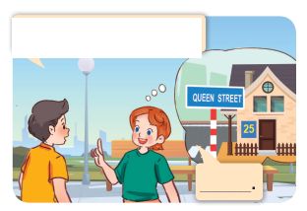


What’s your address?
Lucy
Nick
It’s 25 Queen Street.
Notes:
Step 1: Draw pupils’ attention to the first picture. Get them to look at the bubble to identify the activity shown in it. Check pupils’ comprehension.
Step 2: Draw pupils’ attention to Question 1. Have pupils look at the bubble over Lucy’s head to answer the question.

Slide 24

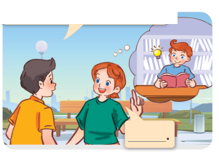
What’s your brother like?
He’s clever.
Notes:
Step 3: Repeat Step 1 and 2 with the rest of the questions.

Slide 25

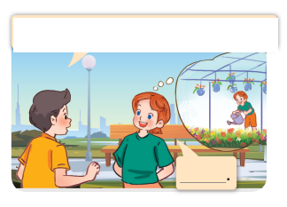
What do you do at the weekend?
I water flowers.
Notes:
Step 3: Repeat Step 1 and 2 with the rest of the questions.

Slide 26

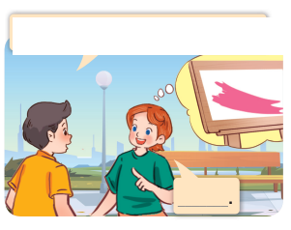
What’s your favourite color?
It’s pink.
Notes:
Step 3: Repeat Step 1 and 2 with the rest of the questions.

Slide 27
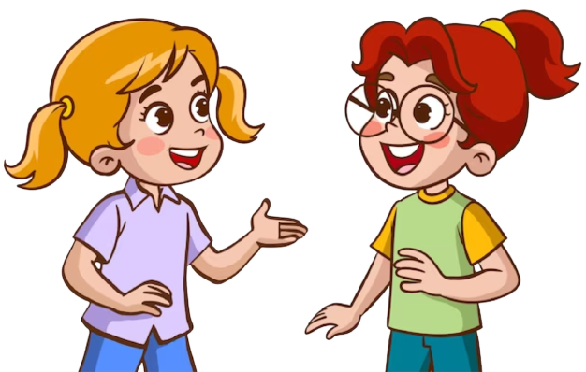
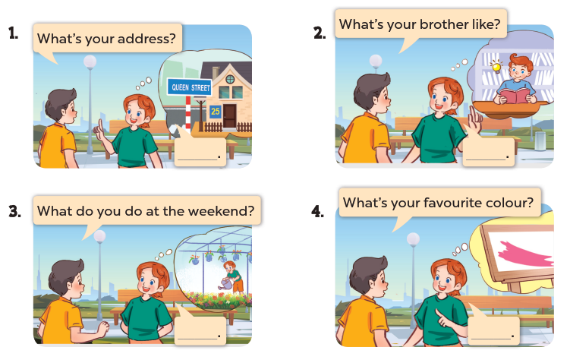
Notes:
Step 4: Have pupils work in pairs to role-play the four exchanges. Go around the classroom to monitor the activity.

Slide 28
3. Read and match.

Slide 29
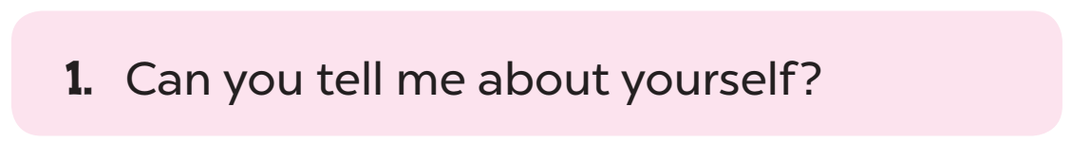
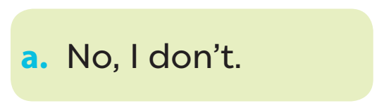

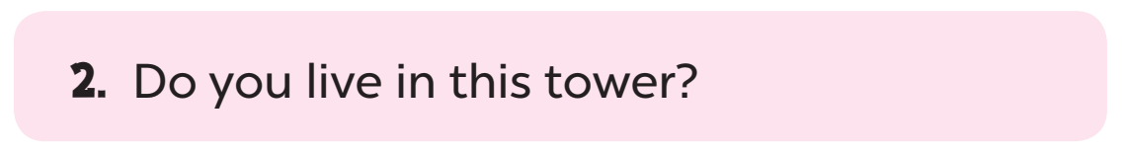
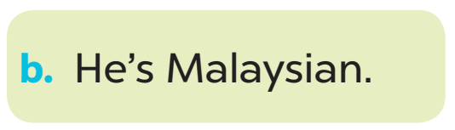
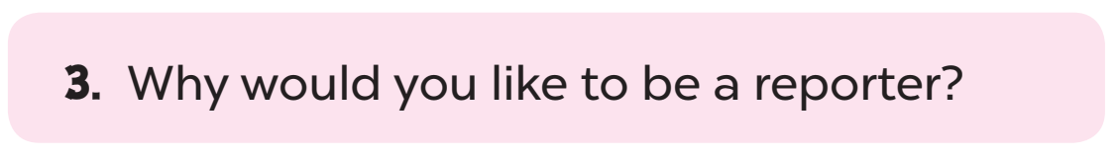
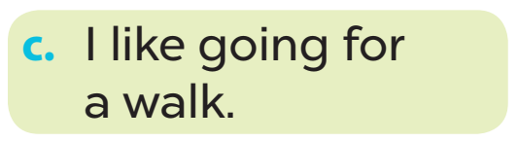
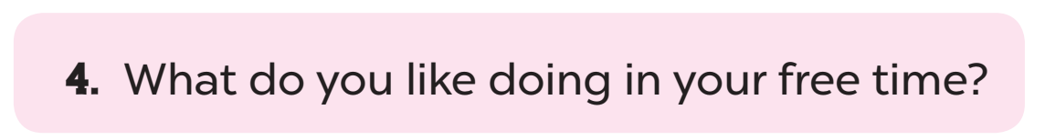
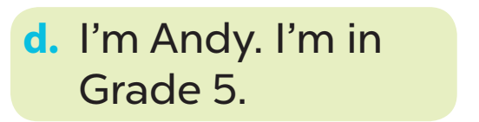
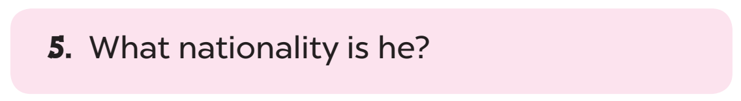
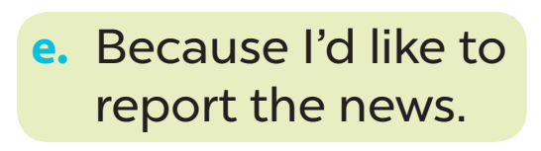
Look and read.
Notes:
Step 2: Give pupils time to do the task. Go around the classroom to offer support.

Slide 30
Let’s check.
Notes:
Step 2: Give pupils time to do the task. Go around the classroom to offer support.

Slide 31
Fun corner and Wrap-up.

Slide 32


THANK YOU
for
PLAYING!

