Slide 1



Unit 12: Our Tet holiday
HOA NGHIA PRIMARY SCHOOL
TEACHER: PHAM THI THU TRANG
CLASS: 5B
Lesson 2 - Period 3

Slide 2
Table of contents
1
2
3
Activity
Activity
4
5
Game time
Activity
Warm-up
Look, listen and repeat.
Listen, point and say.
Let’s talk.

Slide 3
1
Warm-up
What are the missing letters?

Slide 4
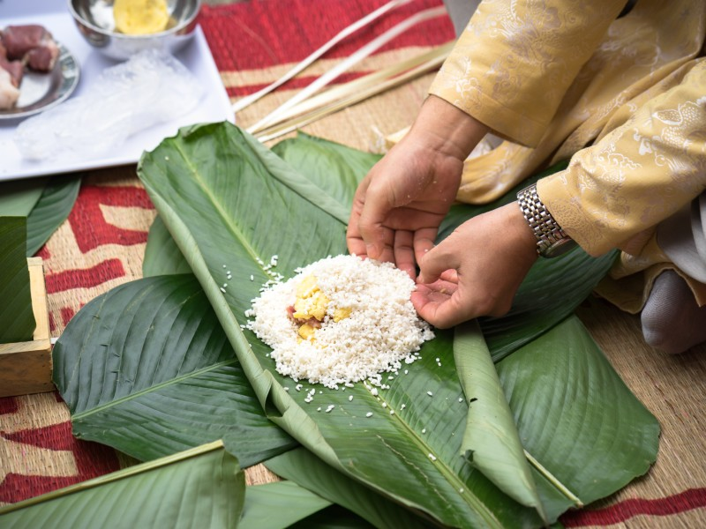
k
_ake chung ca_e
m

Slide 5
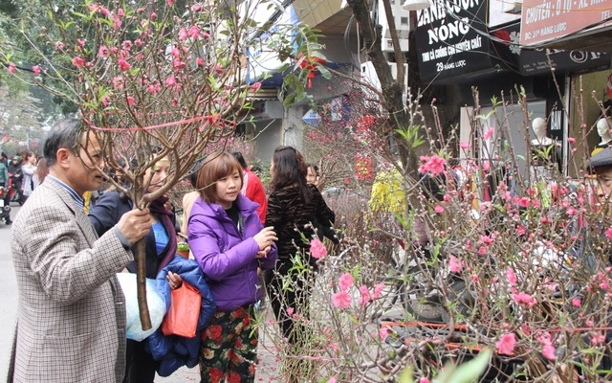
r
bu_ a b_anch of
pe_ch blo_soms
y
a
s

Slide 6
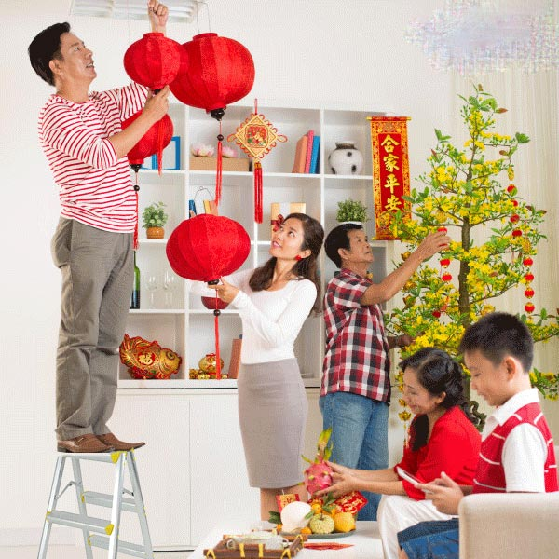
s
d_co_ate the hou_e
e
r

Slide 7
Awesome words

Slide 8
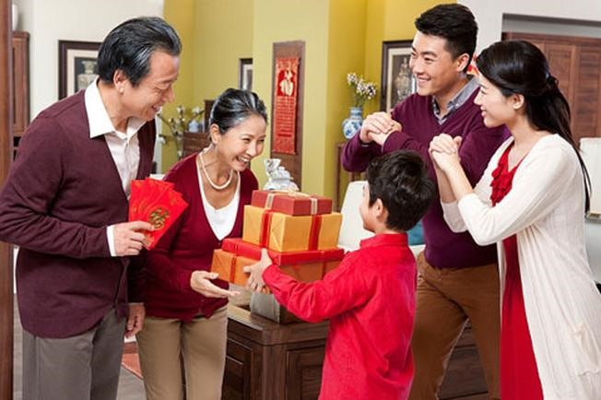
our grandparents’ house

Slide 9
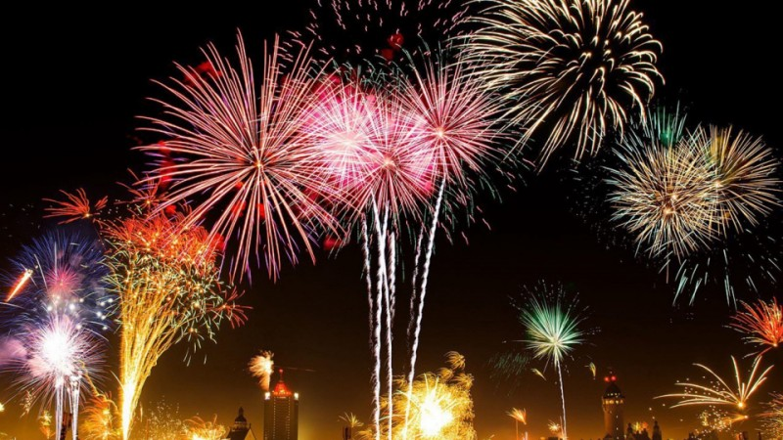
a fireworks show

Slide 10
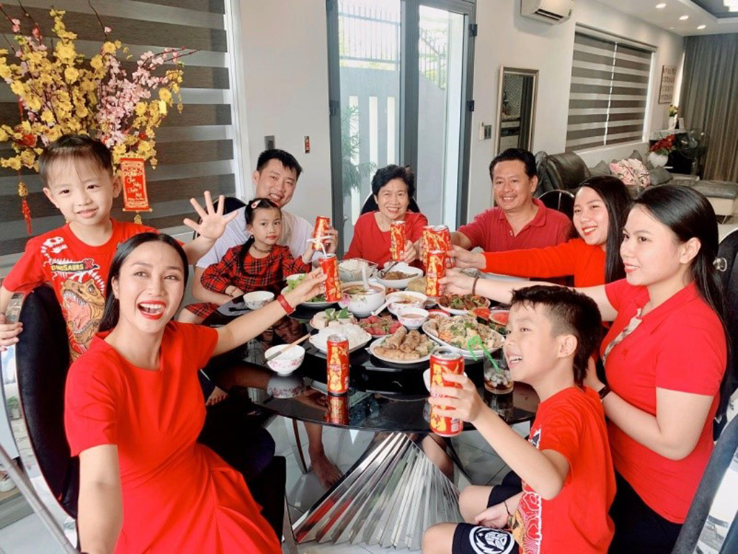
a New Year party

Slide 11
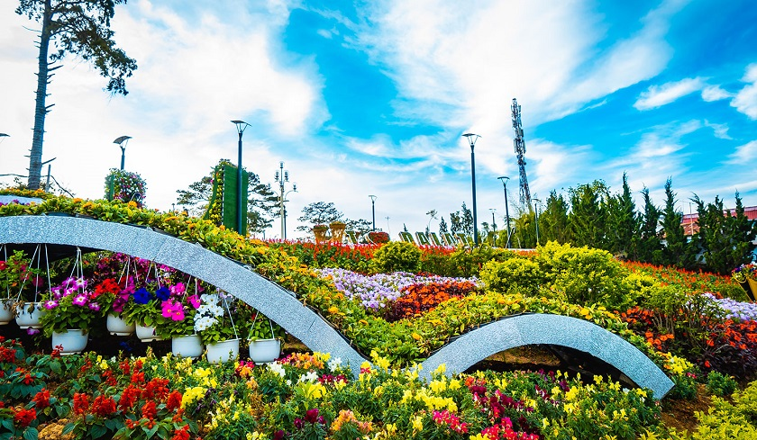
a flower festival

Slide 12
2
Look, listen and repeat.
Activity 1

Slide 13
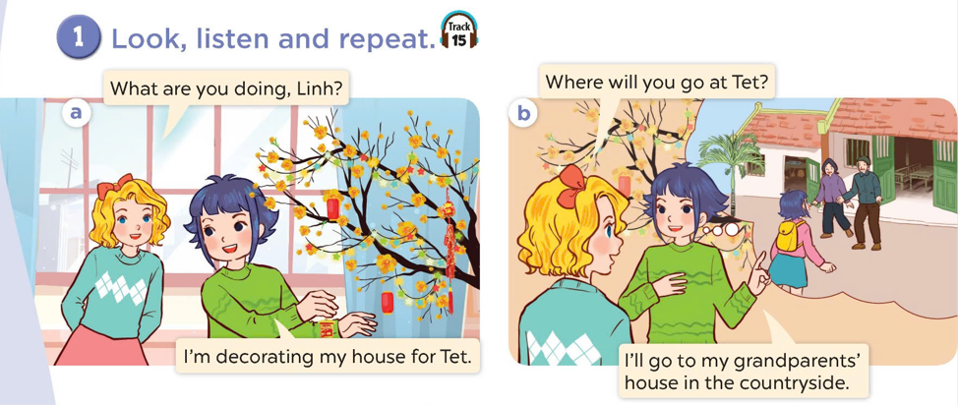
Look at the pictures.
Where are they?
What are they doing?

Slide 14
Look, listen and repeat.

Slide 15
3
Listen, point and say.
Activity 2

Slide 16

Where will you go at Tet?
I will go to my grandparents’ house.

Slide 17

Where will you go at Tet?
I will go to a fireworks show.

Slide 18
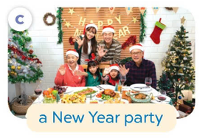
Where will you go at Tet?
Where will you go at Tet?
I will go to a New Year party.

Slide 19

Where will you go at Tet?
I will go to a flower festival.

Slide 20
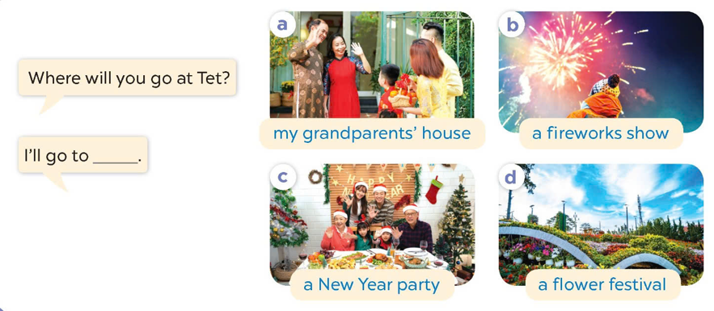
Listen and repeat.
Look and repeat the phrases.
Work in pairs. Ask and answer.

Slide 21
4
Let’s talk.
Activity 3

Slide 22
5
Game time
Lucky number

