Slide 1



HOA NGHIA PRIMARY SCHOOL
TEACHER: PHAM THI THU TRANG
CLASS: 5A
Unit 12: Our Tet holiday
Lesson 1 - Period 1

Slide 2
Table of contents
1
2
3
Warm-up
Look, listen and repeat.
Listen, point and say.
4
5
Fun corner
Let’s talk.
Activity
Activity
Activity

Slide 3
1
Warm-up

Slide 4
Guess the topic.
Look at the picture and guess the topic.

Slide 5







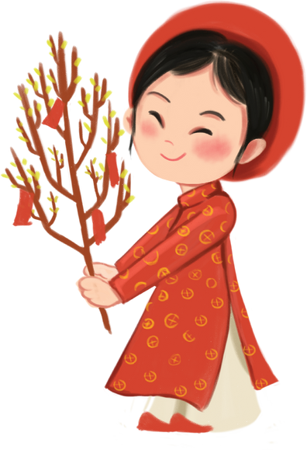




Unit 12:
Our Tet holiday

Slide 6
2
Look, listen and repeat.
Activity 1

Slide 7
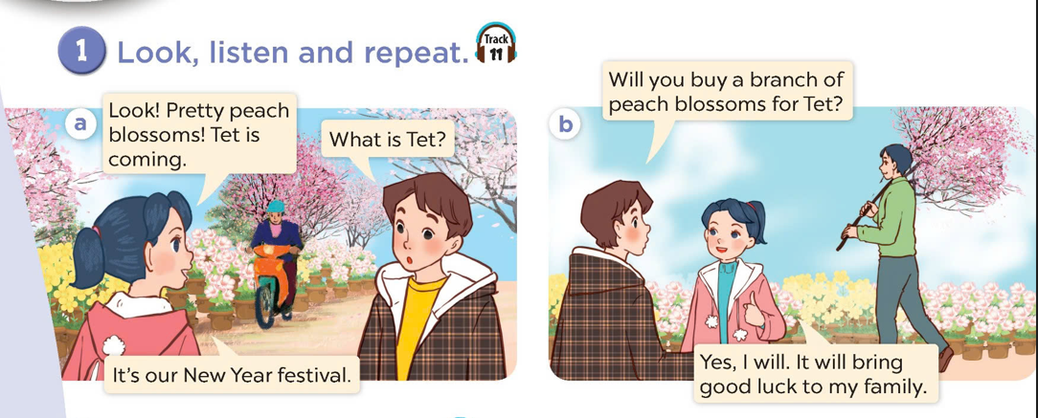
What can you see?
Who are they?
What are they talking about?

Slide 8

Look, listen and repeat.

Slide 9
3
Listen, point and say.
Activity 2

Slide 10
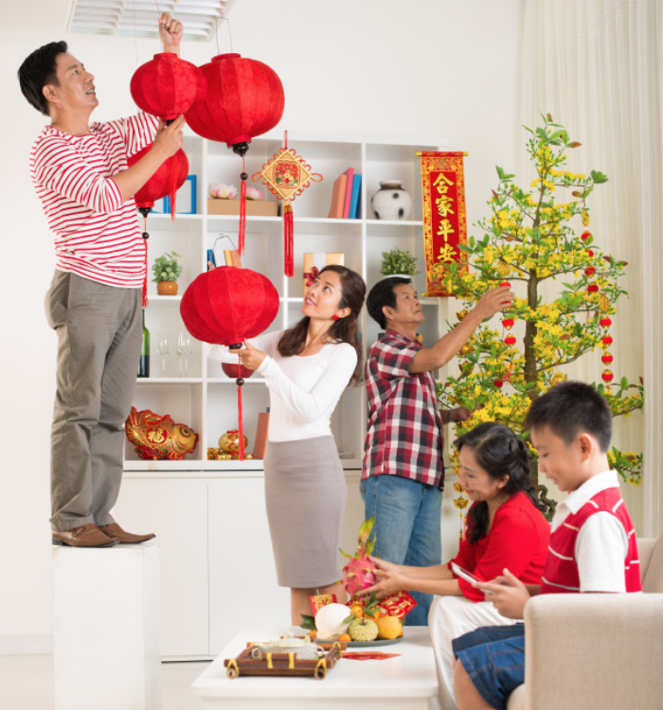
decorate the house

Slide 11
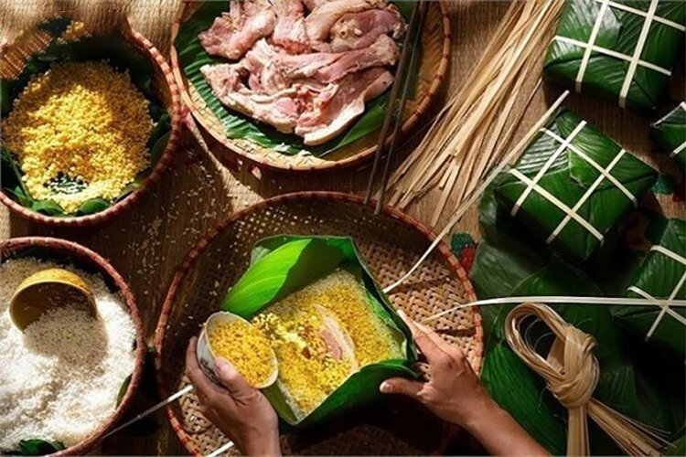
make banh chung

Slide 12
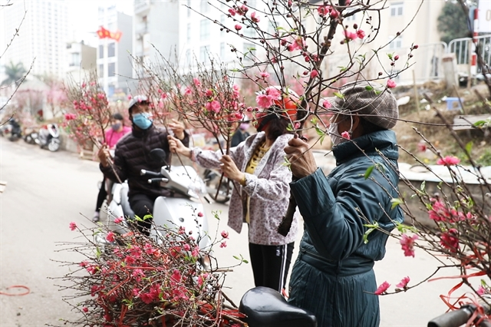
buy a branch of peach blossoms

Slide 13

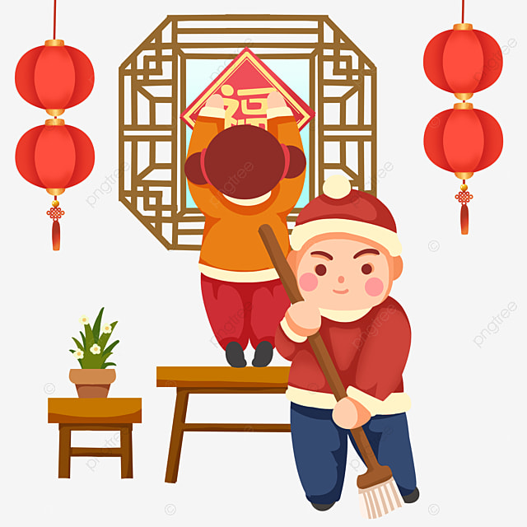
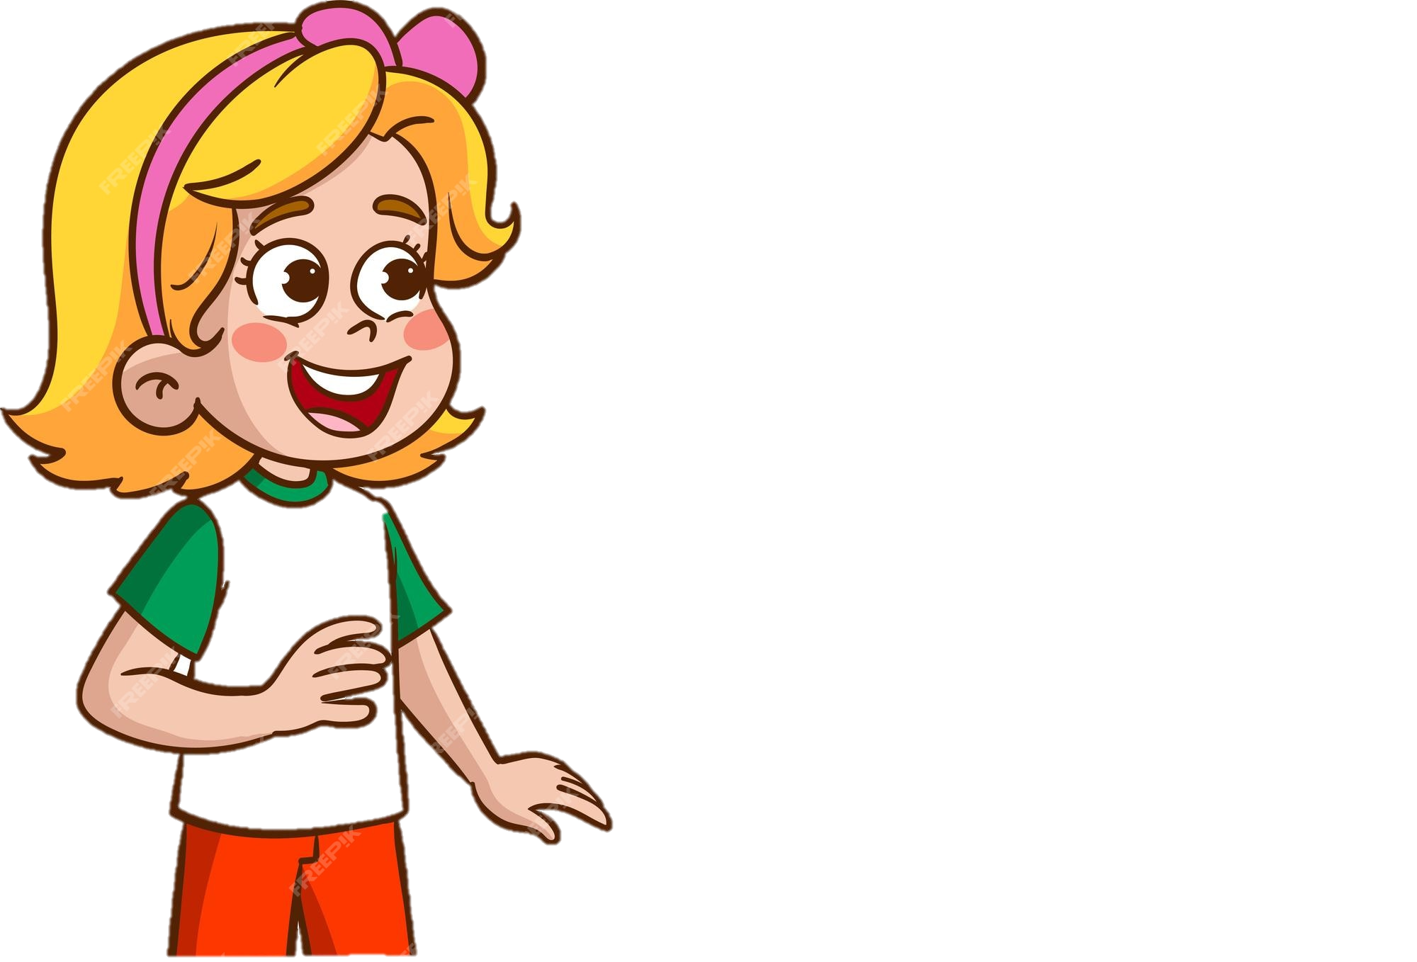

Will you decorate the house?
Yes, I will.

Slide 14
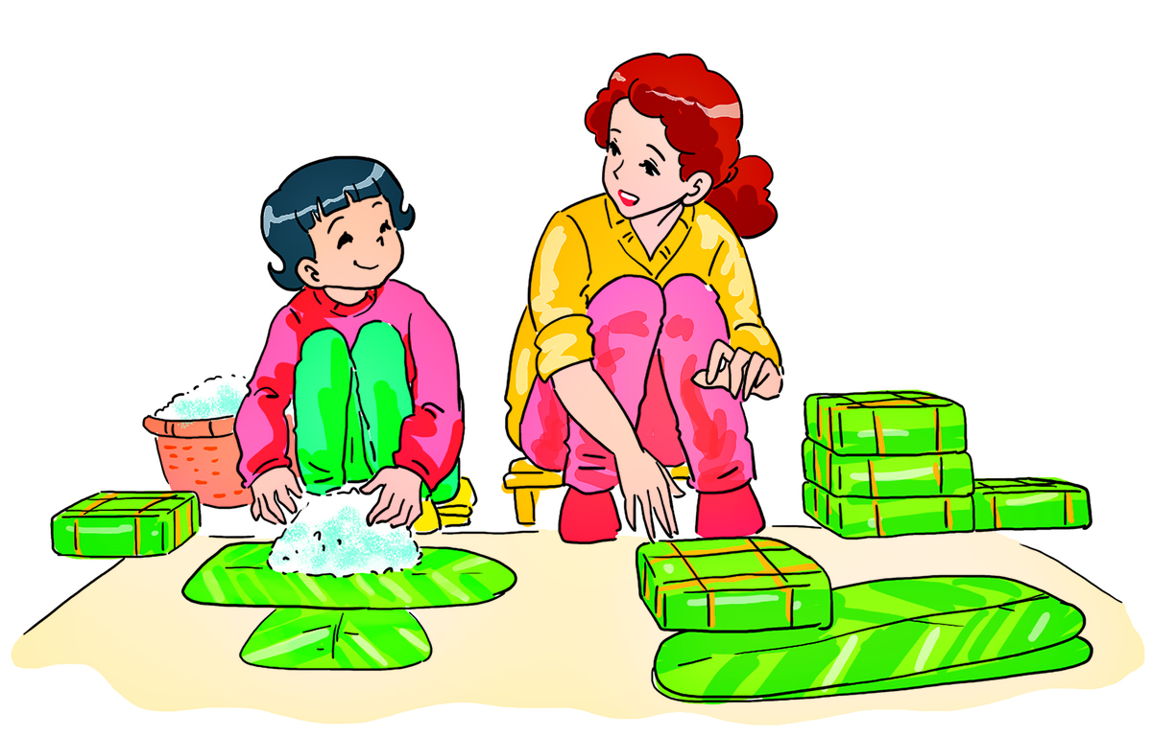

Will you make spring rolls?
No, I won’t. I will make banh chung.

Slide 15
Listen, point and say.

Slide 16
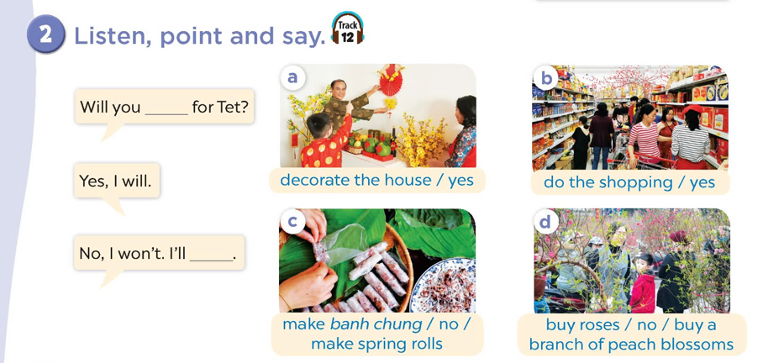

Slide 17
4
Let’s talk.
Activity 3

Slide 18
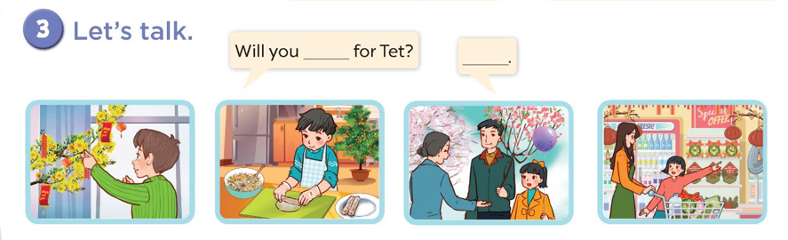

Slide 19
Fun corner
5

