Slide 1









HOA NGHIA PRIMARY SCHOOL
TEACHER: PHAM THI THU TRANG
CLASS: 5A
Our home
Lesson 1 - Period 1

Slide 2

Table of contents
01
02
03
Look, listen and repeat.
Listen, point and say.
Warm-up and review
04
05
Let's talk.
Fun corner and wrap-up

Slide 3



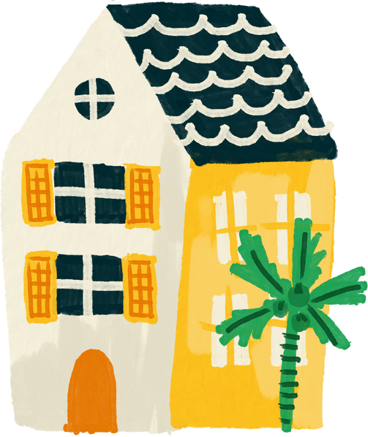


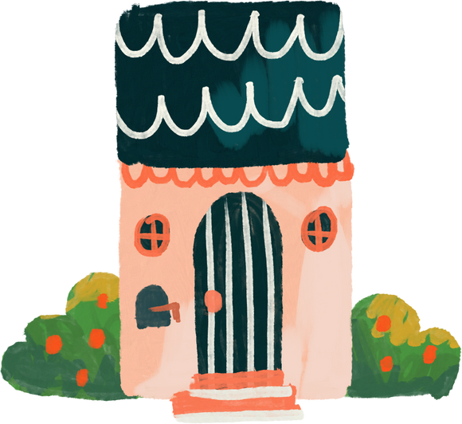
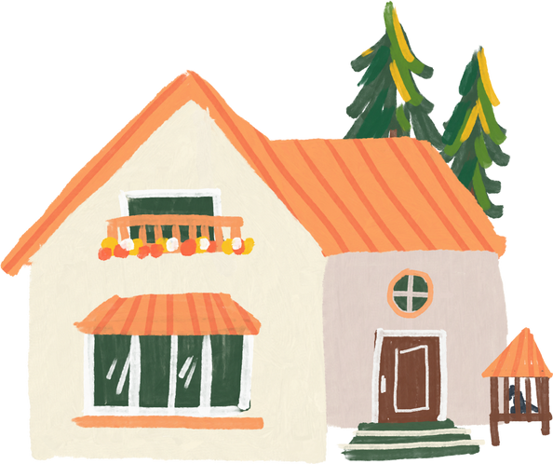
01
Warm-up and review

Slide 4




Guess the key word
Collect the letters.
E
O
HOME
M
H
Next Activity

Slide 5
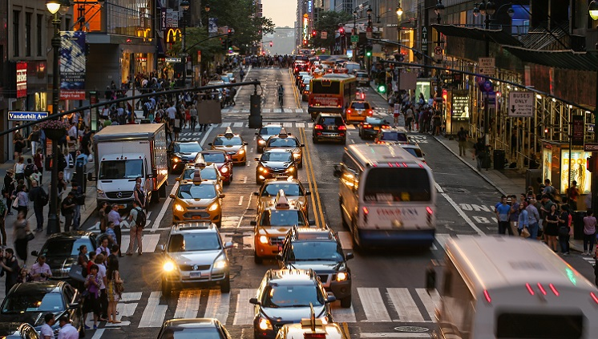
It's a busy .
st_ _e_
street

Slide 6
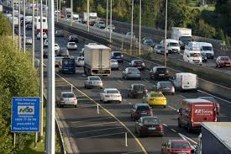
It's a noisy .
r_ _ _
road

Slide 7
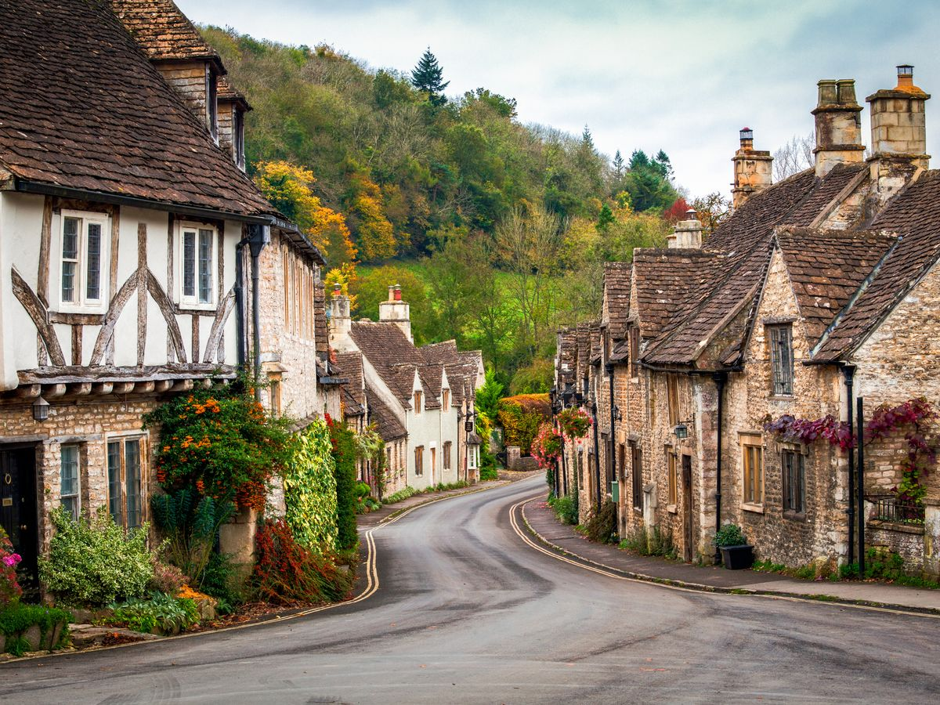
It's a quiet .
village
v_l_ag_

Slide 8

It's a big ..
c_ _y
city

Slide 9
02
Look, listen and repeat.

Slide 10
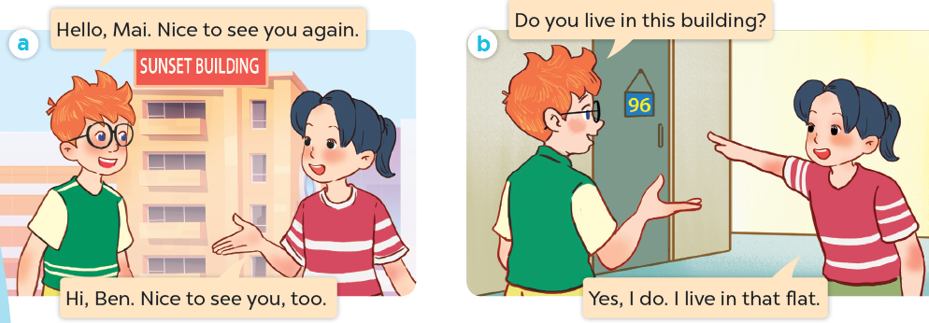
What are they talking about?
Where are they?
Who are they?

Slide 11
Look, listen and repeat.

Slide 12
Look, listen and repeat.

Slide 13
Look, listen and repeat.

Slide 14
03
Listen, point and say.

Slide 15
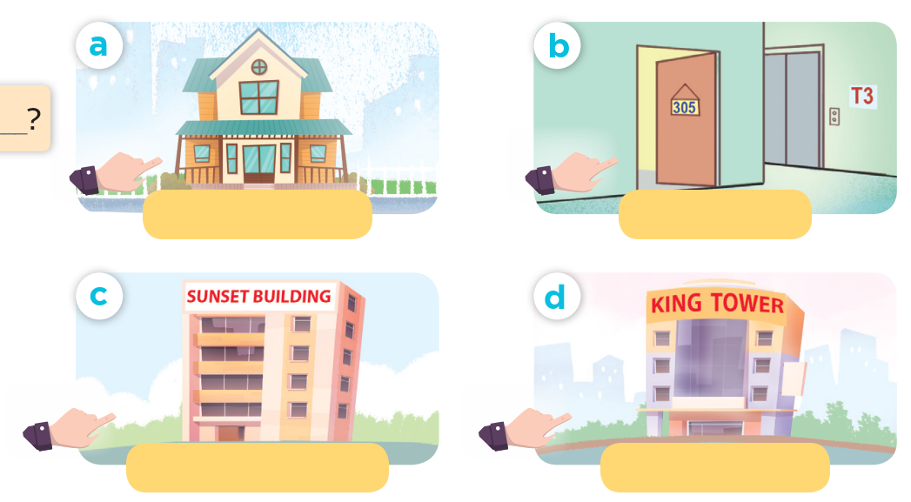
Look and say.

Slide 16
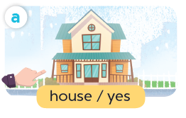
Listen, point and say.
house / yes

Slide 17
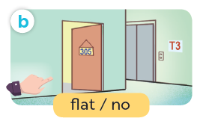
Listen, point and say.
flat / no

Slide 18
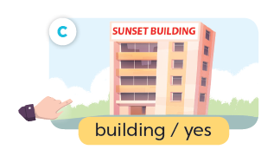
Listen, point and say.
building / yes

Slide 19
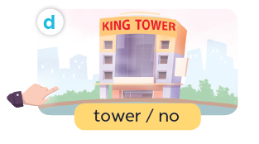
Listen, point and say.
tower / no

Slide 20
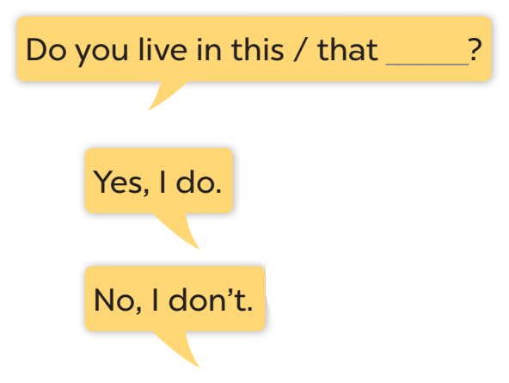




Slide 21
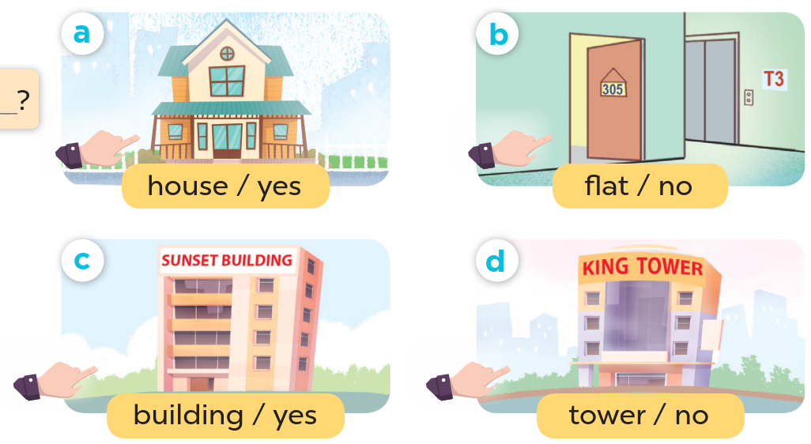
Look at the hands.

Slide 22
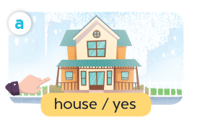
Listen, point and say.
Do you live in this house?
Yes, I do.
house / yes

Slide 23
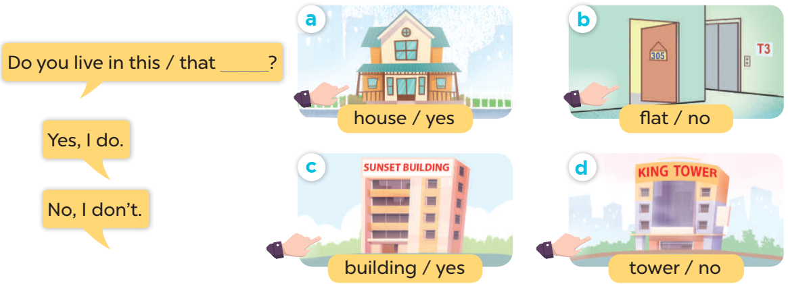
Work in pairs. Ask and answer.

Slide 24
04
Let's talk.

Slide 25
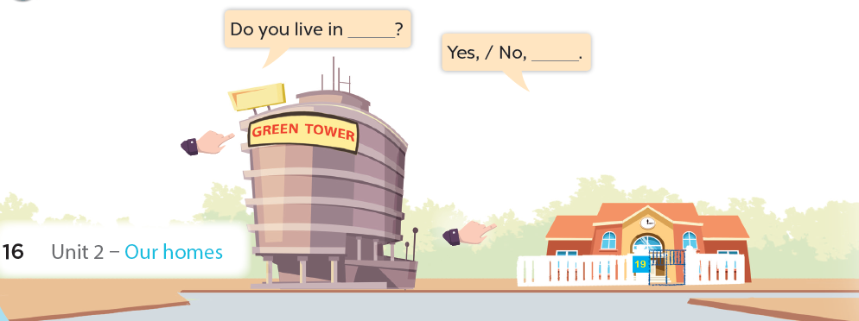

Slide 26
05
Fun corner and wrap-up
Lucky letter

Slide 27
Website: hoclieu.vn
Fanpage: facebook.com/www.tienganhglobalsuccess.vn

