Slide 1
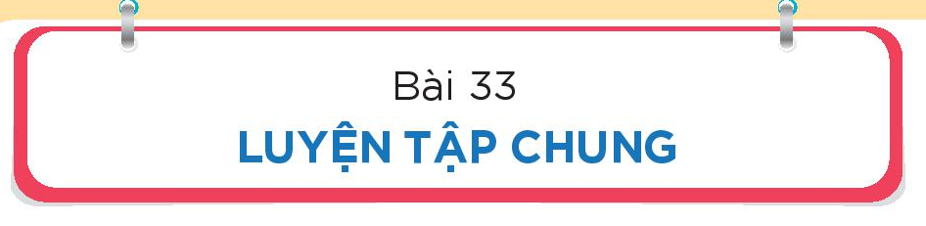

Slide 2

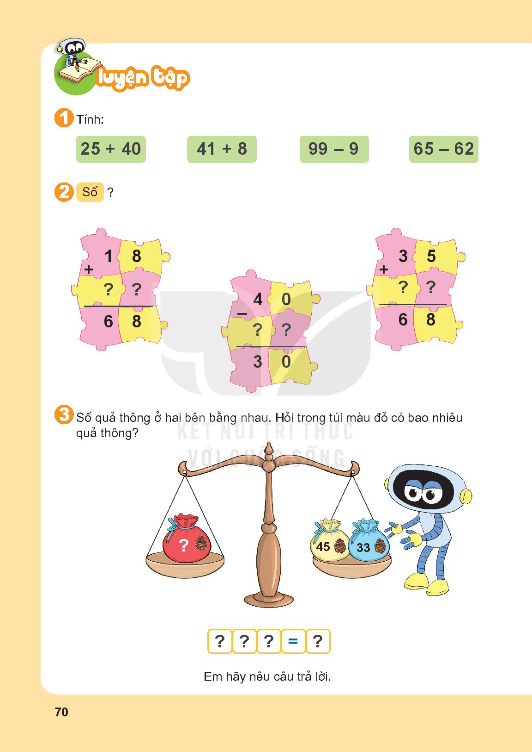
= 65
= 49
= 90
= 5

Slide 3
5
5
3
3
9
1
9

Slide 4
45
+
33
78

Slide 5
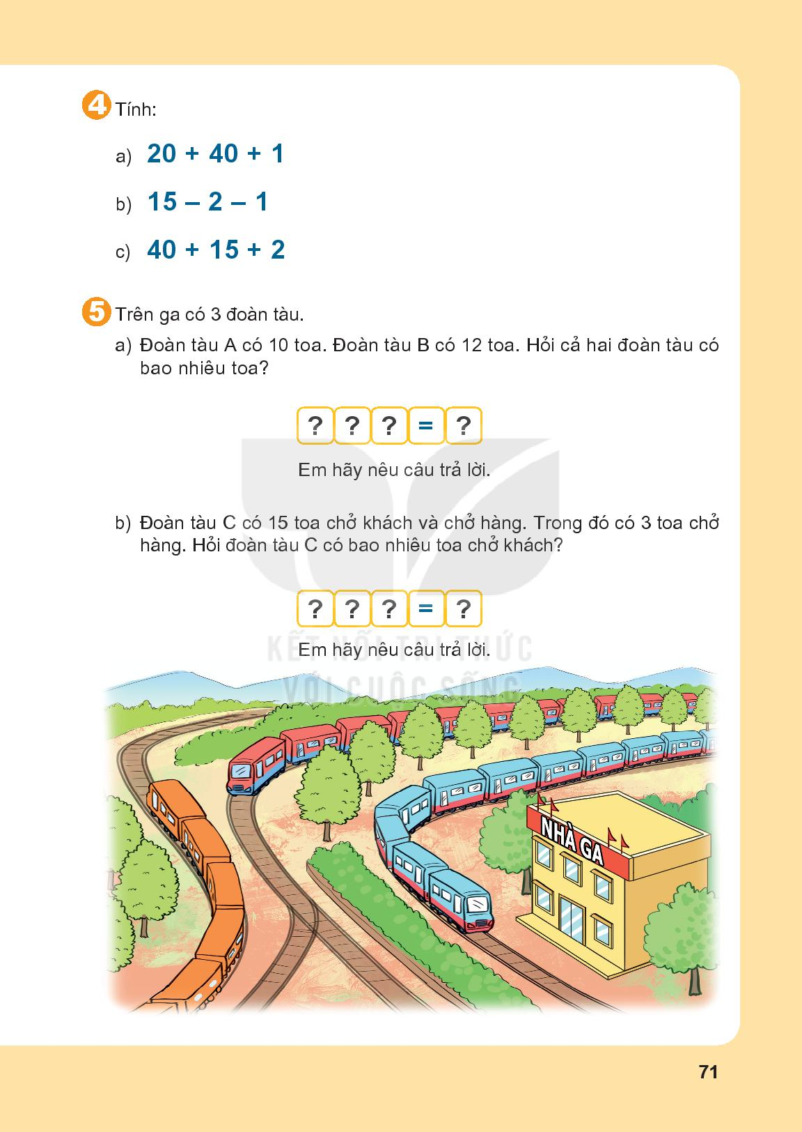
= 61
= 12
= 57

Slide 6
10
+
12
22

Slide 7
15
-
3
12

