Slide 1
Hoa Nghia Primary school
Welcome to our class !
Teacher: Mai Hong Phuong

Slide 2


Daily Activities
14
Lesson 1 – Period 1

Slide 3
01
Warm-up
Guessing Game

Slide 4
Make a guess

Slide 5
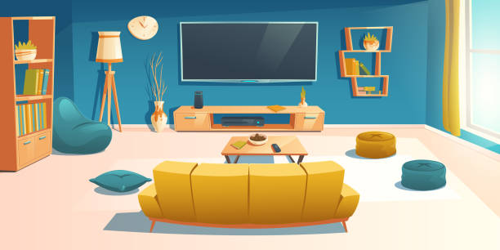
What room is this?
living room

Slide 6
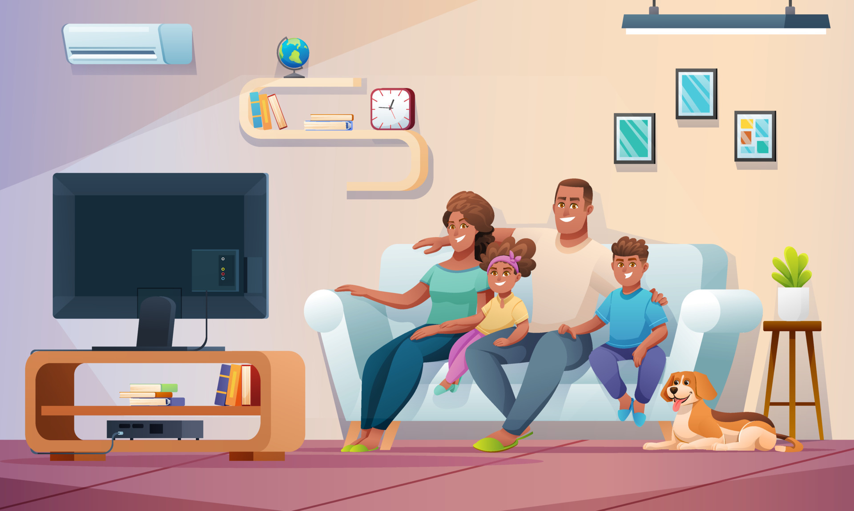
What is it?
TV

Slide 7
What is the family sitting on?
on the sofa

Slide 8
What are they doing?
watching TV

Slide 9
02
New words
Parts of the day

Slide 10


morning
in the morning

Slide 11

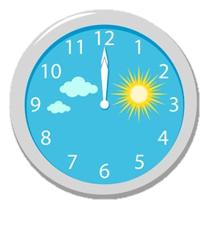
noon
at noon

Slide 12
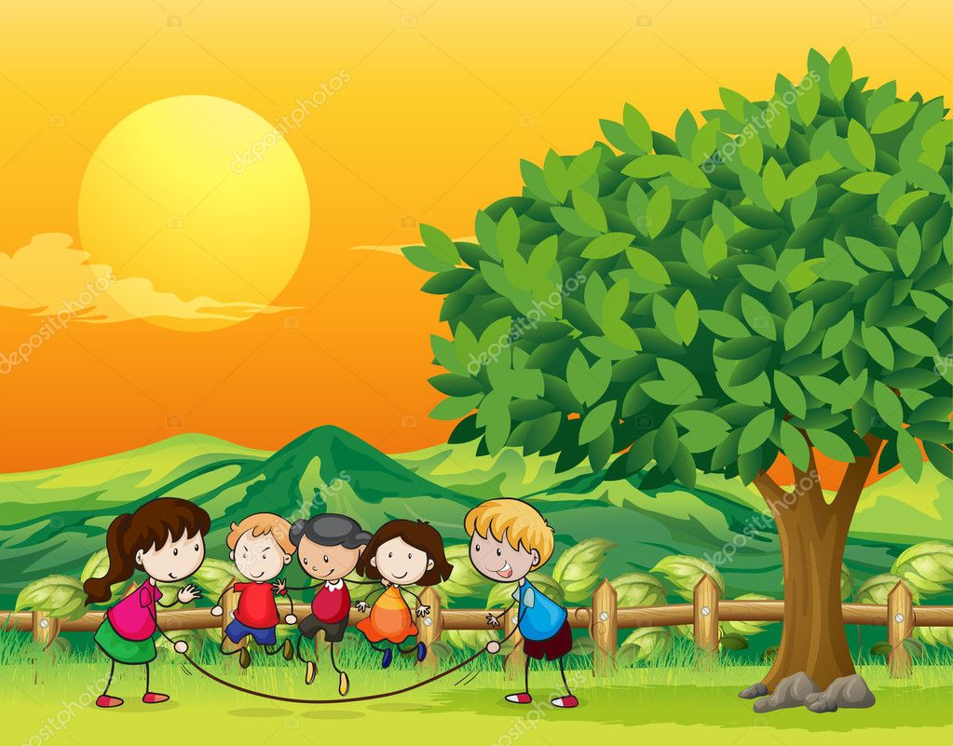

afternoon
in the afternoon

Slide 13
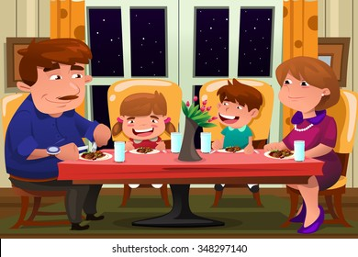

evening
in the evening

Slide 14
03
Activity 1
Look, listen and repeat

Slide 15
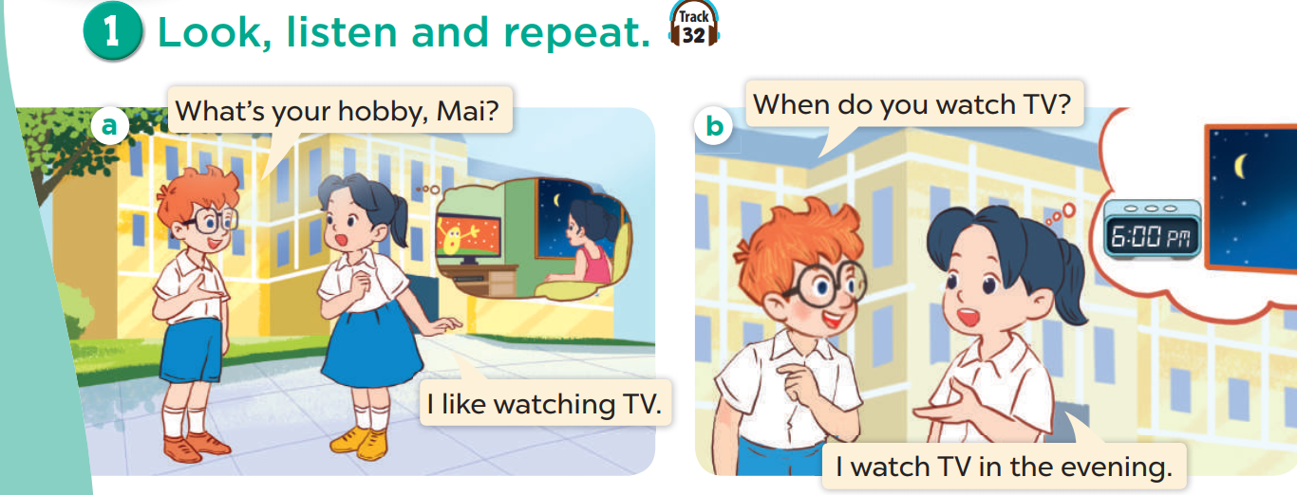
Look and listen.

Slide 16
Listen and repeat.

Slide 17
Listen and repeat.

Slide 18
Work in pairs. Play roles.

Slide 19
04
Activity 2
Listen, point and say

Slide 20
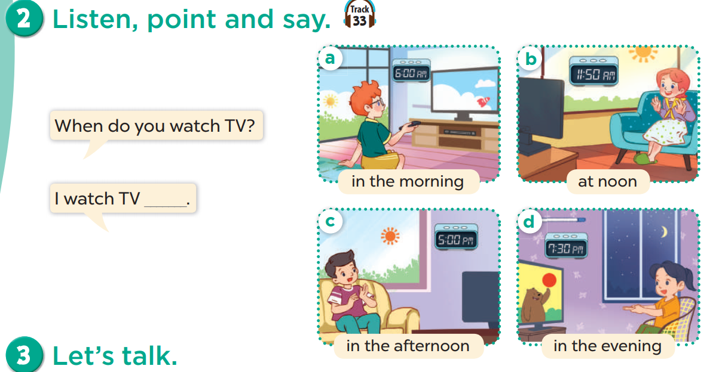

Slide 21
Listen, point and say.

Slide 22
Look and say.
Notes:
Teacher points randomly.
Students say the words

Slide 23
Work in pairs. Ask and answer.
When do you watch TV?
at noon
I watch TV ___________.
in the morning
in the evening
in the afternoon

Slide 24
05
Activity 3
Let’s talk

Slide 25
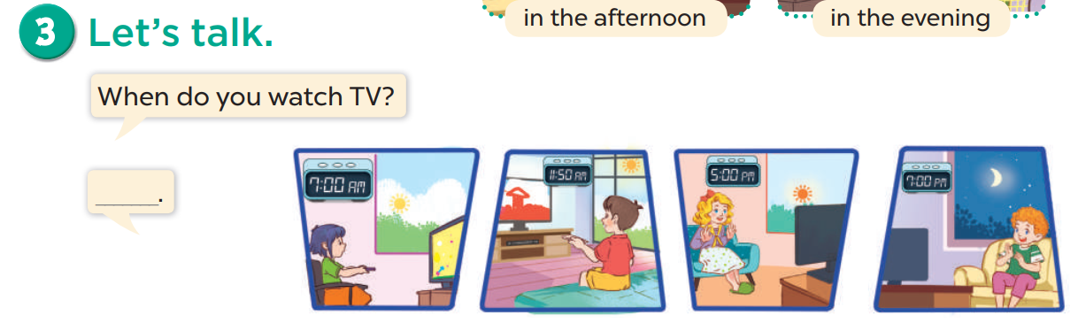

Slide 26
06
Fun Time
Slap the board game

Slide 27


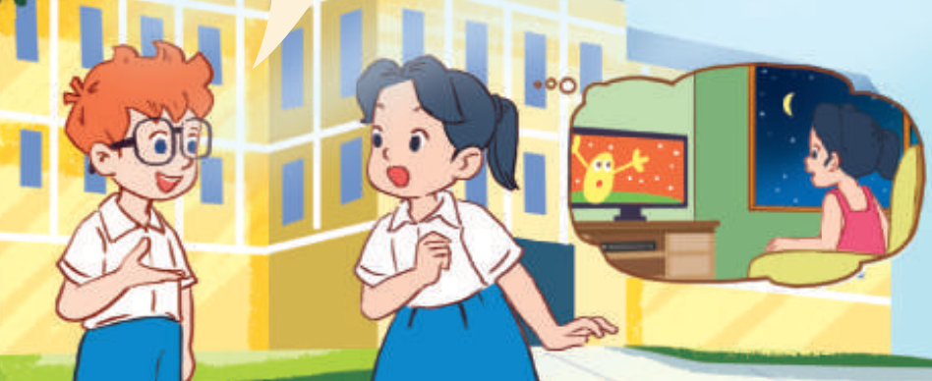
watching TV
washing TV
What is Mai’s hobby?

Slide 28
______ do you watch TV?
When
What

Slide 29
When do you _____ TV?
watching
watch

Slide 30
do
does
When ___ you watch TV?

Slide 31
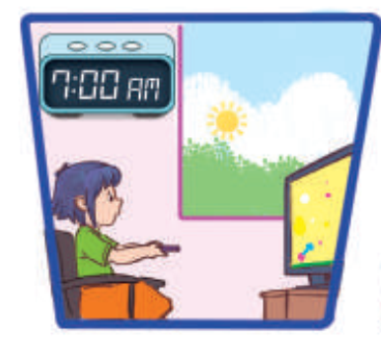
I watch TV in ___.
in the morning
at noon

Slide 32
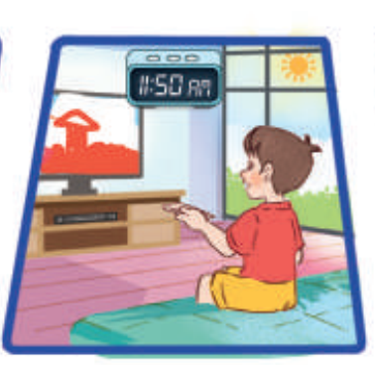
at night
at noon
I watch TV in ___.

Slide 33
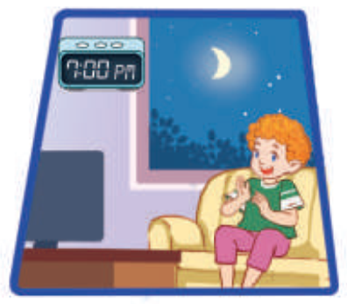
in the evening
in the afternoon
I watch TV in ___.

Slide 34
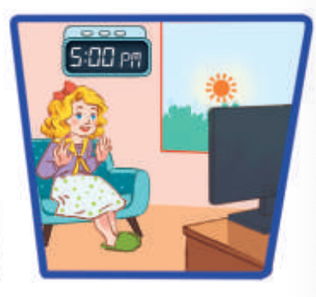
in the morning
in the afternoon
I watch TV in ___.

