Slide 1
Hoa Nghia Primary school
Welcome to our class !
Teacher: Mai Hong Phuong

Slide 2


Daily Activities
14
Lesson 1 – Period 2

Slide 3
01
Warm-up
Guessing Game

Slide 4
Make a guess

Slide 5
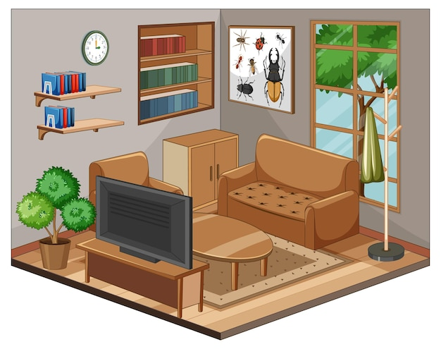


watch TV

Slide 6



do the housework

Slide 7



listen to music

Slide 8



read books

Slide 9



do homework

Slide 10
02
Activity 4
Listen and tick or cross

Slide 11
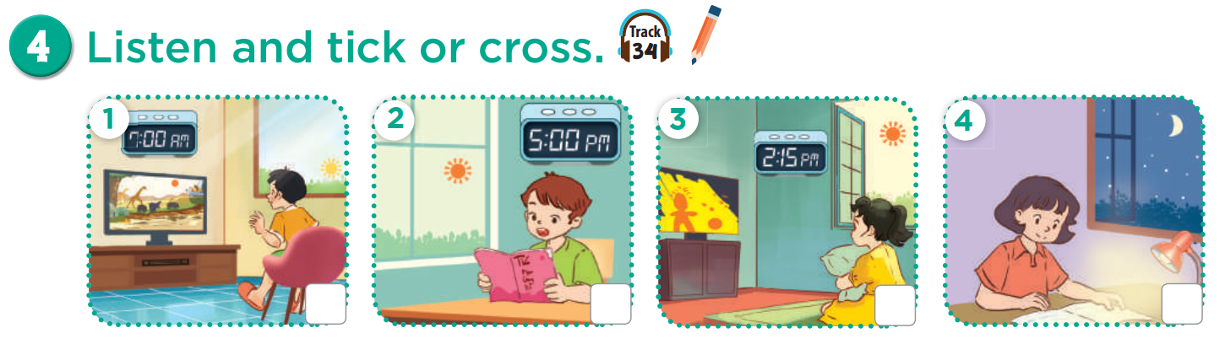

Slide 12
watch TV
in the morning

Slide 13
read books
in the afternoon

Slide 14
watch TV
in the afternoon

Slide 15
do homework
in the evening

Slide 16


Listen and tick or cross.
Listen and check.

Slide 17
03
Activity 5
Look, complete and read

Slide 18
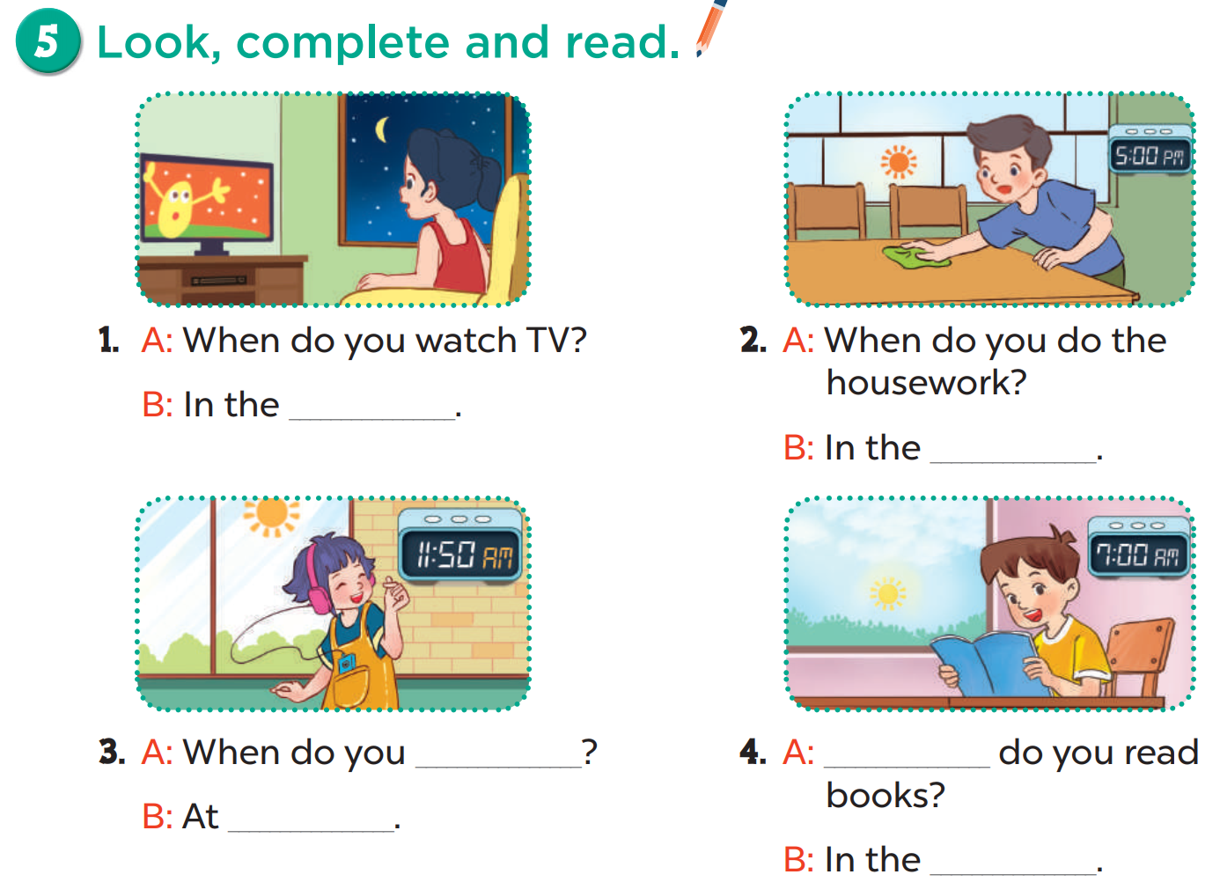

Slide 19
evening

Slide 20
afternoon

Slide 21
listen to music
noon

Slide 22
When
morning

Slide 23
04
Activity 6
Let’s sing

Slide 24
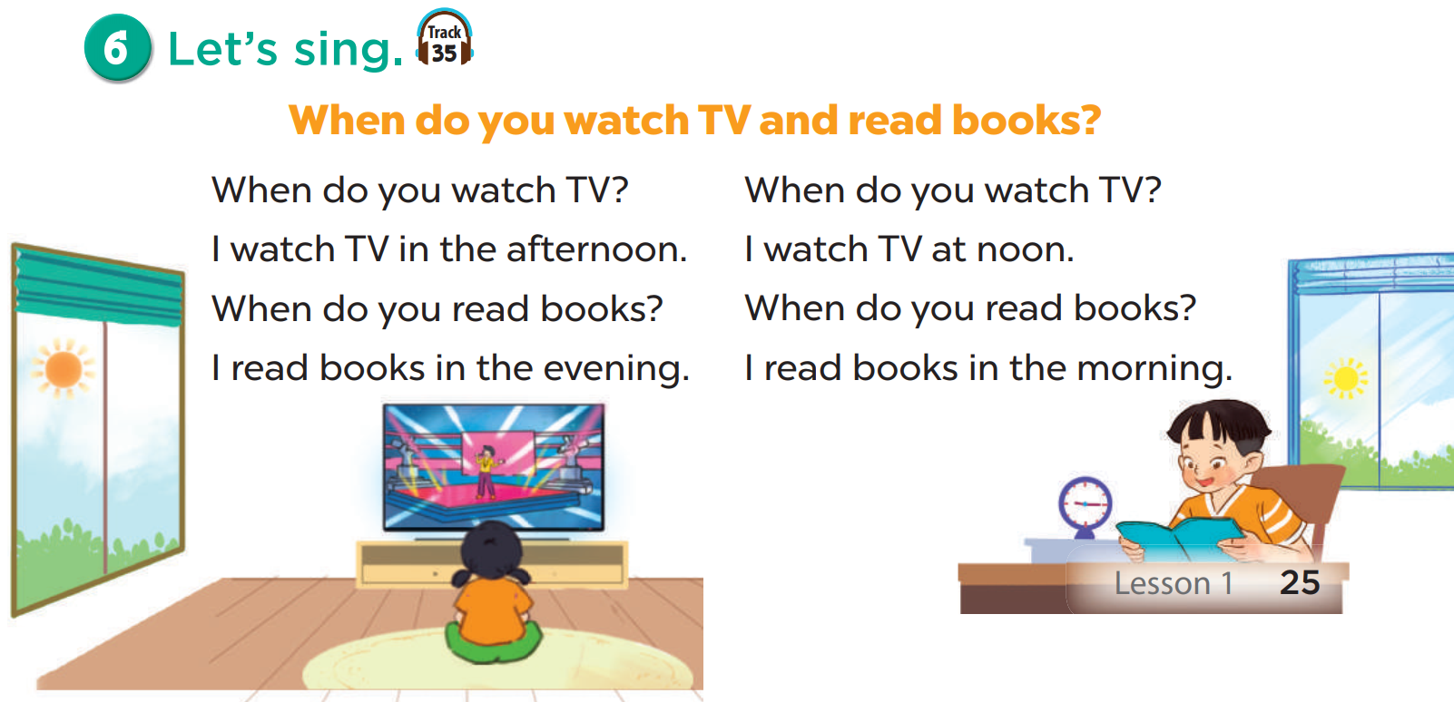
Listen.

Slide 25
Listen and fill in the blank.
1
5
2
6
3
7
4
8

Slide 26
05
Fun Time
Pokémon game

