Slide 1
Hoa Nghia Primary school
Welcome to our class !
Teacher: Mai Hong Phuong

Slide 2


Daily Activities
14
Lesson 2 – Period 3

Slide 3
01
Warm-up
Let’s sing

Slide 4
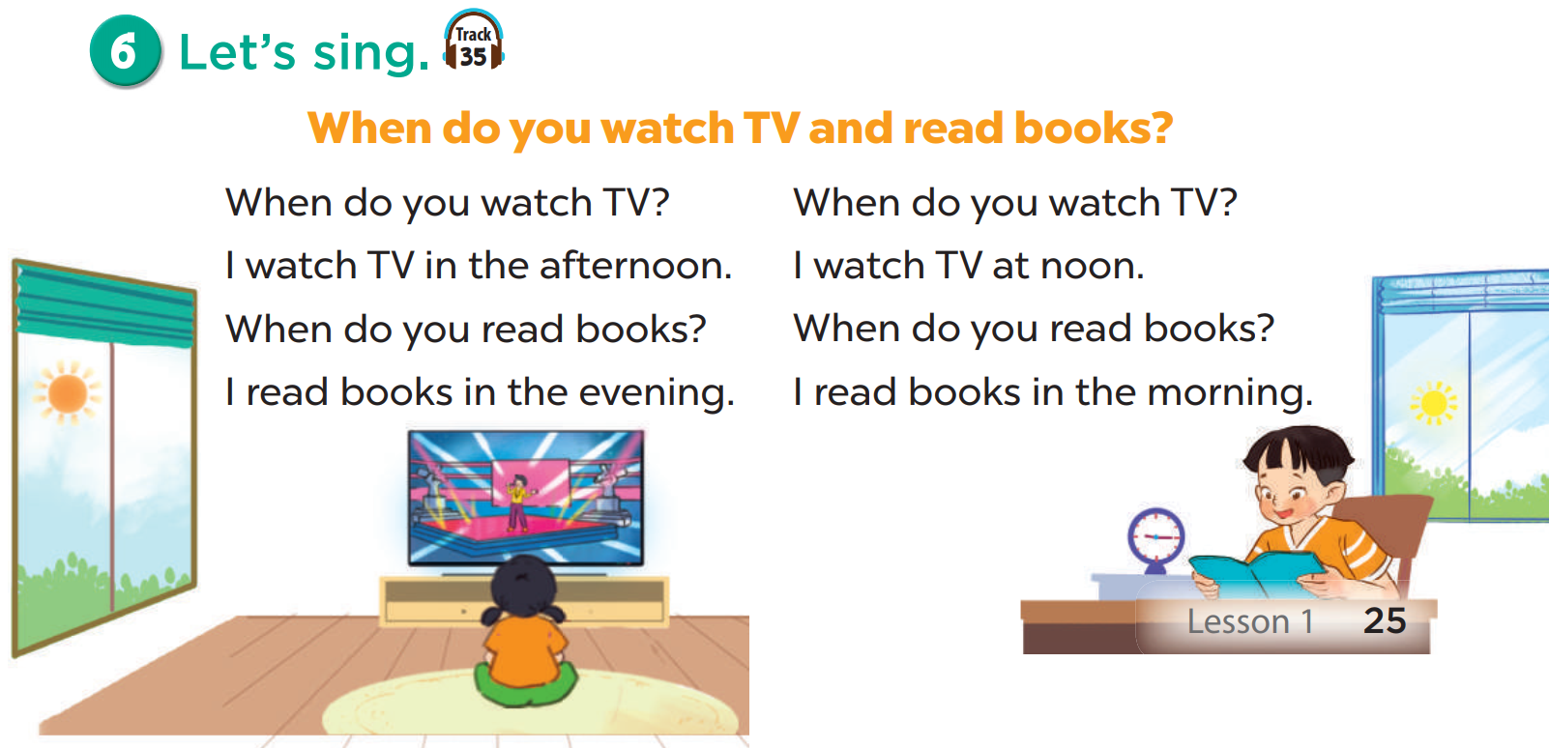
Listen.

Slide 5
02
New words
Daily activities

Slide 6
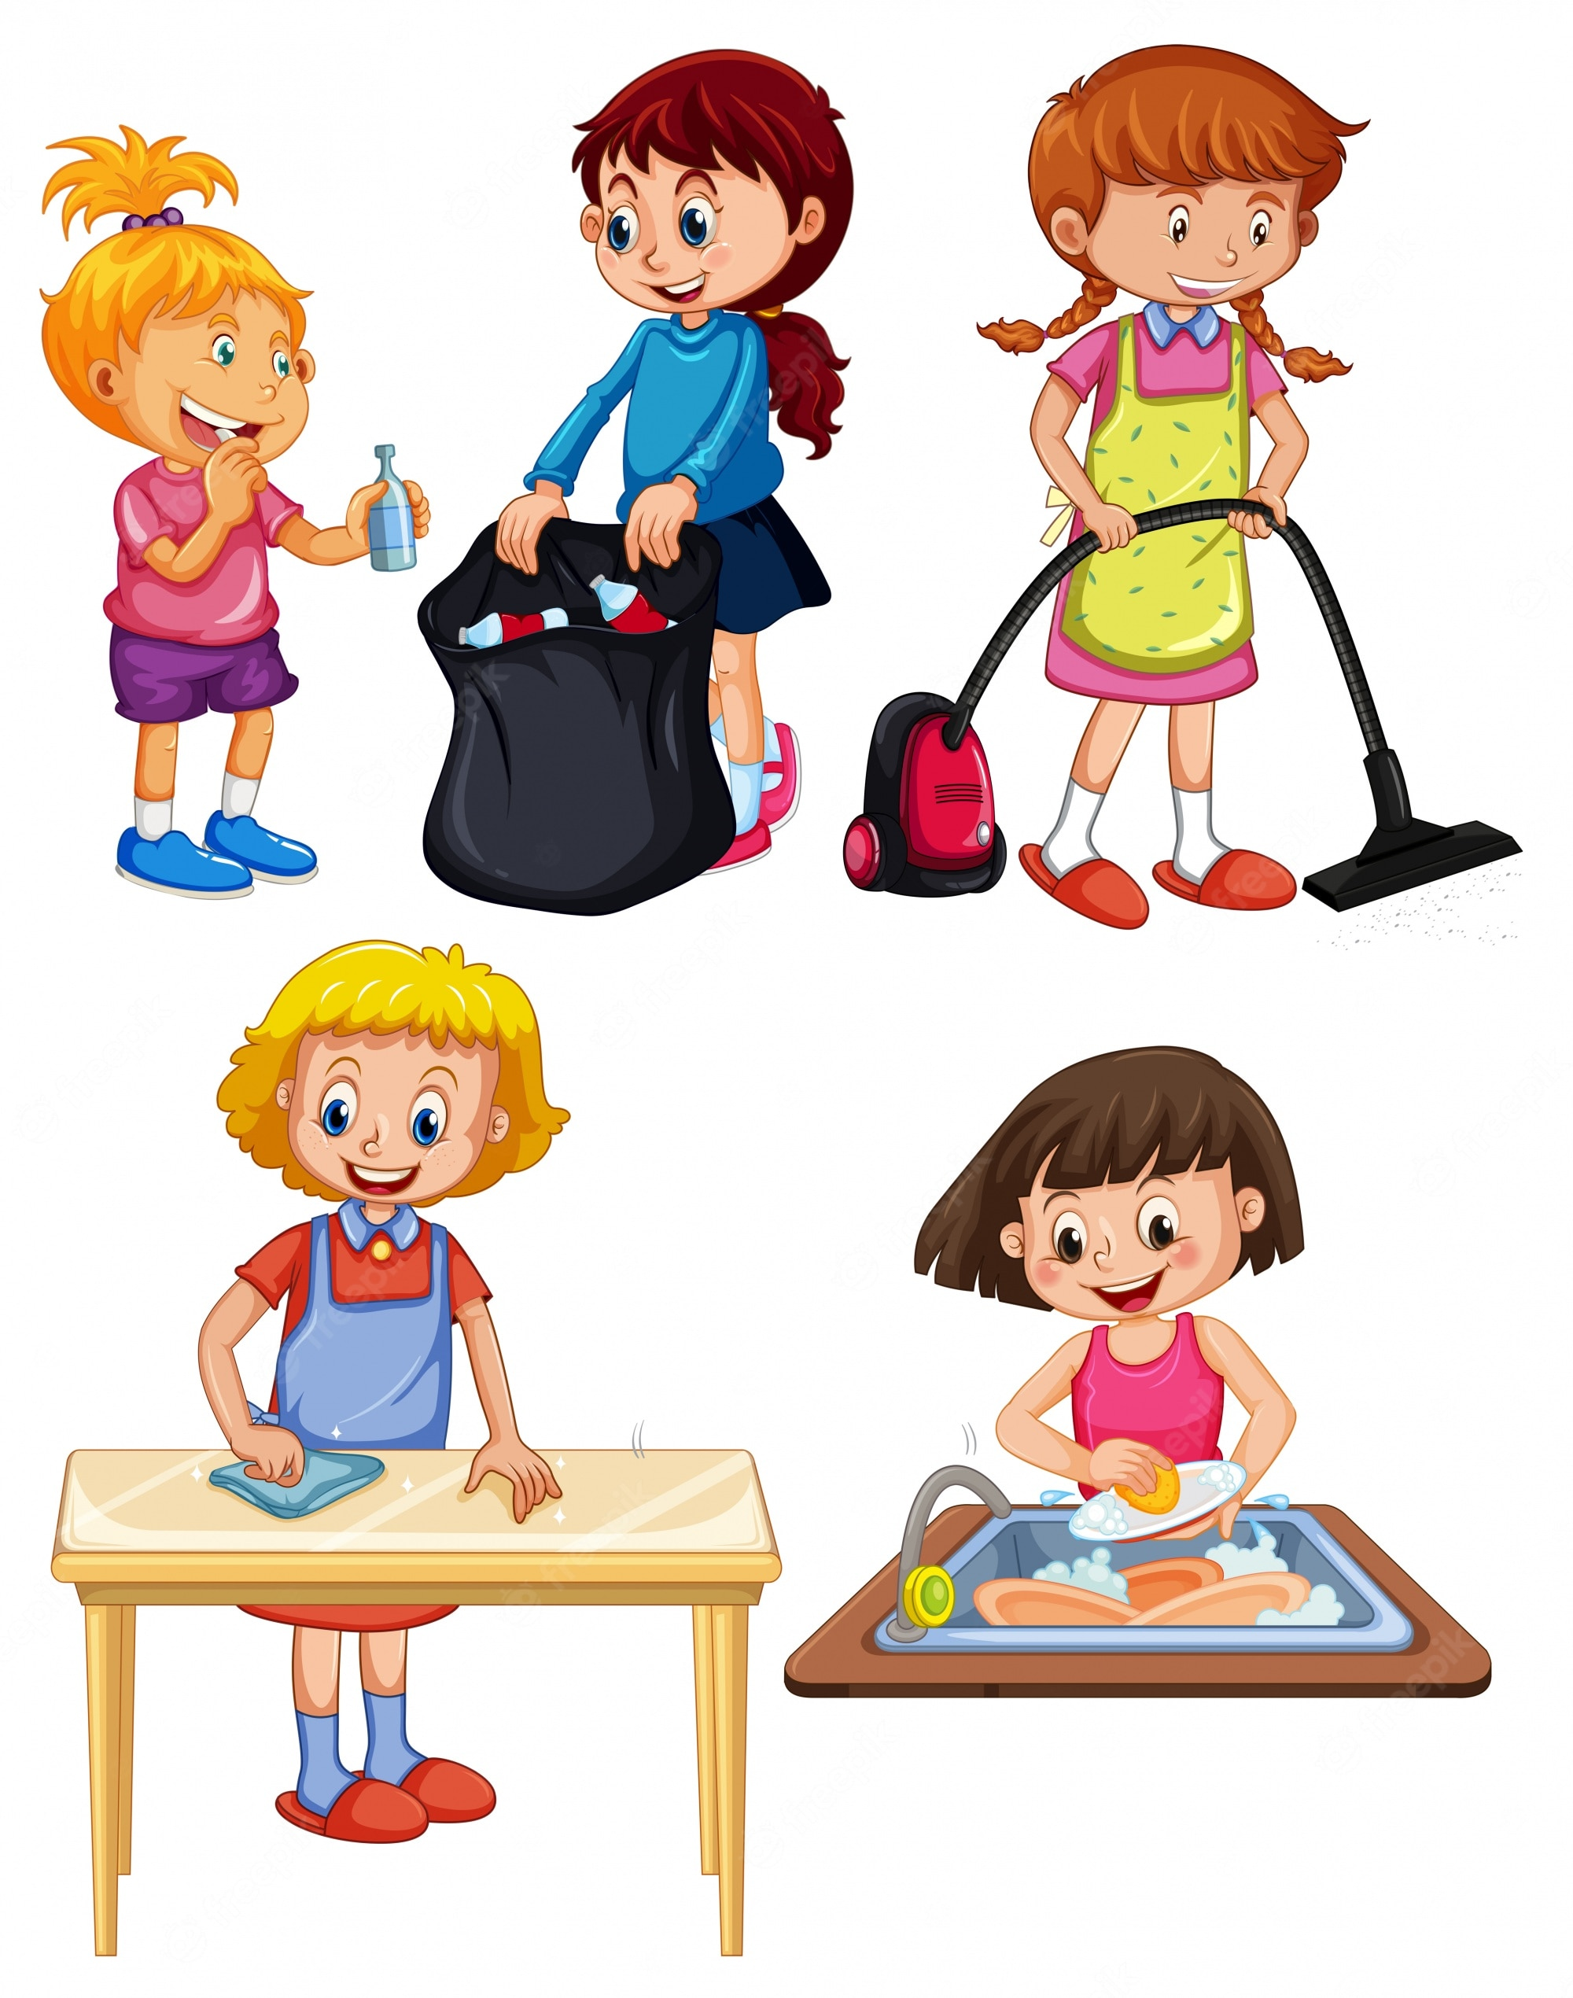
do the housework

Slide 7
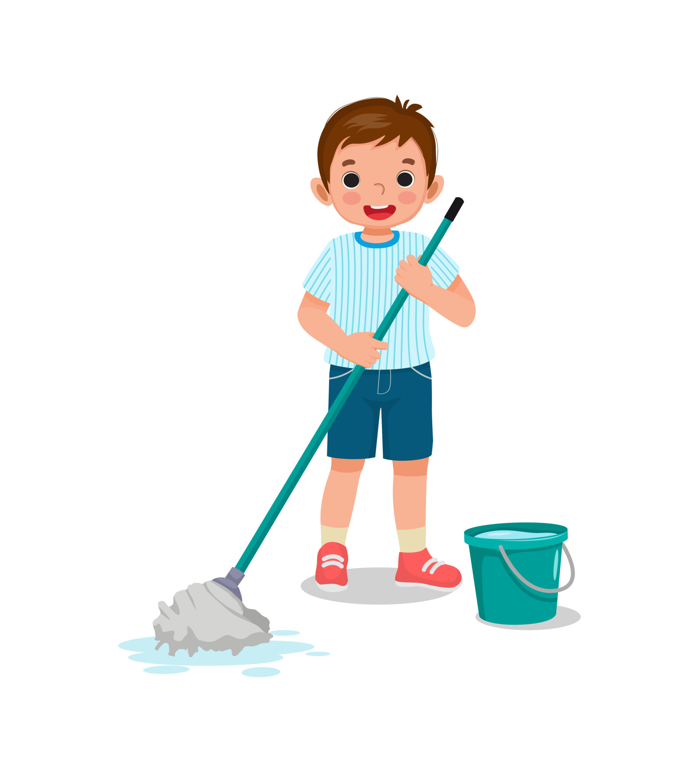
clean the floor

Slide 8

wash the clothes

Slide 9
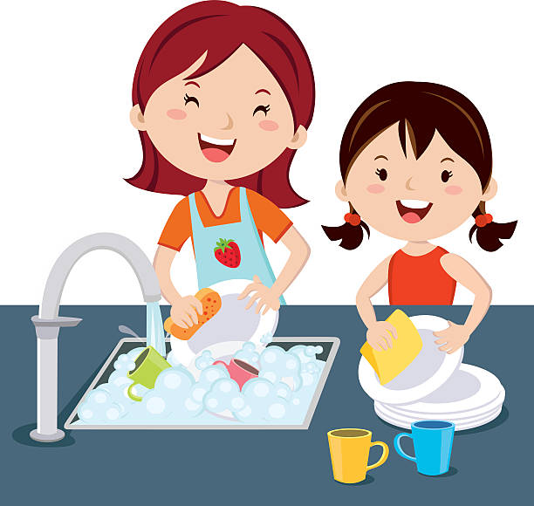
wash the dishes

Slide 10
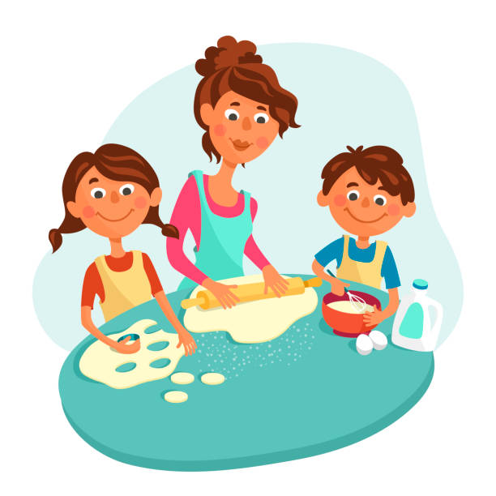
help with the
cooking

Slide 11
clean the floor
wash the dishes
do the housework
wash the clothes
help with the
cooking

Slide 12
clean the floor
SHOW

Slide 13
wash the clothes
SHOW

Slide 14
help with the cooking
SHOW

Slide 15
wash the dishes
SHOW

Slide 16
do the housework
SHOW

Slide 17
03
Activity 1
Look, listen and repeat

Slide 18
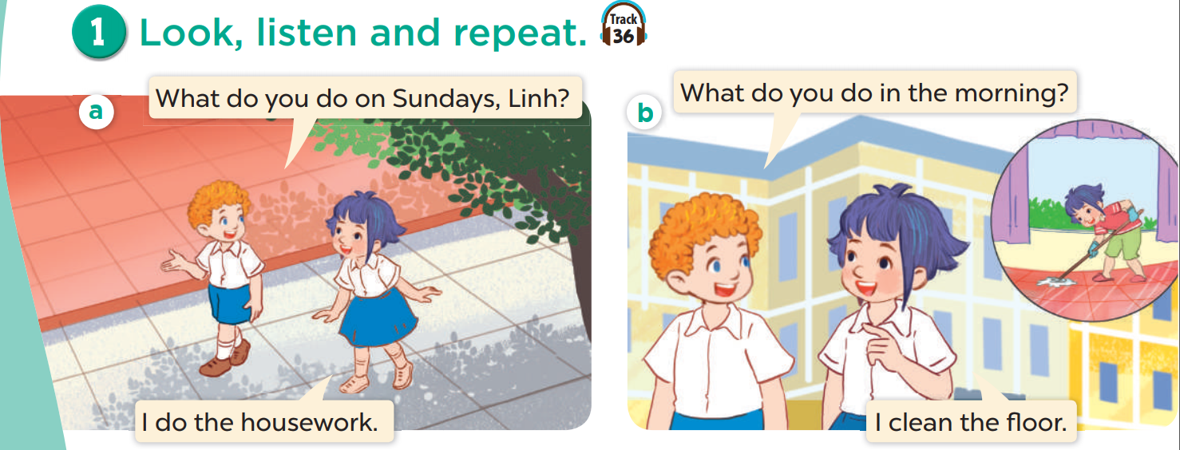
Look and listen.

Slide 19
Listen and repeat.

Slide 20
Listen and repeat.

Slide 21
Work in pairs. Play roles.

Slide 22
04
Activity 2
Listen, point and say

Slide 23
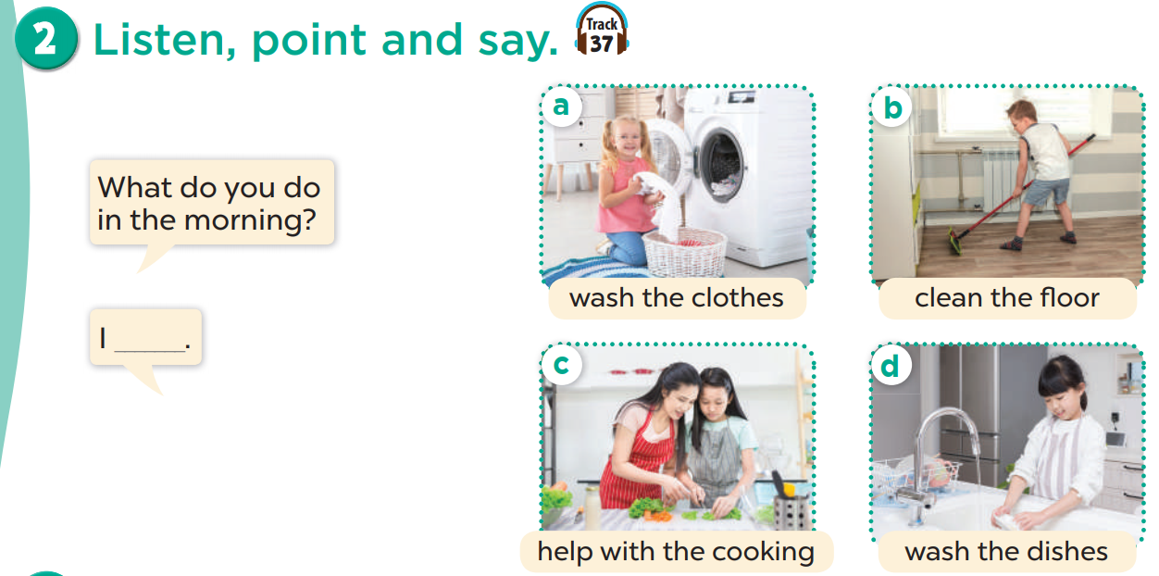

Slide 24
Listen, point and say.

Slide 25
Look and say.
Notes:
Teacher points randomly.
Students say the words

Slide 26
Work in pairs. Ask and answer.
What do you do in the morning?
wash the clothes
clean the floor
I _____________.
wash the dishes
help the cooking

Slide 27
05
Activity 3
Let’s talk

Slide 28
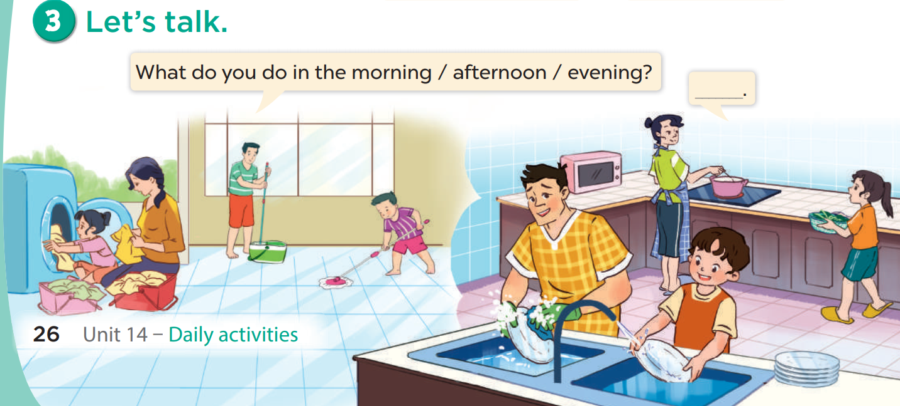

Slide 29
06
Fun Time
Slap the board game

