Slide 1
Tiếng Anh 2
Giáo viên: Tô Thị Hà
Lớp dạy: 2A1
Đơn vị công tác: Trường TH Hưng Đạo

Slide 3
Unit 5: In the classroom
Lesson 3 – Period 3

Slide 4
TABLE OF CONTENTS
Warm-up & Review
Activity 6: Listen and repeat.
Activity 7: Let’s talk.
Activity 8: Let’s sing.
Fun corner & Wrap-up

Slide 5
01
WARM-UP & REVIEW
Game
Lucky colours

Slide 6










He/ She’s ……………
+ 1 point
Notes:
Click colour to move to other slides
Click the hands/ points to remove them
Click the medal to congratulation

Slide 7

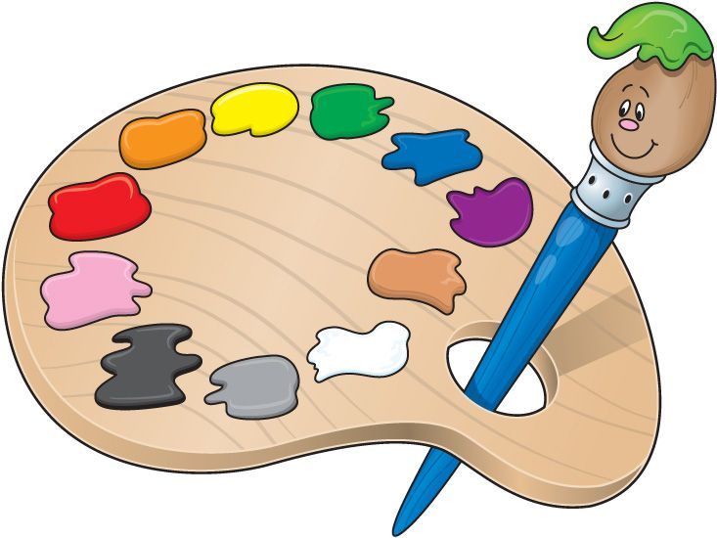
+ 1 point
He’s riding a bike.
Notes:
Click the palette to come back slide 4

Slide 8

+ 1 point
She’s flying a kite.
Notes:
Click the palette to come back slide 4

Slide 9

+ 2 point
She’s playing with a kitten.
Notes:
Click the palette to come back slide 4

Slide 10
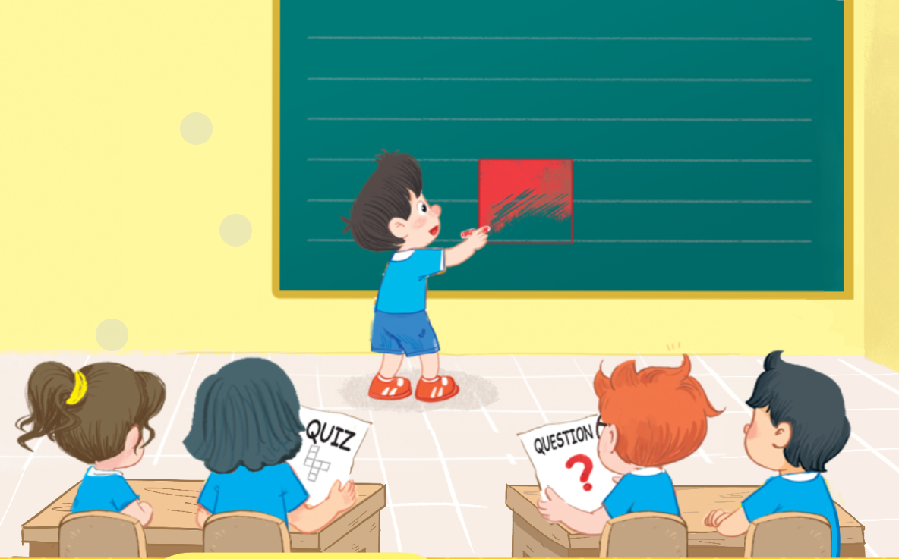
+ 2 point
He’s colouring a square.
Notes:
Click the palette to come back slide 4

Slide 11

+ 1 point
She’s doing a quiz.
Notes:
Click the palette to come back slide 4

Slide 12

+ 3 point
He’s answering a question.
Notes:
Click the palette to come back slide 4

Slide 13
CONGRATULATION!

Slide 14
02
Activity 6
Listen and repeat.

Slide 15

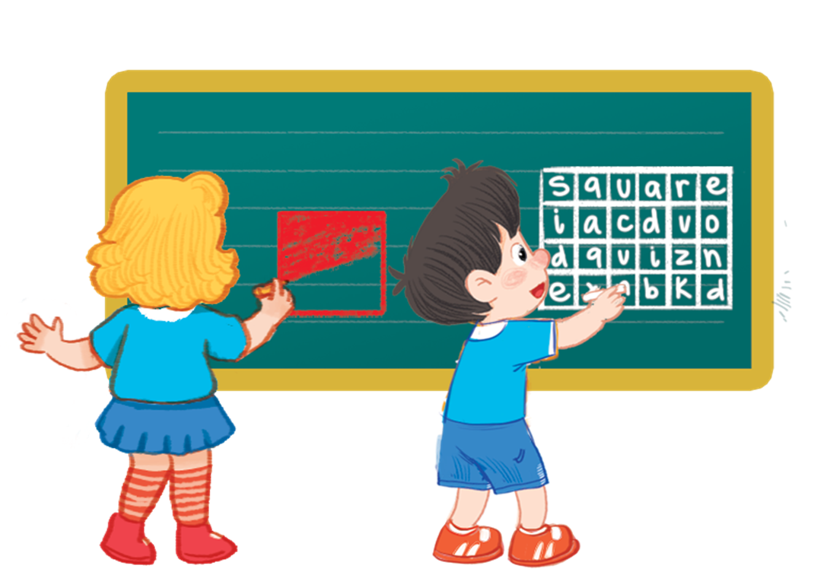
6. Listen and repeat.

Slide 16




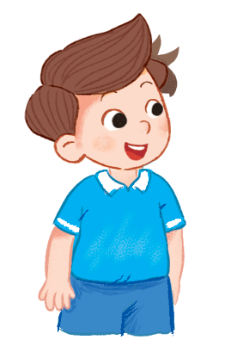



6. Listen and repeat.
What’s she doing?
What’s she doing?
What’s she doing?
What’s she doing?
She’s colouring a square.
She’s colouring a square.
She’s colouring a square.
She’s colouring a square.
What’s he doing?
What’s he doing?
What’s he doing?
What’s he doing?
He’s doing a quiz.
He’s doing a quiz.
He’s doing a quiz.
He’s doing a quiz.

Slide 17
03
Activity 7
Let’s talk.

Slide 18




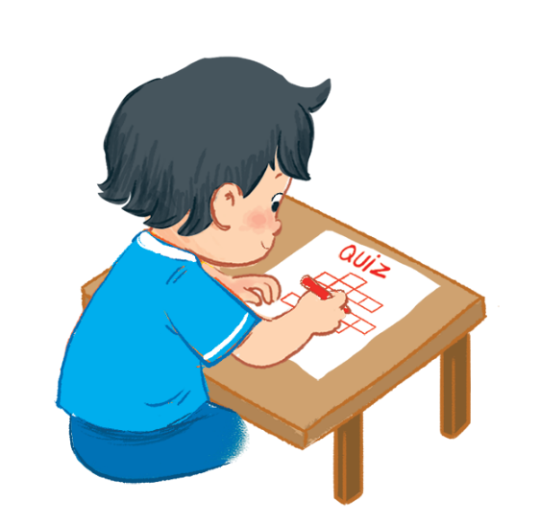
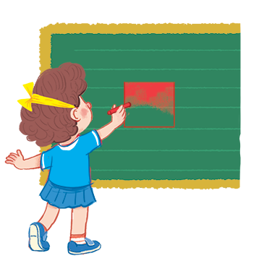
Let’s talk.
What ?
.
a
b
c

Slide 19

Let’s talk.
.
What ____?
a

Slide 20

Let’s talk.
.
What ____?
b

Slide 21

Let’s talk.
.
What ____?
c

Slide 22
04
Activity 8
Let’s sing!

Slide 23

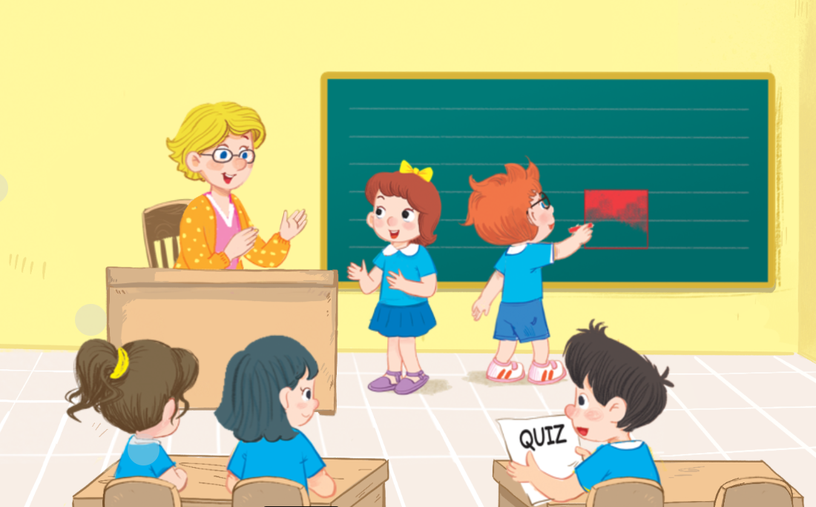
8. Let’s sing.

Slide 24
8. Let’s sing.
What’s he doing?
What’s he doing?
What’s he doing?
What’s he doing?
He’s doing a quiz.
He’s doing a quiz.
He’s doing a quiz.
He’s doing a quiz.
What’s he doing?
What’s he doing?
What’s he doing?
What’s he doing?
He’s colouring a square.
He’s colouring a square.
He’s colouring a square.
He’s colouring a square.
What’s she doing?
What’s she doing?
What’s she doing?
What’s she doing?
She’s answering a question.
She’s answering a question.
She’s answering a question.
She’s answering a question.

Slide 25

GROUP WORK

Slide 26
05
Fun corner & Wrap-up

Slide 27

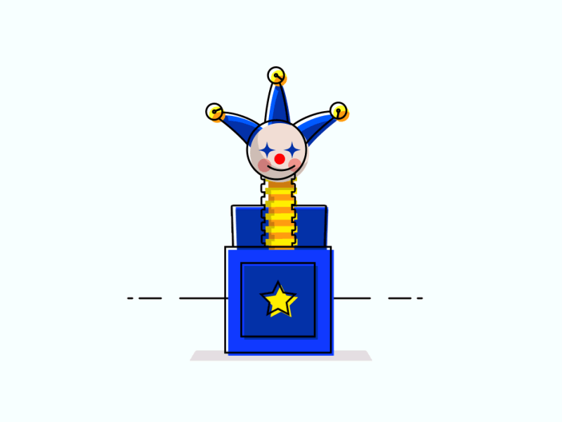




Game: Lucky box
1
2
3
4
5
Notes:
Click the numbers to open the box and see the pictures
Click the pictures to clear them

Slide 28
GOODBYE!

Slide 29
Website: hoclieu.vn
Fanpage: https://www.facebook.com/tienganhglobalsuccess.vn/

