Slide 1
Tiếng Anh 3
Giáo viên: Lê Thị Minh Hiếu
Lớp dạy: 3A2, 3A3, 3A4, 3A5, 3A6
Đơn vị công tác: Trường TH Hưng Đạo

Slide 2




Slide 3



6
Our school
LESSON 1 PERIOD 1

Slide 4
Contents
Warm-up
Activity 1
01
02
Activity 2
Activity 3
03
04
Sing a song
Look, listen and repeat.
Listen, point and say.
Let’s talk.
Fun corner
05
Game

Slide 5
Warm-up

Slide 6


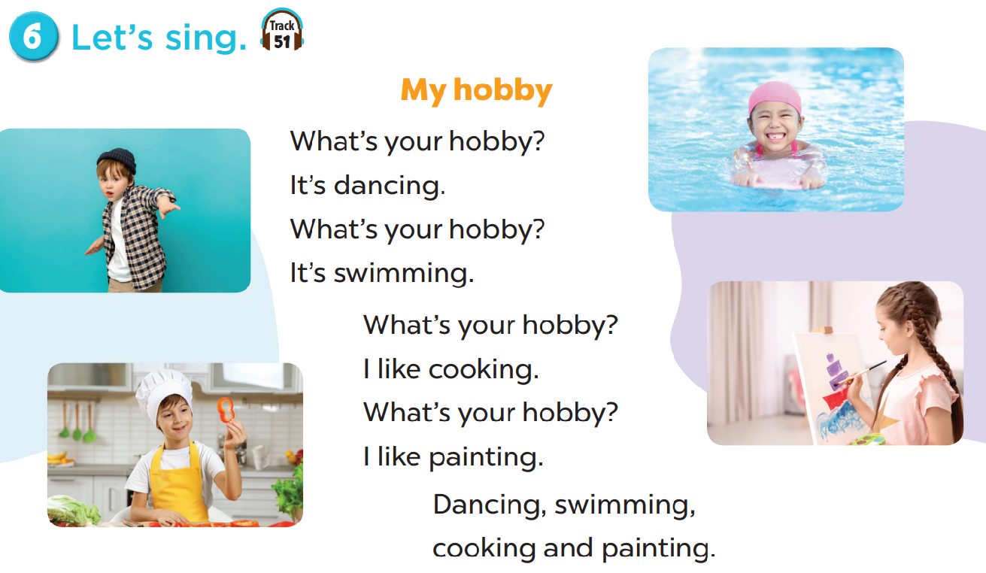

Slide 7

Look, listen and repeat.

Slide 8
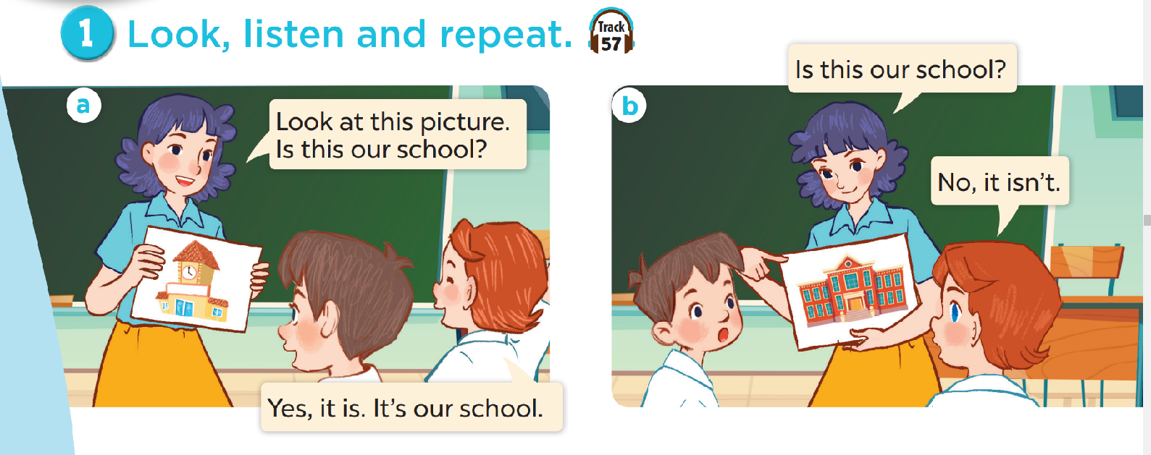
Look and answer the questions.
Where are they?
Who are they?
What are they doing?

Slide 9
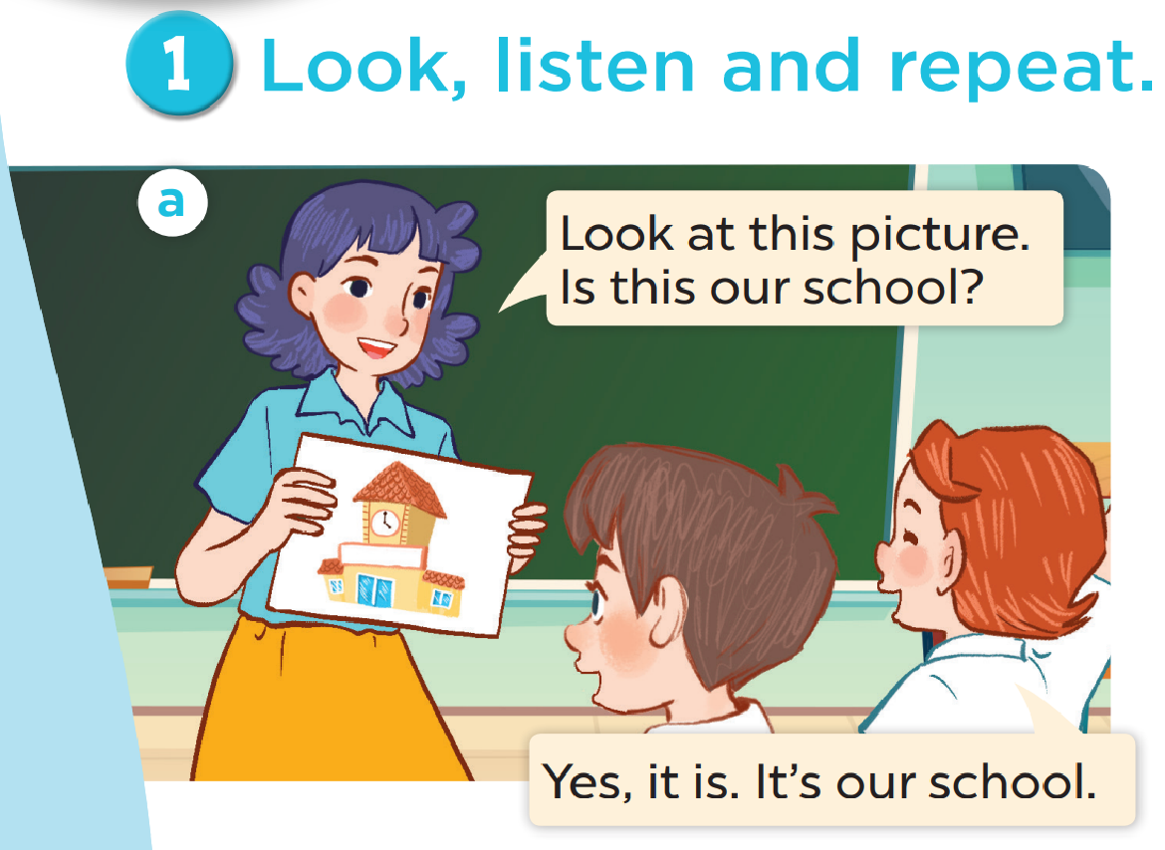

Slide 10
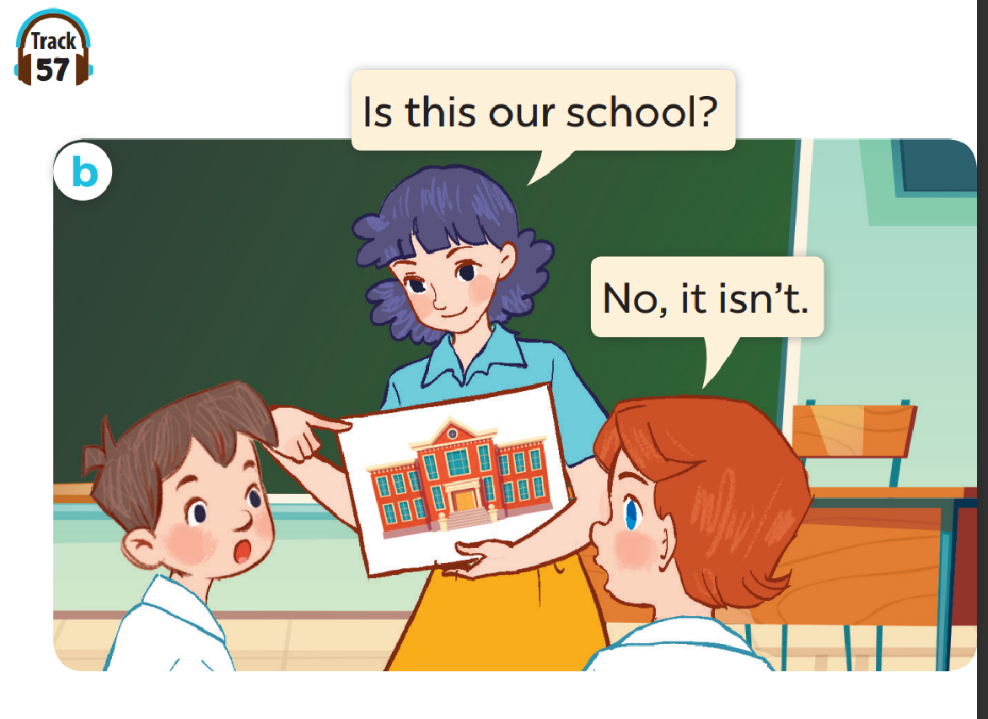

Slide 11
Work in pairs. Practise.
Listen and repeat.

Slide 12

Listen, point and say.

Slide 13
New words

Slide 14
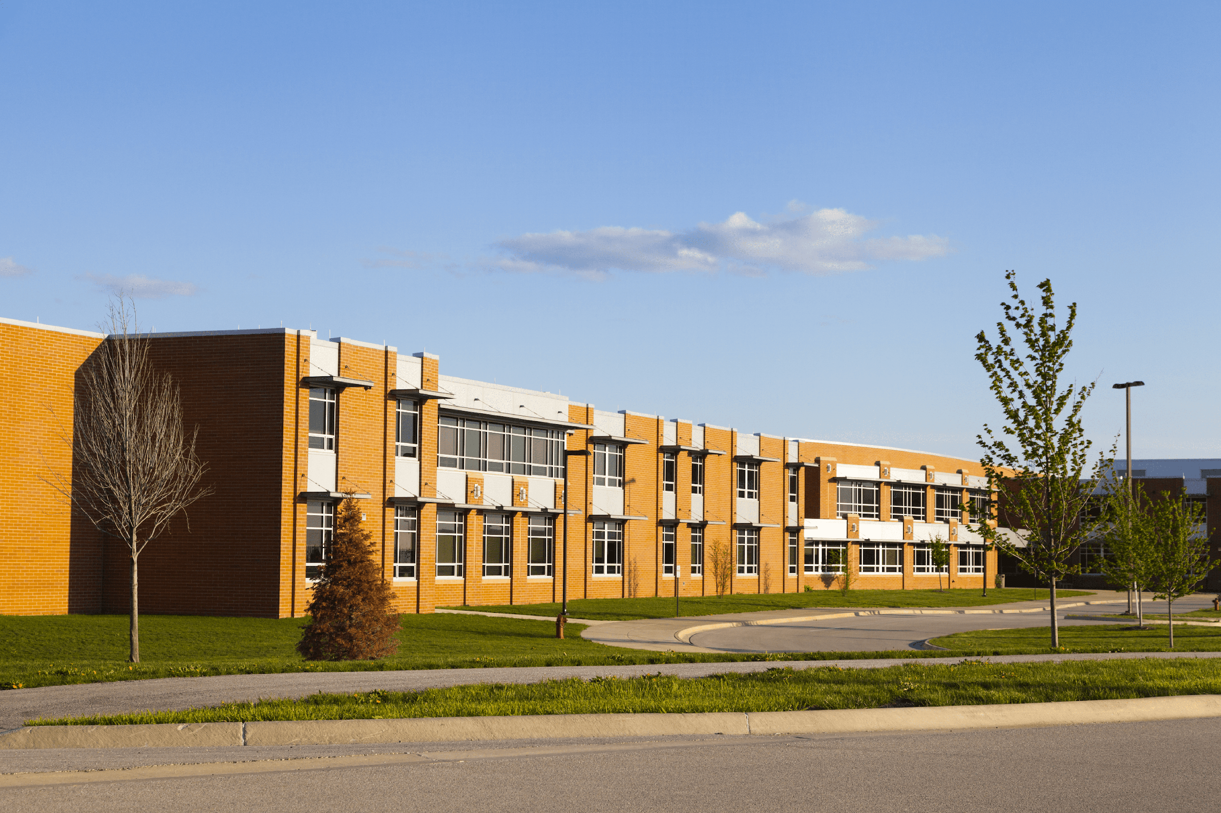
school

Slide 15
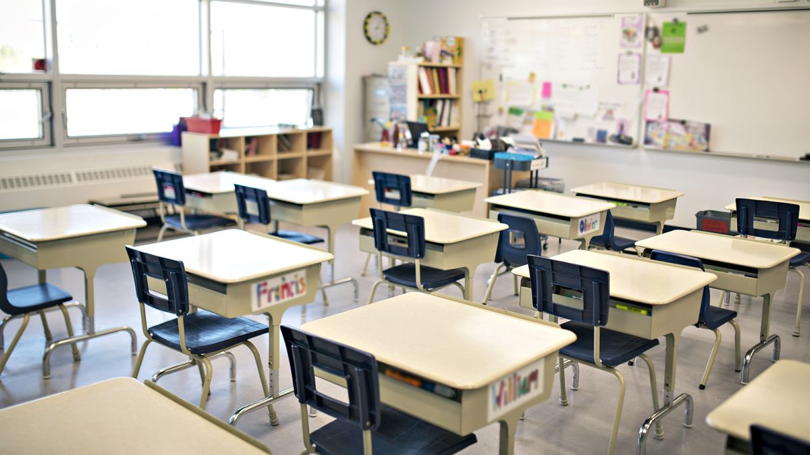
classroom

Slide 16
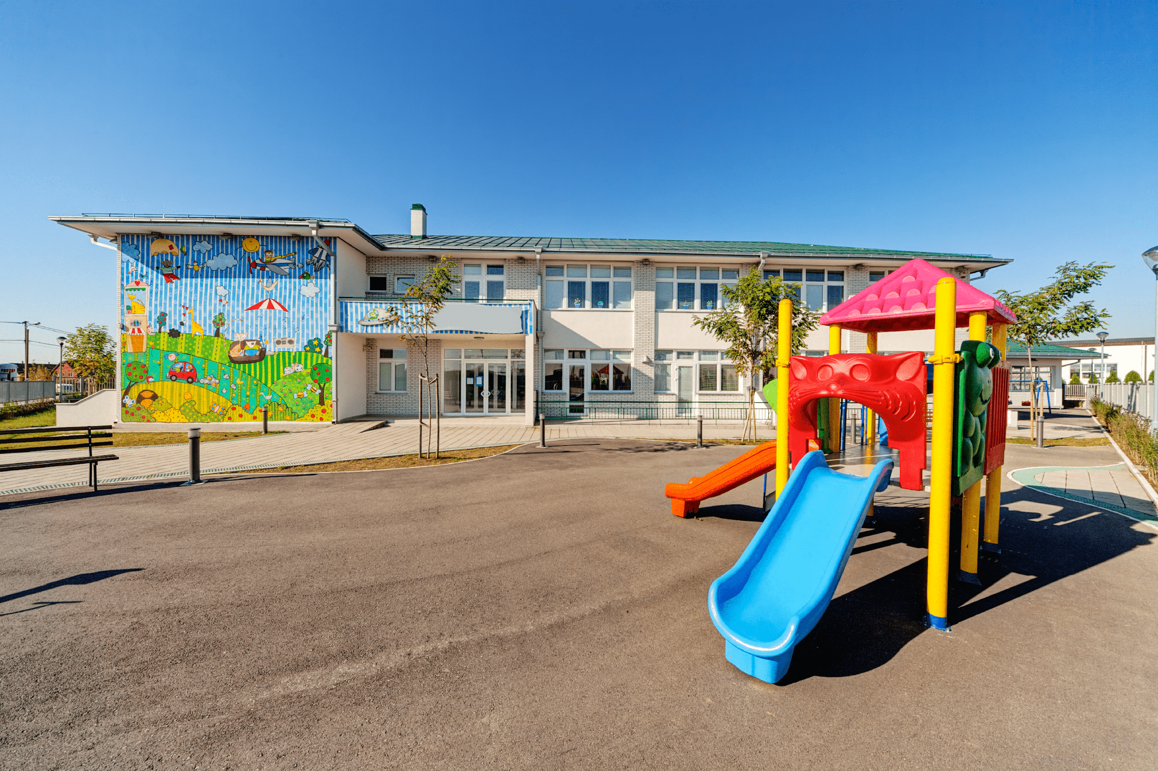
playground

Slide 17
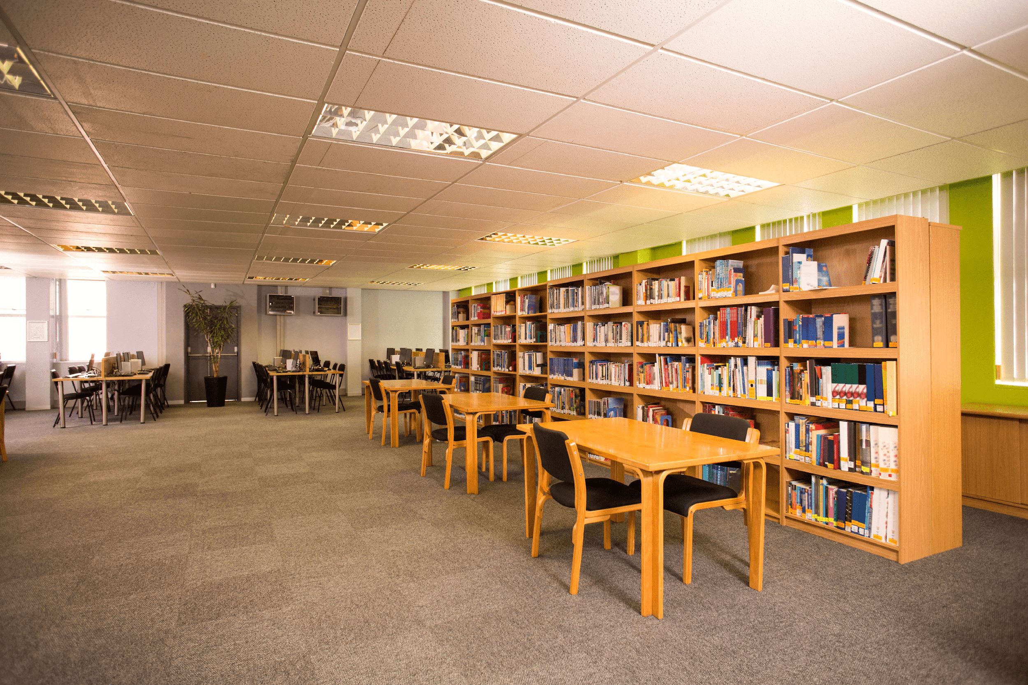
library

Slide 18
Look and guess.

Slide 19
playground

Slide 20
classroom

Slide 21
library

Slide 22
school

Slide 23


Is this our classroom?
No, it isn’t.
Yes, it is.

Slide 24
Is this our library?
Yes, it is.
No, it isn’t.

Slide 25
Is this our playground?
Yes, it is.
No, it isn’t.

Slide 26
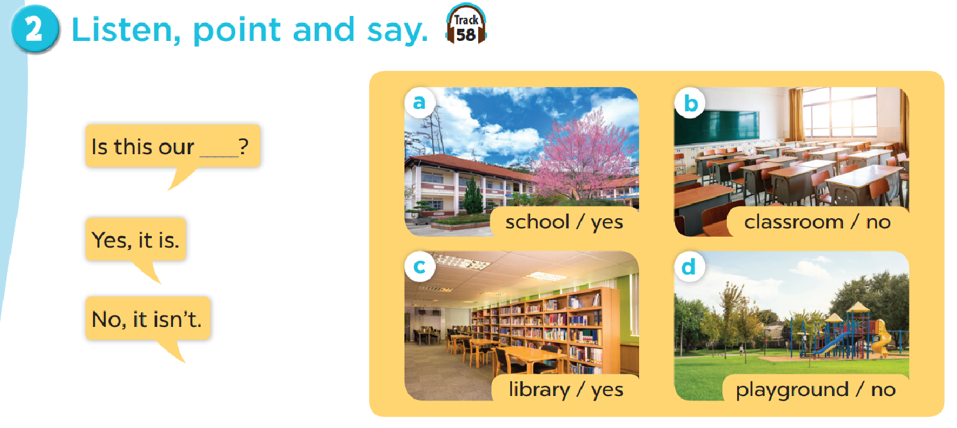
Work in pairs. Practise.

Slide 27

Let’s talk.

Slide 28
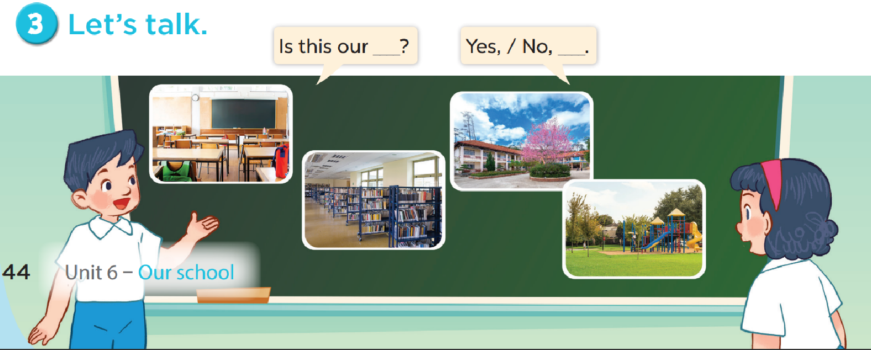

Slide 29

Fun corner

Slide 30
Let’s play a game!
3 points
10 points
No
Yes
classroom
library
4
bomb
playground
No
school
3
2
1
Yes
5
10 points
8
school
library
7
school
- 3 points
6
Yes
Yes
playground
1 point
No
Yes
4 points
Notes:
Gv chia 2 đội.
Hs chọn số, 1 bạn đặt câu hỏi, 1 bạn trả lời với từ cho sẵn và nhận điểm

Slide 31

Website: hoclieu.vn
Fanpage: facebook.com/www.tienganhglobalsuccess.vn

