Slide 1



Giáo viên: Đồng Thị Như Quỳnh
Lớp dạy: 5A5, 5A6, 5A7
Đơn vị công tác: TRƯỜNG TIỂU HỌC HƯNG ĐẠO

Slide 2


Slide 3

Our school rooms
Lesson 1 - Part 1,2,3

Slide 4

01
Warm-up & Review

Slide 5
Game
Wordwall.net

Slide 6

02
Look, listen and repeat.

Slide 7
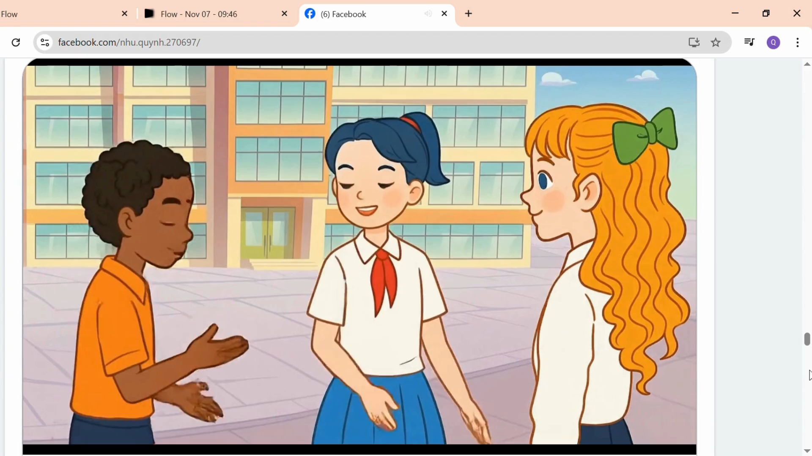

Slide 8

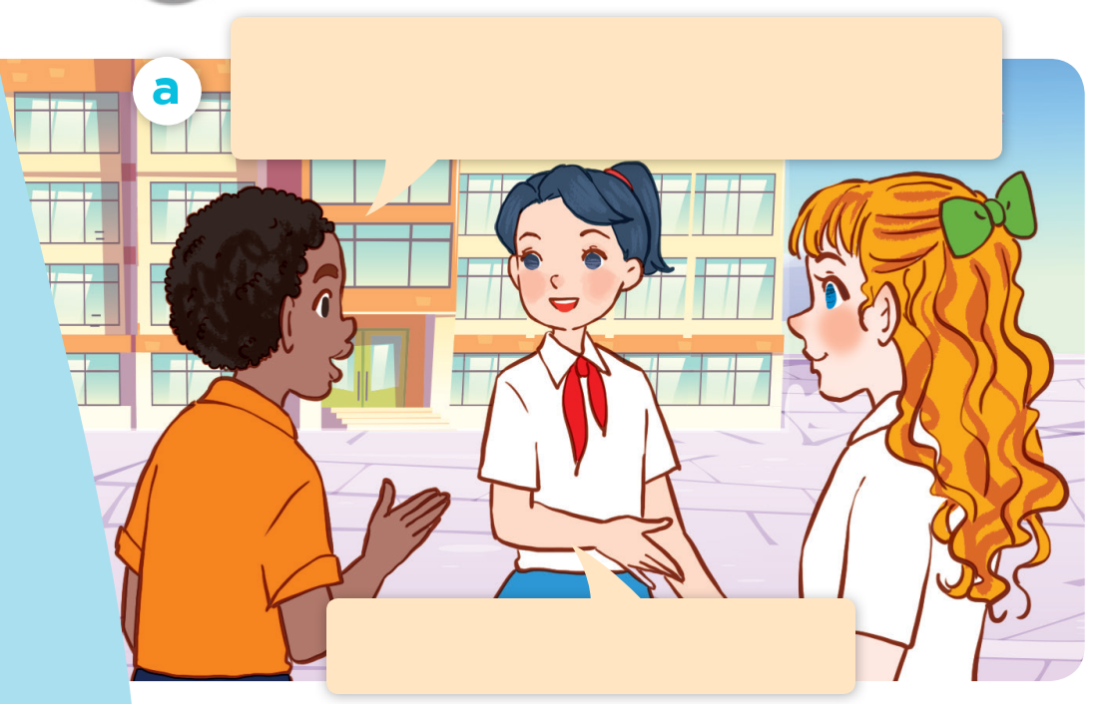
What are they doing?
Where are they?
Who are they?
Listen and repeat.
Good morning. Could you show us around your school?
Yes, of course. Let’s go!

Slide 9
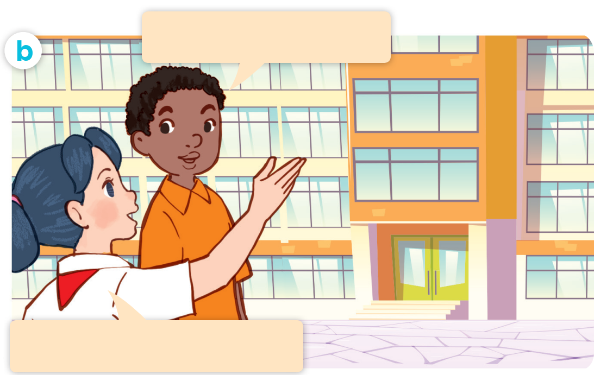
Listen and repeat.
Act it out.
Where’s the library?
It’s on the second floor.

Slide 10


Where’s the library?
It’s on the second floor.

Slide 11
03
Listen, point and say.

Slide 12
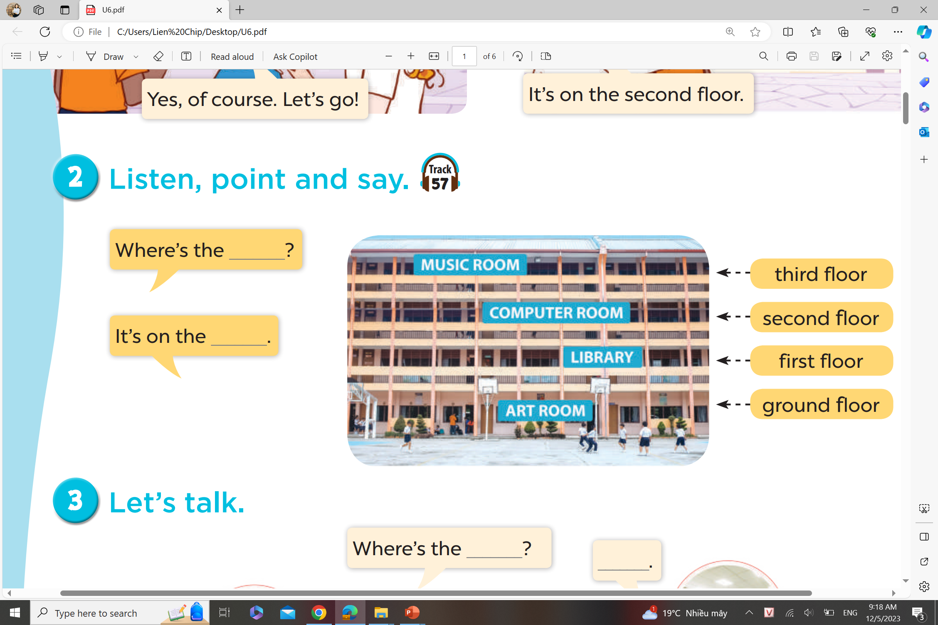
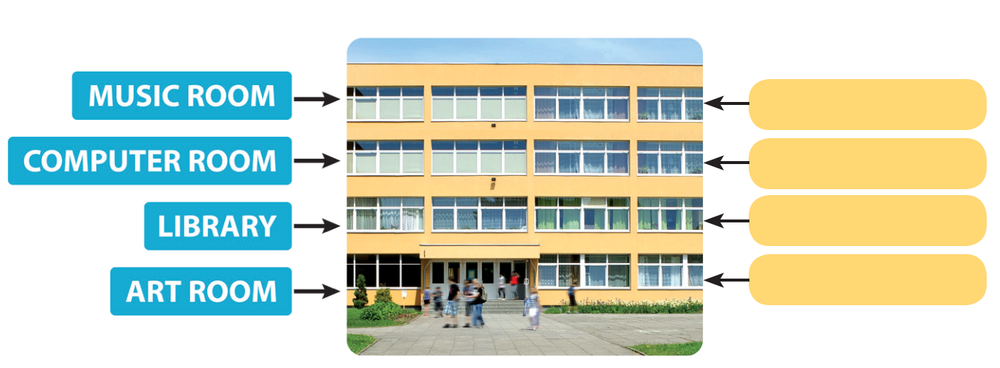
Listen, point and say.
Where’s the ____?
It’s on the ___.
third floor
second floor
first floor
ground floor

Slide 13
Game
Who’s faster?
Matching

Slide 14
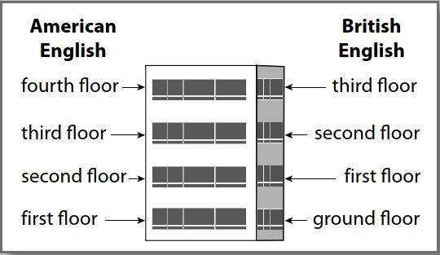
NOTE!

Slide 15
04
Let’s talk.

Slide 16
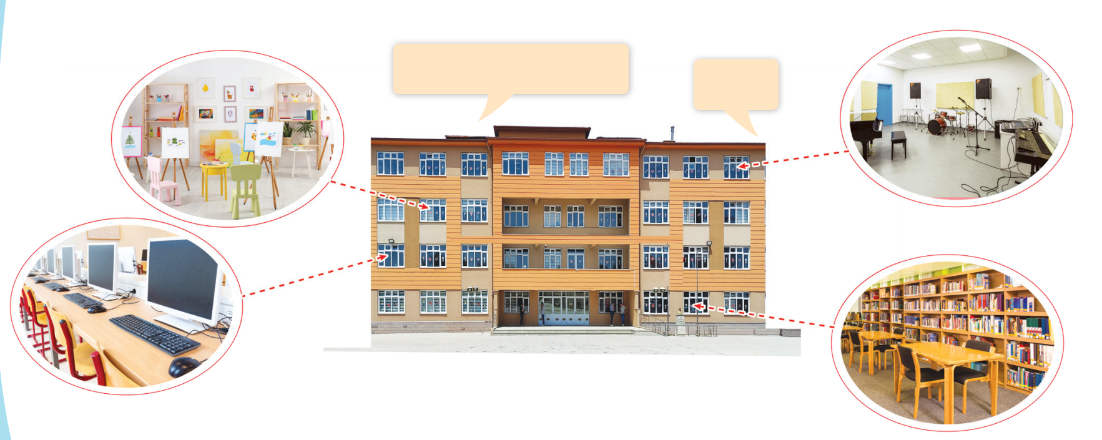
Let’s talk.
Where’s the _____?
_____.

Slide 17
Let’s talk.
Where’s the _____?
_____.

Slide 18
Game
Lucky boxes

Slide 19


Slide 20
TEAM’S TASKS
Team 1: Making a mindmap to introduce the locations of our school rooms. (Using Chat gpt, Canva)
Team 2: Making a video to introduce the locations of our school rooms. (Using Chat gpt, Gemini, Flow, Canva)
Team 3: Composing a song to introduce the locations of our school rooms. (Using Chat gpt, Suno, Dreamina, Flow, Canva)

Slide 21
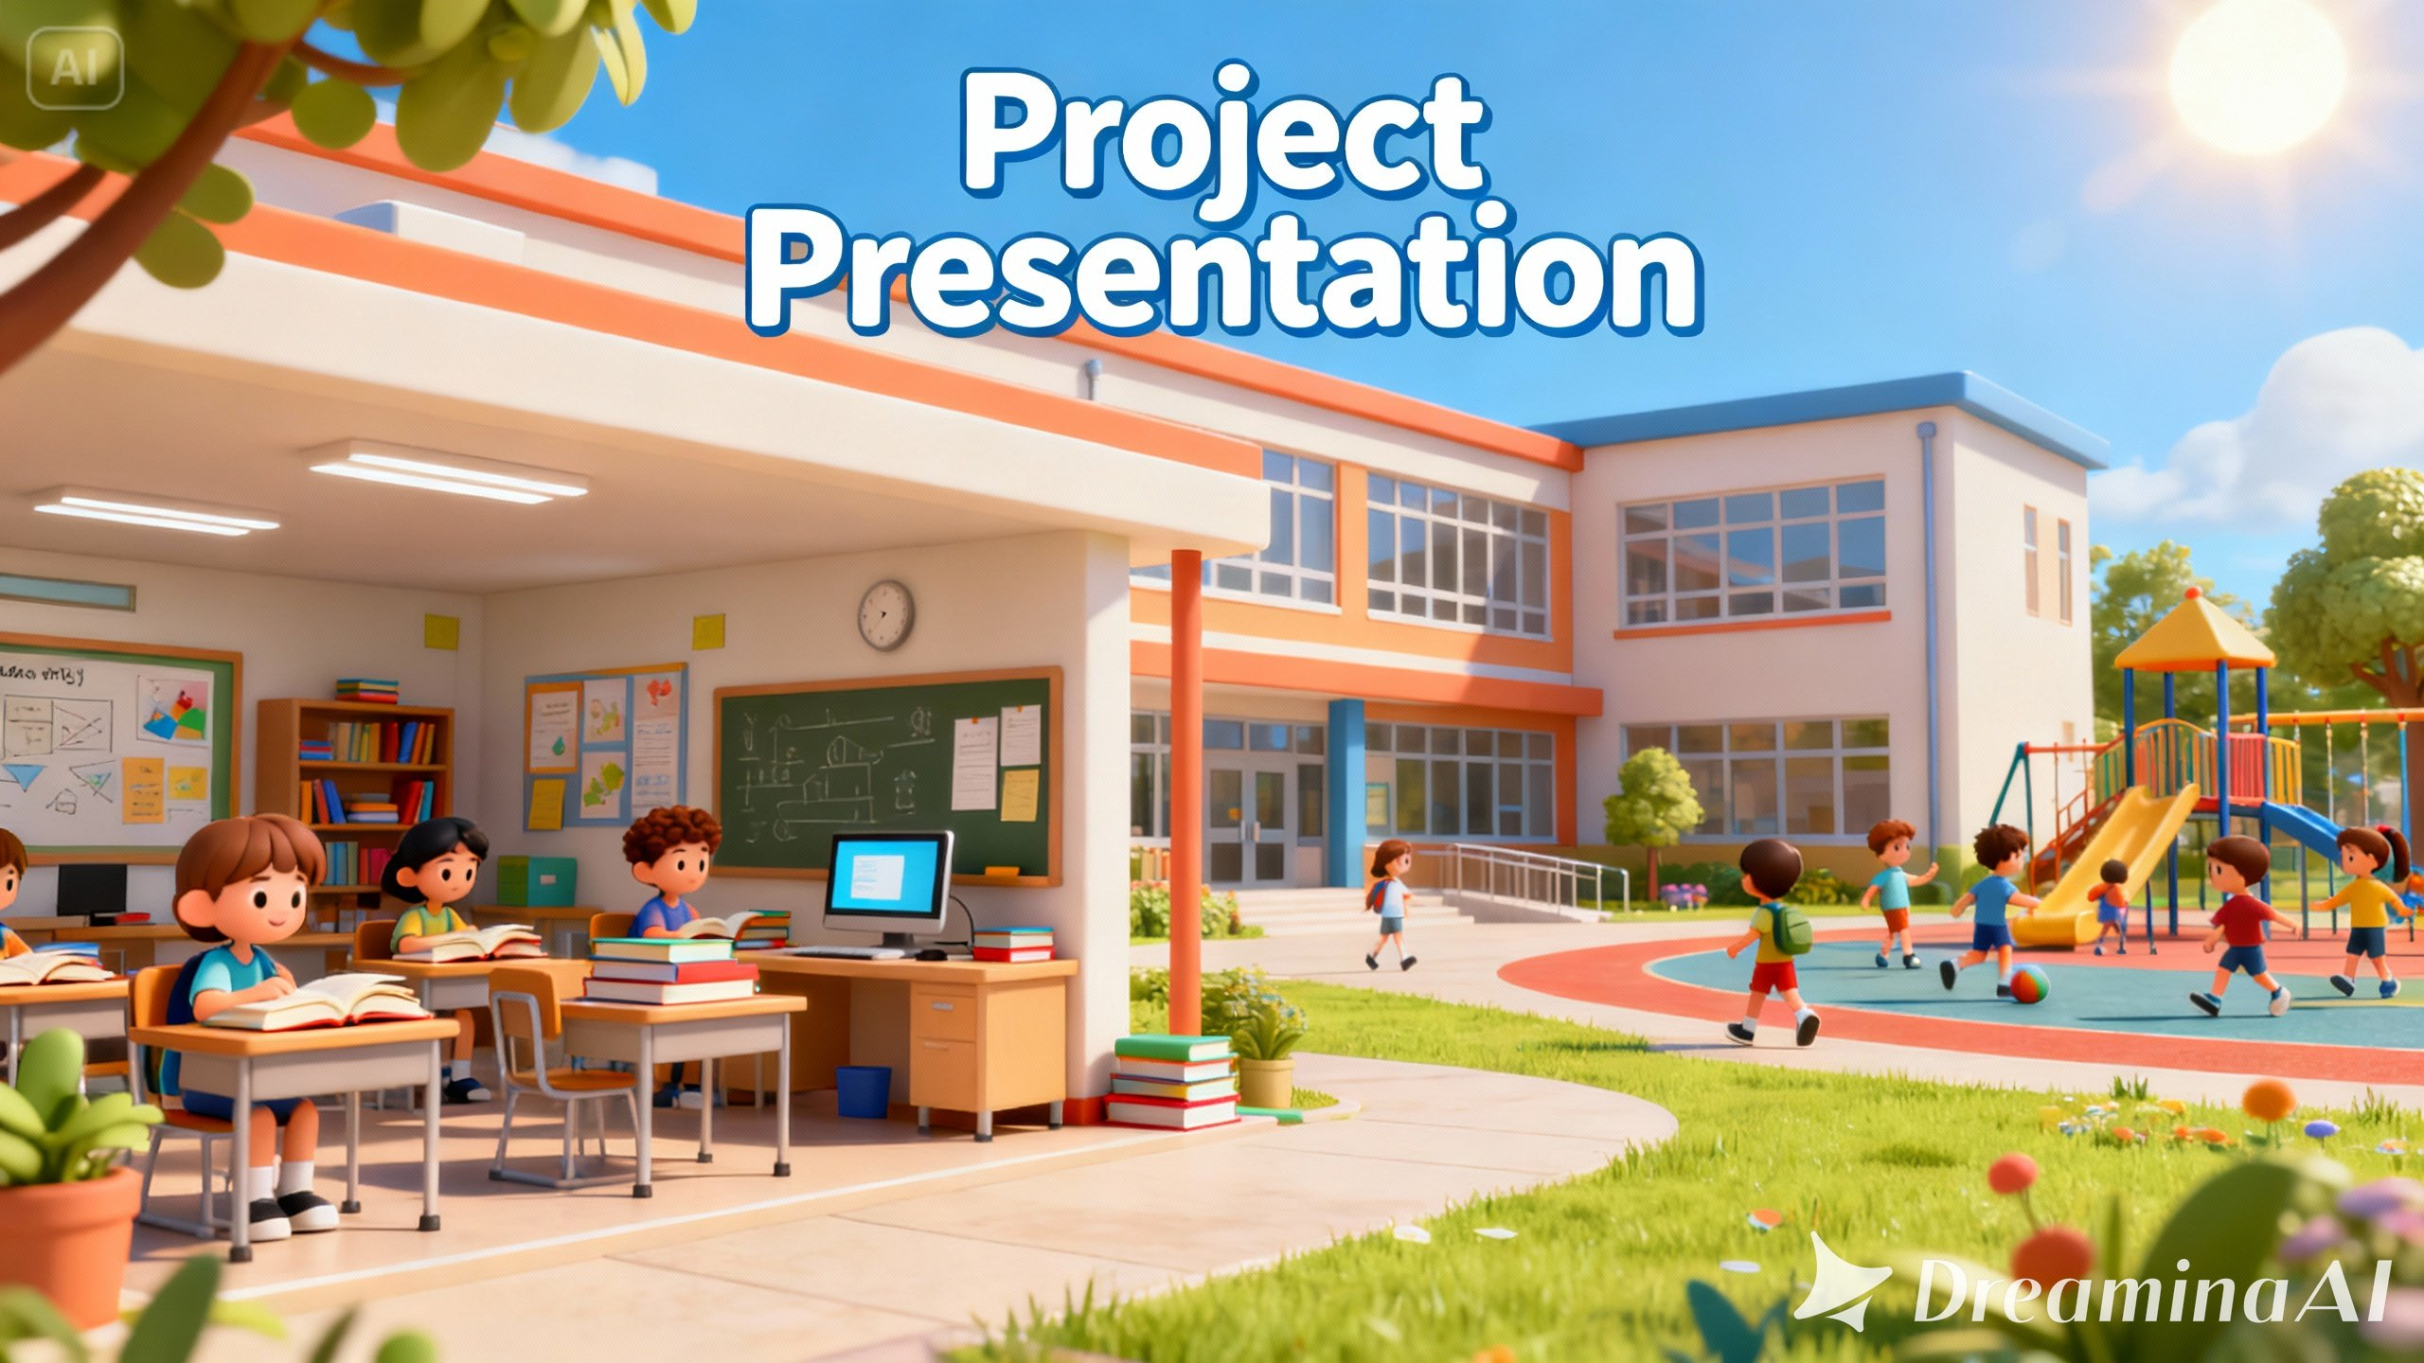

Slide 22
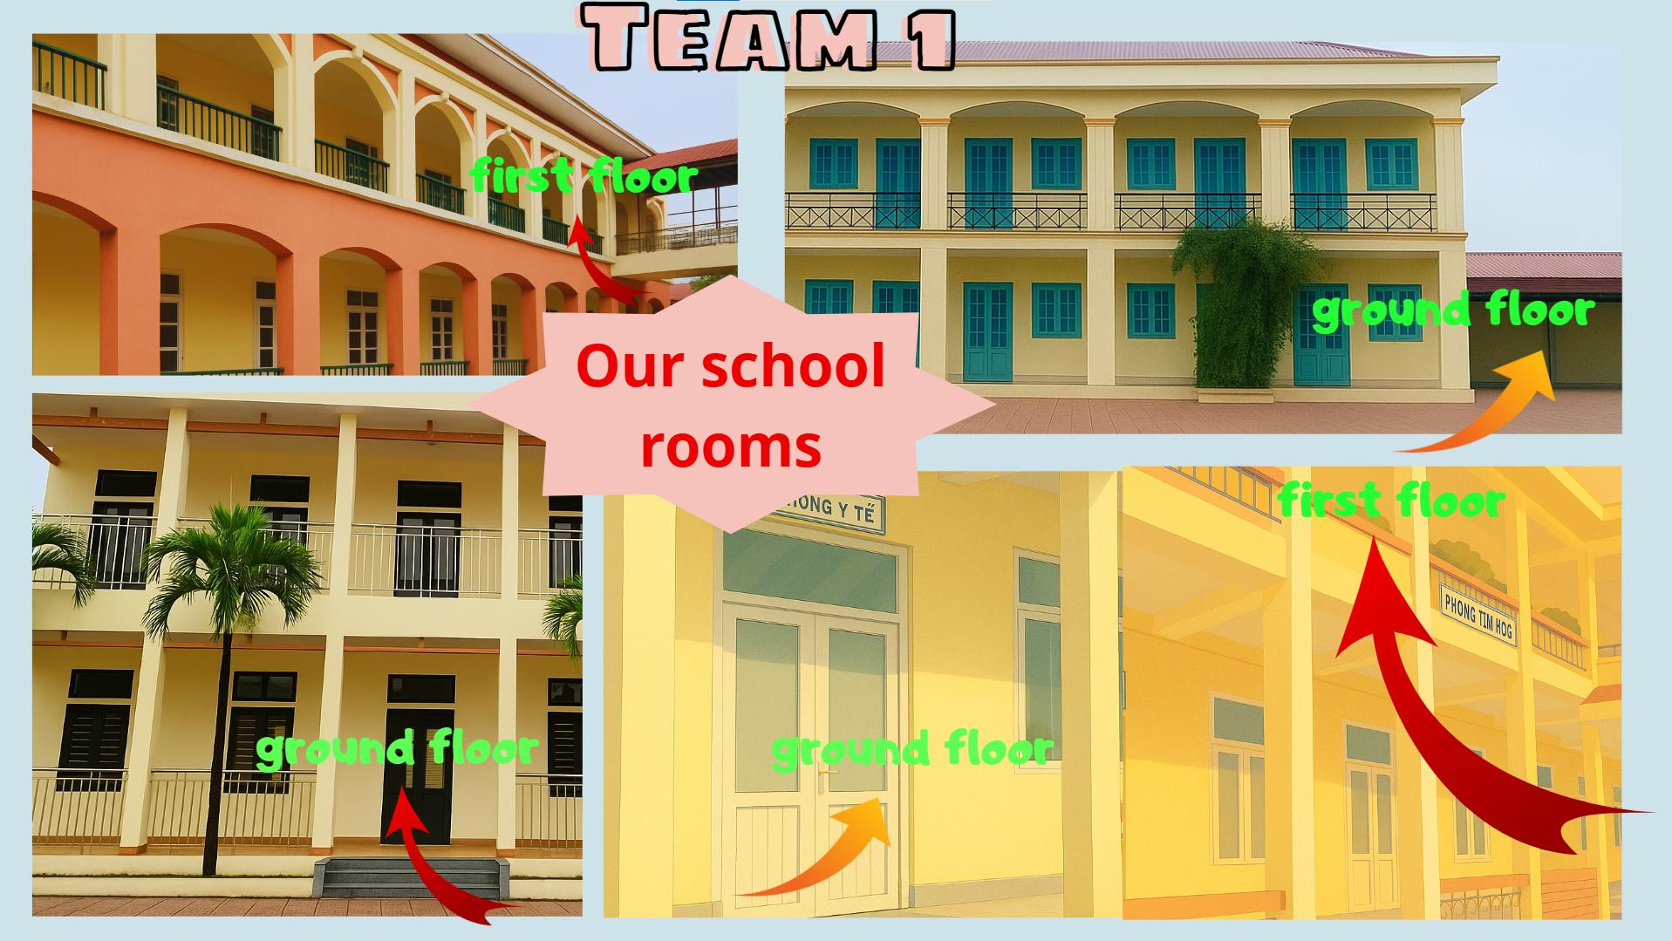

Slide 23




Wrap up

Slide 24
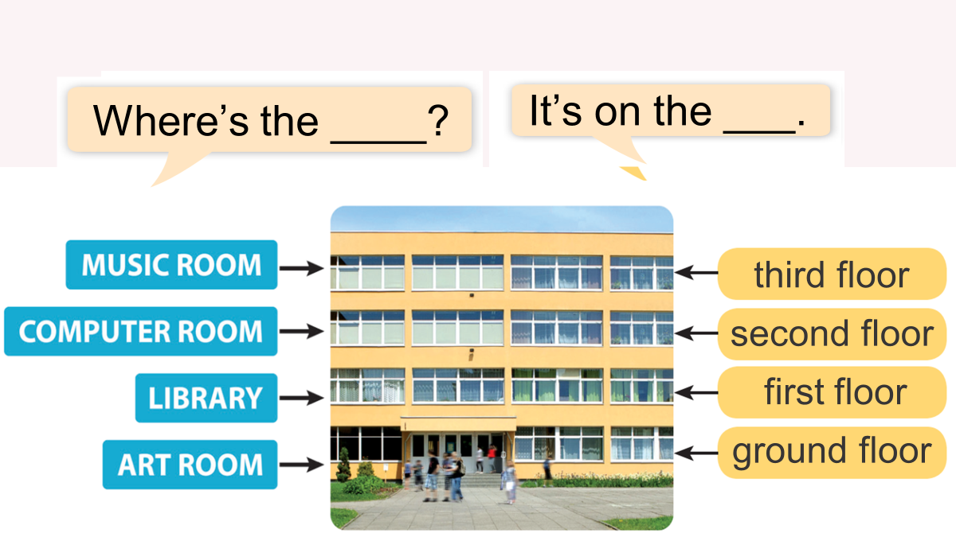

Slide 25
Website: hoclieu.vn
Fanpage: https://www.facebook.com/tienganhglobalsuccess.vn/

