Slide 1
Tiếng Anh 1
Giáo viên: Hoàng Thị Hồng
Lớp dạy: 1A4, 1A5, 1A6
Đơn vị công tác: Trường TH Hưng Đạo

Slide 3

Unit 6 – Lesson 2
In the classroom
Notes:
Goals: By the end of the lesson, pupils will be able to:
say the sound of the letter E/e and the words pen, pencil, red in a chant.
listen, recognize the words and tick the correct boxes.
trace the letter E/e (upper case and lower case). The letter E/e (upper case and lower case).

Slide 4

Warm-up
Notes:
Goals:
- Help pupils feel happy at the beginning of the lesson.
- Review vocabulary of previous lesson (Lesson 1)
Time limit: 5 mins
Game: What’s this?
- Teacher shows on slide a picture disappearing quickly in a few seconds.
- Pupils look and guess the word.
Note: Teacher can duplicate more slides for pupils to play.

Slide 5
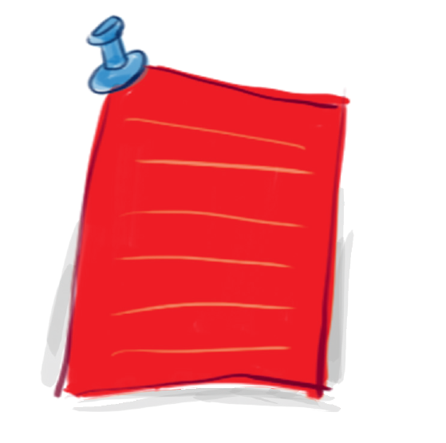

Slide 6
red

Slide 7
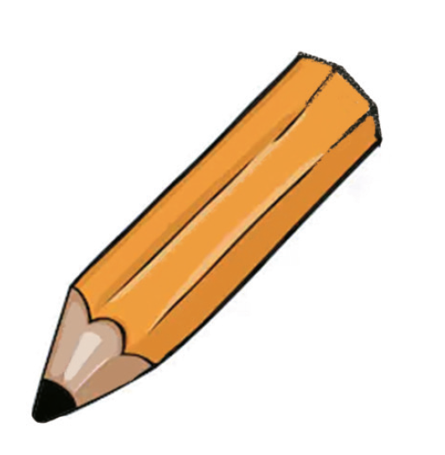

Slide 8
pencil

Slide 9
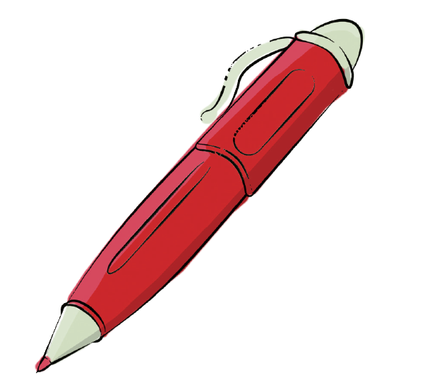

Slide 10
pen

Slide 11
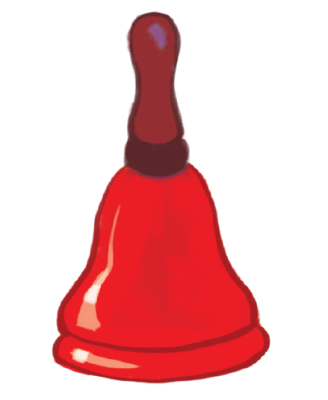

Slide 12
bell

Slide 13


Listen and chant
Notes:
Goal:
- Pupils will be able to say the sound of the letter E/e and the words pen, pencil, red in a chant.

Slide 14

E, e, red.
E, e, pen.
E, e, a red pen.
E, e, red.
E, e, pencil.
E, e, a red pencil.
Notes:
Step 1: Read. Listen and repeat the chant.
Time limit: 4 mins
- Teacher shows the chant on slide. Whole class read together.
- Teacher plays the audio. Pupils listen through, then listen and repeat.
- Pupils then chant and clap along.
- Pupils chant in teams.
Step 2: Pupils chant and do actions.
Time limit: 4 mins
- Teacher shows Pupils how to do actions to describe the vocabulary.
- Pupils do the actions as teams. Then Pupils chant and do the actions along.
Example:
e (clap), e (clap), red
e (clap), e (clap), pen (show the pen)
E (clap), e (clap), a red pen (show the pen).
Step 3: Quick check
Time limit: 4 mins
Pupils chant as teams and individually.

Slide 15

Listen and tick
Notes:
Goal:
- Pupils will be able to listen, recognize the words and tick the correct boxes.
Step 1: Listen and tick the correct picture.
Time limit: 5 mins
- Teacher says Listen and tick and writes words on the board.
- Teacher says and does actions: Listen (put hands on one ear) and tick (write a tick in the air). Pupils follow.
- Teacher plays audio. Pupils do the tasks.
When pupils finish, teacher plays the audio again, pause at each question and checks answer.
Step 2: Quick check
Time limit: 3 mins
- Teacher says a word, pupils go to the board and touch the correct picture.

Slide 16
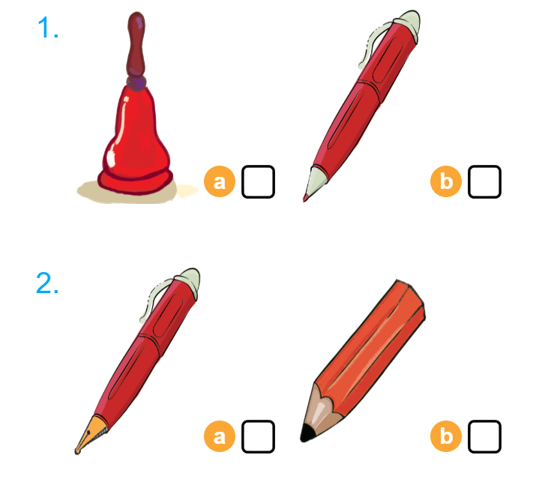

Listen and tick

Slide 17


Look and trace
Notes:
Goal:
- Pupils will be able to trace the letter E/e (upper case and lower case).
Step 1: Pupils write letter in the air
Time limit: 3 mins
- Teacher and pupils write letter “i” in the air. (Teacher can make it fast or slowly)
Step 2: Look and trace
Time limit: 4 mins
- Teacher writes letter on the board.
- Pupils look and trace in their books.

Slide 18
GAME
Notes:
Goals:
- Pupils are able to write letter “e”.
- Pupils are able to identify words that have the sound /e/.
Time limit: 6 mins
- Teacher says a word. If it has the sound /e/, pupils write letter “e” on the board. If not, pupils don’t write.
- Teacher may have some pupils says the word.

Slide 19
Goodbye
Notes:
- Teacher shows the vocabulary of the lesson on slide.
- Pupils say goodbye.

Slide 20
Goodbye

Slide 21
Goodbye

Slide 22

Goodbye

Slide 23
Website: hoclieu.vn
Fanpage: facebook.com/www.tienganhglobalsuccess.vn

