Slide 1
Tiếng Anh 3
Giáo viên: Tô Thị Hà
Lớp dạy: 3A1
Đơn vị công tác: Trường TH Hưng Đạo

Slide 2




Slide 3



6
Our school
LESSON 3 - PERIOD 6

Slide 4
Contents
Warm-up and review
Activity 2
01
02
Activity 3
Activity 6
03
04
Chant
Read and complete.
Let’s write.
Project
Fun corner
05
Game

Slide 5

WARM-UP AND REVIEW

Slide 6

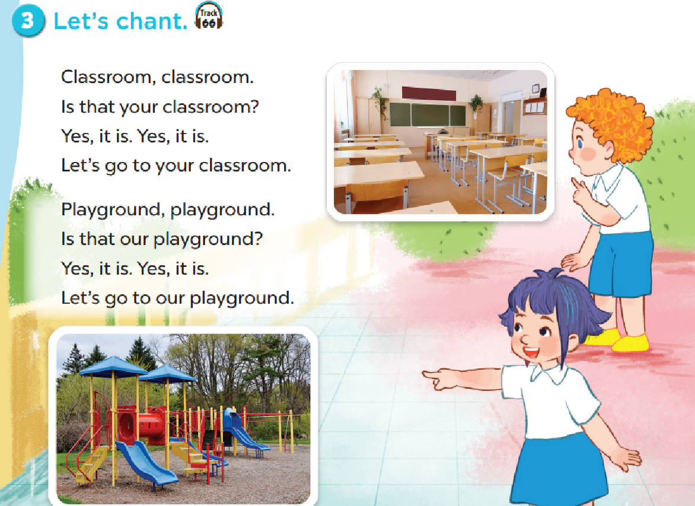

Slide 7

READ AND COMPLETE.

Slide 8
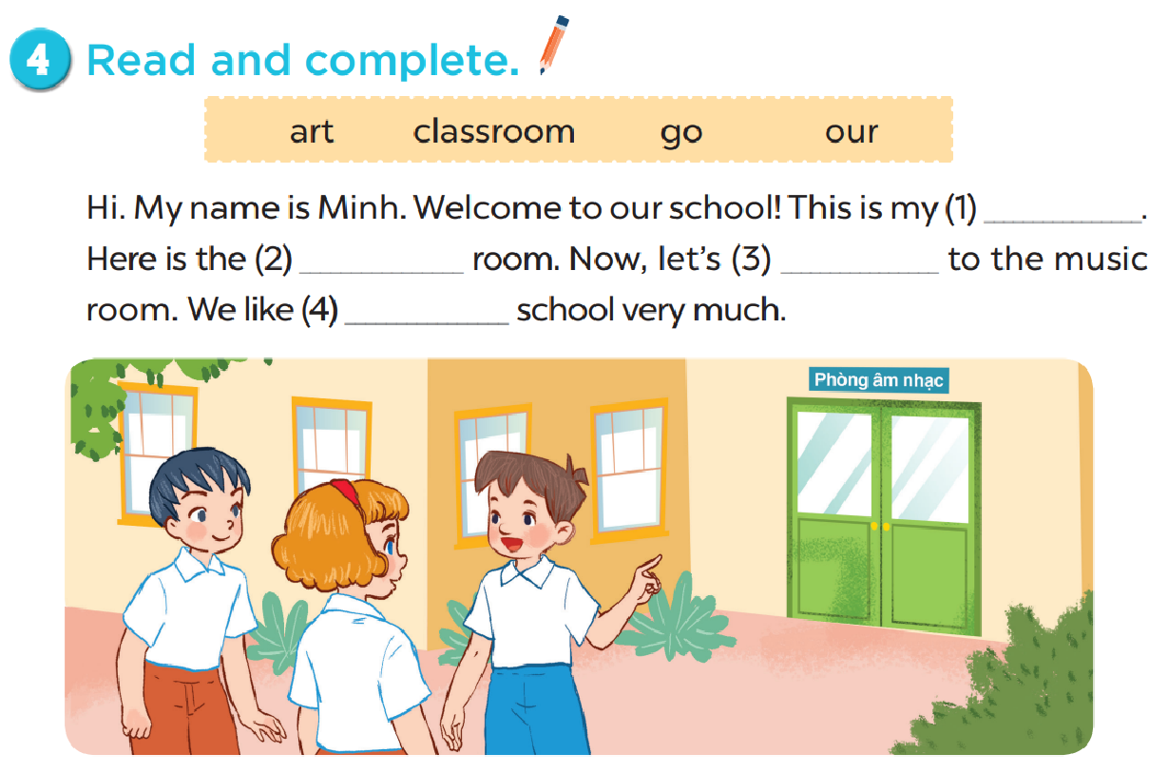
classroom
art
go
our

Slide 9

LET’S WRITE.

Slide 10
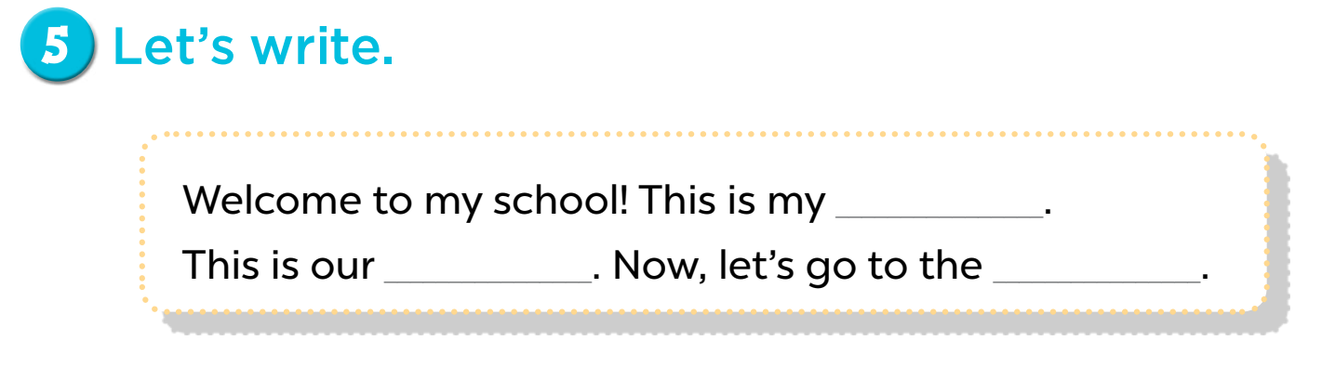

Slide 11

PROJECT

Slide 12
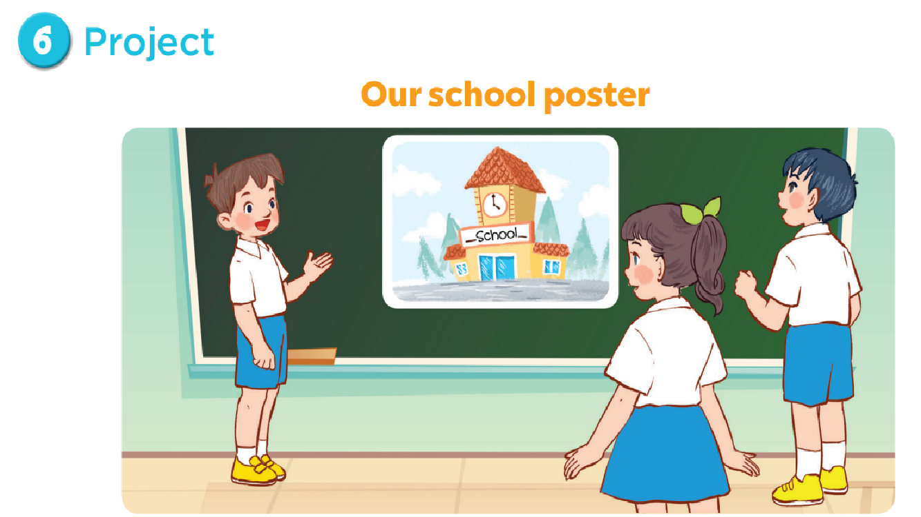

Slide 13

FUN CORNER

Slide 14
0
0
0
O
O
O
X
X
X
1
2
3
X
X
X
0
0
0
O
O
O
X
X
X
4
5
6
X
X
X
0
0
0
O
O
O
X
X
X
7
8
9
X
X
X

Slide 15

Website: hoclieu.vn
Fanpage: facebook.com/www.tienganhglobalsuccess.vn

