Slide 1
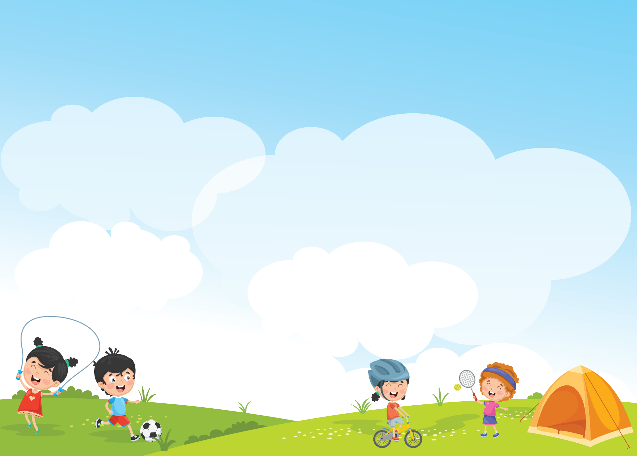


Giáo viên: Đồng Thị Như Quỳnh
Lớp dạy: 5A5, 5A6, 5A7
Đơn vị công tác: TRƯỜNG TIỂU HỌC HƯNG ĐẠO

Slide 2


Our favourite school activities
Lesson 2 (4,5,6)

Slide 3


01
Warm-up and Review

Slide 4

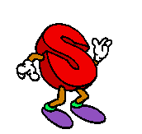
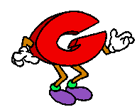
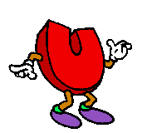
Guessing game
“
Can you
”

Slide 5



read books

Slide 6
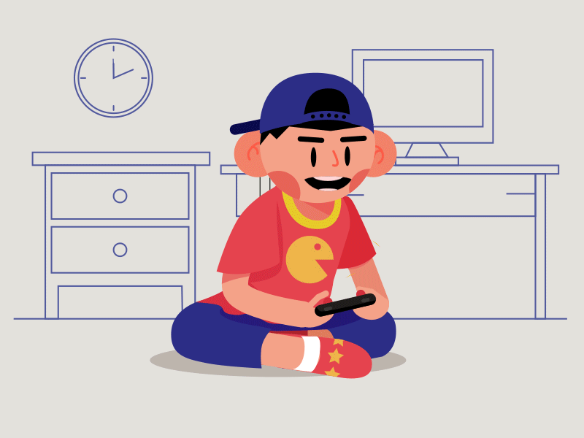
play games

Slide 7
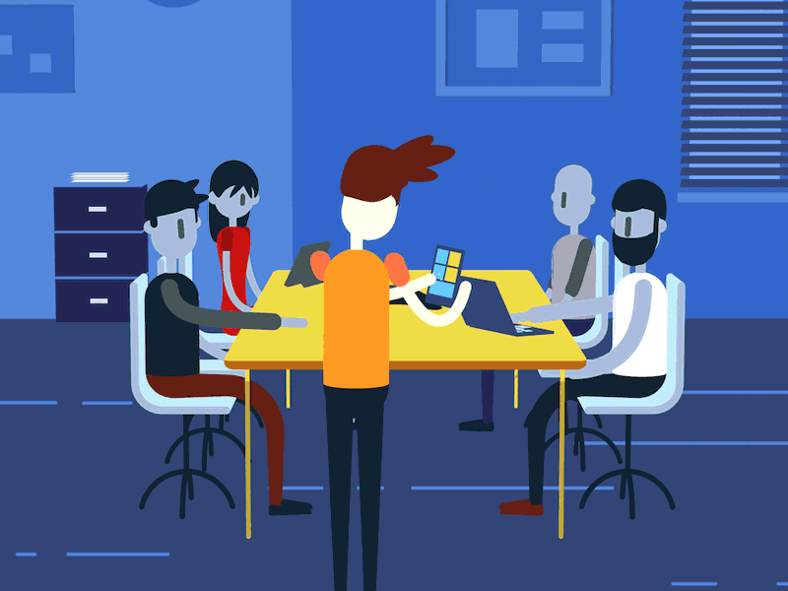
do projects

Slide 8
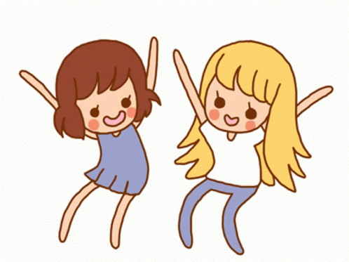
dance

Slide 9
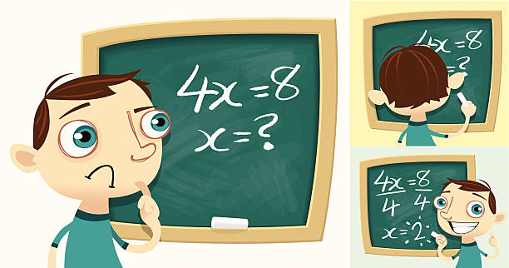
solve maths problems

Slide 10
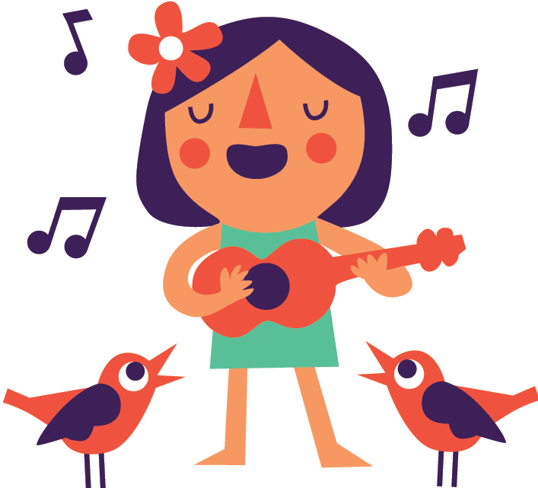
sing

Slide 11
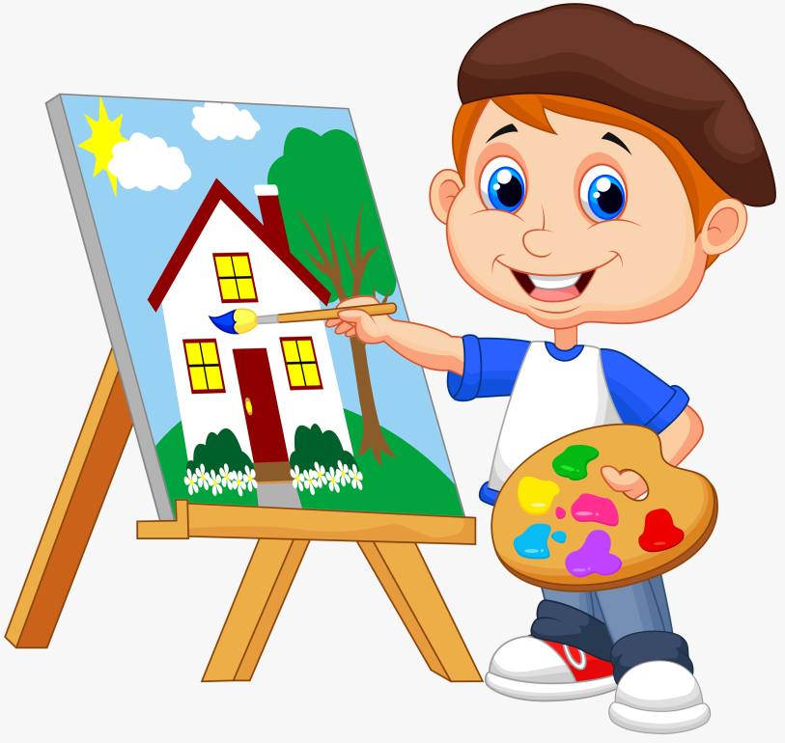
paint

Slide 12
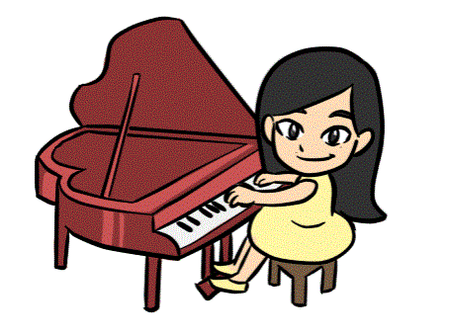
play
the piano

Slide 13
Let’s meet my friends.
Why does he / she like …?
Because he / she thinks …

Slide 14
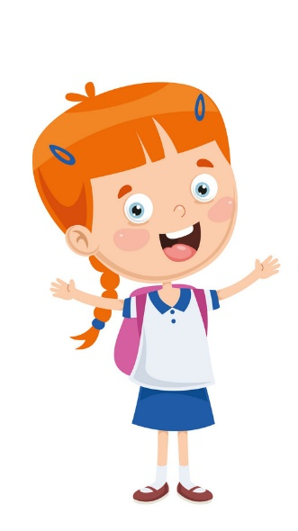

Why does he like doing projects?
Because he thinks …

Slide 15
Why does she like reading books?
Because she thinks …

Slide 16
Why does he like solving maths problems?
Because he thinks …

Slide 17
Why does he like playing games?
Because he thinks …

Slide 18
02
Listen
and tick.

Slide 19
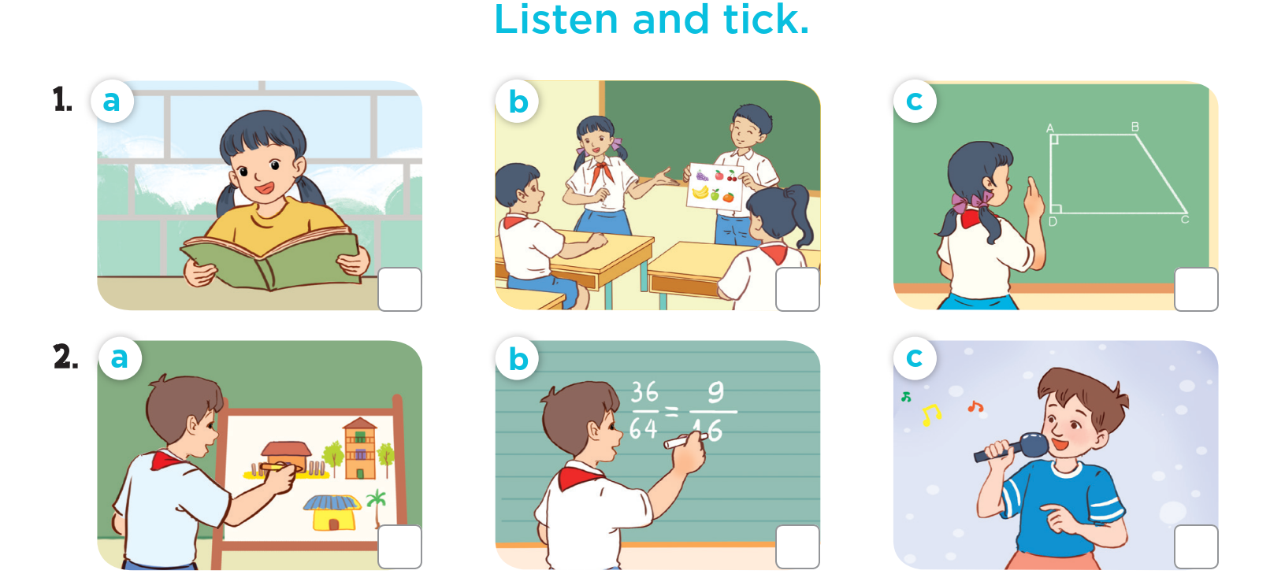




Slide 20
03
Read and
complete.

Slide 21
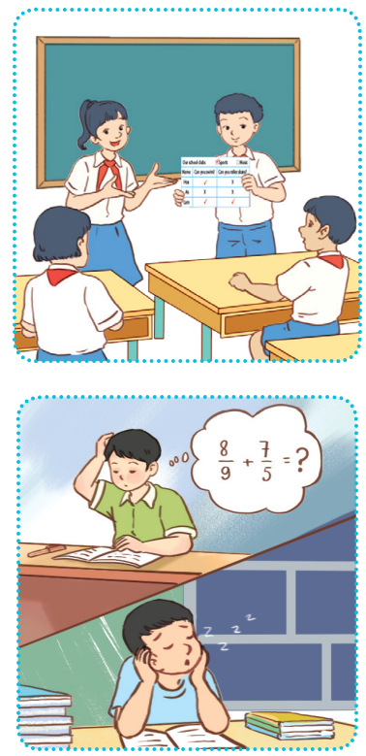
Read and complete.
1. A: What school activity does your sister like?
B: She likes _________________.
A: Why does she like it?
B: Because she thinks it’s interesting.
2. A: What school activities doesn’t your brother like?
B: He doesn’t like __________________________ or reading books.
A: Why doesn’t he like them?
B: Because ___________ they aren’t interesting.
doing projects
solving maths problems
he thinks

Slide 22
04
Let’s play.

Slide 23
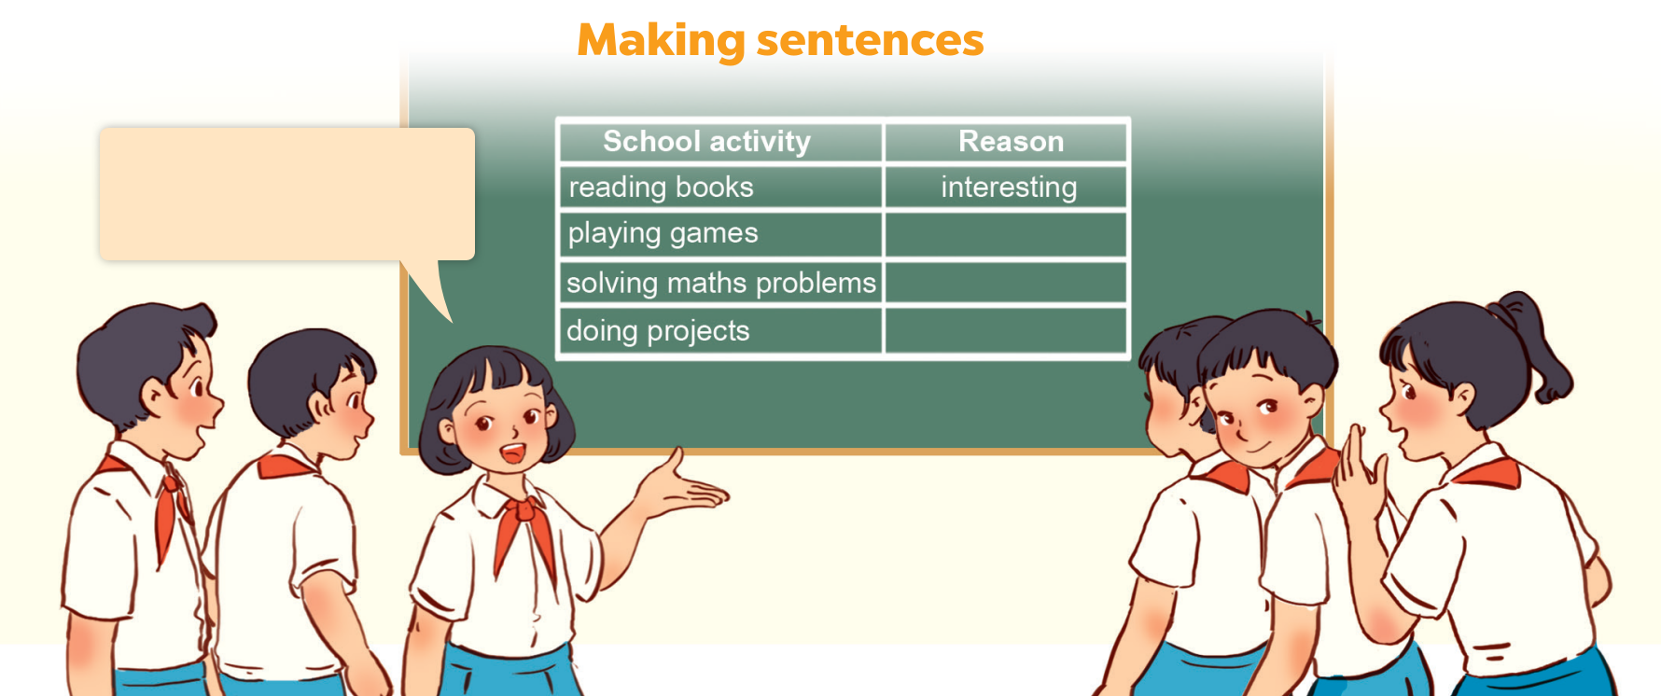
My sister likes reading books because she thinks it’s interesting.

Slide 24
05
Fun corner & Wrap-up
Lucky number

Slide 25
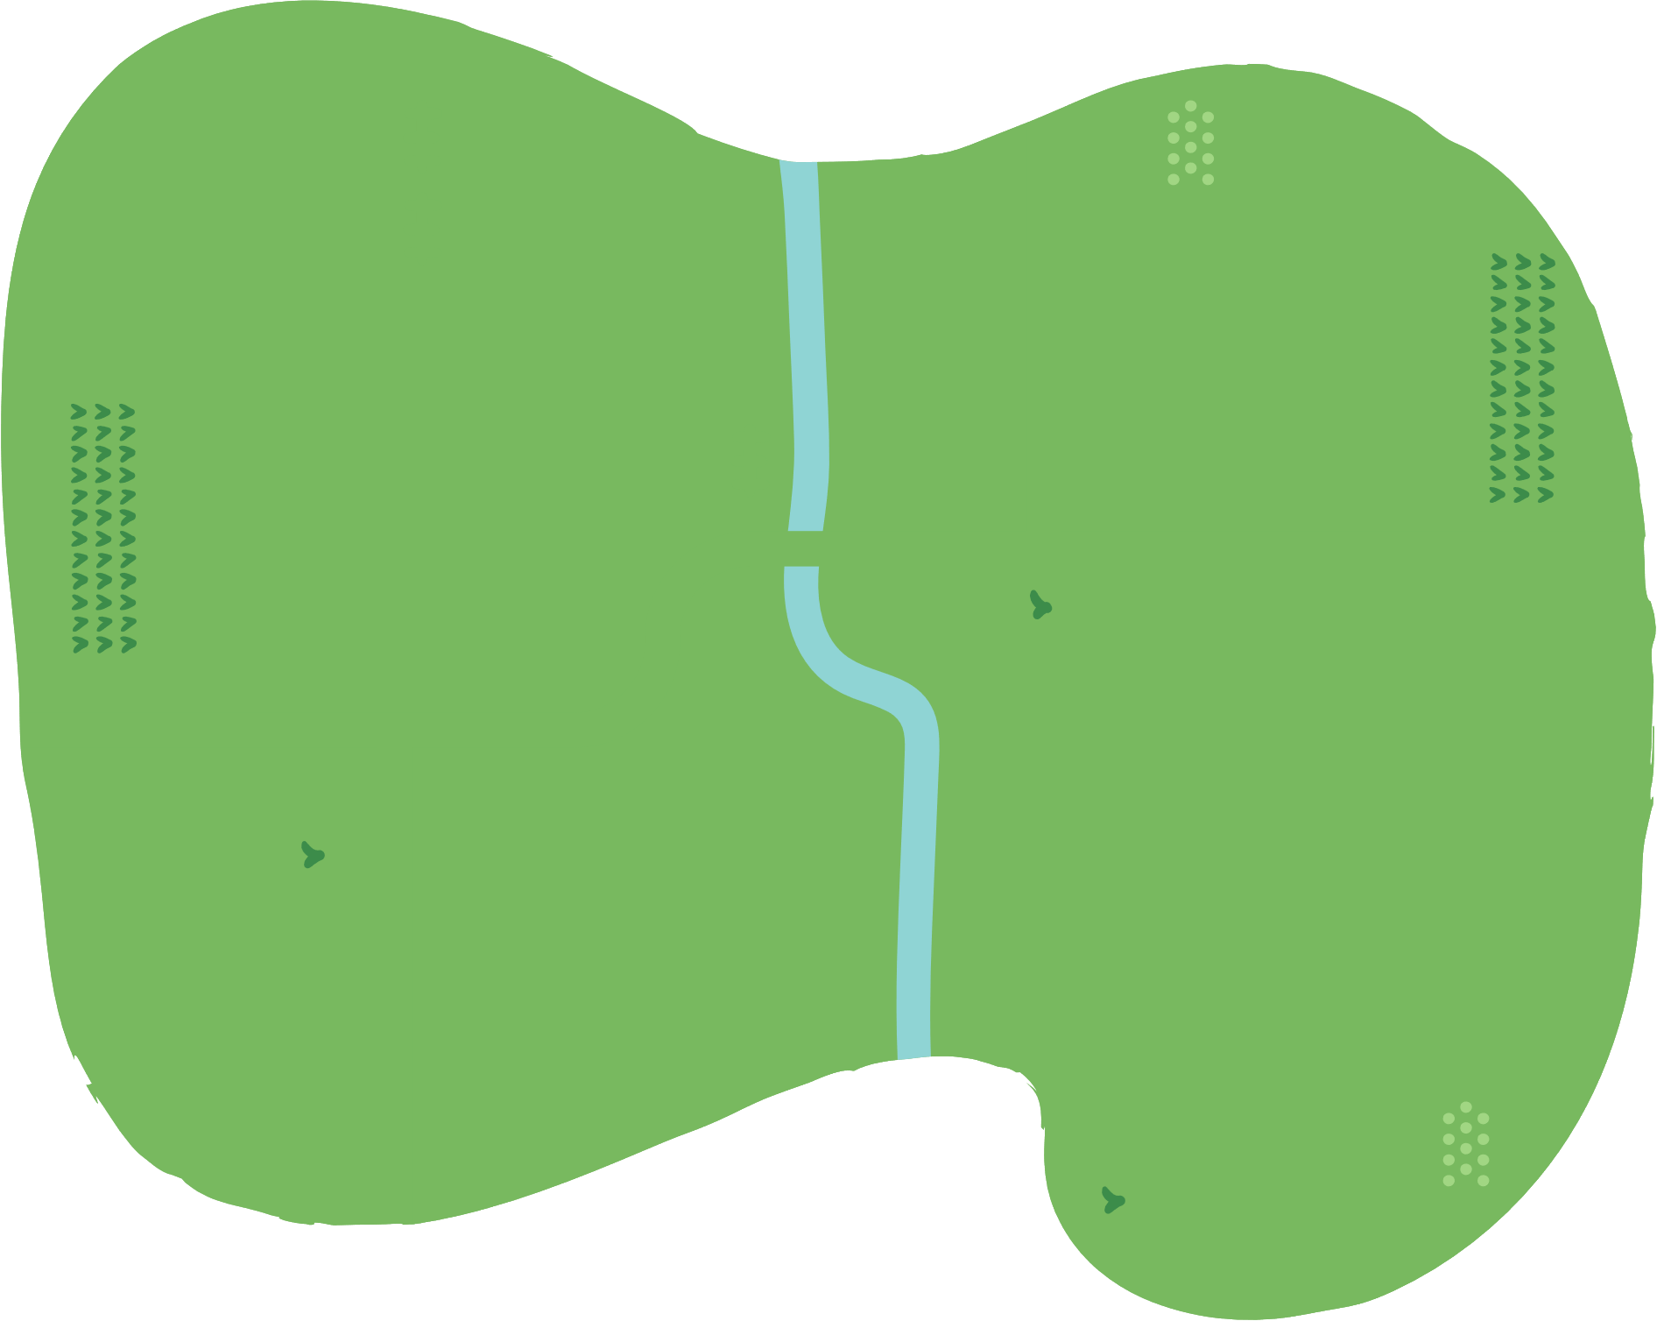


























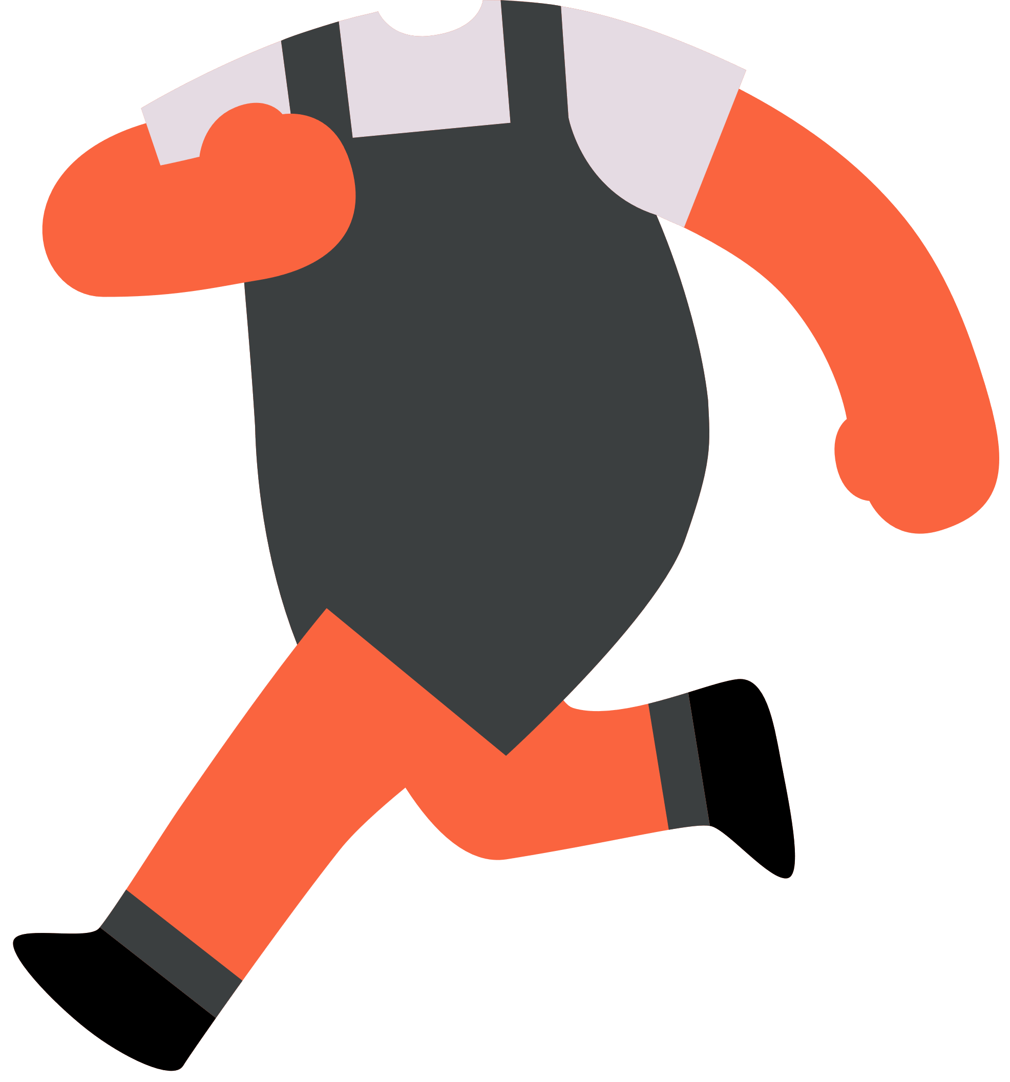








Slide 26
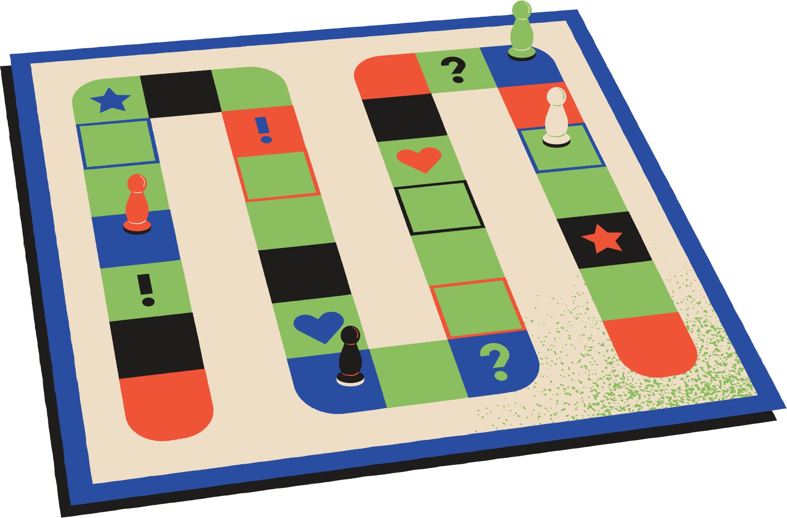

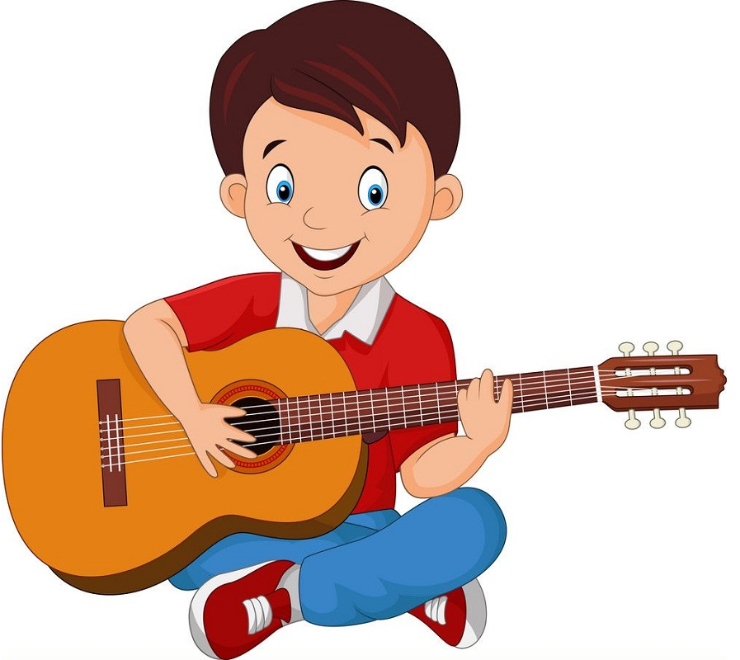
What school activity does he like?
Insert one question here
Insert one question here
Insert one question here
He likes playing
the guitar.

Slide 27
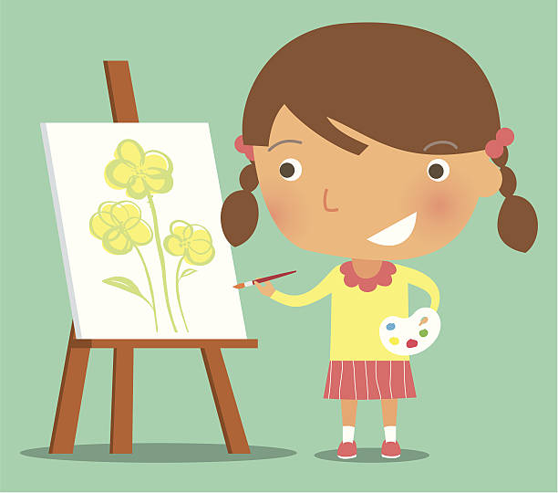
What school activity does she like?
Insert one question here
Insert one question here
Insert one question here
She likes painting.

Slide 28

Why does he like
solving maths problems?
Insert one question here
Insert one question here
Insert one question here
Because he thinks
it’s useful.

Slide 29
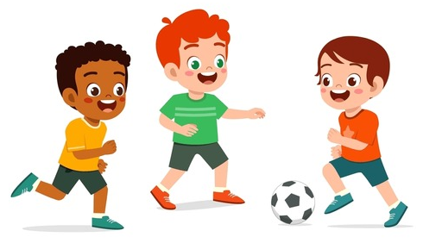
What school activity
do they like?
Insert one question here
They like playing football.

Slide 30

Why does she like
reading books?
Insert one question here
Insert one question here
Insert one question here
Because she thinks
it’s interesting.

Slide 31

What school activity
do they like?
Insert one question here
Insert one question here
Insert one question here
They like singing.

Slide 32
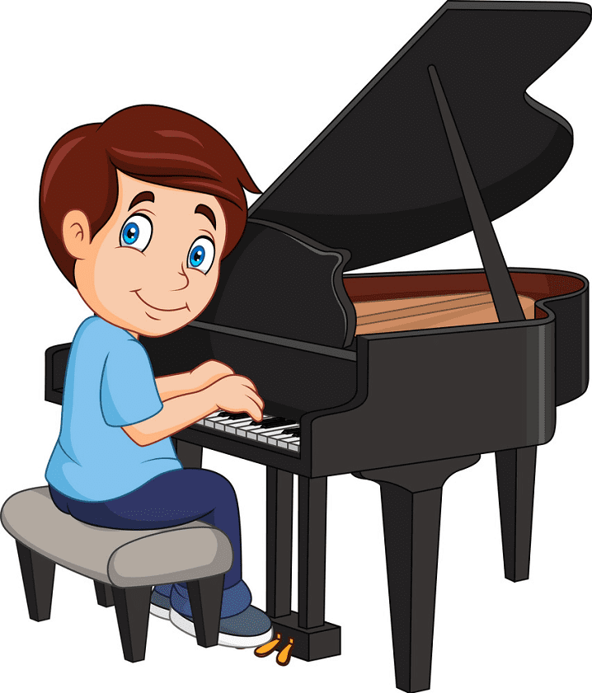
What school activity
does he like?
Insert one question here
Insert one question here
Insert one question here
He likes playing
the piano.

Slide 33

Why do they like
doing projects?
Insert one question here
Insert one question here
Insert one question here
Because they think
it’s good for group work.

Slide 34
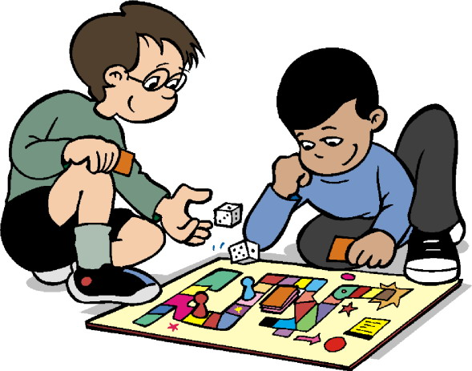
Why does he like
playing games?
Insert one question here
Insert one question here
Insert one question here
Because he thinks
it’s fun.

Slide 35
Website: hoclieu.vn
Fanpage: https://www.facebook.com/tienganhglobalsuccess.vn/

