Slide 1
Tiếng Anh 3
Giáo viên: Lê Thị Minh Hiếu
Lớp dạy: 3A2, 3A3, 3A4, 3A5, 3A6
Đơn vị công tác: Trường TH Hưng Đạo

Slide 2


Slide 3



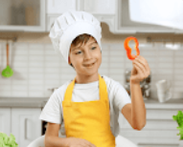
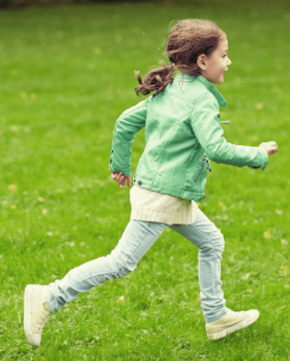


5
My hobbies
LESSON 3
Period 5

Slide 4
Content
1
5
Warm-up
Fun corner and Wrap-up
4
2
3
Let’s chant.
Listen and repeat.
Listen and circle.

Slide 5
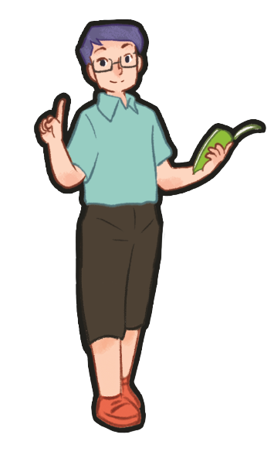
1
Warm-up
Game

Slide 6
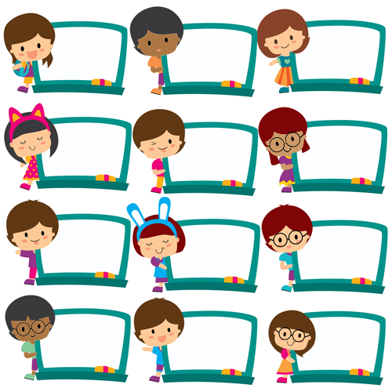
dancing
cooking
painting
swimming
dancing
painting
cooking
cooking
dancing
dancing
swimming
swimming
Notes:
- Greet the class. Divide the class into two groups to take turns singing the song My hobby on page 37. One group sings the first verse. The other sings the second verse.
- T asks pupils to write 1 hobby on their board and when they hear the word of their hobby in the song, they will stand up and raise their board.

Slide 7

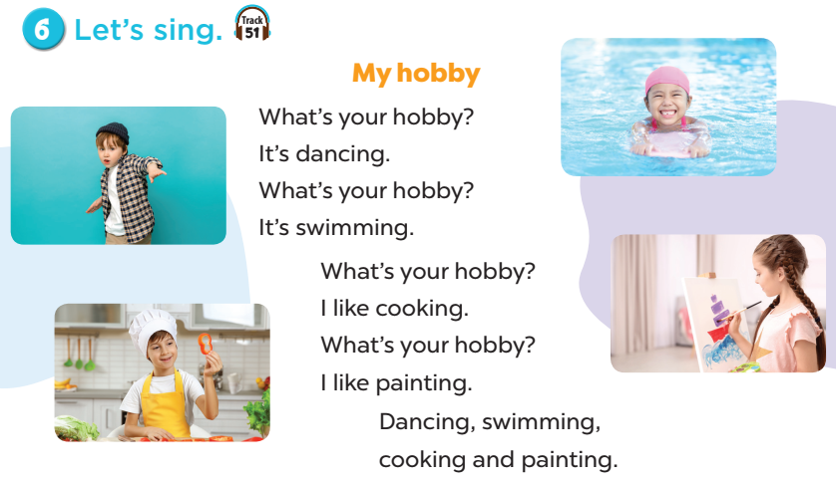
Notes:
- Greet the class. Divide the class into two groups to take turns singing the song My hobby on page 37. One group sings the first verse. The other sings the second verse.
- T asks pupils to write 1 hobby on their board and when they hear the word of their hobby in the song, they will stand up and raise their board.

Slide 8
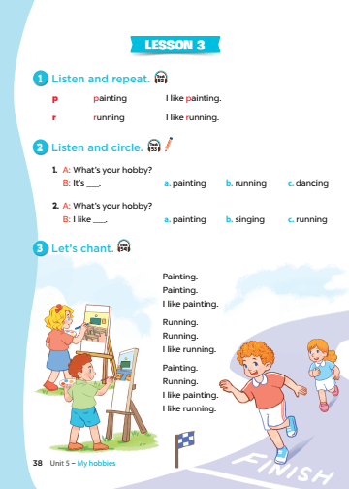
Notes:
T asks pupils to open their SB/ page 38.

Slide 9
2
Listen and
repeat.
Notes:
Review Numbers 1-10 and Alphabet

Slide 10
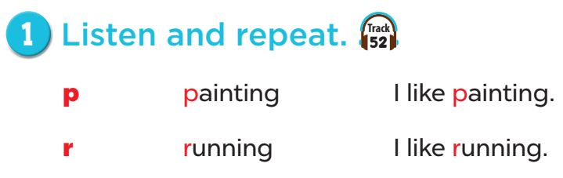
Notes:
Step 1: Draw pupils’ attention to the letter p, the word painting and the sentence I like painting.
Play the recording and encourage pupils to point to the letter / word / sentence while listening.
Step 2: Play the recording again for pupils to listen and repeat. Do this several times until
pupils feel confident. Correct their pronunciation where necessary and praise them if their
pronunciation is good.
Step 3: Repeat Steps 1 and 2 for the letter r.

Slide 11
3
Listen and circle.
Notes:
Review Numbers 1-10 and Alphabet

Slide 12
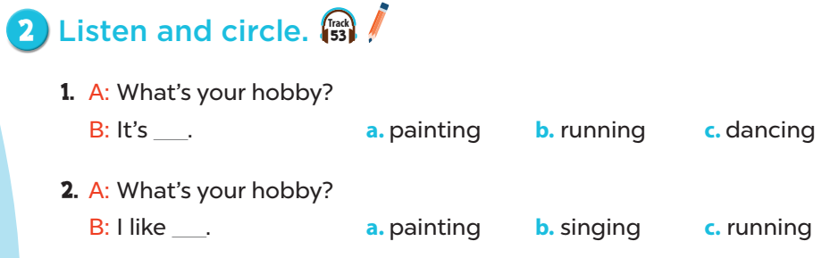
Notes:
Step 1: Draw pupils’ attention to the exchanges and the answer options. Tell pupils about the
activity. Play the recording for pupils to listen. Play the recording again for them to do the task.
Play the recording a third time for them to check the answers.
Step 2: Tell pupils to swap books with a partner then check the answers as a class. Write the
correct answers on the board for pupils to correct their answers.
Step 3: Play the recording again for pupils to check their answers again.
Extension: Invite one or two pupils to stand up, listen to and repeat the exchanges.

Slide 13
Game time

Slide 14
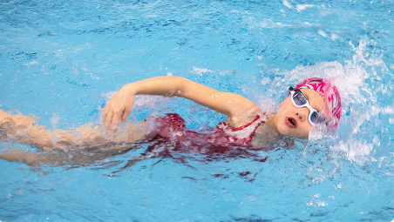
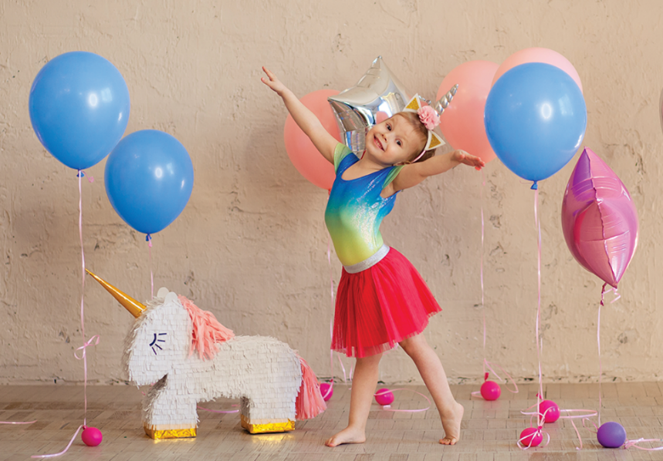

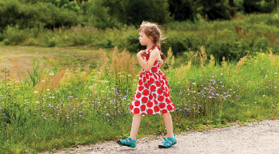
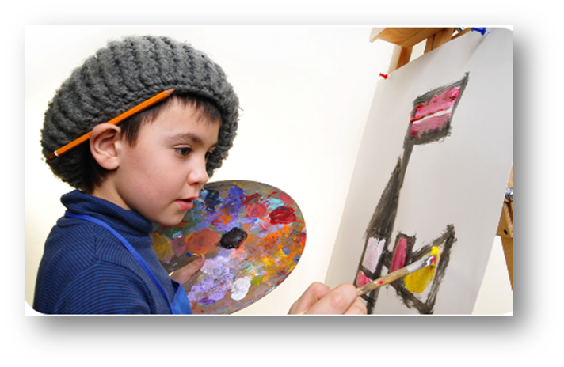

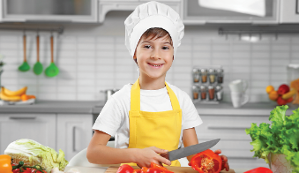

HOBBIES
Notes:
- T review words of hobbies by showing pictures.
- T divides class into 2 teams (Boys and Girls).
- T asks 1 pupil of each team come to the board and face to the others (they can’t see the pictures and questions on ppt at the beginning).
- When T says GO, 2 pupils will turn back, look at the screen, and say out loud the answers (A-B-C-D-E-F) as quickly as they can.
- The first one to say the letter and the word is the winner.

Slide 15
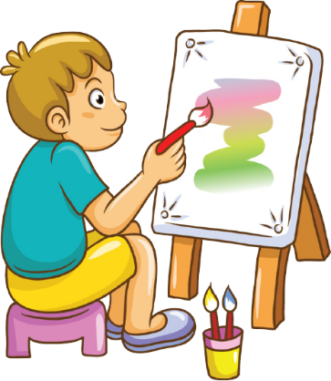
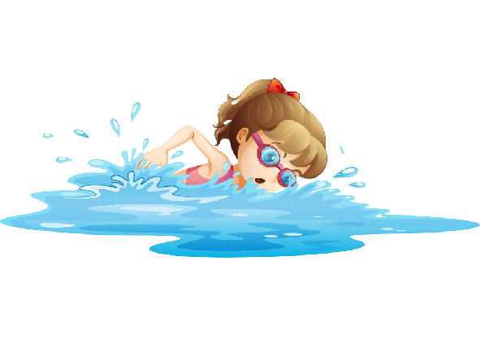

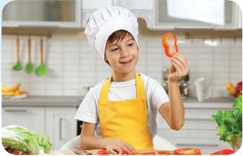


1
2
3
- What’s your hobby?
- It’s running.
- What’s your hobby?
- I like singing.
4
5
6
- What’s your hobby?
- It’s swimming.
7
8
9
- What’s your hobby?
- I like walking.
10
11
12
- What’s your hobby?
- It’s painting.
- What’s your hobby?
- I like cooking.
Notes:
Game: Matching
- T divides class into 2 teams (Boys and Girls).
- Pupils in 2 teams take turn to open the boxes to match the questions and answers to their pictures (open: click the numbers - close: click the red signs).
- Pupils of each team will get points if their matching is correct.
- Review hobbies: painting, cooking, running, walking, singing, swimming.

Slide 16
4
Let’s chant.

Slide 17
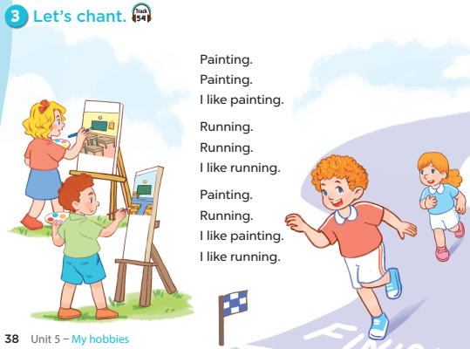
Notes:
Step 1: Draw pupils’ attention to the lyrics of the chant. Check comprehension.
Step 2: Play the recording all the way through. Encourage pupils to listen carefully to the
rhythm and pronunciation. Draw pupils' attention to the sounds of the consonants p and r.
Step 3: Play the recording line by line for pupils to listen and repeat. Correct their pronunciation where necessary.
Step 4: Play the recording all the way through for pupils say the chant. Draw their attention to the
consonant sounds /p/ and /r/ in the words painting and running.
Extension: Divide the class into two or more groups to take turns to listen to and repeat the
chant, while the rest of the class claps along.

Slide 18
5
Fun corner
and
Wrap-up

Slide 19

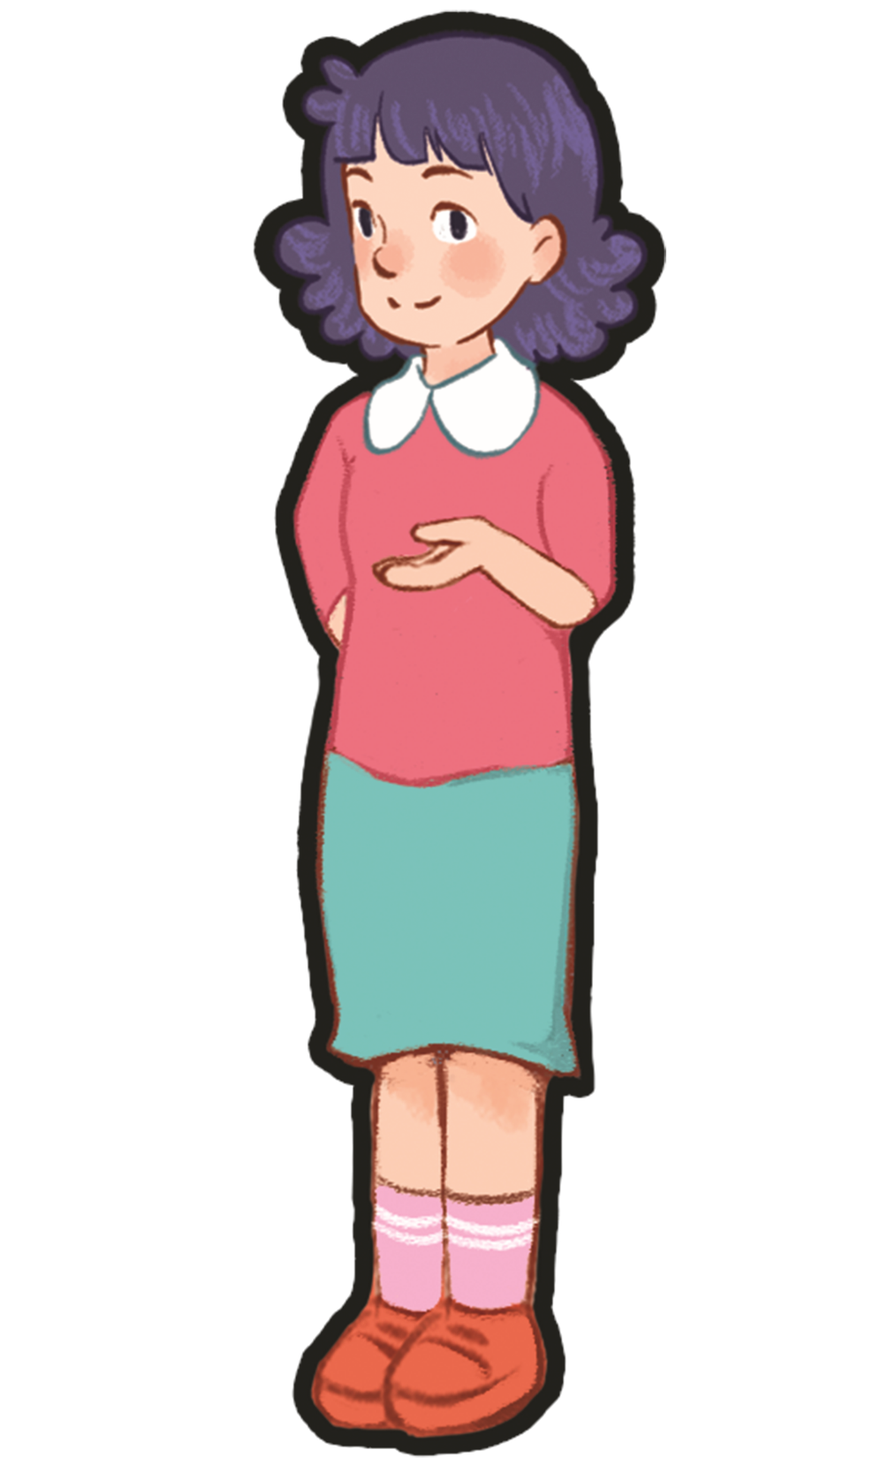

SPELLING HOBBIES
Notes:
Game: Spelling
- T divides class into 2 teams (Boys and Girls).
- Pupils in 2 teams listen to the recording spelling of hobbies
- Pupils of each team will get points if they choose correct answers.
- Review hobbies: painting, cooking, running, walking, singing, swimming.

Slide 20
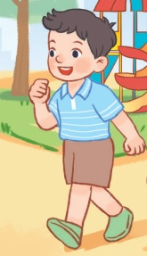
How do you spell this hobby?
Click here
r u n n i n g
w a l k i n g
c o o k i n g
NEXT

Slide 21
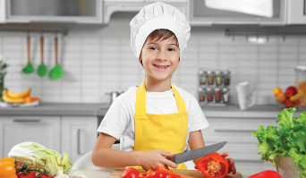
How do you spell this hobby?
Click here
d a n c i n g
s w i m m i n g
c o o k i n g
NEXT

Slide 22
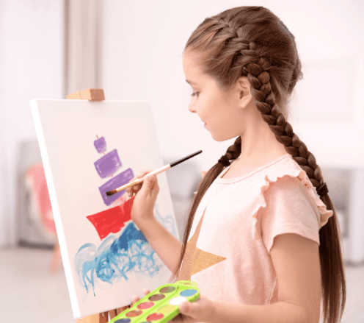
How do you spell this hobby?
Click here
p a i n t i n g
s i n g i n g
d r a w i n g
NEXT

Slide 23

How do you spell this hobby?
Click here
d a n c i n g
r u n n i n g
c o o k i n g
NEXT

Slide 24
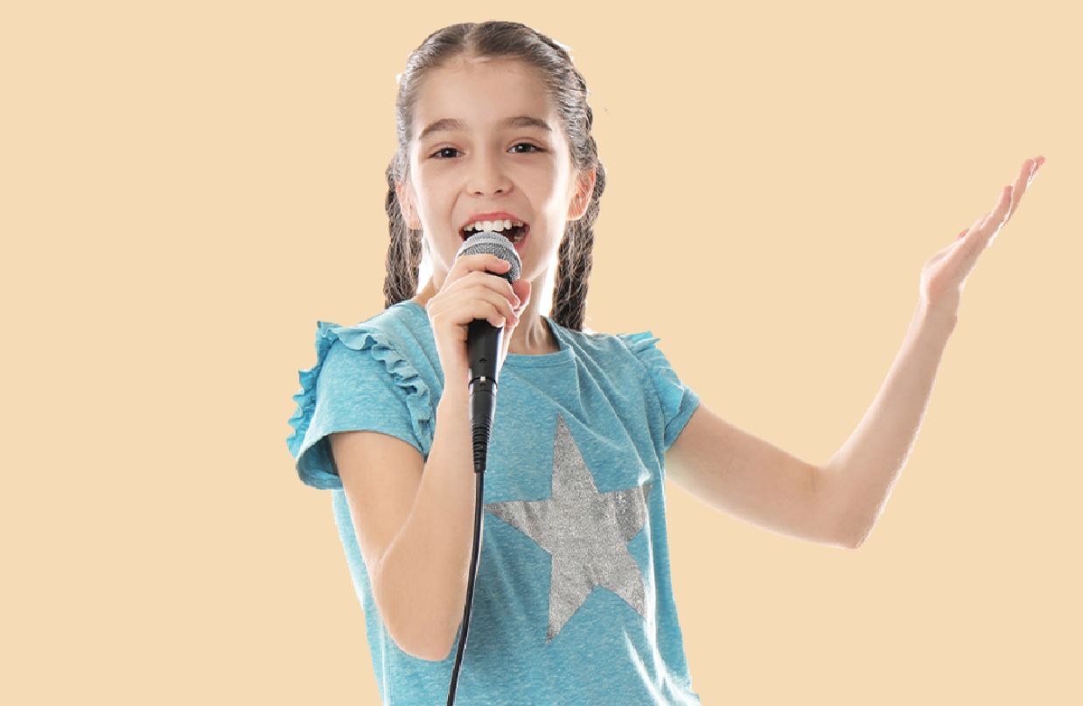
How do you spell this hobby?
Click here
p a i n t i n g
d a n c i n g
s i n g i n g
NEXT

Slide 25
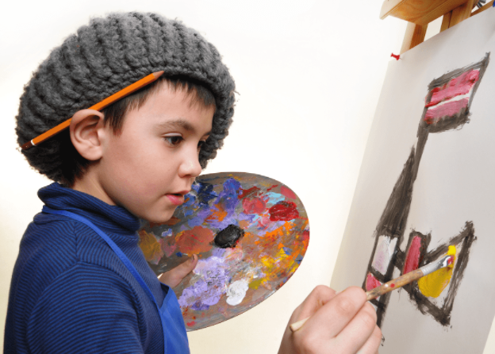
How do you spell this hobby?
Click here
d a n c i n g
d r a w i n g
w a l k i n g
NEXT

Slide 26
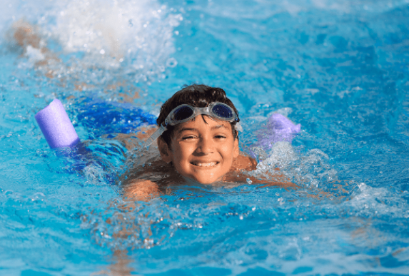
How do you spell this hobby?
Click here
w a l k i n g
s i n g i n g
s w i m m i n g
NEXT

Slide 27
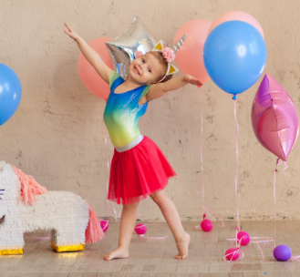
How do you spell this hobby?
Click here
p a i n t i n g
d a n c i n g
c o o k i n g
NEXT

Slide 28
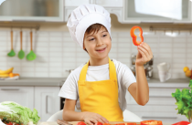
Notes:
T shows 4 pictures on the board and asks pupils to repeat -> Wrap up.

Slide 29

Website: hoclieu.vn
Fanpage: facebook.com/www.tienganhglobalsuccess.vn

