Slide 1
Tiếng Anh 1
Giáo viên: Hoàng Thị Hồng
Lớp dạy: 1A4, 1A5, 1A6
Đơn vị công tác: Trường TH Hưng Đạo

Slide 3

Unit 8 – Lesson 2 In the park
Notes:
Goals: By the end of the lesson, pupils will be able to:
say the sound of the letter H/h and the words hair, hand, head and hat in a chant.
listen, recognize the words and tick the correct boxes.
trace the letter H/h (upper case and lower case).

Slide 4

Warm-up
Notes:
Goals:
- Help pupils feel happy at the beginning of the lesson.
- Review vocabulary of previous lesson
Game: Hot seat
Time limit: 5 mins
- Pupils stand with their backs turning to the board.
- Teacher holds up a flashcard behind them. Class do action to describe. Pupils raise their hands up and guess the word.
- Faster team gets more stars.

Slide 5


Listen and chant
Notes:
Goal:
- Pupils will be able to say the sound of the letter H/h and the words hair, hand, head and hat in a chant. Step 1: Read. Listen and repeat the chant.
Time limit: 4 mins
- Teacher shows the chant on slide. Whole class read together.
- Teacher plays the audio. Pupils listen through, then listen and repeat.
Pupils then chant and clap along.
Pupils chant in teams.
Step 2: Pupils chant and do actions.
Time limit: 4 mins
- Teacher shows pupils how to do actions to describe the vocabulary.
- Pupils do the actions as teams. Then pupils chant and do the actions along.
Example:
H (clap), h (clap), h (clap)
Head (touch the head) and hair (touch the hair)
Hoa’s head (touch the head)
Hoa’s hair (touch the hair)
Step 3: Quick check
Time limit: 4 mins
Pupils chant as teams and individually.

Slide 6

Listen and chant
h, h, h.
Head and hair.
Hoa’s head.
Hoa’s hair.
h, h, h.
Hat and hands.
Hoa’s hat.
Hoa’s hands.

Slide 7


Slide 8


Slide 9


Slide 10


Slide 11

Listen and tick
Notes:
Goal:
- Pupils will be able to listen, recognize the words and tick the correct boxes.
Step 1: Listen and tick the correct picture.
Time limit: 5 mins
- Teacher says Listen and tick and writes words on the board.
- Teacher says and does actions: Listen (put hands on one ear) and tick (write a tick in the air). Pupils follow.
- Teacher plays audio. Pupils do the tasks.
When Pupils finish, teacher plays the audio again, pause at each question and checks answer.
Step 2: Quick check
Time limit: 3 mins
- Teacher says a word, pupils go to the board and touch the correct picture.

Slide 12
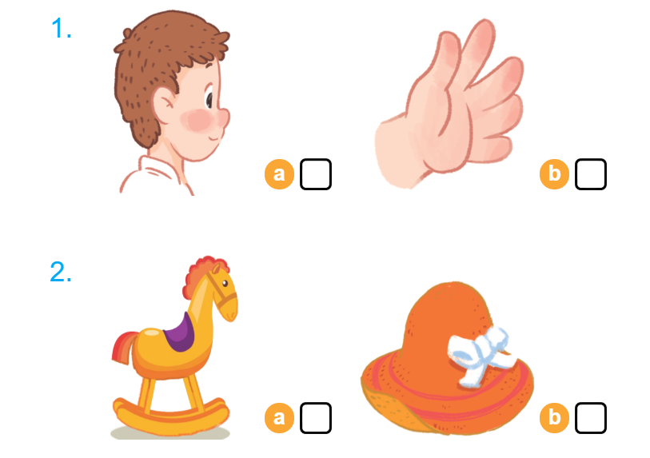

Listen and tick

Slide 13


Look and trace
Notes:
Goal:
- Pupils will be able to trace the letter H/h (upper case and lower case).
Step 1: Pupils write letter in the air
Time limit: 3 mins
Teacher and pupils write letter “h” in the air. (Teacher can make it fast or slowly)
Step 2: Look and trace
Time limit: 4 mins
- Teacher writes letter on the board.
- Pupils look and trace in their books.

Slide 14
Further activity
Notes:
Goals:
- Pupils are able to write letter “h”.
- Pupils are able to identify words that have the sound /h/.
Time limit: 6 mins
- Teacher says a word. If it has the sound /h/, pupils write letter “h” on the board. If not, pupils don’t write.
- Teacher may have some pupils says the word.

Slide 15
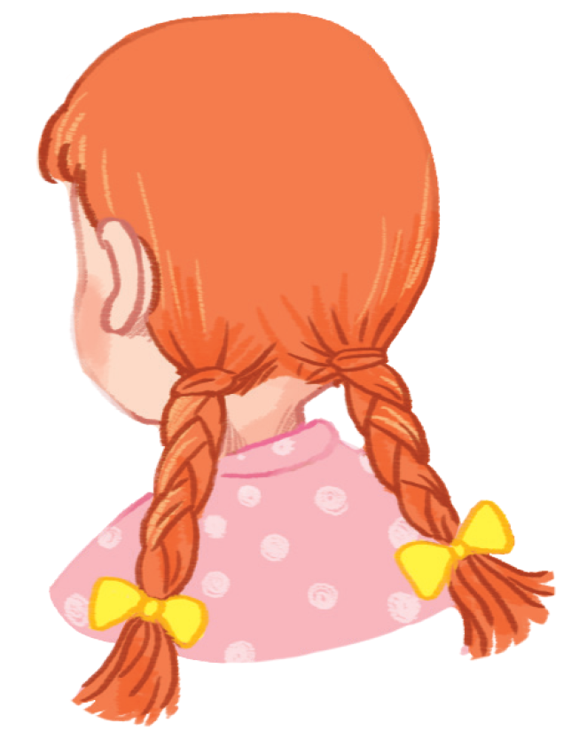
Goodbye
Notes:
- Teacher shows the vocabulary of the lesson on slide.
- Pupils say goodbye.

Slide 16
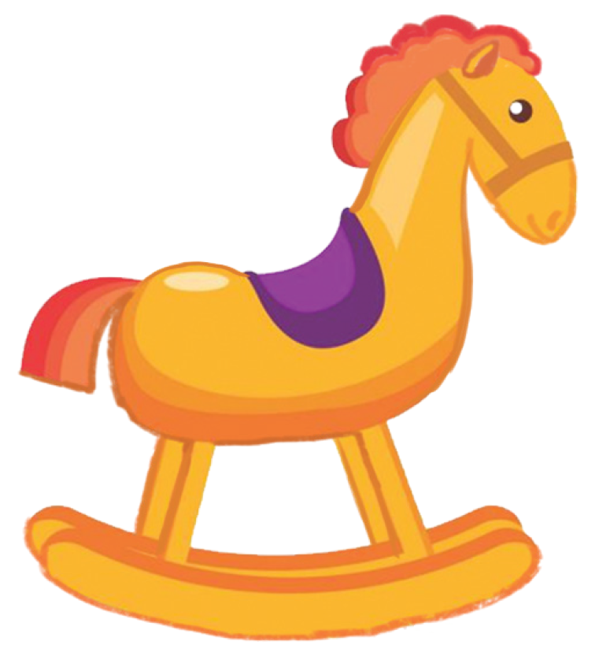
Goodbye

Slide 17
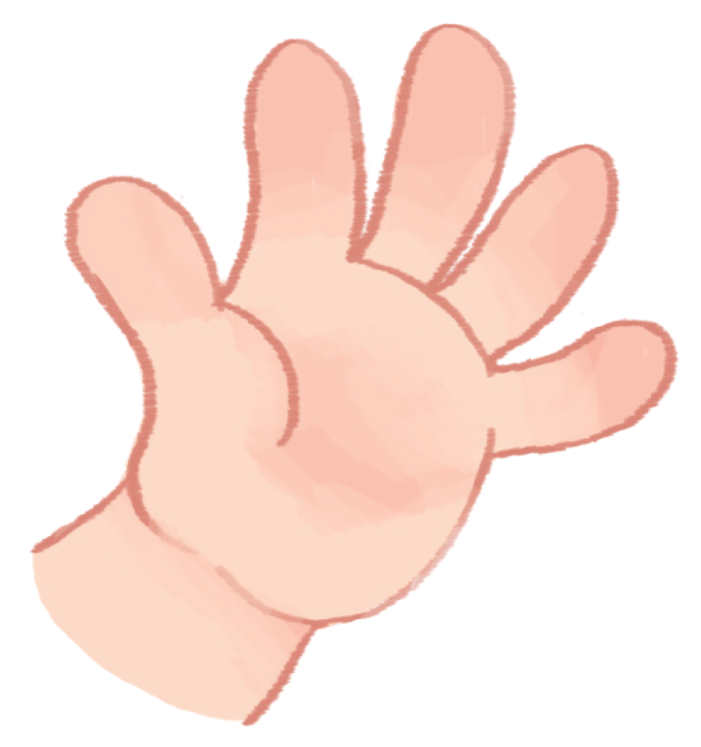
Goodbye

Slide 18
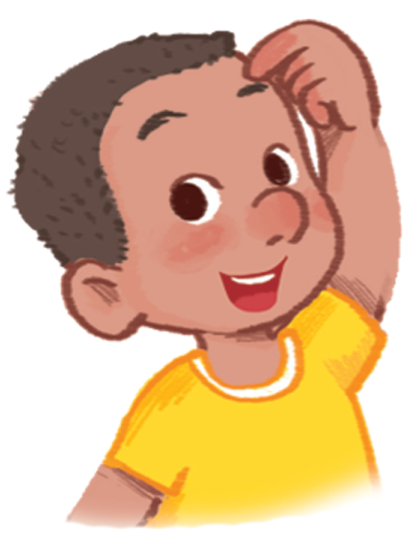
Goodbye

Slide 19
Website: hoclieu.vn
Fanpage: facebook.com/www.tienganhglobalsuccess.vn

