Slide 1



Giáo viên: Đồng Thị Như Quỳnh
Lớp dạy: 2A2
Đơn vị công tác: TRƯỜNG TIỂU HỌC HƯNG ĐẠO

Slide 2
Review 2
Lesson 2 (1, 2, 3)

Slide 3










Classroom Rules

Slide 4







Rule 1
Listen to
your friend
talking in front.

Slide 5








Rule 2
Raise your hand
if you have a question.

Slide 6







Rule 3
Wait for
your turn.

Slide 7

Table of contents
Warm up and review.
2. Activity 3: Listen and tick.
3. Activity 4: Listen and circle.
4. Activity 5: Write and say.
5. Fun corner and wrap-up.

Slide 8

01
Warm-up
Facing game
Options:
Easy
Advanced

Slide 9



Listen to a letter and choose the correct word:
question
van
fox
jelly
volleyball

Slide 10
Listen to a letter and choose the correct word:
van
juice
ox
jelly
village

Slide 11
Listen to a letter and choose the correct word:
quiz
village
ox
jam
van

Slide 12
Listen to a letter and choose the correct word:
quiz
volleyball
fox
juice
van

Slide 13
Listen to a letter and choose the correct word:
square
van
fox
jelly
volleyball

Slide 14
Listen to a letter and choose the correct word:
question
jam
fox
jelly
volleyball

Slide 15
Listen to a letter and choose the correct word:
volleyball
village
box
square
quiz

Slide 16
Listen to a letter and choose the correct word:
question
van
fox
jam
volleyball

Slide 17


Slide 18



Listen to a letter and say the correct word:

Slide 19
Listen to a letter and say the correct word:

Slide 20
Listen to a letter and say the correct word:

Slide 21
Listen to a letter and say the correct word:

Slide 23

02
Activity 3
LISTEN AND tick

Slide 24











Listen and tick.
1
2
3

Slide 25



1


Slide 26


2


Slide 27


3


Slide 28
03
Activity 4
Listen AND CIRCLE

Slide 29


Listen and circle.
1
q
v
2
x
j
3
x
q
4
v
j

Slide 30
04
Activity 5
Write and say

Slide 31







Write and say.
1
fo
x
2
q
uestion
3
j
uice
4
v
illage

Slide 32
05
Fun corner and wrap-up

Slide 33

Option 1
Option 2

Slide 34












Slap the board
0
1
5
4
2
6
8
3
10
9
7
1
7
2
6
3
9
5
0
4
8
10
Notes:
- Khi kết thúc trò chơi, nhấp vào nút con ong để giành chiến thắng.

Slide 35




Slide 36

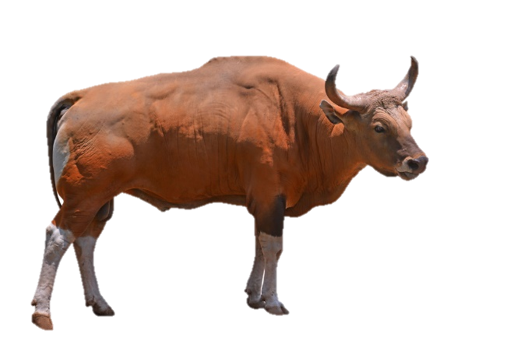



Slide 37


Slide 40


Slide 42
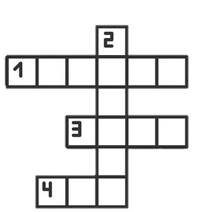

Slide 43



Slide 45


What is the odd one out ?
Notes:
Chuẩn bị một số hình ảnh về các từ của các chữ cái Q/q (/k/), X/x (/ks/), J/j (/dʒ/) và V/v (/v/).
- Dán ba bức tranh lên bảng và yêu cầu học sinh quyết định xem bức tranh nào mà các em cho là khác lạ.
ví dụ. box, van, fox (Đây có thể là “van” vì “box” và “fox” có âm là chữ X/x (/ks/).
- Tiếp tục trò chơi cho đến khi sử dụng hết các hình ảnh.

Slide 46

What is the odd one out ?

Slide 47

What is the odd one out ?

Slide 48
What is the odd one out ?

Slide 49

What is the odd one out ?

Slide 50
What is the odd one out ?

Slide 51

What is the odd one out ?

Slide 52

What is the odd one out ?

Slide 53

What is the odd one out ?

Slide 54
What is the odd one out ?

Slide 55
Website: hoclieu.vn
Fanpage: facebook.com/www.tienganhglobalsuccess.vn

