Slide 1
Tiếng Anh 2
Giáo viên: Hoàng Thị Hồng
Lớp dạy: 2A3
Đơn vị công tác: Trường TH Hưng Đạo

Slide 3


Unit 7
In the kitchen
Lesson 3 - Period 3

Slide 4
TABLE OF CONTENTS
1
Warm-up and Review
2
Activity 6: Listen and repeat.
3
Activity 7: Let’s talk.
4
Activity 8: Let’s sing.
5
Fun corner and Wrap-up

Slide 5
01
Warm-up and Review

Slide 6








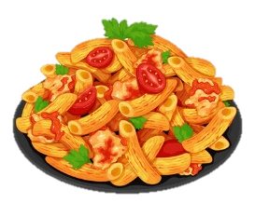

















I like …
You are given 3 points
You are given 8 points
You are given 10 points
You are given 5 points
You are given 4 points
You are given 2 points

Slide 7

02
Activity 6
Listen and repeat.

Slide 8





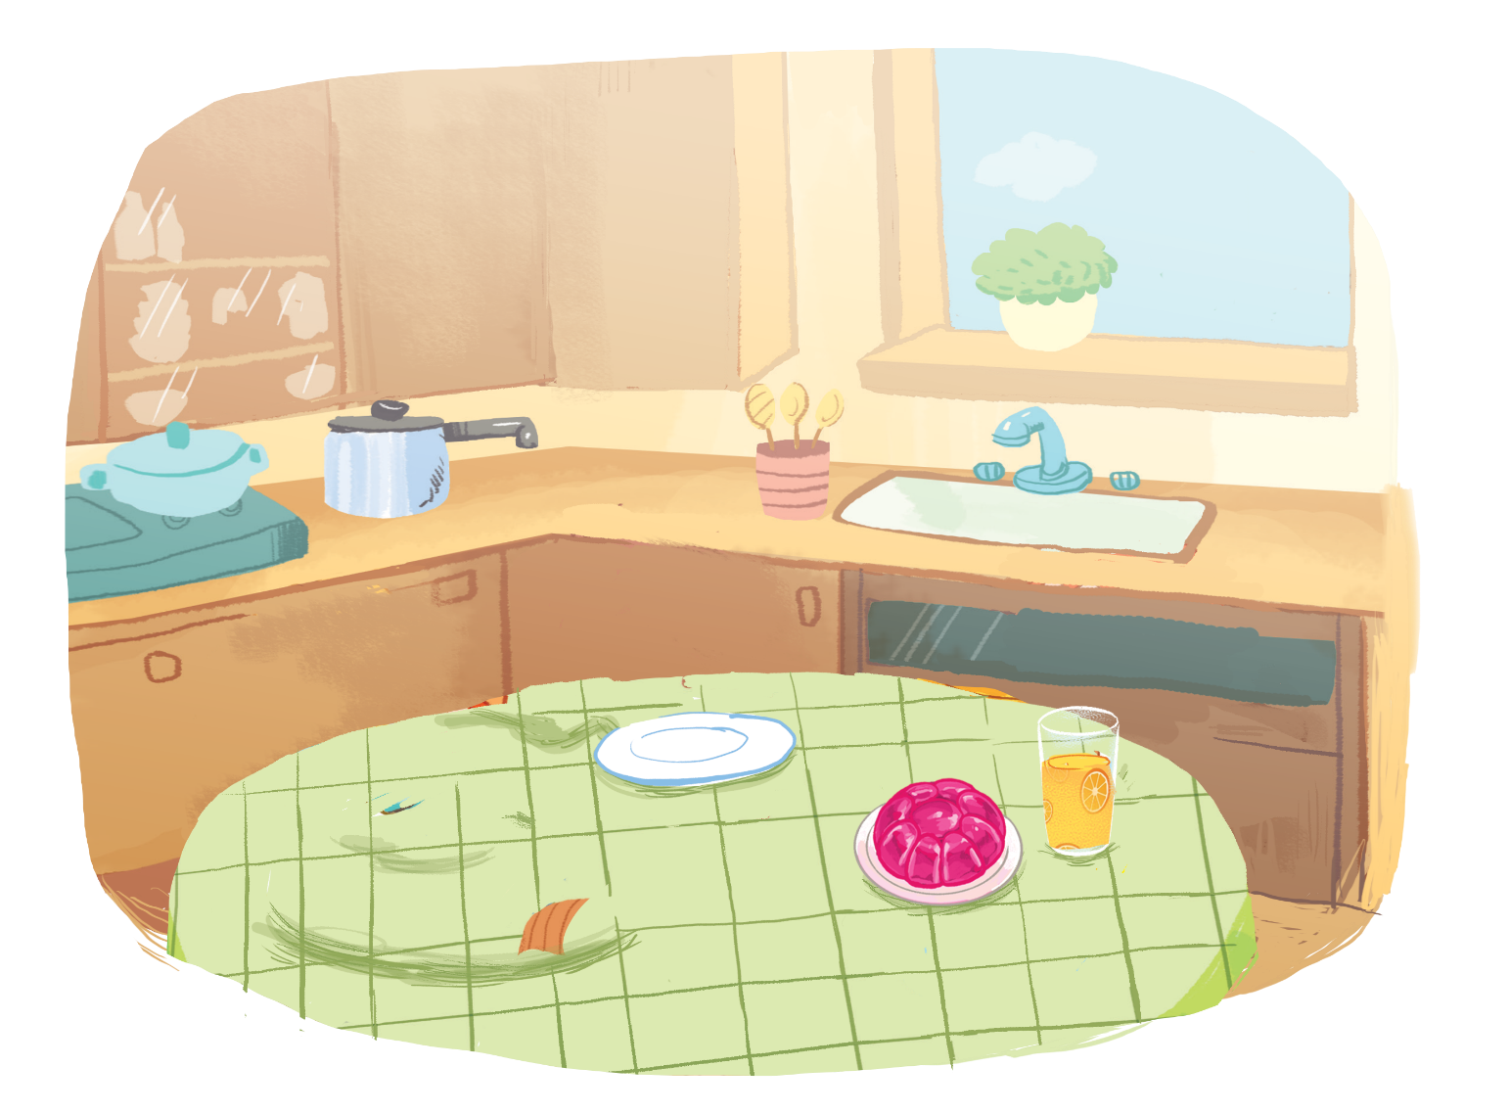



Listen and repeat.
Pass me the jam, please.
Pass me the jam, please.
Pass me the jam, please.
Pass me the jam, please.
Here you are.
Here you are.
Here you are.
Here you are.

Slide 9
03
Activity 7
Let’s talk.

Slide 10







Let’s talk.
, please.
Here .
a
b
c

Slide 11
, please.
Here .
a

Slide 12
, please.
Here .
b

Slide 13
, please.
Here .
c

Slide 14
04
Activity 8
Let’s sing!

Slide 15


Let’s sing!
Jam, juice, jelly.
Jam, juice, jelly.
Jam, juice, jelly.
Jam, juice, jelly.
Pass me the jam.
Pass me the jam.
Pass me the jam.
Pass me the jam.
Pass me the juice.
Pass me the juice.
Pass me the juice.
Pass me the juice.
Pass me the jelly.
Pass me the jelly.
Pass me the jelly.
Pass me the jelly.
Here you are.
Here you are.
Here you are.
Here you are.
Here you are.
Here you are.
Here you are.
Here you are.
Here you are.
Here you are.
Here you are.
Here you are.

Slide 16
05
Fun corner
and
Wrap-up

Slide 17


Option 1
Option 2

Slide 18
Vocabulary race

Slide 19









Vocabulary race
j a m
j u i c e
j e l l y
c a k e
p a s t a
____ ____ ____
___ ___ ___ ___ ___
____ ____ ____ ____ ____
___ ___ ____ ____
___ ___ ___ ___ ___
Notes:
- Sau khi bấm PLAY sẽ hiện hình ảnh đầu tiên, GV click vào biểu tượng các dấu gạch ( _ _ _ ) bên dưới tranh để hiện đáp án. Sau đó click tiếp vào màn hình để hiện đáp án và chuyển sang câu hỏi tiếp theo.

Slide 20


Slide 21
ROLE PLAY

Slide 22




Get the points
+3
+1
+4
+2
+5

Slide 23




…………..,………..
…….……...

Slide 24




…………
………..…,……...

Slide 25



…………….…, ……..
…………

Slide 26



…………….…., ……..
…………...

Slide 27


…………….…., ……..
…………...

Slide 29

Time to say goodbye!
j

Slide 30
Website: hoclieu.vn
Fanpage: https://www.facebook.com/tienganhglobalsuccess.vn/

