Slide 1



Giáo viên: Đồng Thị Như Quỳnh
Lớp dạy: 5A5, 5A6, 5A7
Đơn vị công tác: TRƯỜNG TIỂU HỌC HƯNG ĐẠO

Slide 2







Unit 8
IN OUR CLASSROOM
Lesson 3 (4, 5, 6)

Slide 3




01
Warm-up & Review

Slide 4



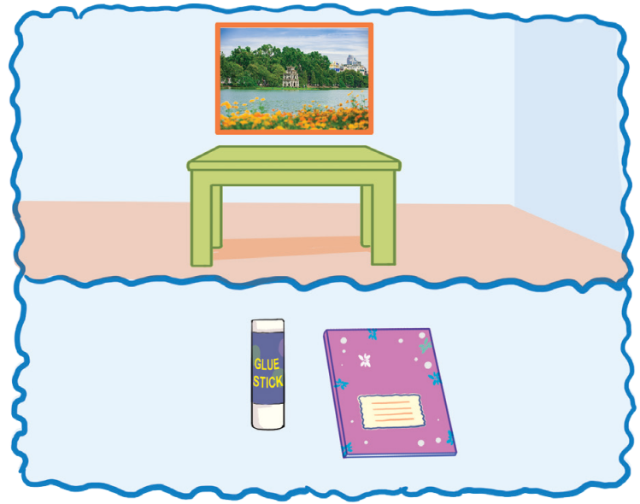
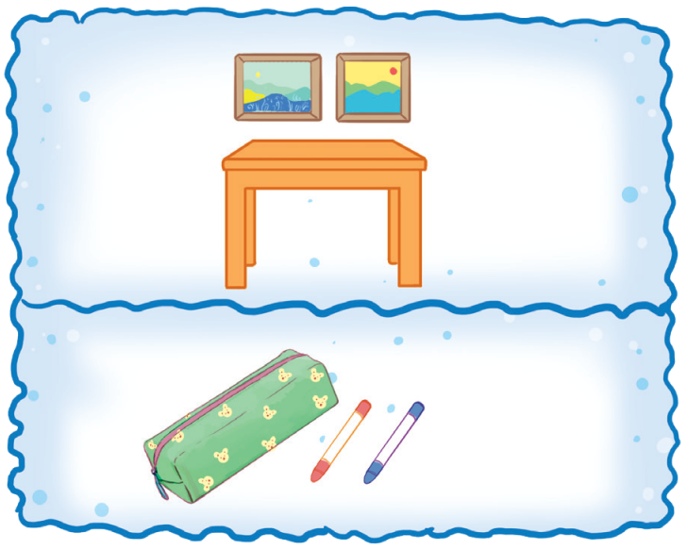

SING AND CLAP.
Where is the photo?
It’s above the table. Where is the glue stick?
It’s beside the notebook.
Where are the pictures? They’re above the table. Where are the crayons? They’re beside the pencil case.

Slide 5







Let’s chant in the front.

Slide 6




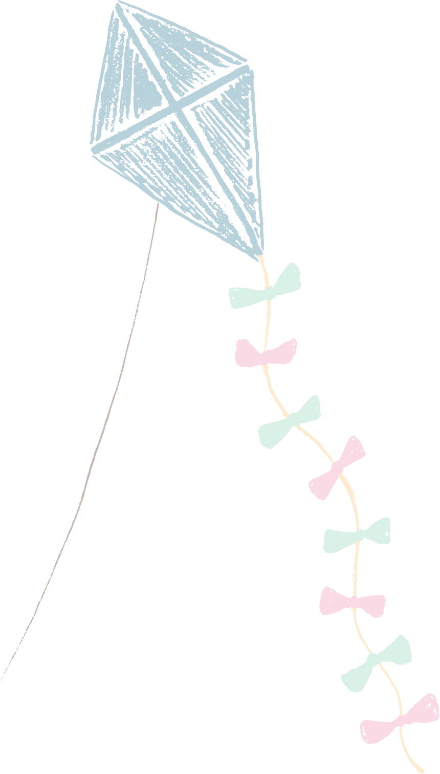






Slide 7
02
Read and answer.

Slide 8



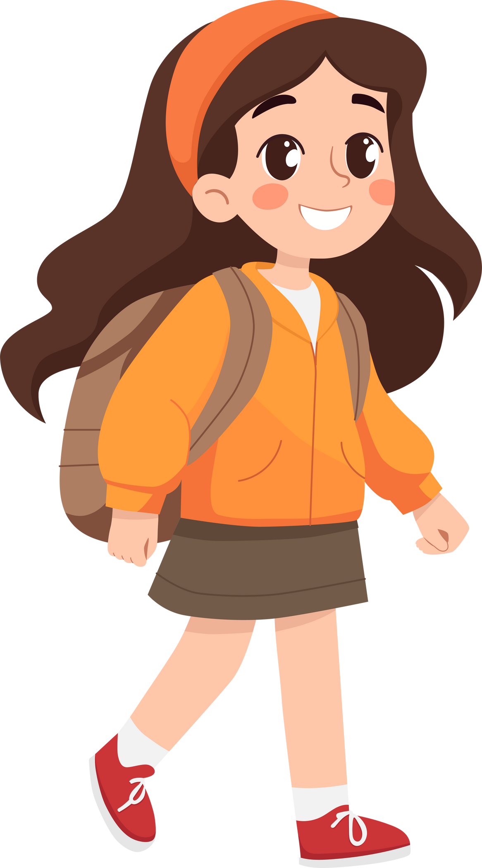

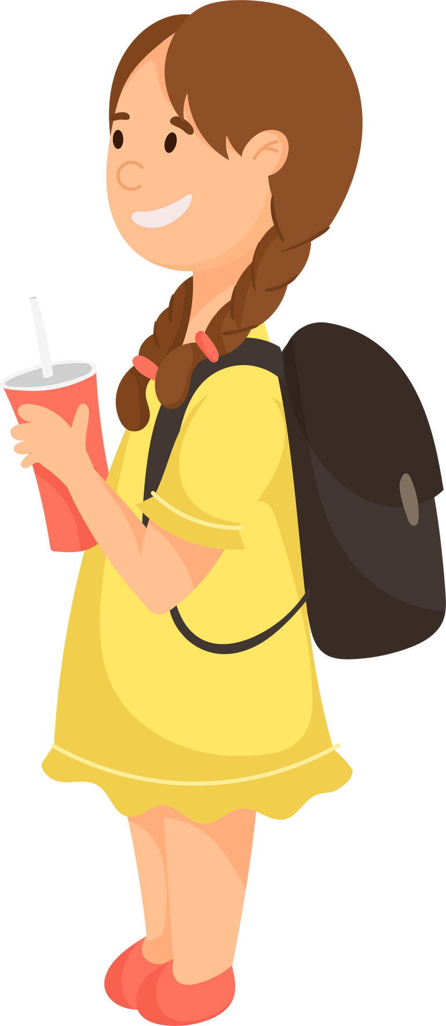


Listen and read.
Trang
Lan
Hung

Slide 9
Listen and Read.
Trang, Hung and Lan are in Class 5A. They’re very tidy! Trang’s set square is on her desk, beside her pencil case. Hung’s pencils are on his desk, in front of his pencil sharpener. Lan’s school bag is under her desk.
Trang has a new storybook. It’s in her school bag. Hung’s storybook is beside his notebook. Lan’s storybook is in the desk. They want to read together after the lesson. They love stories, especially fairy tales for children.

Slide 10

Read and Answer.
1. Whose set square is on her desk?
Whose set square
Trang, Hung and Lan are in Class 5A. They’re very tidy! Trang’s set square is on her desk, beside her pencil case. Hung’s pencils are on his desk, in front of his pencil sharpener. Lan’s school bag is under her desk.

Slide 11
Read and Answer.
2. Where are Hung’s pencils?
3. Whose storybook is in her school bag?
4. Where is Lan’s storybook?

Slide 12





SWAP YOUR BOOKS!

Slide 13

Let’s check!
Where
Hung’s pencils
2. Where are Hung’s pencils?
Trang, Hung and Lan are in Class 5A. They’re very tidy! Trang’s set square is on her desk, beside her pencil case. Hung’s pencils are on his desk, in front of his pencil sharpener. Lan’s school bag is under her desk.

Slide 14
Let’s check!
3. Whose storybook is in her school bag?
Trang has a new storybook. It’s in her school bag. Hung’s storybook is beside his notebook. Lan’s storybook is in the desk. They want to read together after the lesson. They love stories, especially fairy tales for children.

Slide 15

Let’s check!
Where
Lan’s storybook
4. Where is Lan’s storybook?
Trang has a new storybook. It’s in her school bag. Hung’s storybook is beside his notebook. Lan’s storybook is in the desk. They want to read together after the lesson. They love stories, especially fairy tales for children.

Slide 16
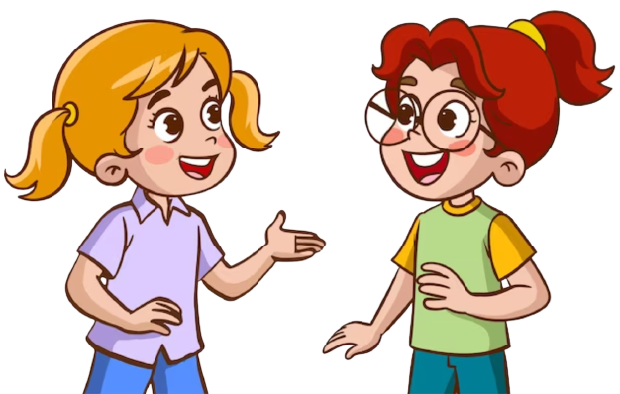
Ask and answer ! ! !
1. Whose set square is on her desk?
2. Where are Hung’s pencils?
3. Whose storybook is in her school bag?
4. Where is Lan’s storybook?

Slide 17

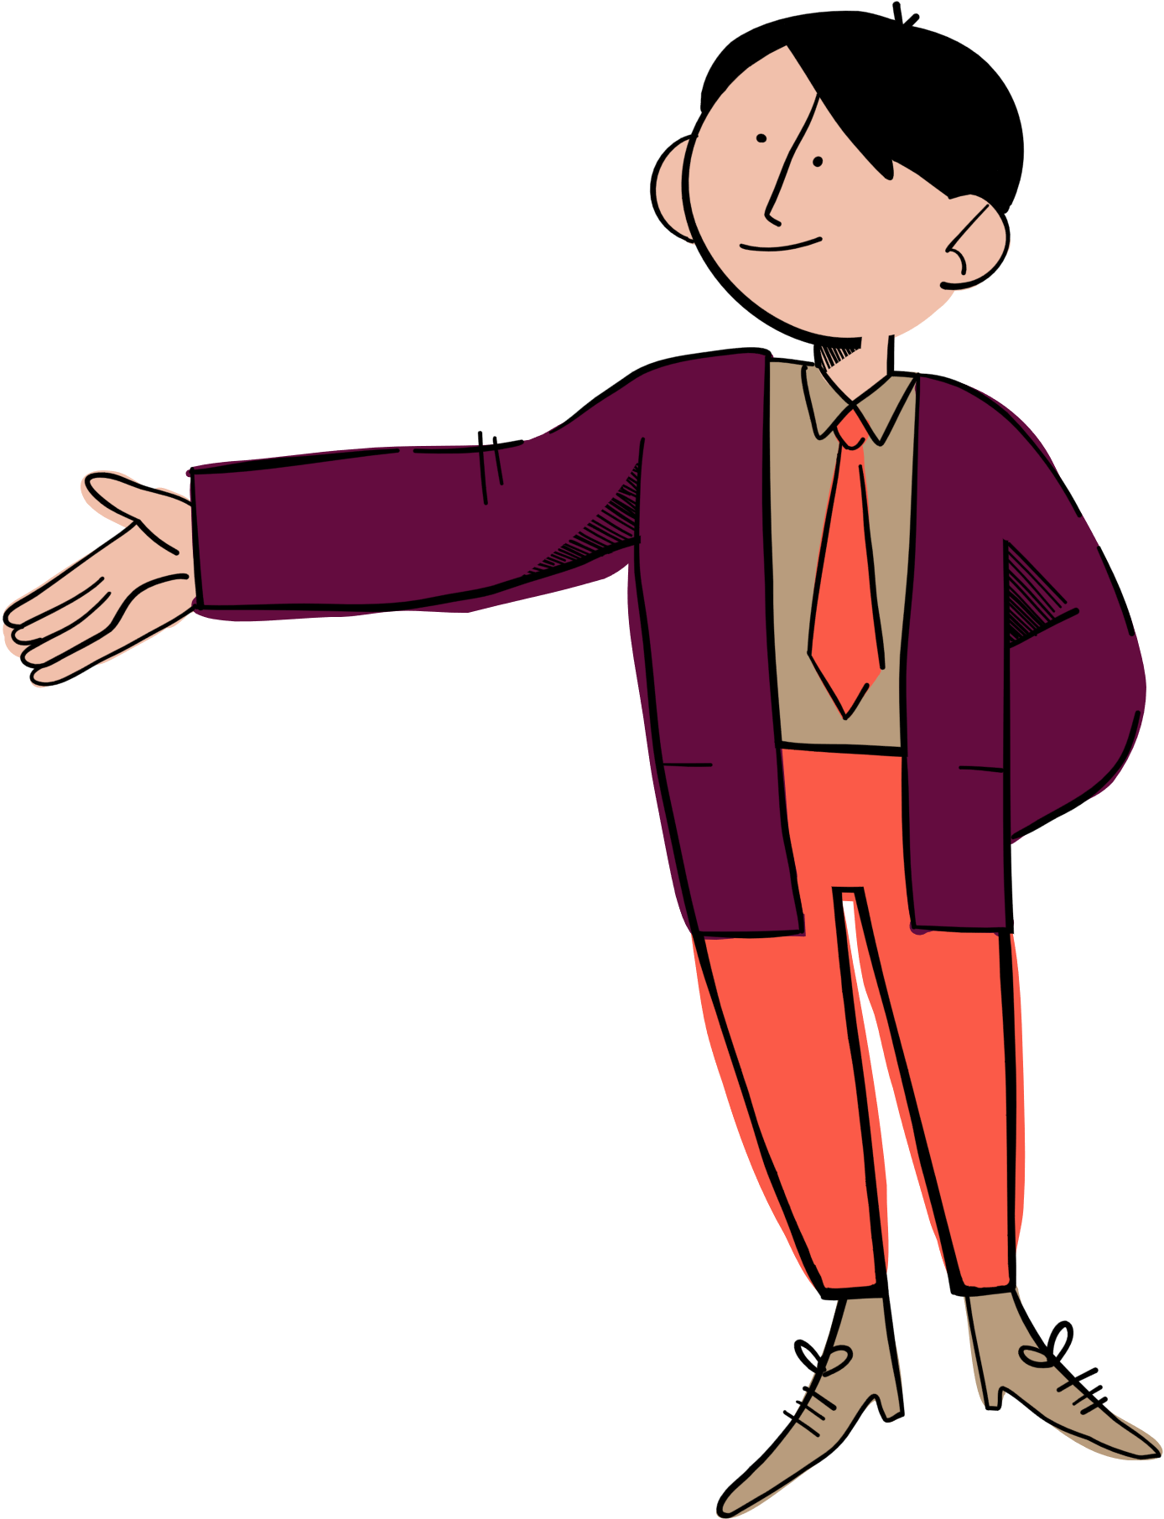



Where is Hung’s storybook?
Who is the text about?
Whose set square is on her desk?
Whose pencils are in front of his pencil sharpener?
Whose storybook is in her school bag?
Where are Hung’s pencils?
Whose school bag is under her desk?
Where is Lan’s storybook?

Slide 19
03
Look and write.

Slide 20




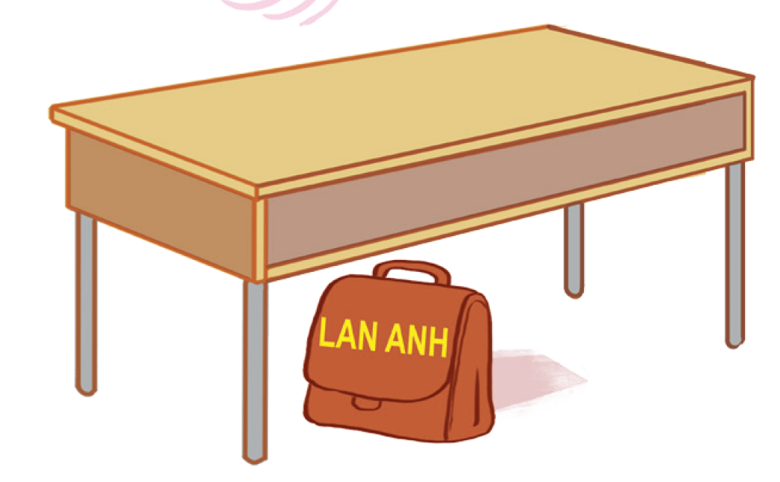
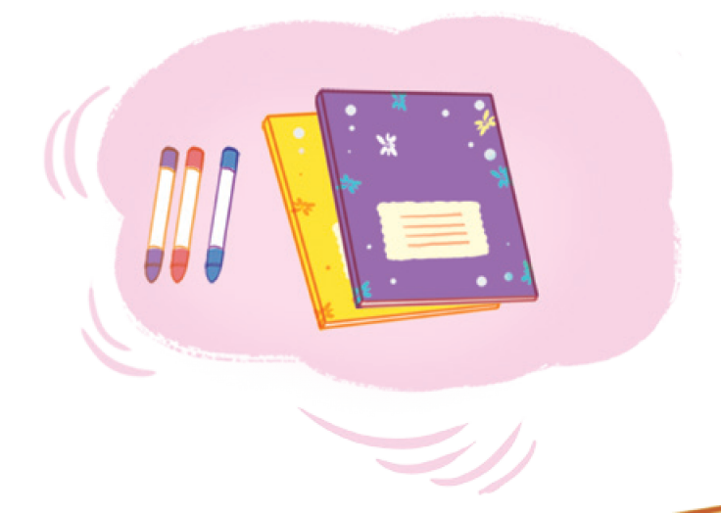
Look and say!

Slide 21




Read and guess.
I have some new __________________.
The crayons are _______ the notebooks.
Lan Anh has a new ________________ .
Lan Anh’s __________ is ___________ .

Slide 22
Look and write.
crayons
I have some new _________ .
The crayons are _______ the notebooks.
Lan Anh has a new _________ .
Lan Anh’s _______ is _________ .

Slide 23
SWAP YOUR BOOKS!

Slide 24
Let’s check!
crayons
I have some new ________.
beside
The crayons are _______ the notebooks.
school bag
Lan Anh has a new ___________.
school bag
under the desk
Lan Anh’s __________ is ______________.

Slide 26
04
Project

Slide 27
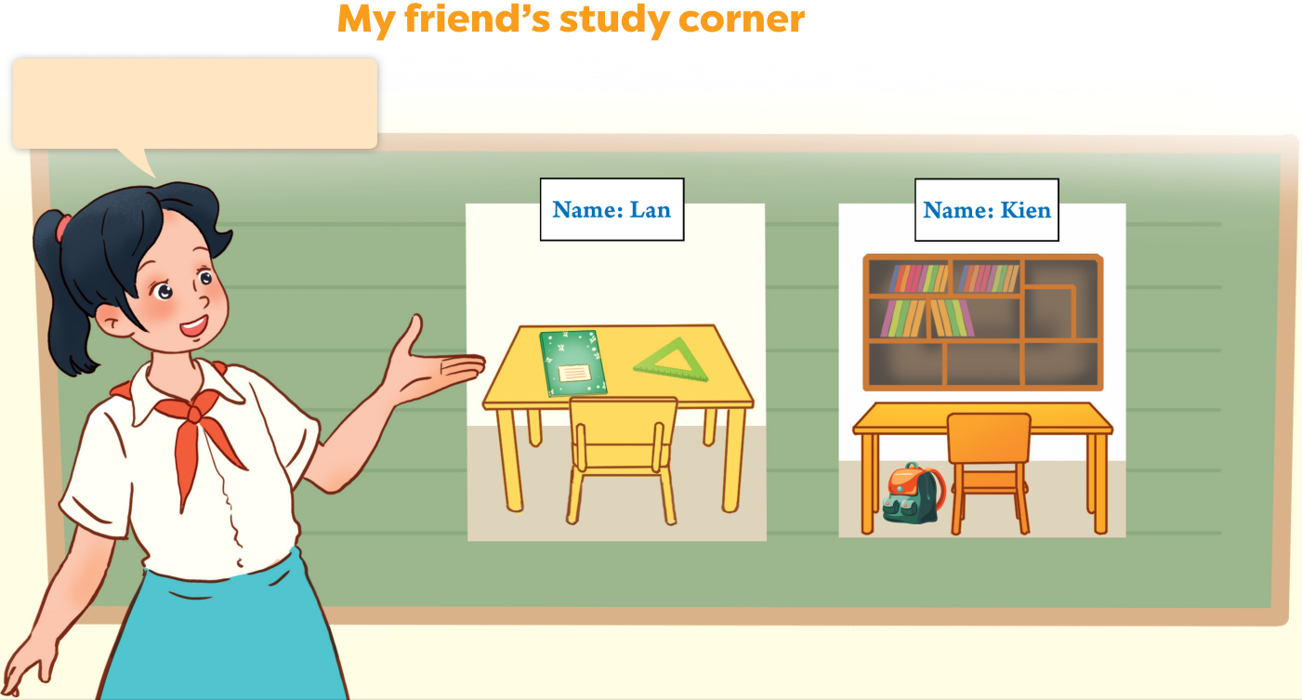
Look at your groups’ pictures!

Slide 28


Work in groups.
Study
Corner
Study
Corner
Study
Corner

Slide 29
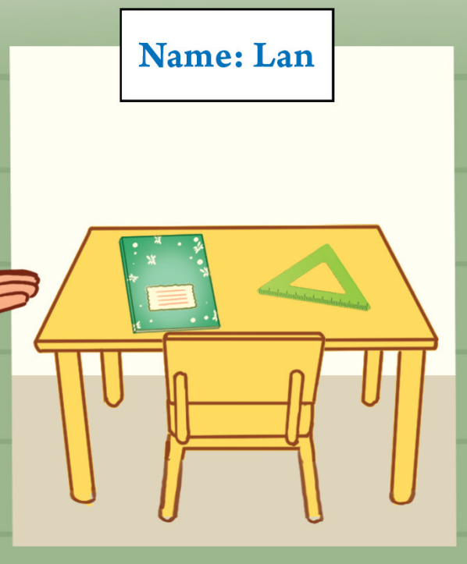
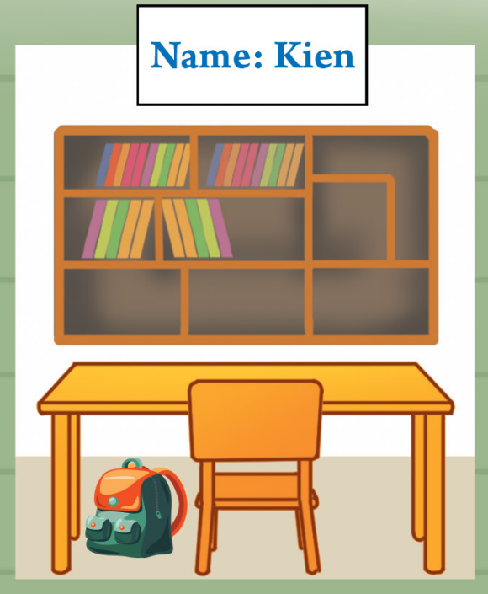
Present your group’s picture.

Slide 31
05
Fun corner & Wrap-up

Slide 32


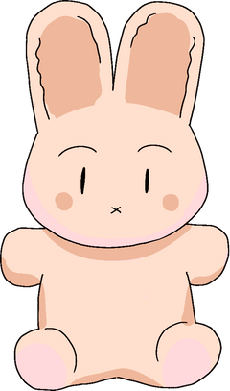



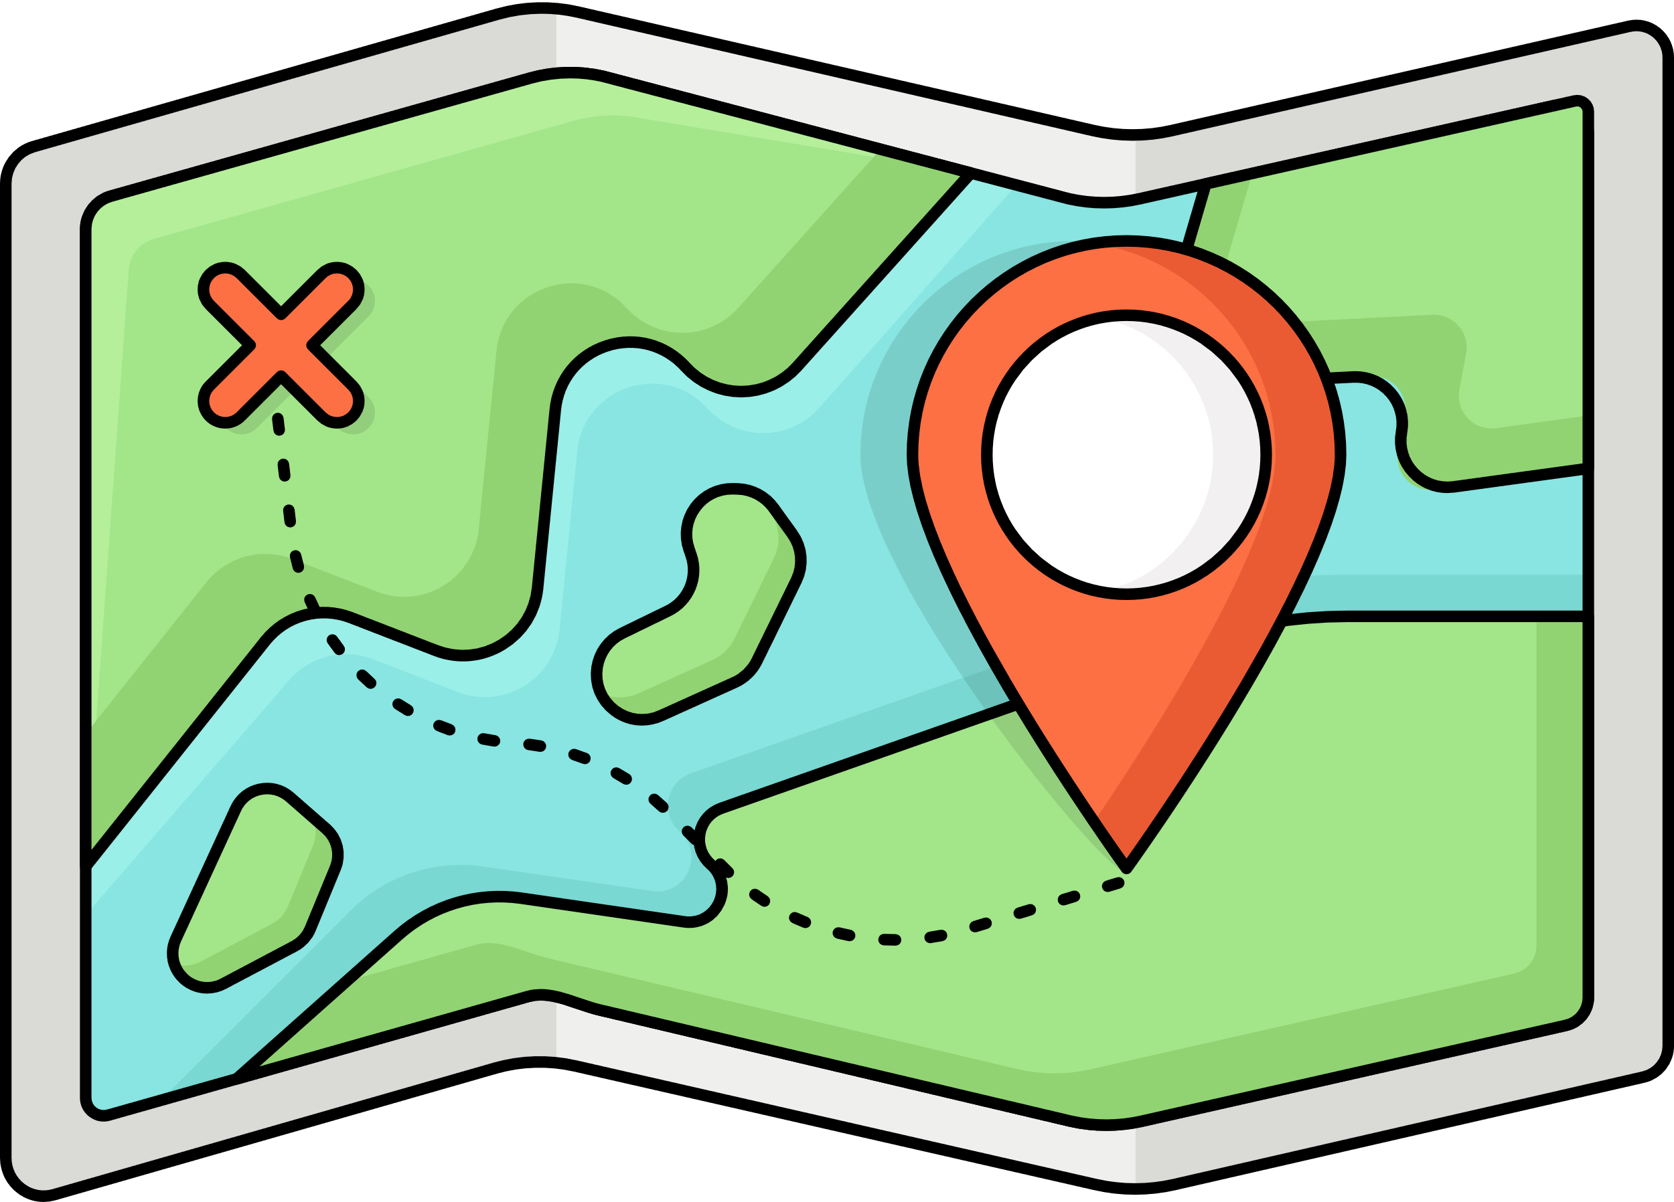



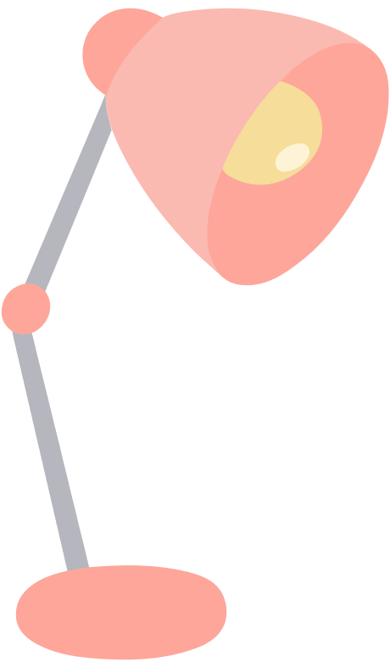




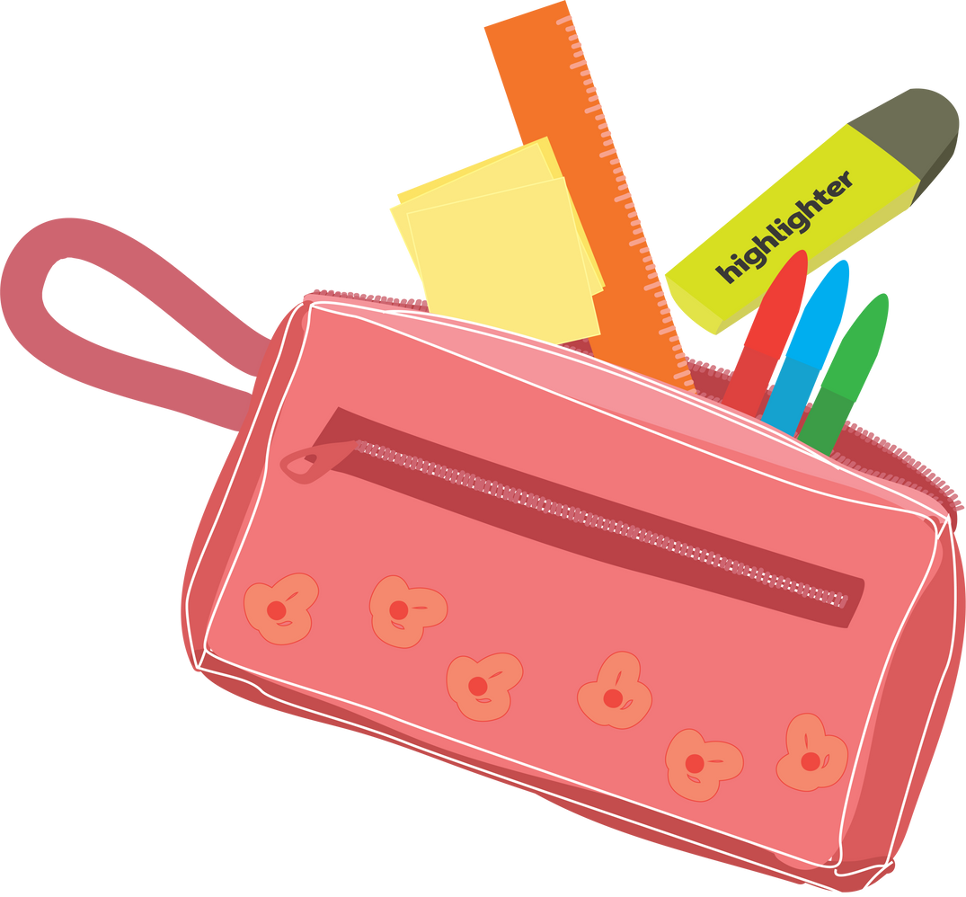






Welcome to 5th Grade!
Let's play
Missing Cards game

Slide 33





Slide 34





Slide 35











Slide 36


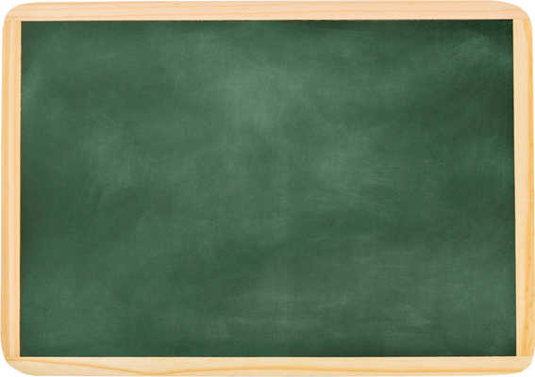


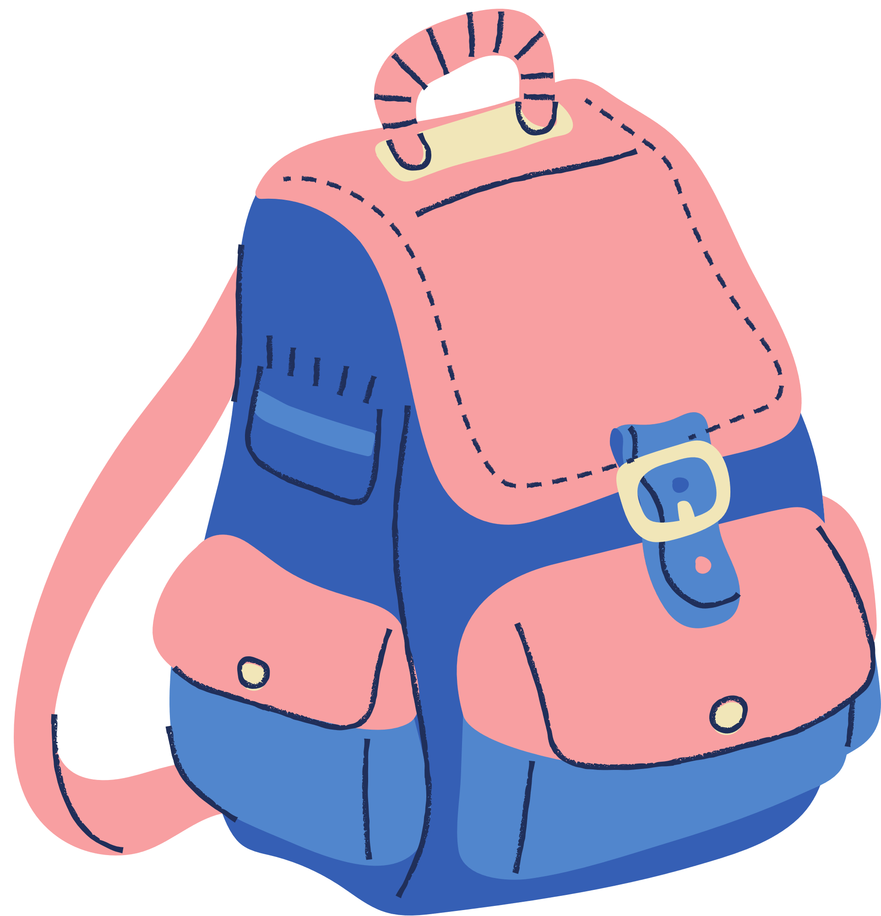
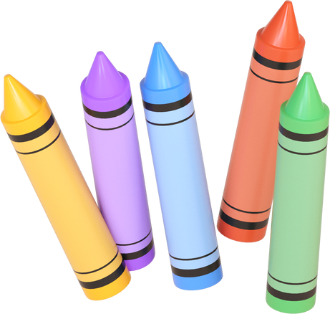



Slide 37


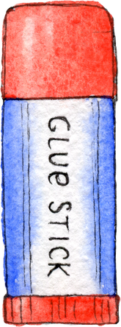

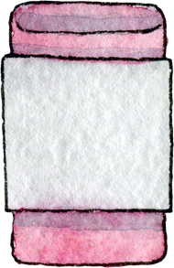
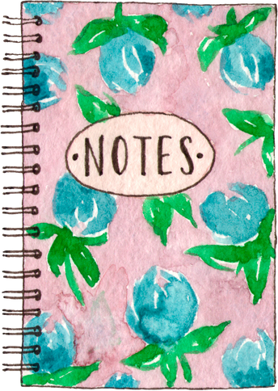
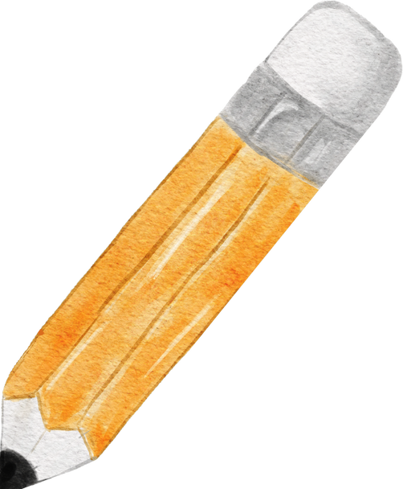



Slide 38



Let’s see!
Score Board
Team 1
Team 2
Team 3
Team 4

Slide 39
Website: hoclieu.vn
Fanpage: https://www.facebook.com/tienganhglobalsuccess.vn/

