Slide 2
Tiếng Anh 2
Giáo viên: Tô Thị Hà
Lớp dạy: 2A1
Đơn vị công tác: Trường TH Hưng Đạo

Slide 4


WELCOME
To Our Class

Slide 5
Unit 3: At the seaside
Lesson 1 – Period 1

Slide 6
TABLE OF CONTENTS
Warm-up & Review
Activity 1: Listen and repeat.
Activity 2: Point and say.
Fun corner & Wrap-up

Slide 7
01
Warm-up & Review
Game: Sing and complete

Slide 8

Where’s Kate?
She’s in the yard.
Is she ____ a bike?
Yes, __ is. Yes, __ is.
Where’s Ken?
He’s in the yard.
Is he riding a ___?
No, __ isn’t. No, __ isn’t.
riding
she
she
bike
he
he

Slide 9
Where’s Kate?
She’s in the yard.
Is she ____ a bike?
Yes, __ is. Yes, __ is.
Where’s Ken?
He’s in the yard.
Is he riding a ___?
No, __ isn’t. No, __ isn’t.
riding
she
she
bike
he
he

Slide 10



Unit
02
Activity 1
Listen and repeat.

Slide 11



Unit
1. Listen and repeat.
seaside

Slide 12


Unit
1. Listen and repeat.
sail
sand
sea

Slide 13
Unit
1. Listen and repeat.
sail
sand
seaside
sea

Slide 14



Let’s guess!
What’s the picture?
sand
Notes:
Click the picture 3 times for pupils to guess.
Click the word to hear the sound.

Slide 15

Let’s guess!
What’s the picture?
sea
Notes:
Click the picture 3 times for pupils to guess
Click the word to hear the sound

Slide 16
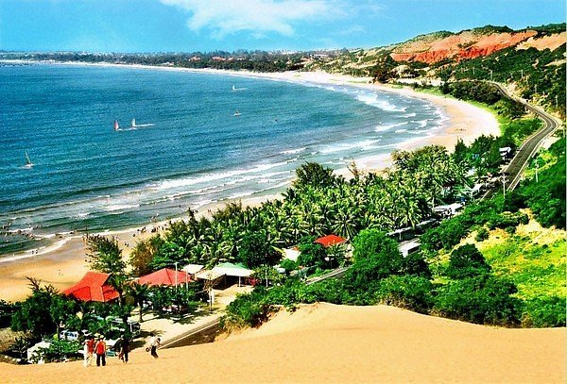
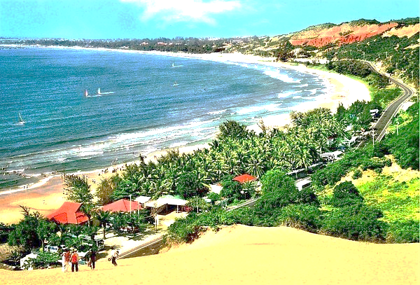
What’s the picture?
seaside
Notes:
Click the picture 3 times for pupils to guess
Click the word to hear the sound

Slide 17
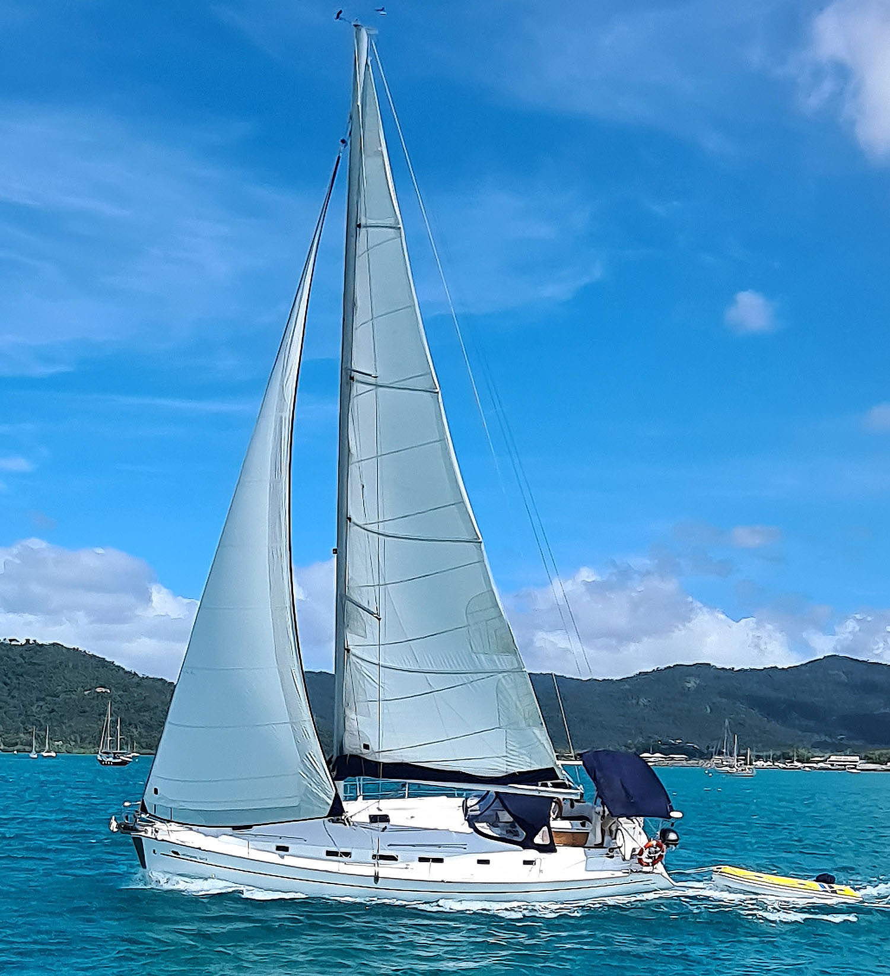


What’s the picture?
sail
Notes:
Click the picture 3 times for pupils to guess
Click the word to hear the sound

Slide 18
Unit
03
Activity 2
Point and say.

Slide 19


Unit
s
Point and say.
seaside
Notes:
Click letter S to hear the sound
Click to see the picture and the word
Click the word to hear the sound

Slide 20

Unit
s
Point and say.
sail
Notes:
Click letter S to hear the sound
Click to see the picture and the word
Click the word to hear the sound

Slide 21

Unit
Point and say.
s
sea
Notes:
Click letter S to hear the sound
Click to see the picture and the word
Click the word to hear the sound

Slide 22
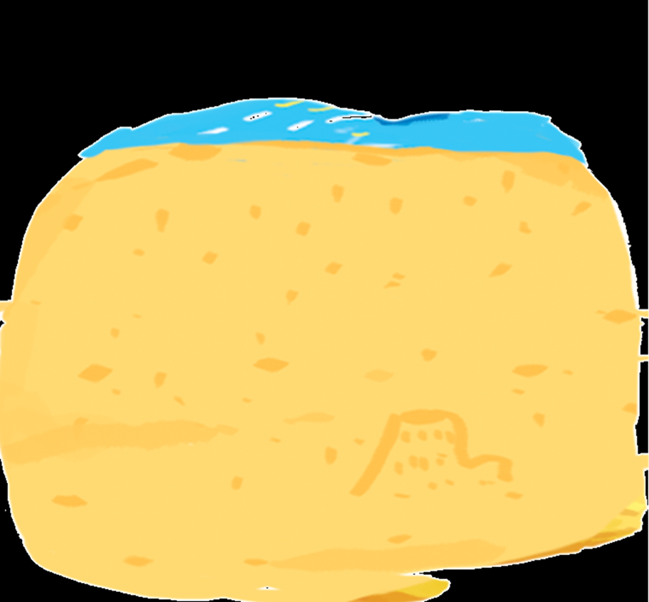
Unit
s
Point and say.
sand
Notes:
Click letter S to hear the sound
Click to see the picture and the word
Click the word to hear the sound

Slide 23
Unit
s
Point and say.
seaside
sail
sea
sand

Slide 24

Unit
Point and say.
GROUP WORK

Slide 25

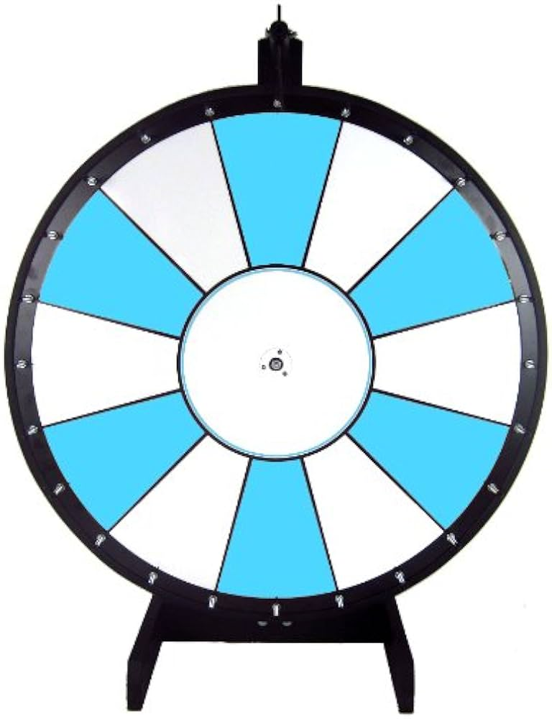






Unit
Point and say.
Notes:
Click the hand to spin and stop the wheel

Slide 26
04
Fun corner & Wrap-up
Game: Pelmanism

Slide 27








Game: Pelmanism
sand
seaside
sea
sail
Notes:
Click to open or cover the pictures and the words

Slide 28


Slide 29
GOODBYE!
See you next time!

Slide 30
Website: hoclieu.vn
Fanpage: https://www.facebook.com/tienganhglobalsuccess.vn/

