Slide 1
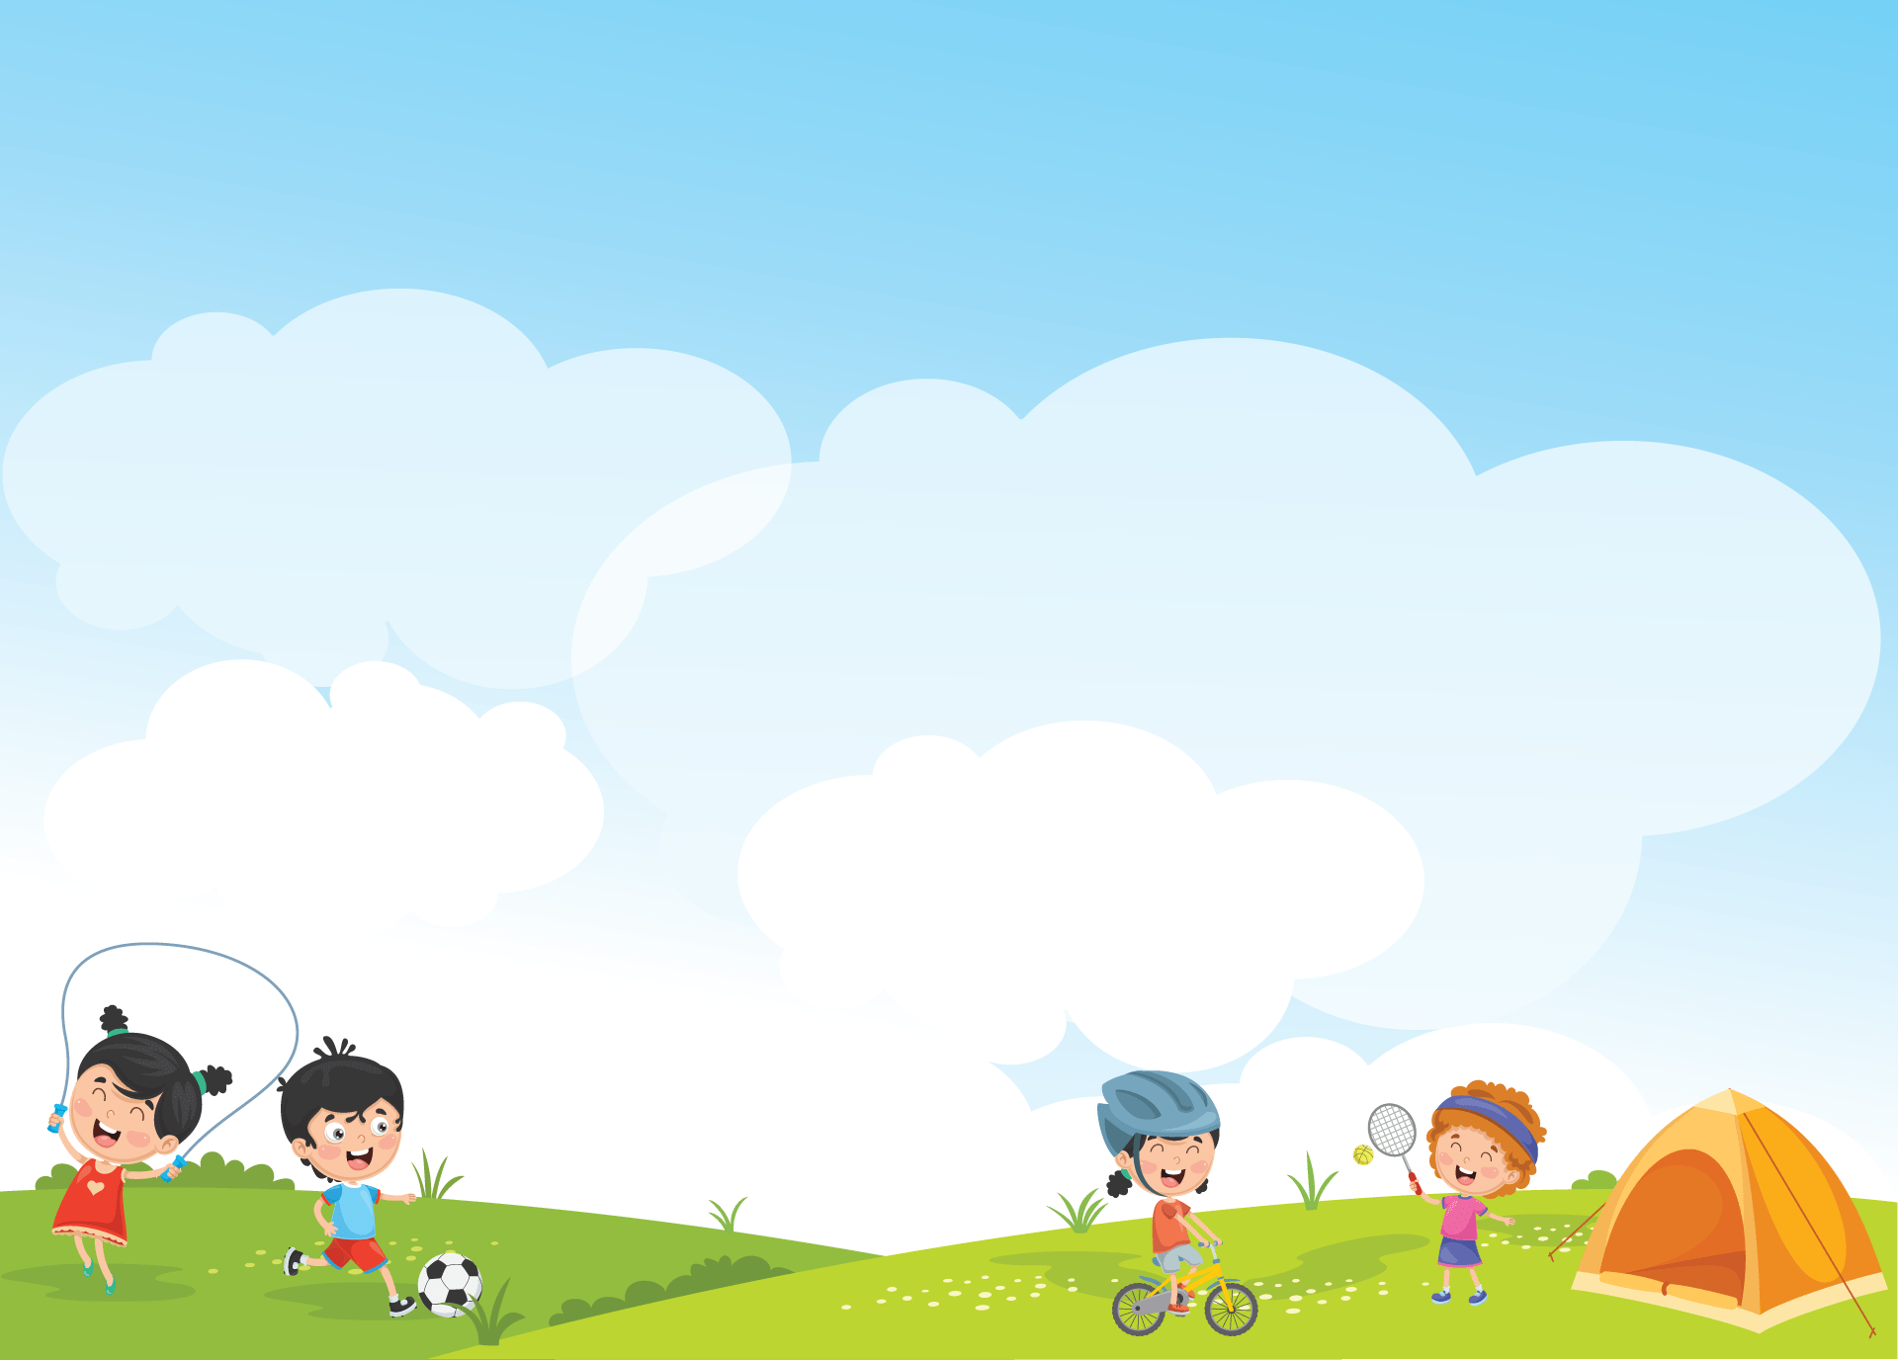


Giáo viên: Đồng Thị Như Quỳnh
Lớp dạy: 5A5, 5A6, 5A7
Đơn vị công tác: TRƯỜNG TIỂU HỌC HƯNG ĐẠO

Slide 2





My foreign friends
Unit 3
Lesson 3 (1,2,3)

Slide 3


01
Warm-up and Review

Slide 4


Describing people's
APPEARANCE
and
PERSONALITY

Slide 5

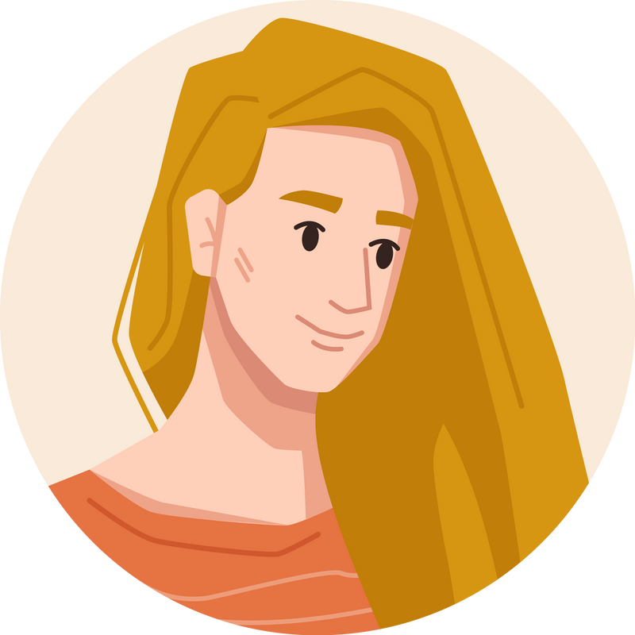
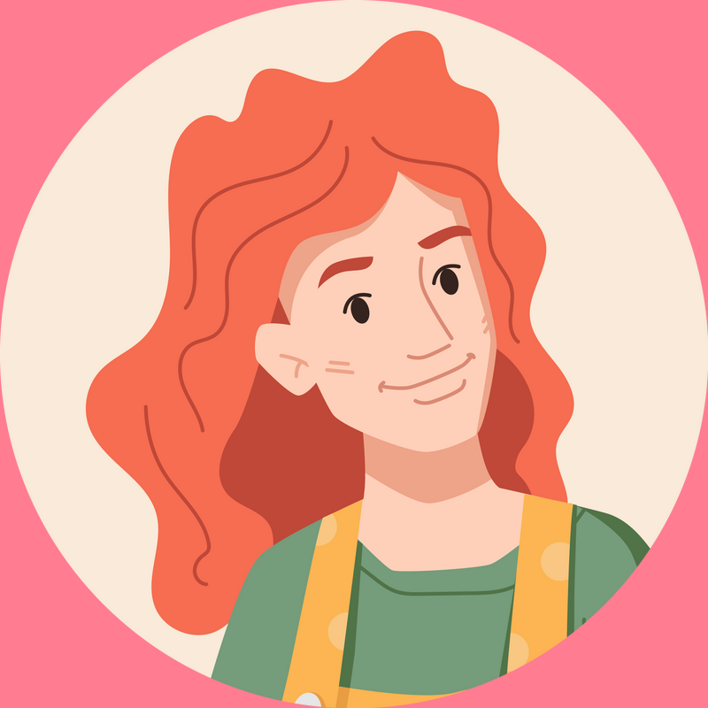

She has long and red hair.

Slide 6

She has long and red hair.

Slide 7

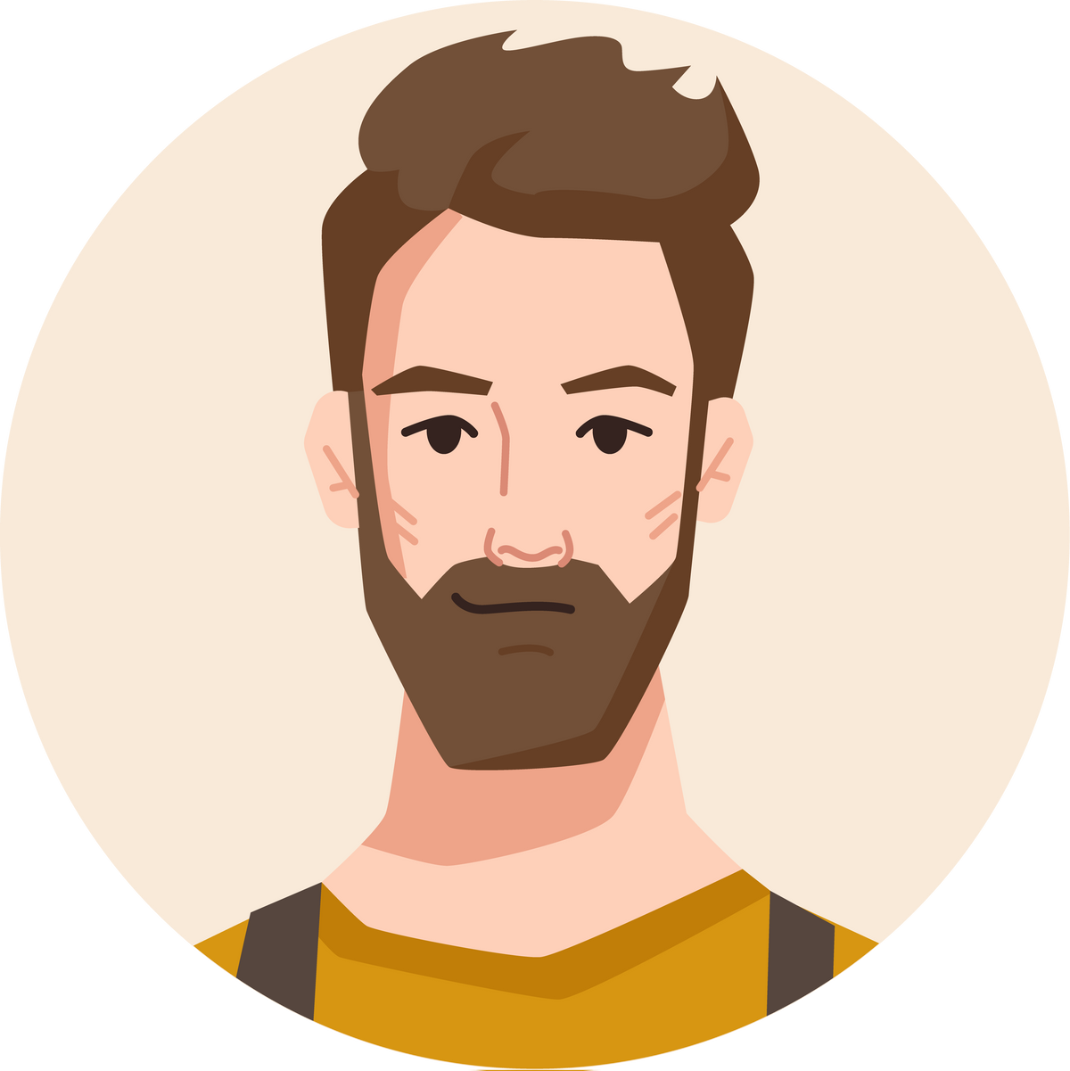
He has long and brown hair.
He is big and fat.
He has short and brown hair.

Slide 8
He has long and brown hair.
He is big and fat.
He has short and brown hair.

Slide 9
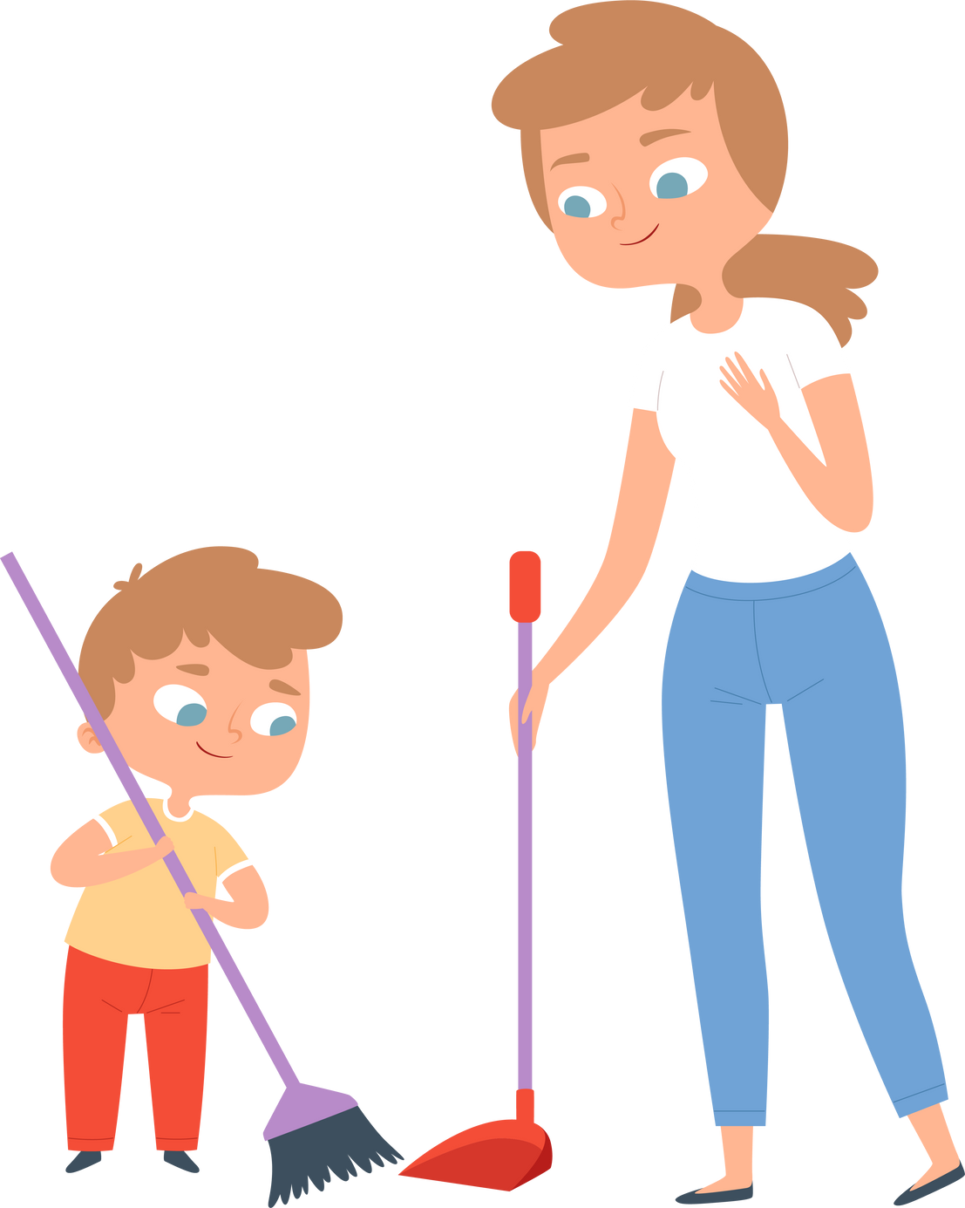
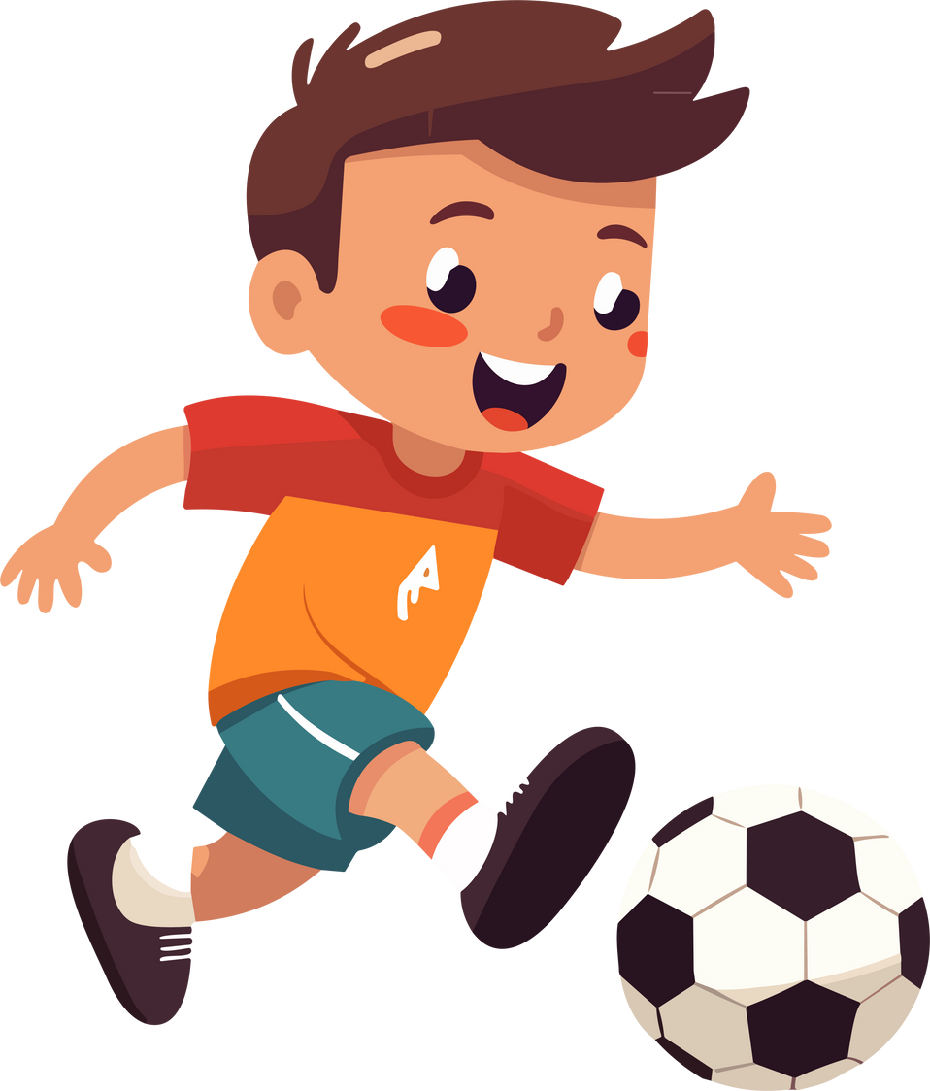
He is very active.

Slide 10
He is very active.

Slide 11

My sister has eyes.

Slide 12
big
My sister has eyes.

Slide 13


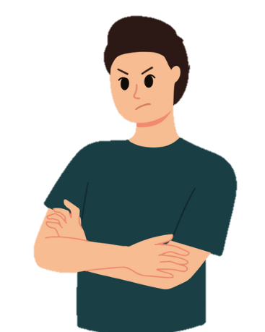
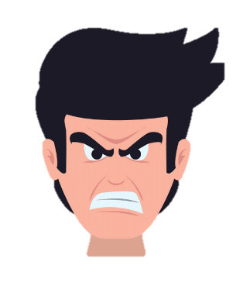
My brother is friendly.

Slide 14
My brother is friendly.

Slide 15


My little brother is helpful.
My little brother is clever.
My little brother is active.

Slide 16
My little brother is helpful.
My little brother is clever.
My little brother is active.

Slide 17
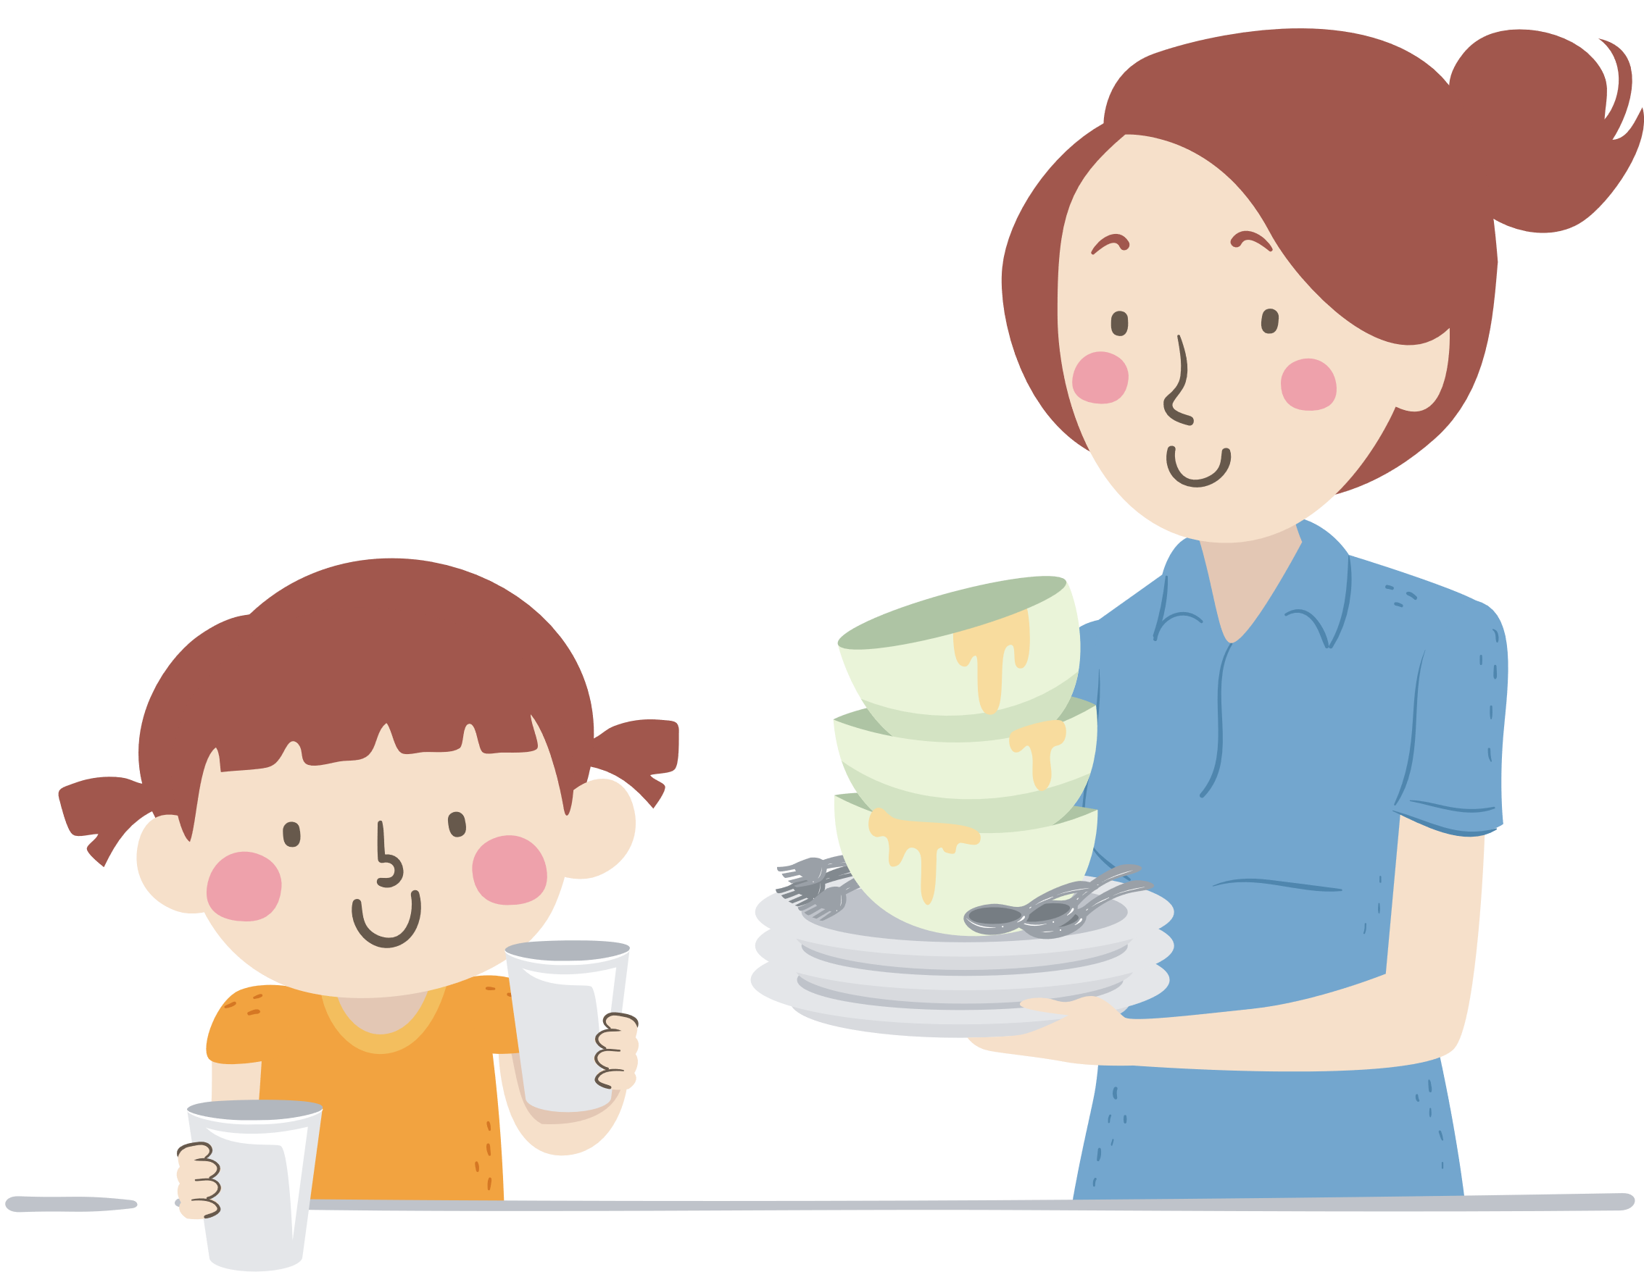
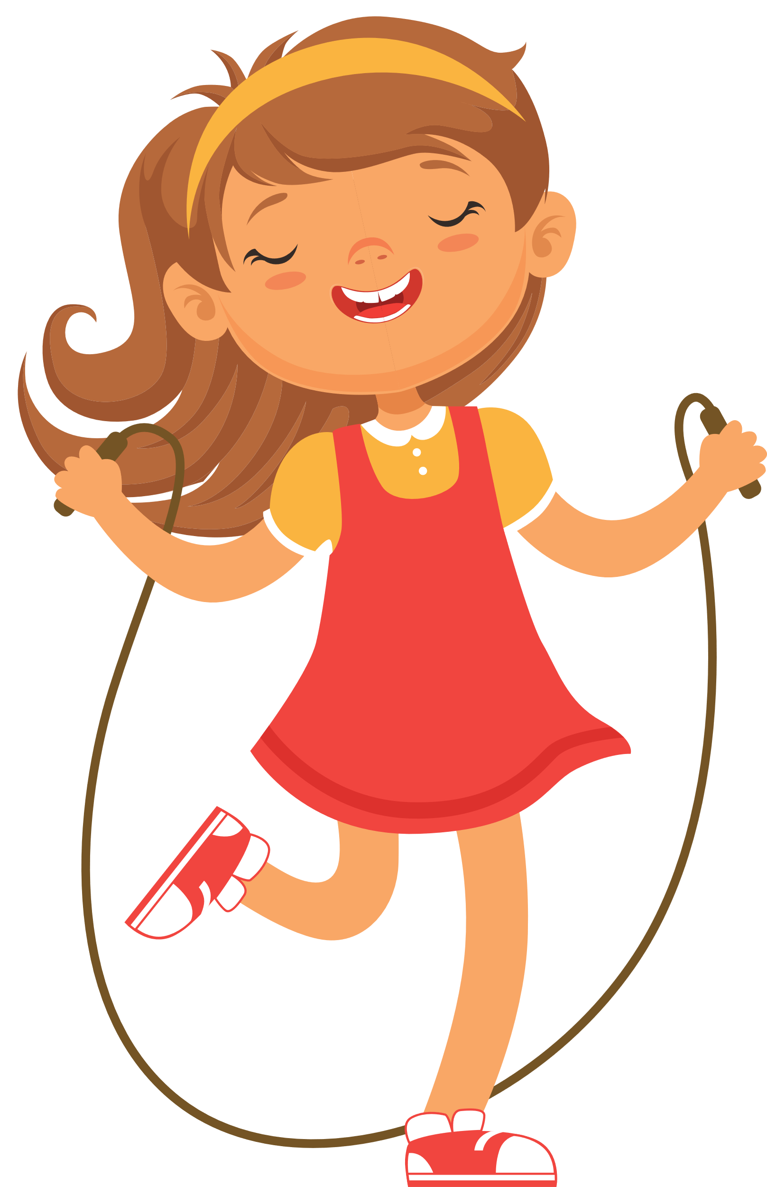
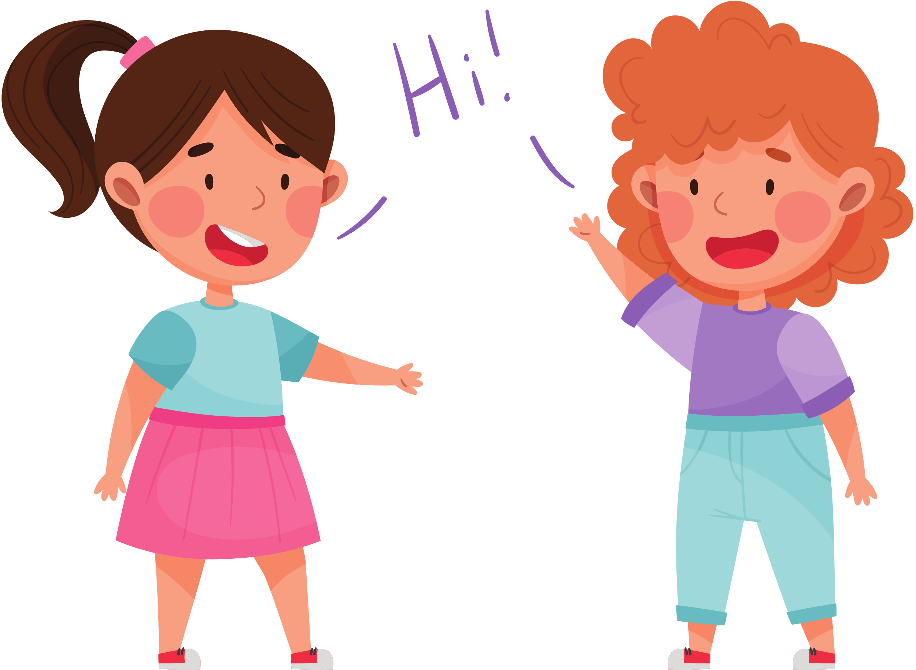
My younger sister is helpful.

Slide 18
My younger sister is helpful.

Slide 19





Slide 20
02
Listen and repeat.

Slide 21
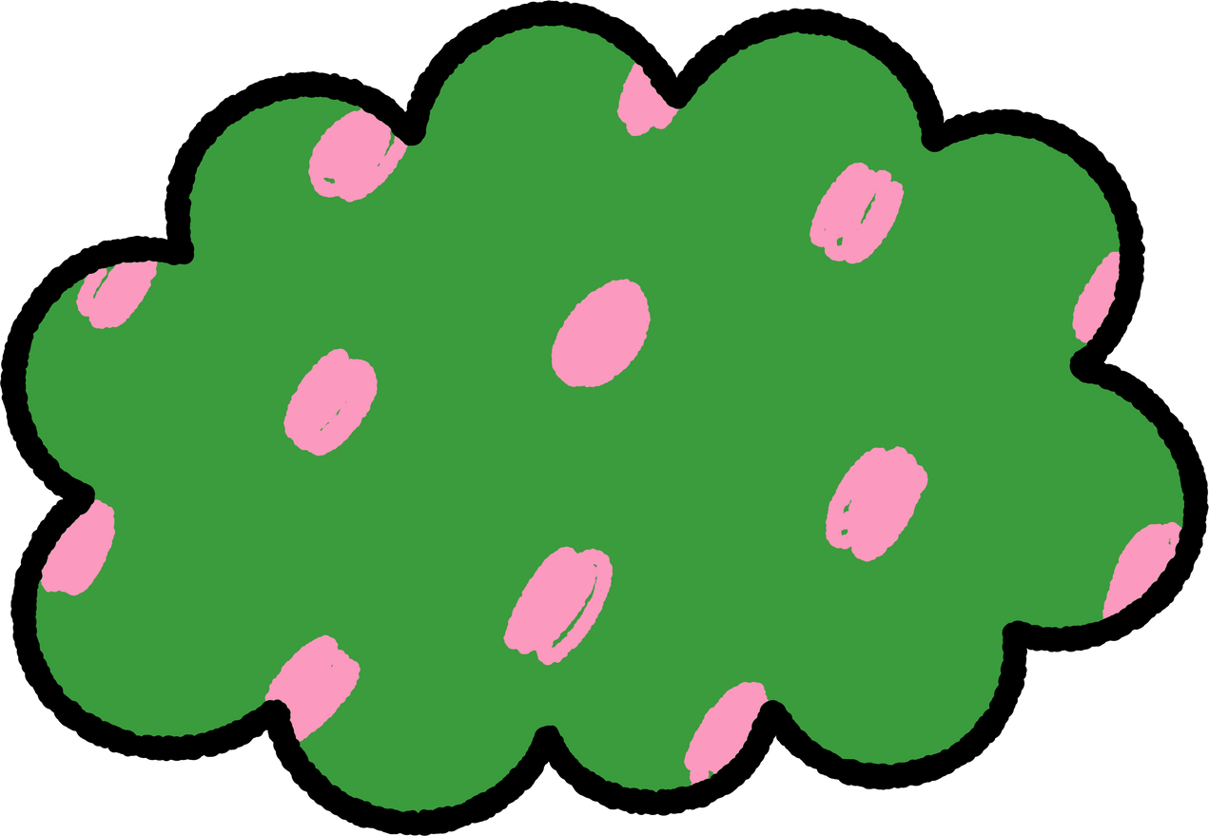




LISTEN, POINT AND REPEAT.
‘active
He’s ‘active.

Slide 22
LISTEN, POINT AND REPEAT.
‘friendly
She’s ‘friendly.

Slide 23



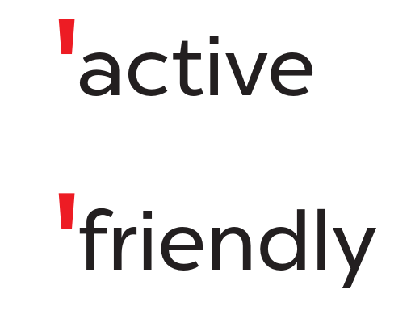
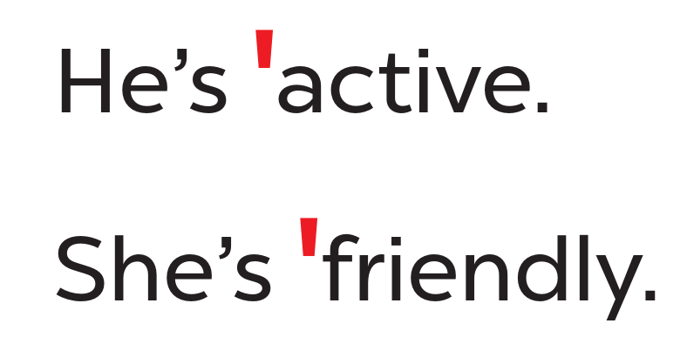


WORK IN PAIRS.

Slide 24
03
Circle, listen and check.

Slide 25




READ AND CIRCLE.
a. friendly
b. fifteen
c. active
a. sixteen
b. eighteen
c. clever
a. helpful
b. about
c. nineteen

Slide 26

SWAP YOUR BOOKS.

Slide 27
LISTEN AND CHECK.
a. friendly
b. fifteen
c. active
a. sixteen
b. eighteen
c. clever
a. helpful
b. about
c. nineteen

Slide 28



LOOK AND SAY ALOUD.
friendly
helpful
active
clever
She’s active.
He’s friendly.
He’s clever.
She’s helpful.

Slide 30
04
Let’s chant.

Slide 31

LOOK AND SAY.
play basketball
active

Slide 32

LOOK AND SAY.
clean the table
helpful

Slide 33
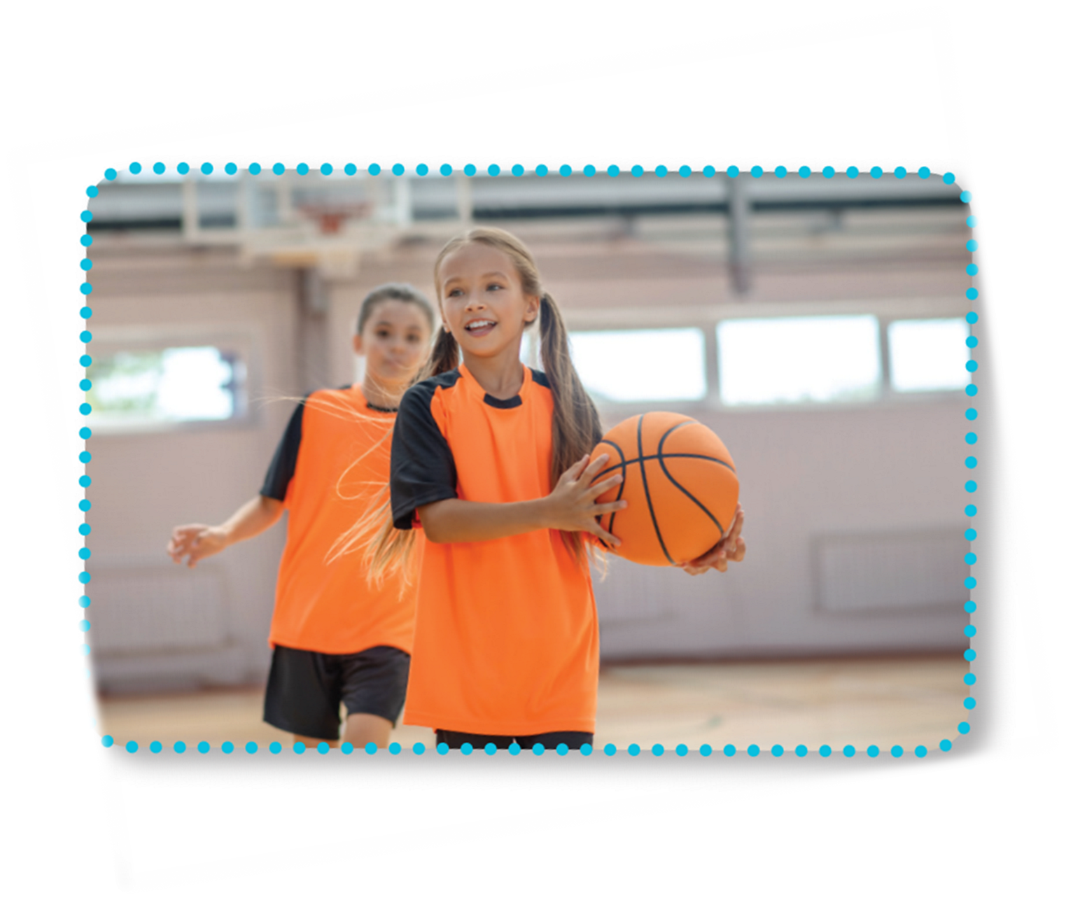

LOOK AND READ.
Is she active?
Yes, she is.
Is she friendly?
Yes, she is.
She’s active and friendly.

Slide 34
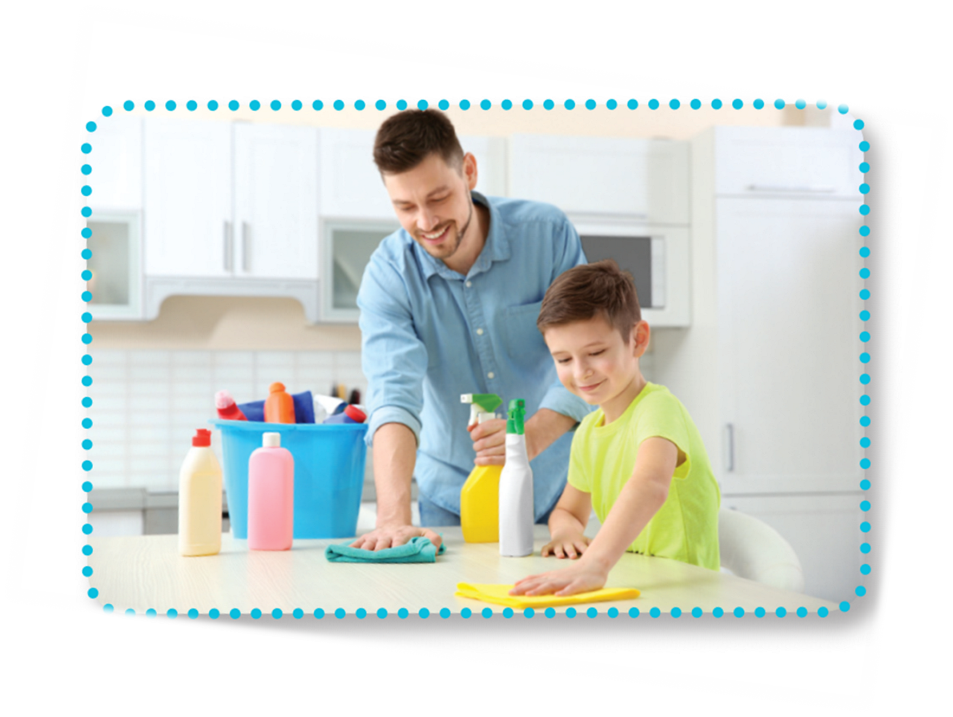
LOOK AND READ.
Is he helpful?
Yes, he is.
Is he clever?
Yes, he is.
He’s helpful and clever.

Slide 35

LISTEN AND POINT.
Is she active?
Yes, she is.
Is she friendly?
Yes, she is.
She’s active and friendly.

Slide 36

LISTEN AND POINT.
Is he helpful?
Yes, he is.
Is he clever?
Yes, he is.
He’s helpful and clever.

Slide 37

LISTEN AND REPEAT.
Is she active?
Yes, she is.
Is she friendly?
Yes, she is.
She’s active and friendly.

Slide 38

LISTEN AND REPEAT.
Is he helpful?
Yes, he is.
Is he clever?
Yes, he is.
He’s helpful and clever.

Slide 39

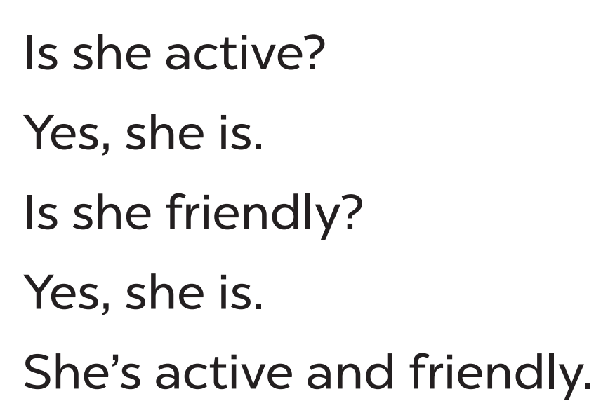
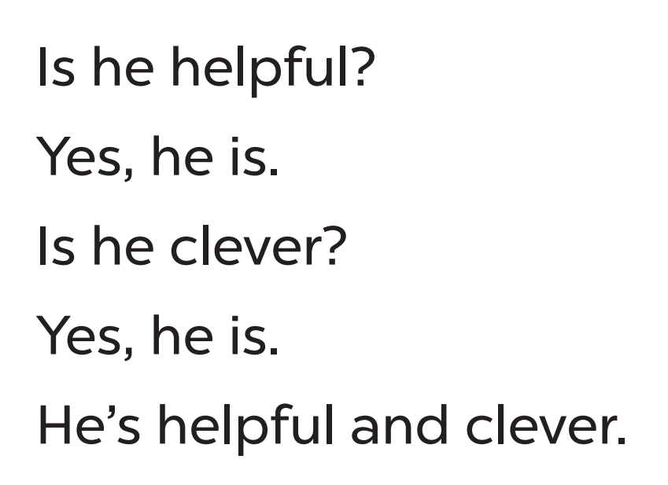
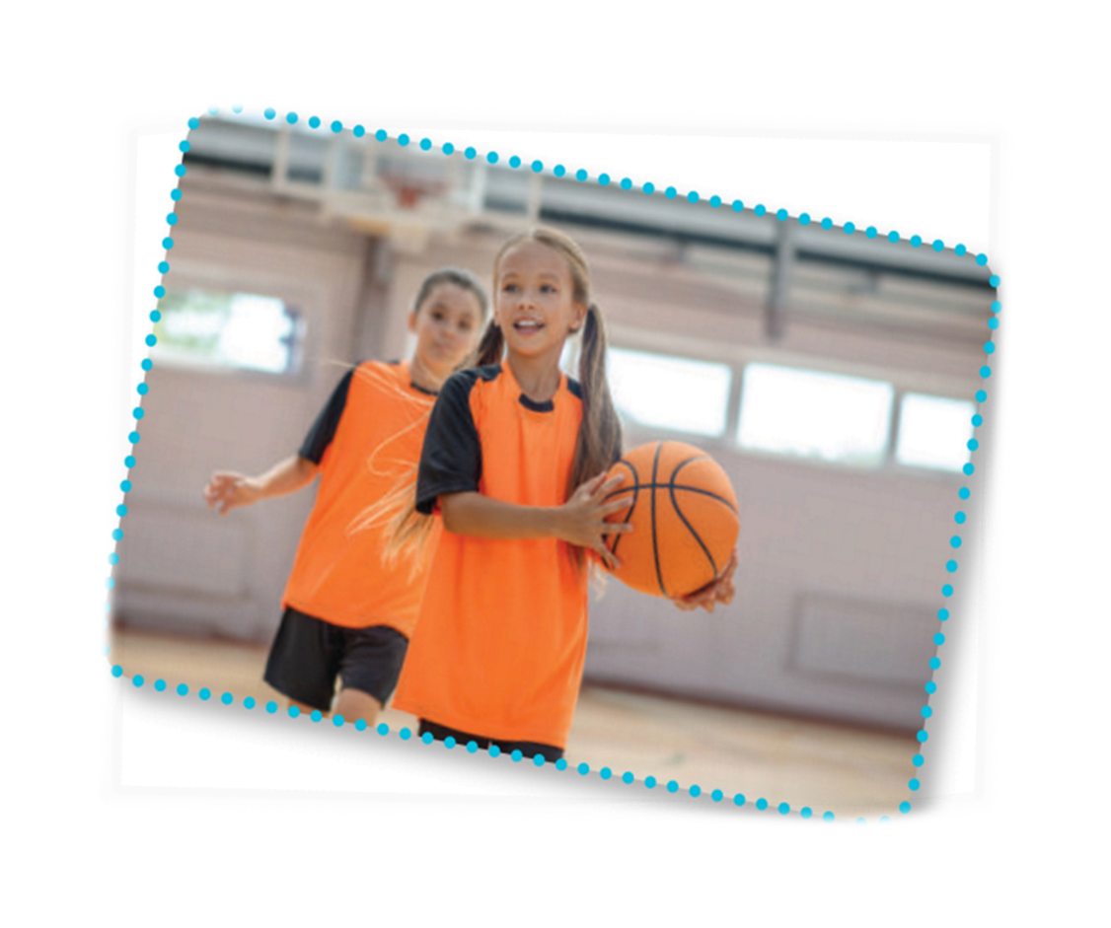

CHANT AND CLAP

Slide 40




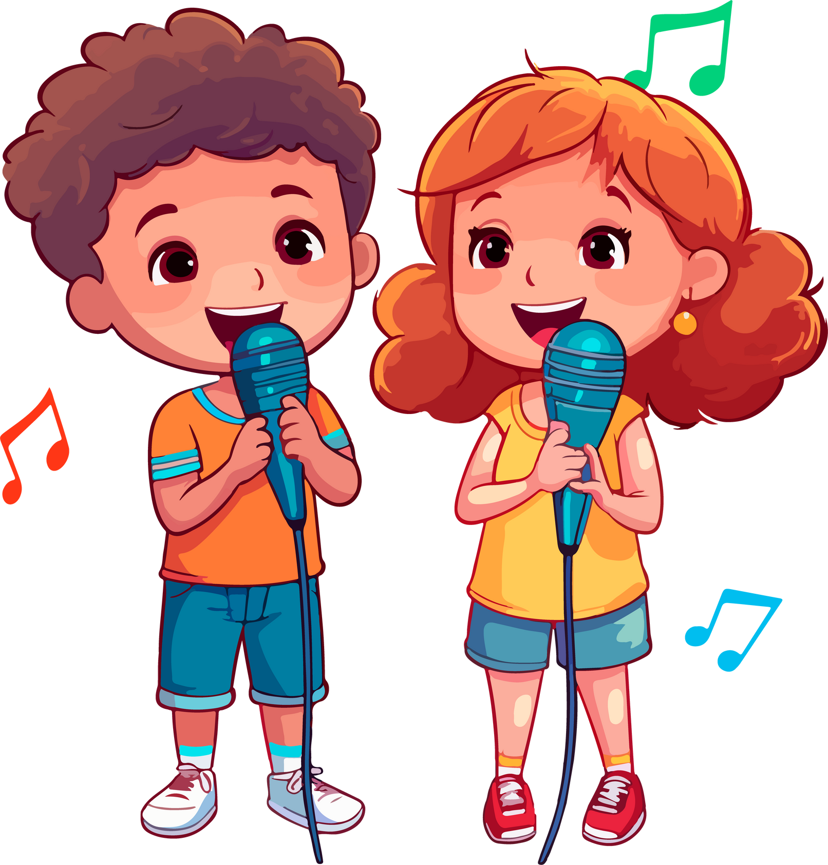


LET’S CHANT IN THE FRONT.
Notes:
Link video hoạt hình: https://hoclieu.vn/hop-phan-bo-tro/video-hoat-hinh/203?gidzl=92okFGyK4JiWCwOu3mqMD24oe3WI2HLjEJAgQKPOJcu-OVXg4b1FQ6fX-3XEMKSwOc7oEpCT2OOq2nKGE0

Slide 41
PRACTISE THE NEW CHANT.
happy
busy
quiet
tidy
gentle
Is she active?
Is he helpful?
Yes, she is.
Yes, he is.
Is she friendly?
Is he clever?
Yes, she is.
Yes, he is.
She’s active and friendly.
He’s helpful and clever.
Notes:
Extension (For consolidation): Replace two adjectives in the chant with other adjectives which have the stress on the first syllable for example, happy, busy, quiet, tidy, gentle. Have pupils practice the new chant.

Slide 43
05
Fun corner
and Wrap-up

Slide 44








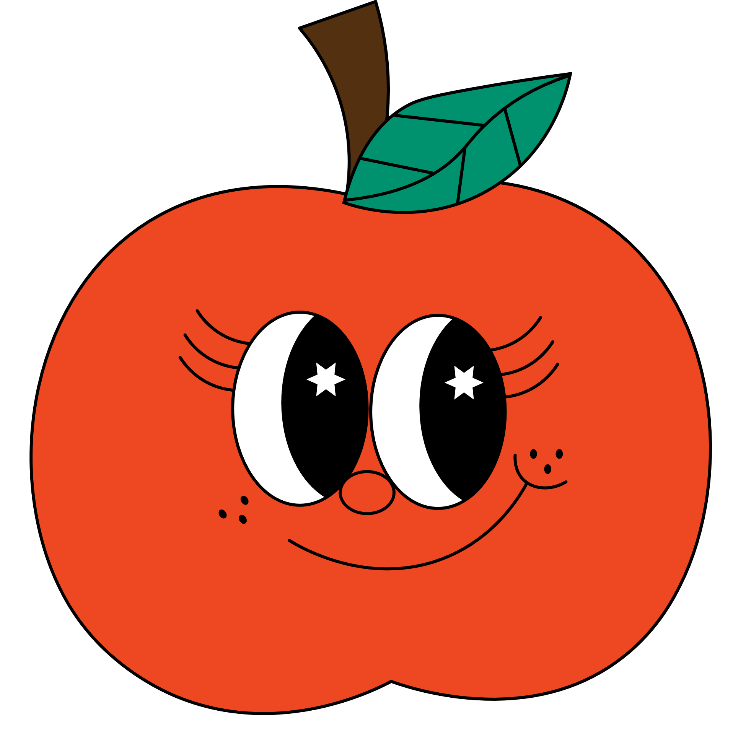


Let’s talk about your beloved ones!
Have fun!

Slide 45








What is like?
Let’s talk about the friend sitting at your left.

Slide 46






What is like?
Let’s talk about the friend sitting at your right.

Slide 47



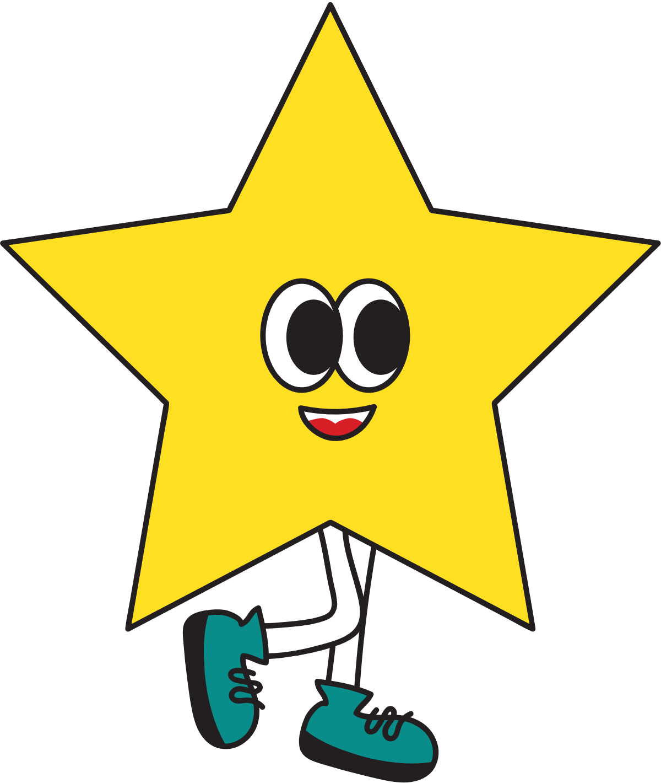


What is like?
Let’s talk about the friend behind you.

Slide 48


What is like?
Let’s talk about the friend in front of you.

Slide 49

What is like?
Let’s talk about your favourite teacher.

Slide 50


Good job!

Slide 51
Website: hoclieu.vn
Fanpage: https://www.facebook.com/tienganhglobalsuccess.vn/

