Slide 1
Tiếng Anh 3
Giáo viên: Lê Thị Minh Hiếu
Lớp dạy: 3A2, 3A3, 3A4, 3A5, 3A6
Đơn vị công tác: Trường TH Hưng Đạo

Slide 2



Slide 3




3
Our friends
LESSON 3 – PERIOD 6

Slide 4


CONTENTS
1
Warm up & Review
2
Read and match.
3
Let’s write.
4
Project
Fun corner & Wrap-up
5
Next
Notes:
G

Slide 5










A
B
Warm-up & Review
1
60
10
70
45
90
30
20
100
35
80
40
50
CLICK THE WHEEL
Notes:
HS chọn con cá mình thích để đi đến câu hỏi, nhấn vào loa để nghe rồi chọn câu trả lời. Nhấn vào nút Home để quay lại vòng quay và nhận điểm.

Slide 6






LISTEN AND CHOOSE THE RIGHT SOUND.
Th
θ
Th
θ
Th
θ
__ - __ank - __ank you, Bill.
th
ð
th
θ

Slide 7

LISTEN AND CHOOSE THE RIGHT SOUND.
th
ð
th
ð
th
ð
__ - __is - Is __is Linh?
th
ð
th
θ

Slide 8

LISTEN AND CHOOSE THE RIGHT SOUND.
th
ð
th
ð
th
ð
__ - __at - Is __at Ben?
th
ð
th
θ

Slide 9
LISTEN AND CHOOSE THE RIGHT SOUND.
Th
θ
Th
θ
Th
θ
___ - __ank - ___ank you, Mai.
th
ð
th
θ

Slide 10
LISTEN AND CHOOSE THE RIGHT SOUND.
Th
ð
__ - __is - __is is Mary.
Th
ð
Th
ð
th
ð
th
θ

Slide 11

LISTEN AND CHOOSE THE RIGHT SOUND.
Th
ð
Th
ð
Th
ð
__ - __at - __at's Lucy.
th
ð
th
θ

Slide 12
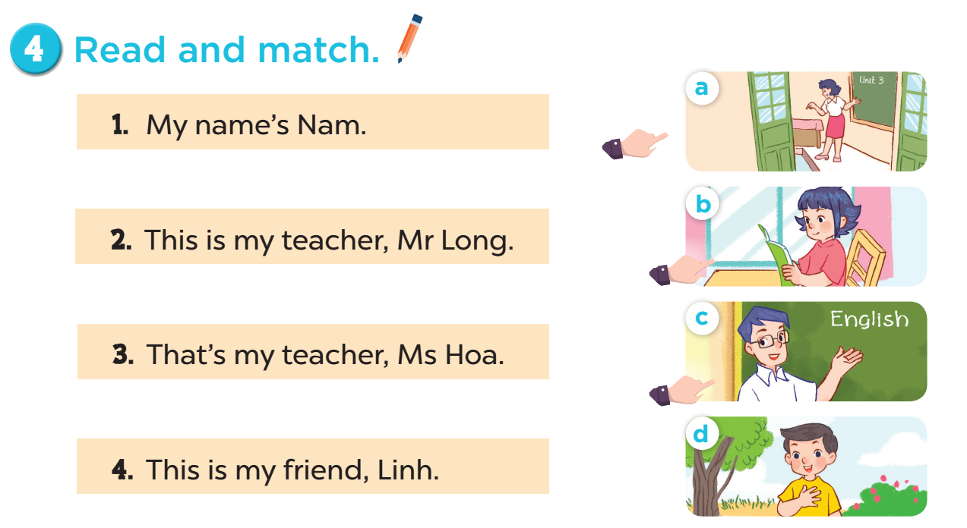

Slide 13
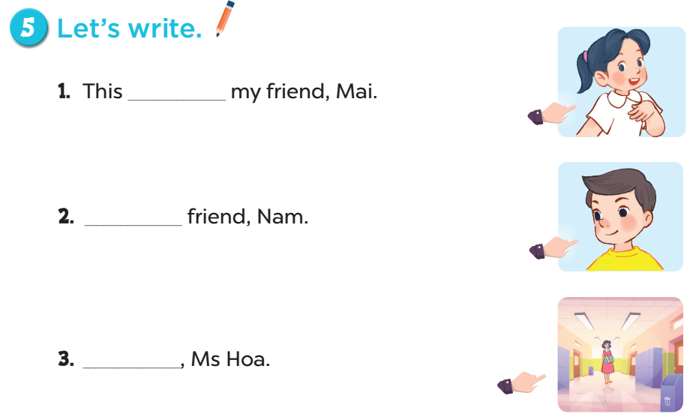
is
This is my
That’s my
teacher

Slide 14


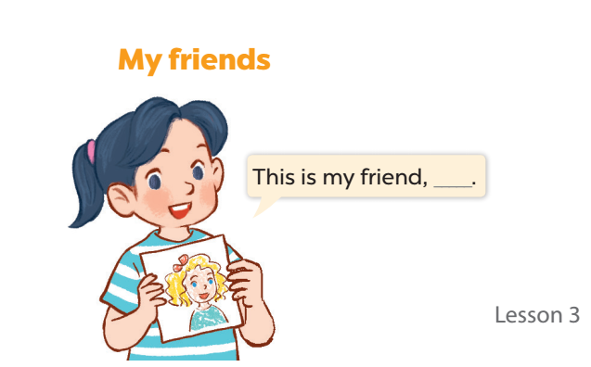


Slide 15

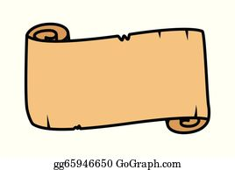

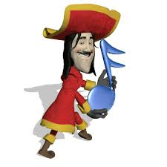
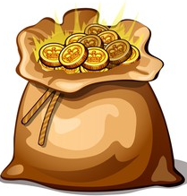



5
Fun corner & Wrap-up
TEAM A
9
9
9
0
1
2
3
4
5
6
7
8
0
1
2
3
4
5
6
7
8
0
1
2
3
4
5
6
7
8
50 points
- 10 points
1
2
TEAM B
10 points
3
4
40 points
9
9
9
0
1
2
3
4
5
6
7
8
0
1
2
3
4
5
6
7
8
0
1
2
3
4
5
6
7
8
30 points
20 points
5
6
Notes:
GV chia lớp thành 2 đội và lần lượt trả lời câu hỏi. Với mỗi đáp án đúng, học sinh được chọn một ô cửa trên tàu và nhận số điểm tương tứng với hình đã chọn.

Slide 16

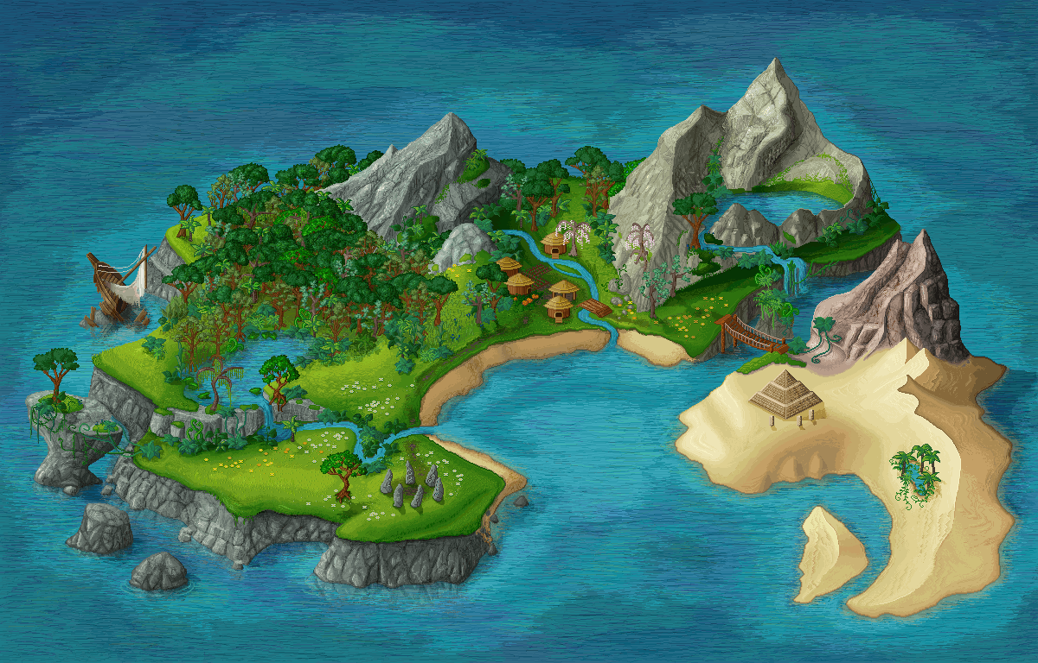




_____my friend, Mary.
This is
This
That’s
This is
NEXT

Slide 17


A
B
C
What are on the ship?
Let’s choose one window!

Slide 18
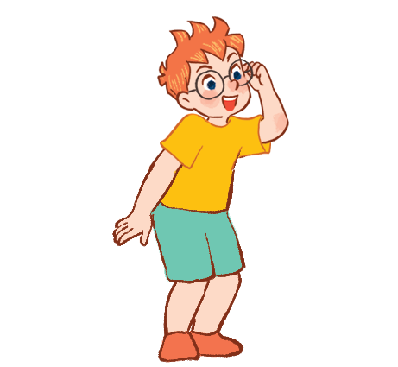

________ friend, Ben.
That is my
This is my
That is my
Is that my
NEXT

Slide 19
A
B
C
What are on the ship?
Let’s choose one window!

Slide 20

_________friend, Lucy.
This is my
This is my
Is this my
That’s my
NEXT

Slide 21
A
B
C
What are on the ship?
Let’s choose one window!

Slide 22

______ Bill?
Yes, it is.
Is that
This is
Is this
Is that
NEXT

Slide 23
A
B
C
What are on the ship?
Let’s choose one window!

Slide 24

________ friend, Linh.
This is my
This is my
Is this my
That’s
NEXT

Slide 25
A
Bb
Cc
What are on the ship?
Let’s choose one window!

Slide 26

______ friend, Nam.
That is my
This is my
That is my
Is that my
NEXT

Slide 27
A
B
C
What are on the ship?
Let’s choose one window!

Slide 28

Website: sachmem.vn
Fanpage: www.facebook.com/sachmem.vn

