Slide 1
Tiếng Anh 2
Giáo viên: Tô Thị Hà
Lớp dạy: 2A1
Đơn vị công tác: Trường TH Hưng Đạo

Slide 3





Slide 4
Unit 4: In the countryside
Lesson 2 – Period 2

Slide 5

TABLE OF CONTENTS
Warm-up and Review
2.Activity 3: Listen and chant.
3.Activity 4: Listen and circle.
4.Activity 5: Look and write.
5.Fun corner & Wrap-up

Slide 6

01
Warm up and Review

Slide 7




Game: WHAT’S THE PICTURE?
road
Notes:
Click the shapes to see pieces of the picture for pupils to guess
Click the camera to see the picture
Click the word to hear the sound

Slide 8


rainbow
Notes:
Click the shapes to see pieces of the picture for pupils to guess
Click the camera to see the picture
Click the word to hear the sound

Slide 9



river
Notes:
Click the shapes to see pieces of the picture for pupils to guess
Click the camera to see the picture
Click the word to hear the sound

Slide 10
02
Activity 3
Listen and chant.

Slide 11



3. Listen and chant.
There’s a rainbow.
There’s a river.
There’s a road.

Slide 12
3. Listen and chant.
R, r, road.
There’s a road.
R, r, river.
There’s a river.
R, r, rainbow.
There’s a rainbow.

Slide 13

GROUPWORK

Slide 14
03
Activity 4
Listen and tick.

Slide 15


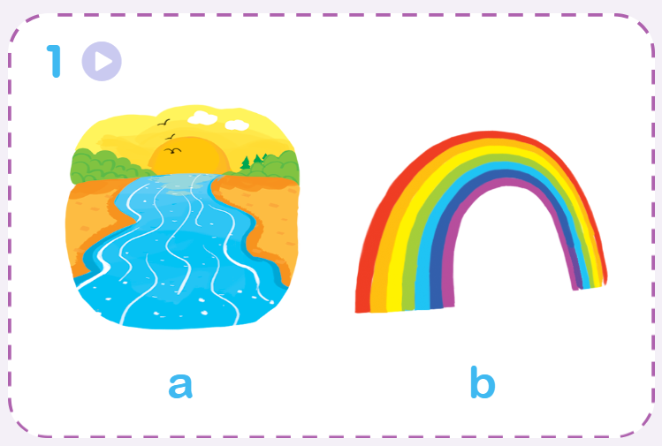
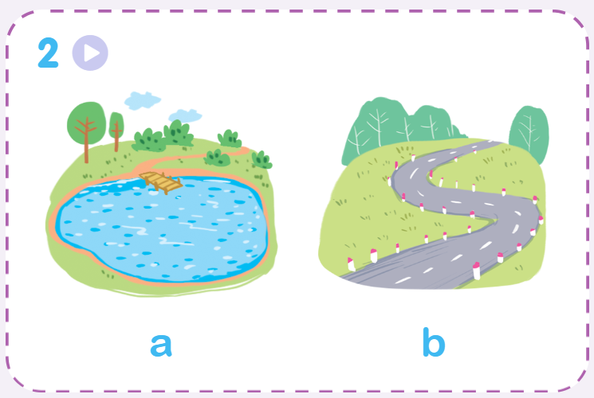
Listen and circle.

Slide 16


Listen and circle.
1.
a
b

Slide 17


Listen and circle.
2.
a
b

Slide 18
04
Activity 5
Look and write.

Slide 19







Look and write.

Slide 20

Look and write.

Slide 21

Look and write.

Slide 22
Look and write.
_oad
r

Slide 23
Look and write.
r
_iver

Slide 24
Look and write.
r
_ainbow

Slide 25
05
Fun corner and Wrap-up

Slide 26



Game: PELMANISM
river
ruler
road
Notes:
Click the penguins and hot-air balloons to see the pictures and words
Click the pictures or words to remove them

Slide 27


rainbow
river
road
Notes:
Click the penguins and hot-air balloons to see the pictures and words
Click the pictures or words to remove them

Slide 28


Slide 29

Goodbye! See you again!

Slide 30
Website: hoclieu.vn
Fanpage: https://www.facebook.com/tienganhglobalsuccess.vn/

