Slide 1



Giáo viên: Đồng Thị Như Quỳnh
Lớp dạy: 2A2
Đơn vị công tác: TRƯỜNG TIỂU HỌC HƯNG ĐẠO

Slide 2

L
M
E
E
C
O
W

Slide 3
Unit 4: In the countryside
Lesson 3 (6,7,8)

Slide 4

01
Warm-up
and Review

Slide 5
Game:
TICK THE
R/r LETTER PICTURES

Slide 6
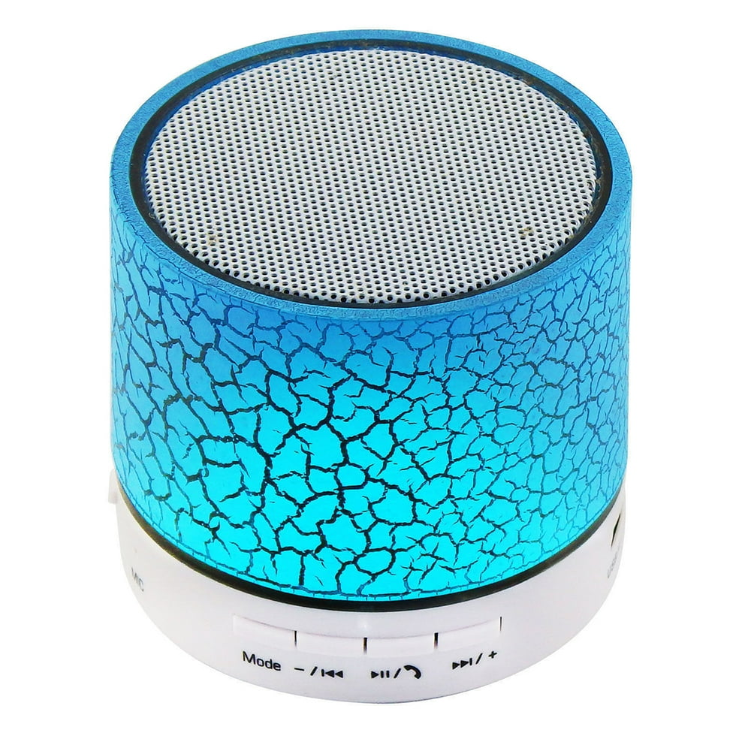













Slide 7
02
Activity 6
Listen and repeat.

Slide 8



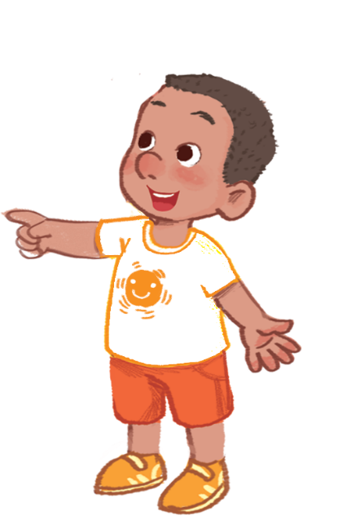

Listen and repeat.

Slide 9
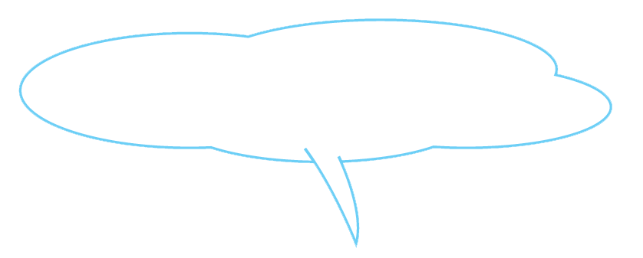

Listen and repeat.
What can you see?
What can you see?
What can you see?
What can you see?
I can see a rainbow.
I can see a rainbow.
I can see a rainbow.
I can see a rainbow.

Slide 10
03
Activity 7
Let’s talk.

Slide 11






Let’s talk.
What can you see?
I .
a
b
c

Slide 12

Let’s talk.
What can you see?
I _______.
a
Notes:
Click the bubble to see the answer

Slide 13


Let’s talk.
What can you see?
I _______.
b

Slide 14


Let’s talk.
What can you see?
I _______.
c

Slide 15
04
Activity 8
Let’s sing.

Slide 16



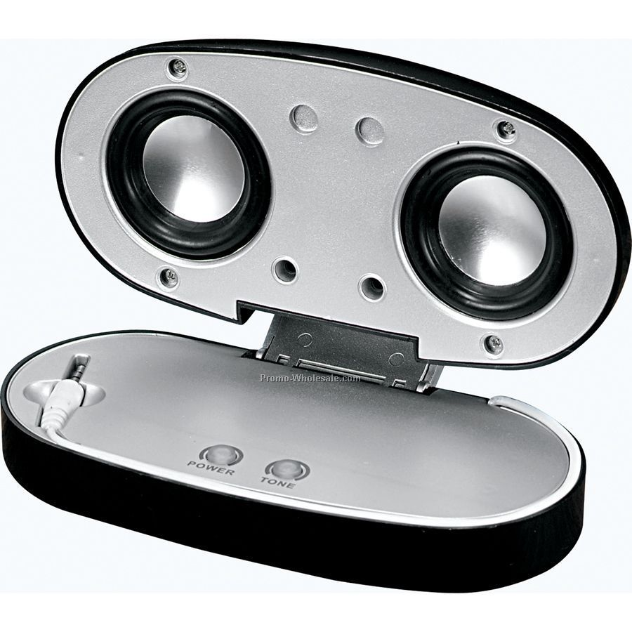
Let’s sing!
What can you see?
I can see a rainbow.
A rainbow in the sky.
What can you see?
I can see a river.
A river near the road.
Turn 1
Turn 2
Turn 3
Next
Notes:
Click Turn 1/2/3 to move to the Group Choosing slide.

Slide 17

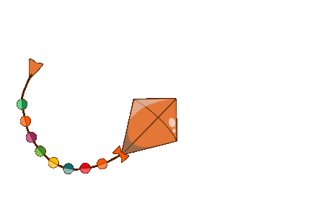
Group 1
Group 3
Group 1
Let’s sing!
Group 2
Notes:
Click to choose the group to sing.

Slide 18
Group 1
Group 3
Group 2
Let’s sing!
Group 2

Slide 19
Group 1
Group 3
Group 3
Let’s sing!
Group 2

Slide 20
05
Fun corner
and Wrap-up

Slide 21
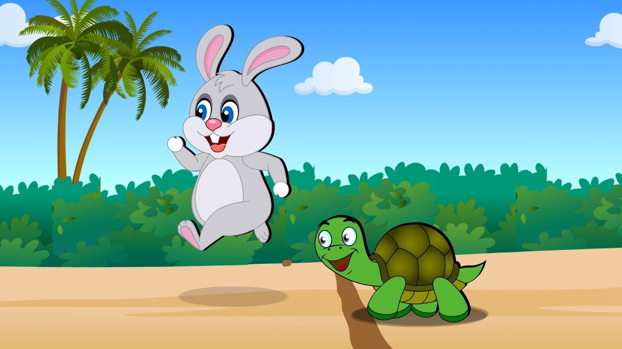
Game
NOUGHTS AND CROSSES
Let’s play!

Slide 22




2
X
X
O
O
O
X
1
3
X
O
O
X
X
6
O
4
5
7
8
9
O
O
O
X
X
X
Winner
Notes:
Click the number to move to the slides of the questions
Click on the right of the square to add the cross remove it
Click on the left to add the nought or remove it

Slide 23


What can you see?
I can see a ______.
rainbow
Notes:
Click to see the answers

Slide 24
What can you see?
I can see a ____.
river

Slide 25

What can you see?
I can see a ____.
road

Slide 26

What can you see?
I can see a ____.
ruler

Slide 27

What can you see?
I can see a _______.
red apple

Slide 28

What can you see?
I can see a _____.
rabbit

Slide 29

What can you see?
I can see a ___.
sail

Slide 30

What can you see?
I can see a ___.
kite

Slide 31

What can you see?
I can see a _____.
kitten

Slide 32
N
S
U
L
A
T
I
O
N
G
A
T
O
R
C

Slide 33
Website: hoclieu.vn
Fanpage: https://www.facebook.com/tienganhglobalsuccess.vn/

