Slide 1
Tiếng Anh 1
Giáo viên: Hoàng Thị Hồng
Lớp dạy: 1A4, 1A5, 1A6
Đơn vị công tác: Trường TH Hưng Đạo

Slide 3

REVIEW 1
Period 1

Slide 4

Table of contents
01
02
Warm-up and Review
Activity 1.
Listen and repeat.
03
04
Activity 2.
Look and circle.
Fun corner and Wrap-up

Slide 5


01
Warm-up and Review

Slide 6

GUESS THE WORDS
C
A
B

Slide 7


Look and choose.
a. cat
b. dog
c. duck

Slide 8

a. desk
b. door
c. duck

Slide 9

a. desk
b. bag
c. hat

Slide 10

a. ball
b. door
c. dog

Slide 11

a. cake
b. hat
c. bag

Slide 12

a. red
b. pen
c. bag

Slide 13

a. apple
b. cake
c. can

Slide 14

a. cat
b. can
c. cup

Slide 15


Very Good!

Slide 16
02
Activity 1. Listen and repeat.

Slide 17


Listen and repeat.
Hi! I’m Phonic Phil!
And I’m Super Sue!

Slide 18


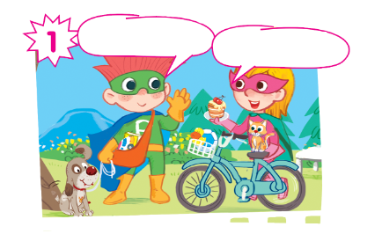

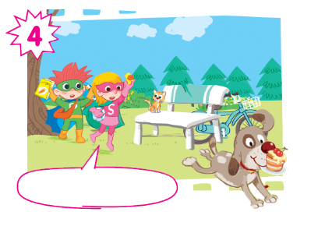
Oh, no! My cake!

Slide 19
Listen and repeat.
Hi! I’m Phil.
Hi! I’m Sue.

Slide 20
Listen and repeat.
Look! This is my dog.
And this is my cat.

Slide 21
Listen and repeat.
I have a car... and a book.
I have a ball... and a duck.

Slide 22
Listen and repeat.
Oh, no! My cake!

Slide 23
Listen and repeat.
Hi! I’m Phil.
Look! This is my dog.
Hi! I’m Sue.
And this is my cat.
I have a car... and a book.
I have a ball... and a duck.
Oh, no! My cake!
Oh, no! My cake!

Slide 24
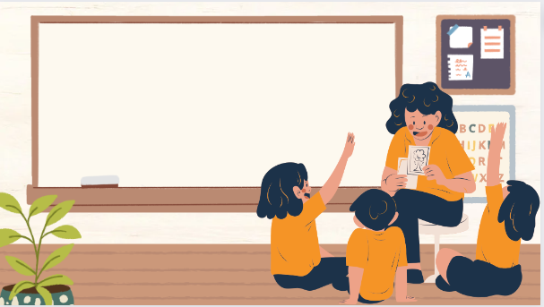
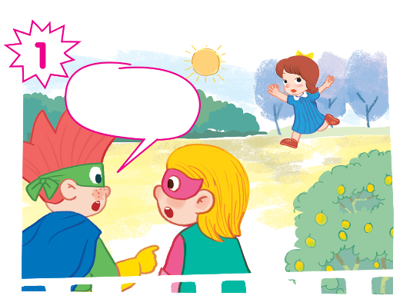
Play as a character

Slide 25
Hi! I’m Phil.
Look! This is my dog.
Hi! I’m Sue.
And this is my cat.
I have a car... and a book.
I have a ball... and a duck.
Oh, no! My cake!
Oh, no! My cake!

Slide 26
03
Activity 2. Look and circle.

Slide 27
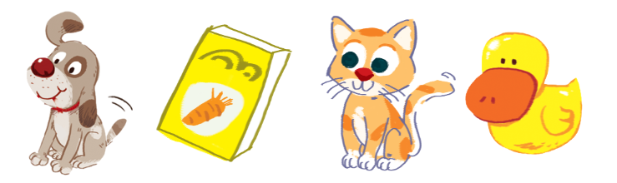
Look and circle.
dog cake cat duck book can car ball

Slide 28
Look and circle.
dog cake cat duck book can car ball

Slide 29
Look and circle.
cake cat duck book can car ball

Slide 30
Look and circle.
cake cat duck can car ball

Slide 31
Look and circle.
cake duck can car ball

Slide 32
Look and circle.
dog
book
cat
duck

Slide 33
04
Fun corner and Wrap-up

Slide 34
Website: hoclieu.vn
Fanpage: https://www.facebook.com/tienganhglobalsuccess.vn/

