Slide 1



Giáo viên: Đồng Thị Như Quỳnh
Lớp dạy: 5A5, 5A6, 5A7
Đơn vị công tác: TRƯỜNG TIỂU HỌC HƯNG ĐẠO

Slide 2









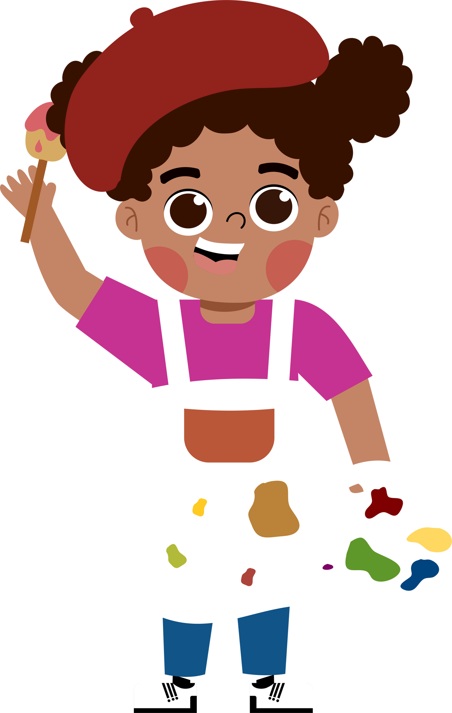








5
My future job
  Lesson 1 - Period 2

Slide 3

01
Warm-up and review

Slide 4
Game:baamboozle.com

Slide 5

What would you like to be in the future?

Slide 6




02.
Listen and number.

Slide 7






Listen and number.
2
3
1
4
gardener
writer
reporter
firefighter

Slide 8
03.
Read and complete.

Slide 9
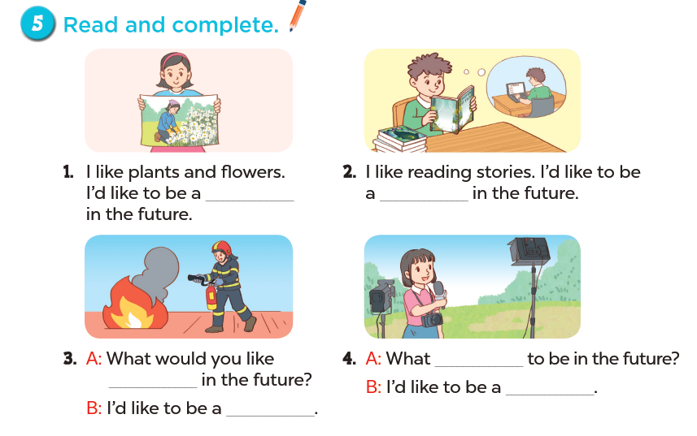
Read and complete.

Slide 10
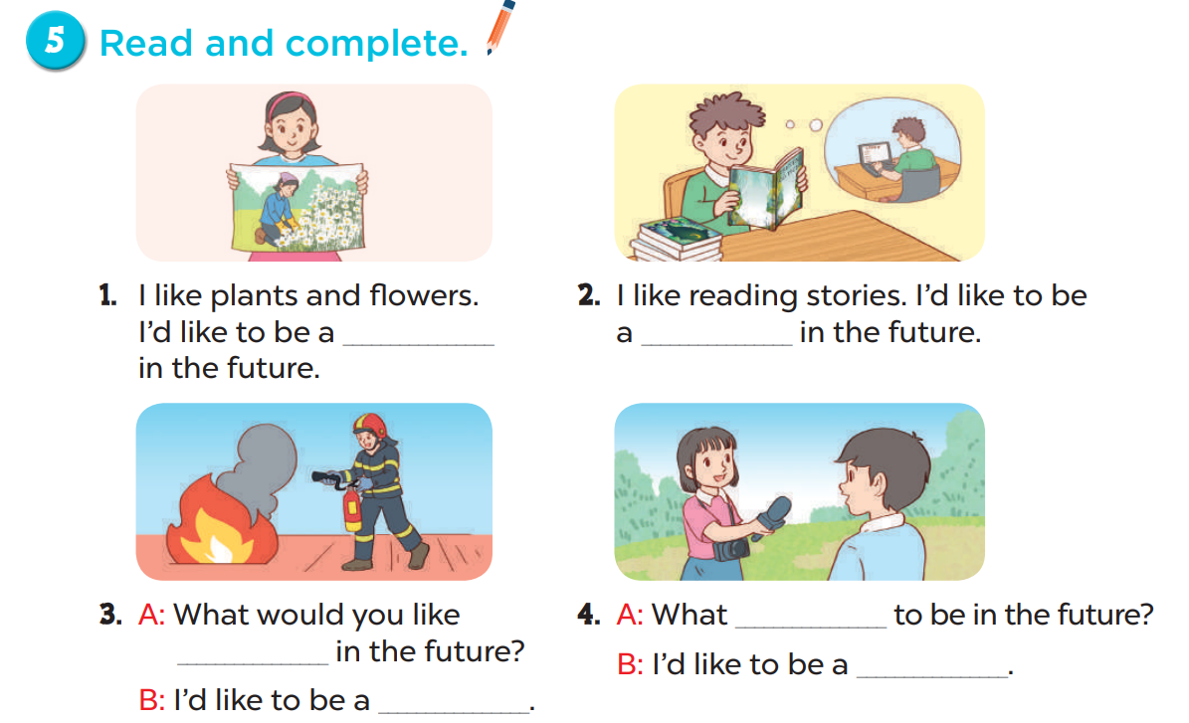
Look and say.
Read and complete.
gardener
writer
would
to be
reporter
firefighter

Slide 11
04.
Listen, complete and sing.

Slide 12
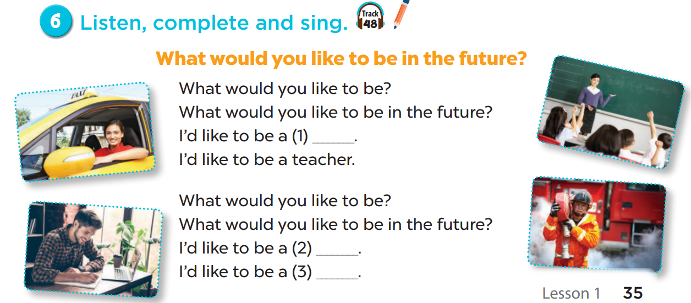
Listen, complete and sing.
firefighter
writer
driver

Slide 13
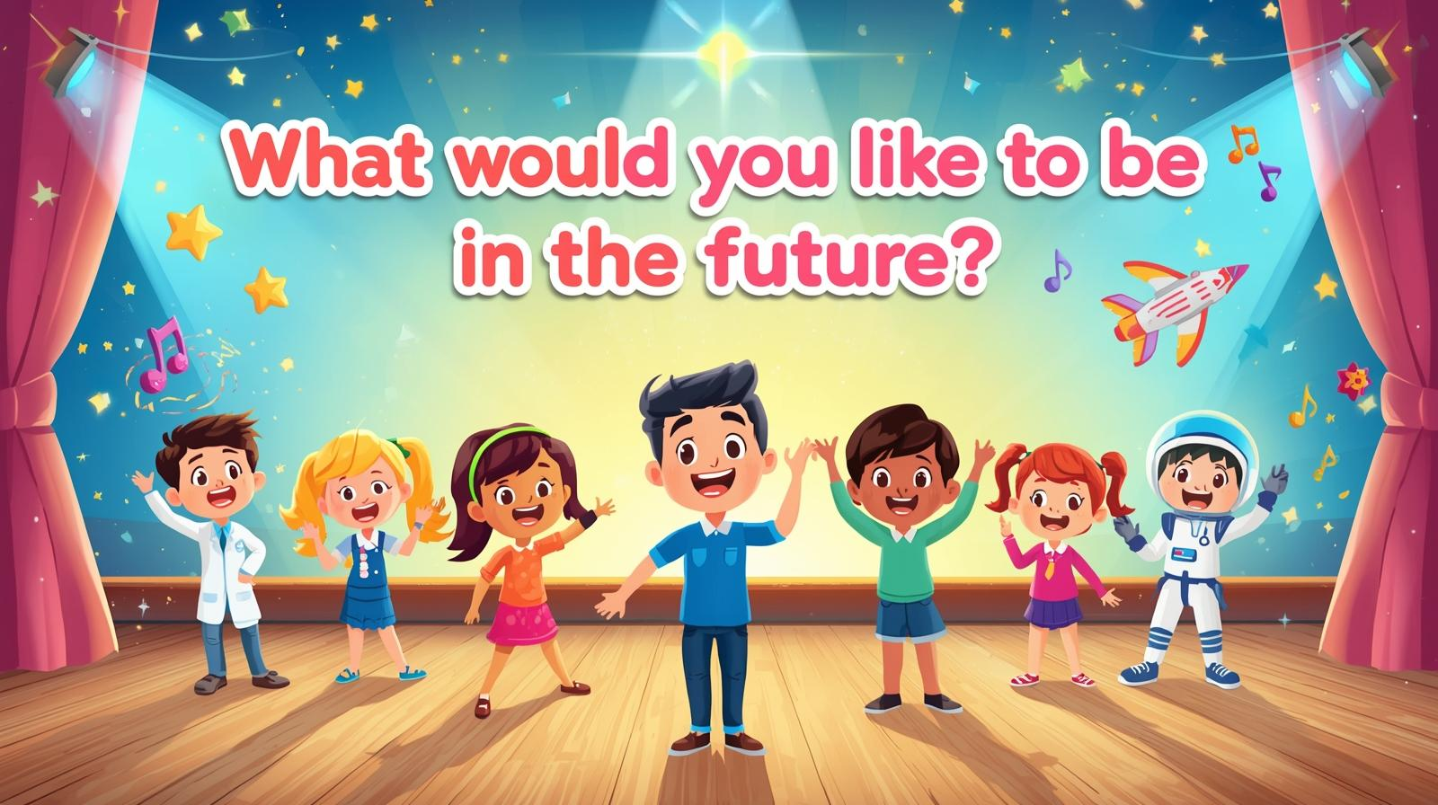
App: Plicker.com to vote for the team

Slide 14
05.
Fun corner and Wrap-up

Slide 15


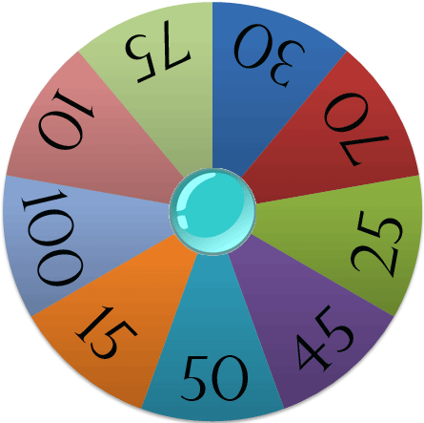






Spin the wheel
Points

Slide 16

would / ’d
I _________ like to be
a firefighter.
SPIN

Slide 17
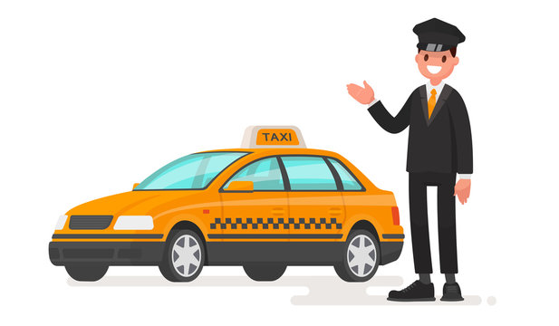
like/ I’d / to/ a/ be/./ driver/
I’d like to be a driver.
SPIN

Slide 18
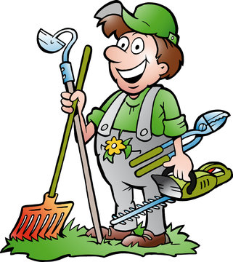
like
I’d ________ to be a gardener.
SPIN

Slide 19

I like reading stories. I’d like to be a _______.
writer
SPIN

Slide 20

reporter
I’d like to be a ________.
SPIN

Slide 21

would
What ______ you like to be in the future?
teacher
SPIN
I’d like to be a ________.

Slide 22
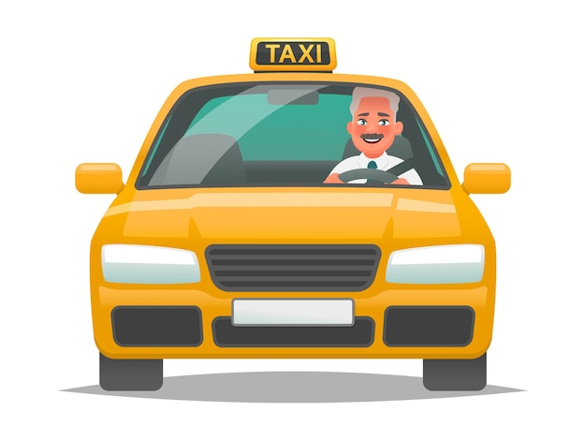
driver
I’d like to be a ________.
SPIN

Slide 23
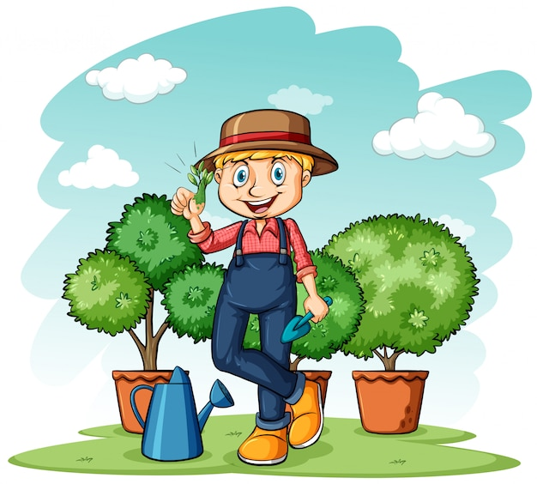
like/ to/ I’d/ gardener/ be/a/./
I’d like to be a gardener.
SPIN

Slide 24

would/ reporter/ I/ like/ be/ to/ a/./
I would like to be a reporter.
SPIN

Slide 25
Website: hoclieu.vn
Fanpage: https://www.facebook.com/tienganhglobalsuccess.vn/

