Slide 1



Giáo viên: Đồng Thị Như Quỳnh
Lớp dạy: 2A2
Đơn vị công tác: TRƯỜNG TIỂU HỌC HƯNG ĐẠO

Slide 2


WELCOME
To Our Class

Slide 3
Unit 3: At the seaside
Lesson 2 (3,4,5)

Slide 4
01
WARM-UP & REVIEW
Game: Jumbled letters

Slide 5

sand
dasn
Timer
Notes:
Click Timer to start
Click to see the answer
Click the word to hear the sound

Slide 6
sea
aes
Timer
Notes:
Click Timer to start
Click to see the answer
Click the word to hear the sound

Slide 7
sail
ails
Timer
Notes:
Click Timer to start
Click to see the answer
Click the word to hear the sound

Slide 8
02
Activity 3
Listen and chant.

Slide 9





Unit
3. Listen and chant.
S, s, sea.
S, s, sail.
S, s, sand.
I can see the sea.
I can see the sail.
I can see the sand.

Slide 10

TEAM WORK
Team 1
Team 3
Team 5
Team 2
Team 4
Team 6
Notes:
Click to choose the Team
Click the word Team to congratulate

Slide 11

TEAM WORK
Chant

Slide 12
Unit
3. Listen and chant.
S, s, sea.
S, s, sail.
S, s, sand.
I can see the sea.
I can see the sail.
I can see the sand.
Team

Slide 13
03
Activity 4
Listen and tick.

Slide 14




Unit
4. Listen and tick.
1
✓

Slide 15


Unit
4. Listen and tick.
2
✓

Slide 16
04
Activity 5
Look and write.

Slide 17


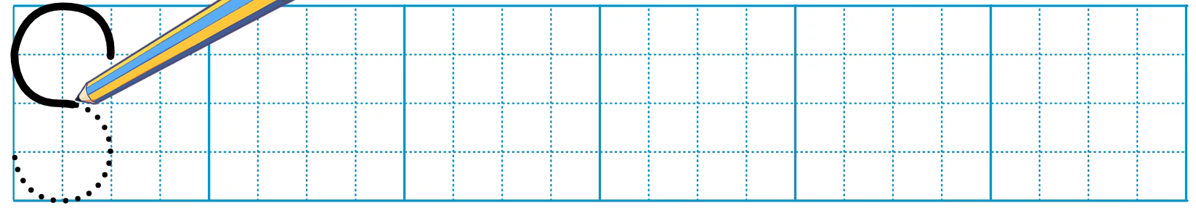
Unit
Look and write.

Slide 18
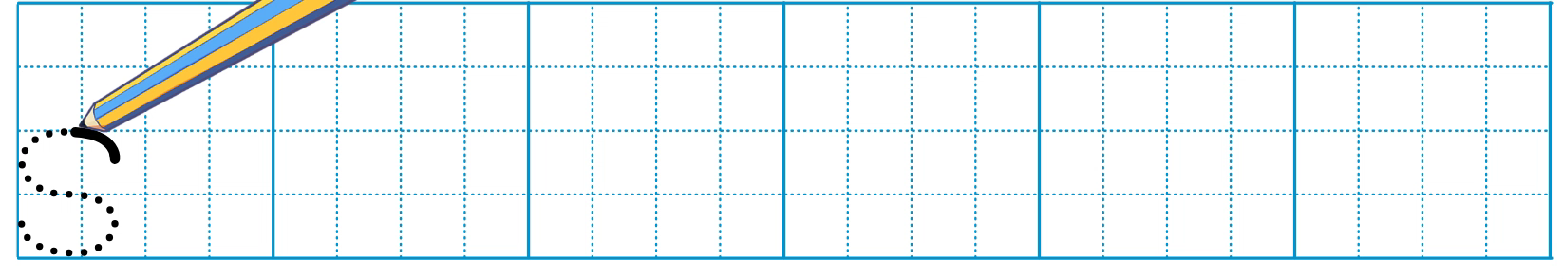
Unit
Look and write.

Slide 19
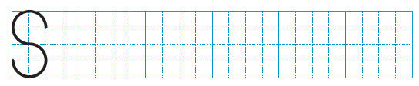



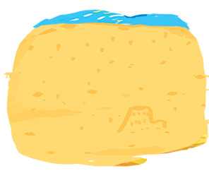
Unit
Look and write
s
ea
s
ail
s
and

Slide 20

05
Fun corner & Wrap-up
Option 1
Game: Vocabulary review

Slide 21

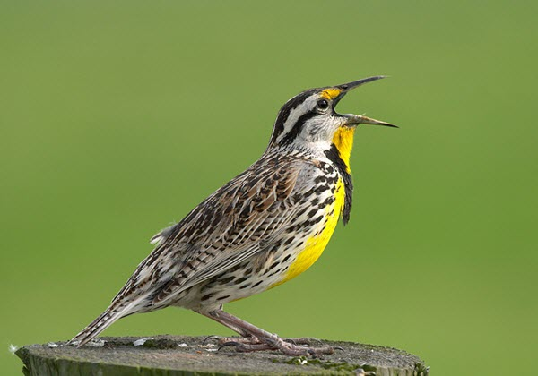
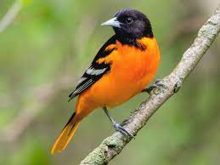
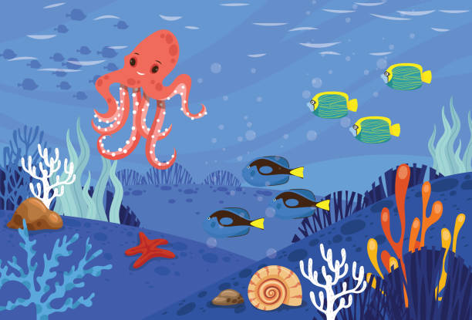


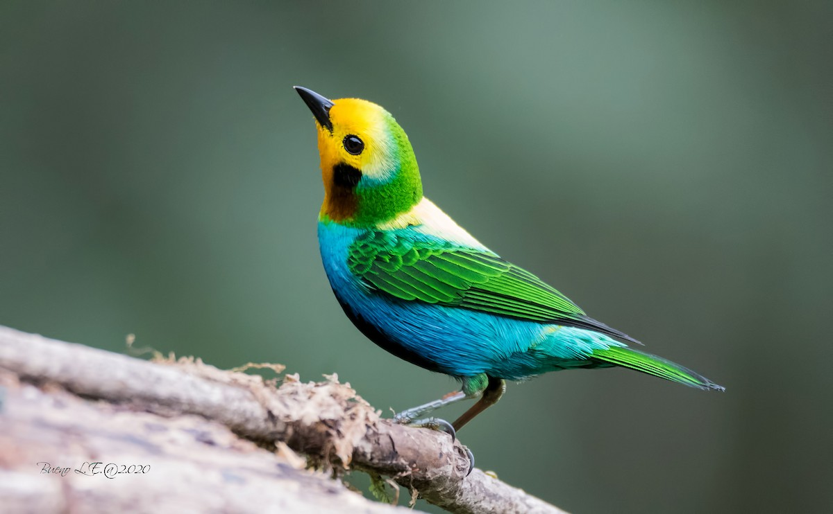
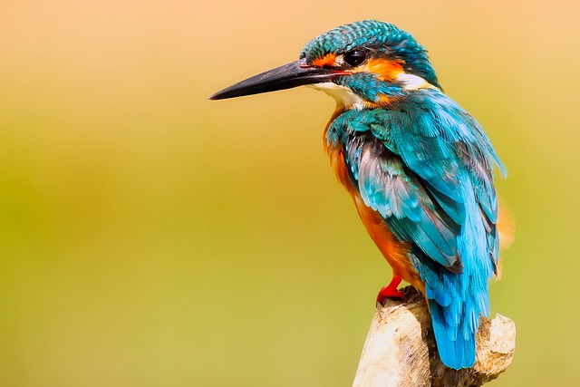

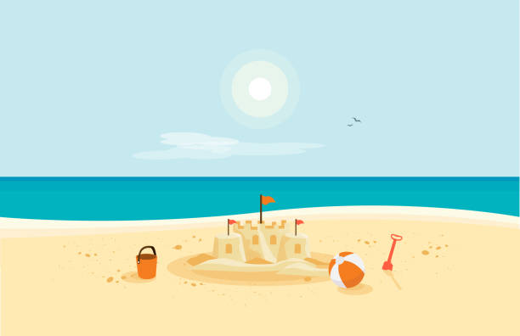
start
Notes:
Click the mouse to move it or clear it
When the mouse appears, click the bird next to the mouse to open the picture, say the word then click the picture to close itself
Repeat the steps with other pictures

Slide 22
Option 2
Match the word with the correct picture

Slide 23
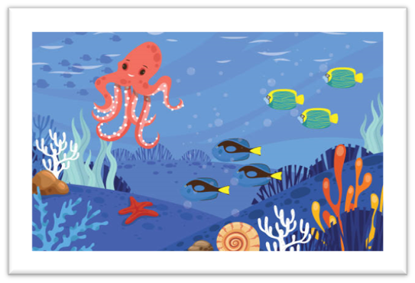
sail
1.
sea
sand

Slide 24

sail
2.
sea
sand

Slide 25
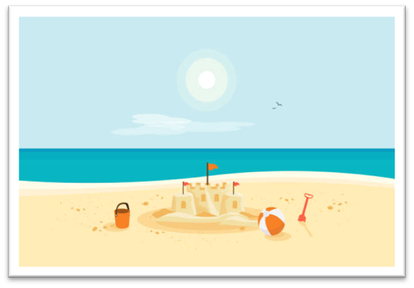
sea
3.
seaside
sand

Slide 26

seaside
sea
4.
sail

Slide 27


Slide 28
Website: hoclieu.vn
Fanpage: https://www.facebook.com/tienganhglobalsuccess.vn/

