Slide 1















Giáo viên: Tô Thị Hà
Lớp dạy: 2A1
Đơn vị công tác: Trường Tiểu học Hưng Đạo

Slide 3
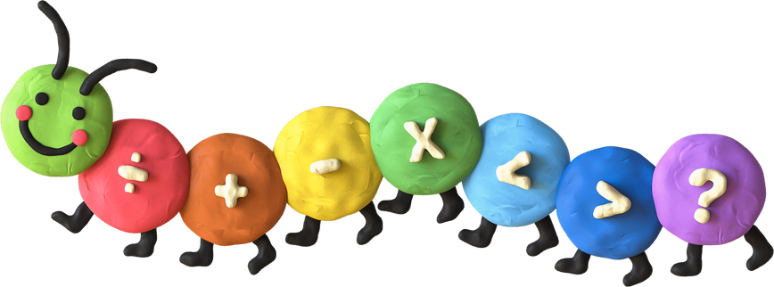

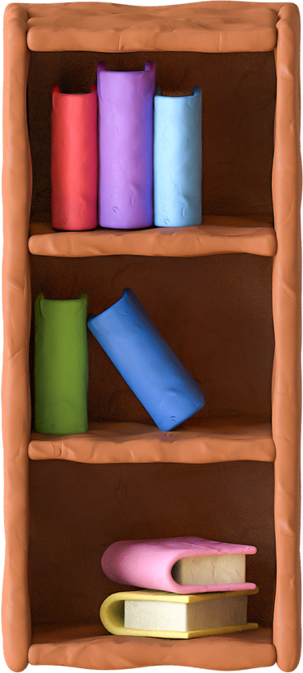
Unit 2: In the backyard
Lesson 1 – Period 1

Slide 4
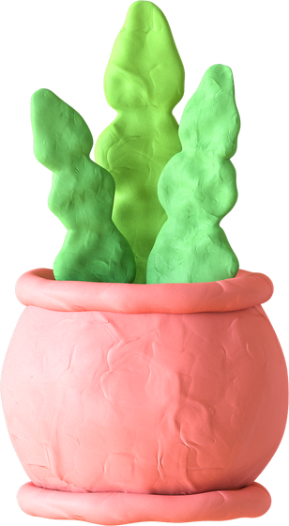

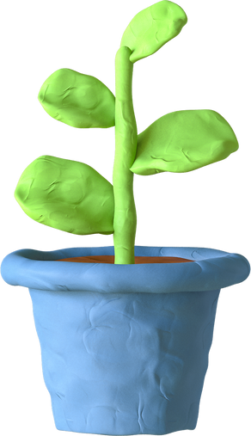
Table of contents
1
Warm-up
& Review
2
Listen
and repeat.
3
Point
and say.
4
Fun corner
& Wrap-up

Slide 5
01
Warm-up and Review

Slide 6
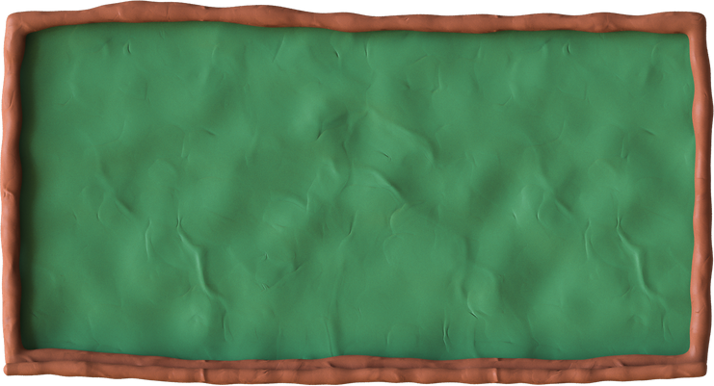

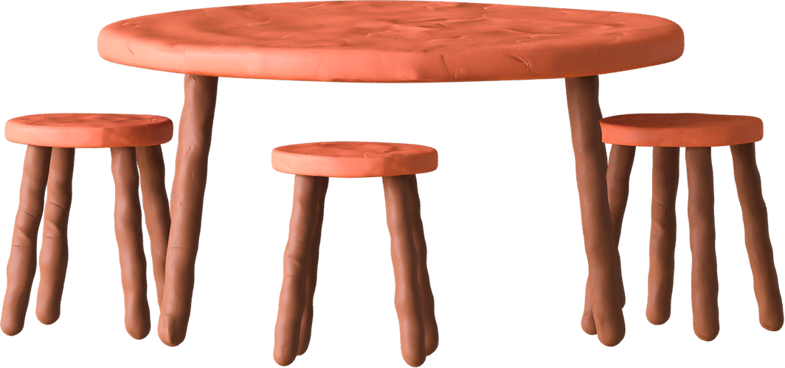
Game
LUCKY FLOWERS

Slide 7





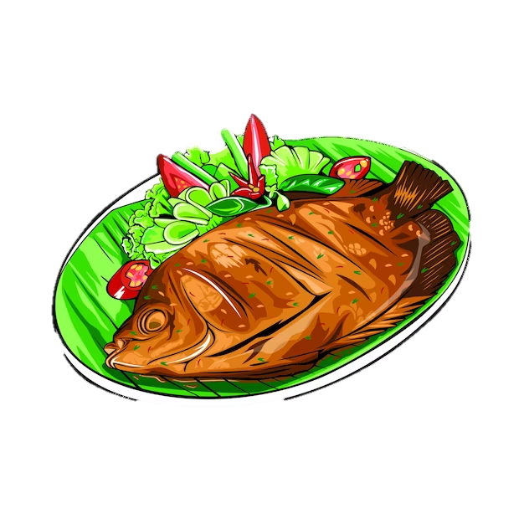








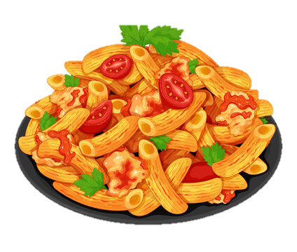



Game
LUCKY FLOWERS
You get
3 points.

Slide 8
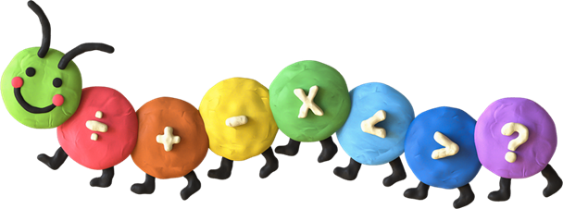

Look and say

Slide 9

02
Listen and repeat.

Slide 10





1. Listen and repeat.

Slide 11

1. Listen and repeat.
backyard →

Slide 12

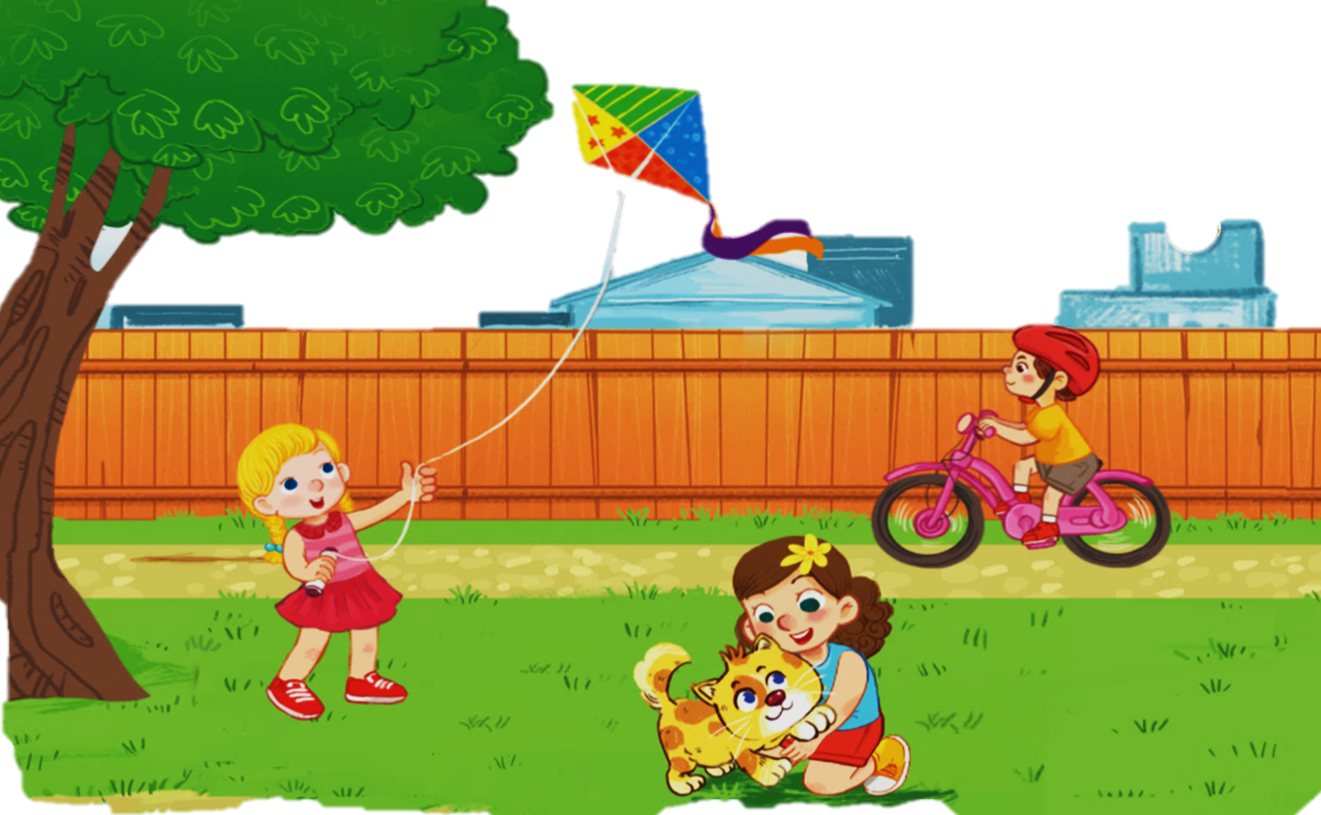

1. Listen and repeat.
Kk
kite
bike
kitten

Slide 13
1. Listen and repeat.
k
ite
k
bi e
k
itten

Slide 14
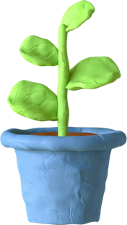
03
Point and say.

Slide 15

2. Point and say.
Kk
kite
bike
kitten

Slide 16


2. Point and say.
WORK IN PAIRS
k
kite

Slide 17
2. Point and say.
WORK IN PAIRS
kitten
k

Slide 18

04
Fun corner
Word Game

Slide 19




FUN CORNER
Word Game
Next
1
3
2
bike

Slide 20


FUN CORNER
Word Game
Next
1
3
2
kite

Slide 21


FUN CORNER
Word Game
Next
1
3
2
popcorn

Slide 22


FUN CORNER
Word Game
Next
1
3
2
pasta

Slide 23


FUN CORNER
Word Game
Next
1
3
2
duck
milk

Slide 24




Slide 25



Say goodbye

Slide 26

Say goodbye

Slide 27

Say goodbye

Slide 28

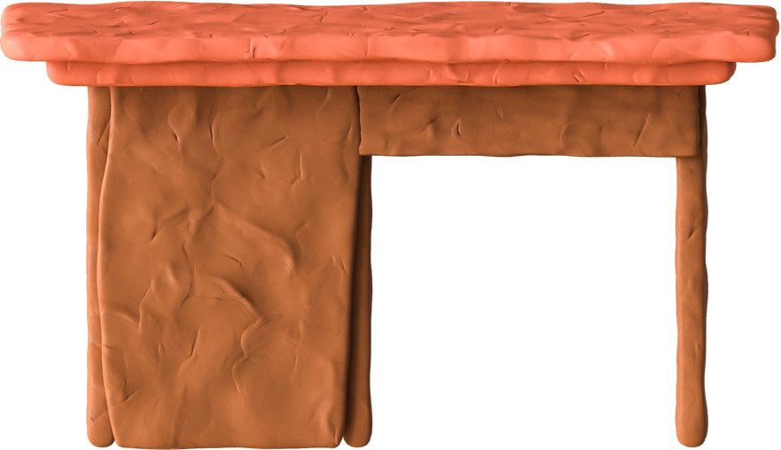
Goodbye
See you later

Slide 29
Website: hoclieu.vn
Fanpage: https://www.facebook.com/tienganhglobalsuccess.vn/

